Slide 1
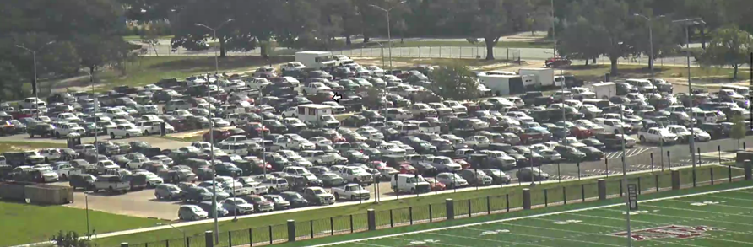
Texas A&M Waiting Lists
Insert image or graphic
Debbie Hoffmann, Director
Therese Kucera, Manager
Texas A&M Transportation Services

Slide 2
Historical Info
Waiting lists initiated in 2004
Created through registration
  Faculty/staff prioritized by months of service
  Students prioritized by classification
After registration, new requests added on first come, first served basis
Selectable Lots
  Faculty/Staff have ability to select all
  Graduate Student selectable lots
  Undergraduate selectable lots
Notes:
We have made small tweaks over the years (example - lots that used to be only staff selectable available to graduate students)
Briefly explain prioritization of assignments (have website ready and show) Have tweaked this a bit to accommodate faculty/staff displaced due to a permanent lot closure (example lately - Lot 19)
Tweaked this a bit over the years due to extremely long wait lists and to help better set expectations to our customers (example-removed the ability for Freshmen to select certain lots with long wait lists where we have historically been unable to accommodate this classification)
After initial assignments are made, we review our wait lists to determine which lots will be available on 08/01 to anyone wanting to add lots to their wait lists.

Slide 3
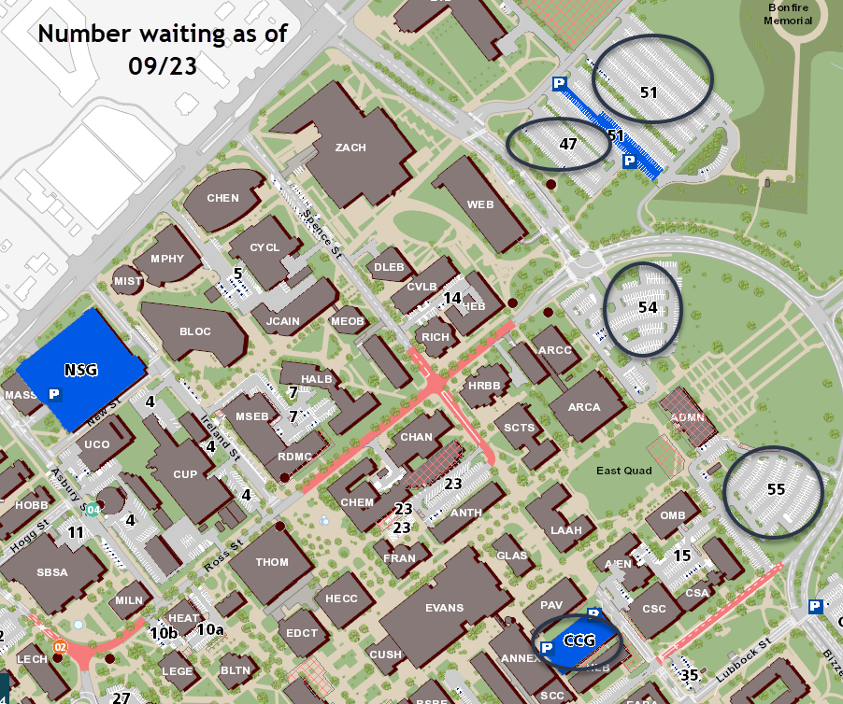
Faculty/Staff Waiting
Lot 51 – 143 staff - 1196 total
currently 119 in Lot 50 and 12 in NSG
Lot 47 – 240
Lot 54 – 243
Lot 55 – 177
Central Campus Garage – 149
Notes:
These are examples of where we have some of the longest staff waiting lists. Explain 51 and how staff are at the top. Others circled are all staff lots. Customers can’t add themselves to 47, 54 and 55 because the lists are so long we won’t be able to accommodate the list developed during registration. Remember that people can be on more than one list, like 47, 54 and 55.
We are able to accommodate any staff needing parking on West Campus
Immediate availability in NSG for faulty/staff

Slide 4
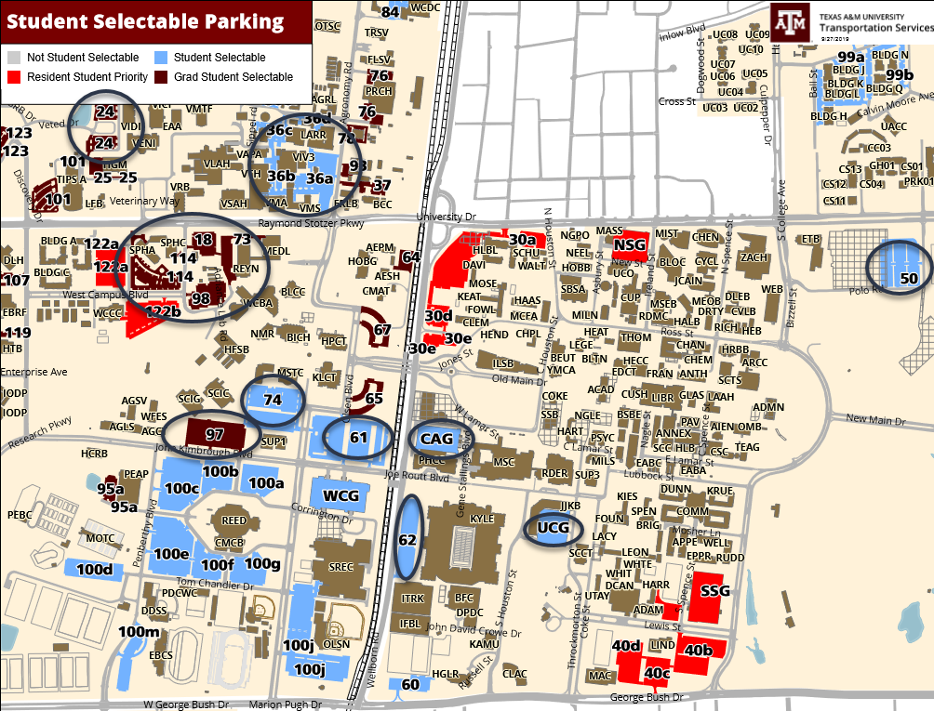
Students Waiting
Lot 50 – 3,595
University Center Garage – 2,831
Cain Garage – 2,498
Lot 61 – 2,007
Lot 74 – 1,579
Lot 62 – 1,443
Notes:
These are some of the student lots with the longest waitlists. NOTE – 50 is half the size it used to be and we are having to put more staff in there than before, hence the longer list. Some of these people have permits today and some don’t, especially when we talk about the students.
We have smaller waitlists in the Vet School, Business and Ag area. Please note that no students are accommodated until staff requests are met. We have no staff waiting for any of the lots circled on this map.
Since most of our parking is on West campus, that’s where most of the students park. Once we finish he Polo Garage, we will be able to bring some of them back to that area.
No wait lists for 100 or WCG, but 61 has a long list.

Slide 5
Waiting List Process
Count occupancy at peak times
  Cameras
  Drive-thrus
  Officers’ reports
Analyze data and adjust sales capacity, if appropriate
Award permits in areas where space is available
Notes:
We know peak times on campus. We can count many areas using our cameras. Other areas require driving around campus and physically counting the vacant spaces. These numbers are recorded and help us determine what permits we can offer each week. This changes from year to year depending on new class buildings, office relocations, etc. We always hold back some space in the student selectable lots, so we can immediately accommodate staff as needed.

Slide 6
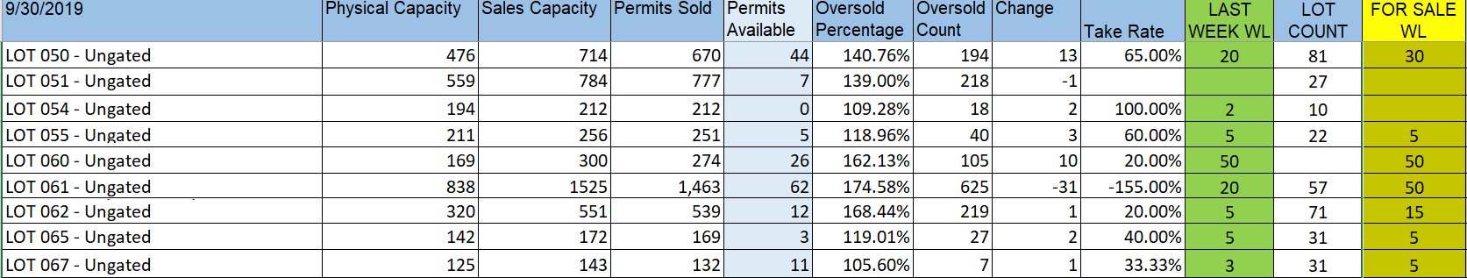
Waiting List Take Rates
  So far this year during the weekly waiting list moves:
    Offered from 490 - 976 permits per week (avg. 764)
    Take rate between 3.28-% - 19.48% (avg. 9.6%)
Notes:
Talk a little about origin lots vs destination lots: We consider some of our origin lots to be 51, 100 and WCG. This is where most people start off. We consider our destination lots to be CCG, UCG, 62, 54, 55. Once we fill these destination lots, there is less movement in those lots.
Take rate example – Lot 74 – so far this year 100 offered and 31 accepted; 100 offered and 14 accepted; 100 offered and 13 accepted; last week 100 offered and 36 accepted.

Slide 7


