Slide 1
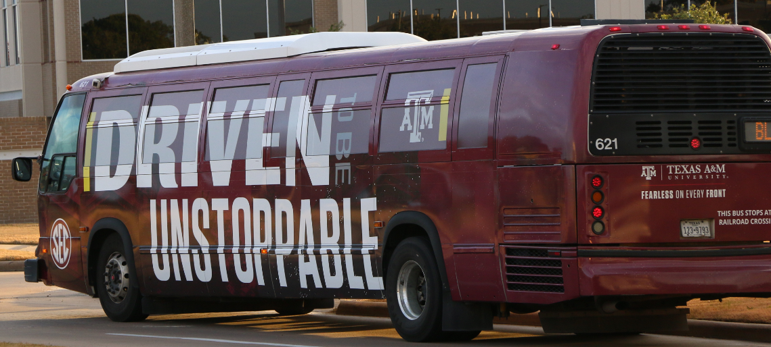
Transit Fall 2019 Changes
Justin Tippy, Transit Manager
Texas A&M Transportation Services

Slide 2
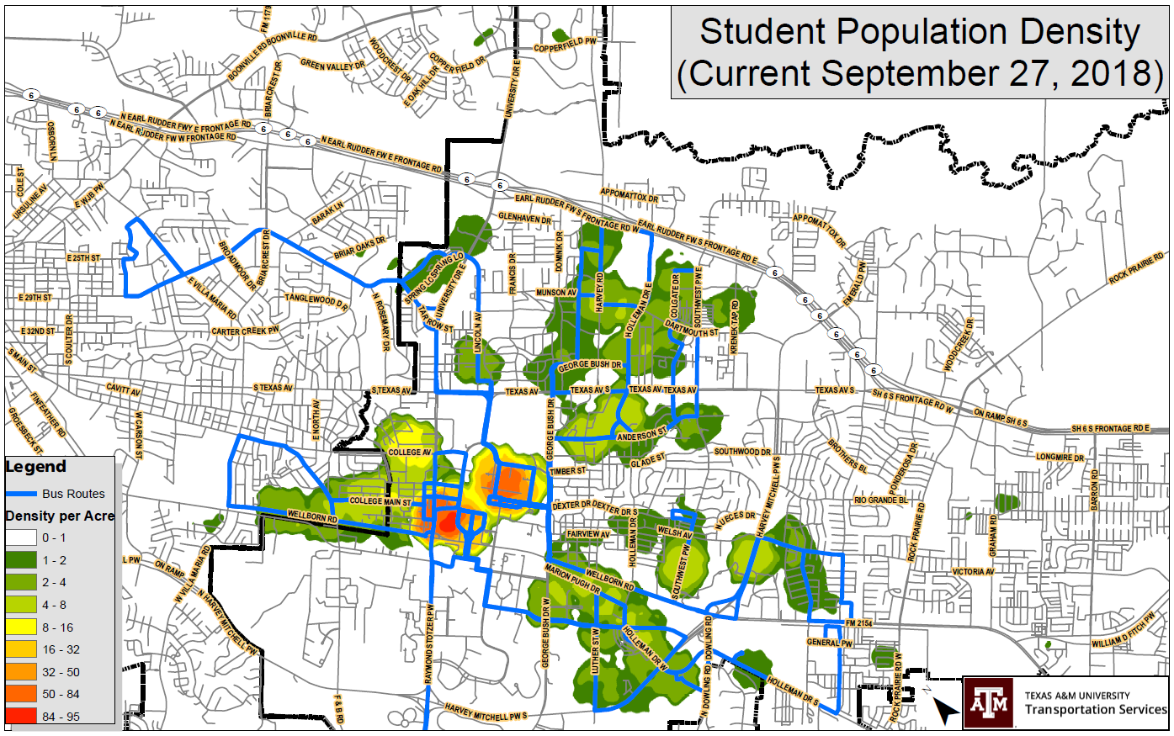

Slide 3

Topics
BUILD Grant
Combining Routes 34 and 40 South
Combining Routes 03 and 09
Impact of Polo Garage construction and displaced Lot 50 permit holders
2 different service levels during one semester as ridership changes
Trying to take in all information and make the puzzle work

Slide 4
Partnership with Brazos Transit
By partnering with Brazos Transit, we will be able to replace 20 buses through the BUILD grant
Buses will be delivered 18-24 months from now
Provides help with our aging fleet of which 43 buses are 17-18 years old
12 years ago we benefited from this partnership by receiving 9 small buses that were operated for their useful life and then retired

Slide 5
Fall 18 Ridership
Off campus, ridership is the lowest on Routes 25, 34 and 40S
Route 40 has been split into 40N and 40S since the beginning of fall 2018 due to construction
Route 12 was split into Routes 12 and 25 fall 2018 due to the RELLIS campus opening and some Blinn students taking classes there
Notes:
Ridership by bus, over 3 million passengers in the fall
By looking at this ridership per bus, we can see where our buses are being underutilized or overloaded. The average ridership per bus is about 46,000. From looking at this we can see that we can create some efficiencies from combining 34 and 40S. Also, we may be able to help the overloading of route 03 by making it more efficient by combining 03 and 09.

Slide 6
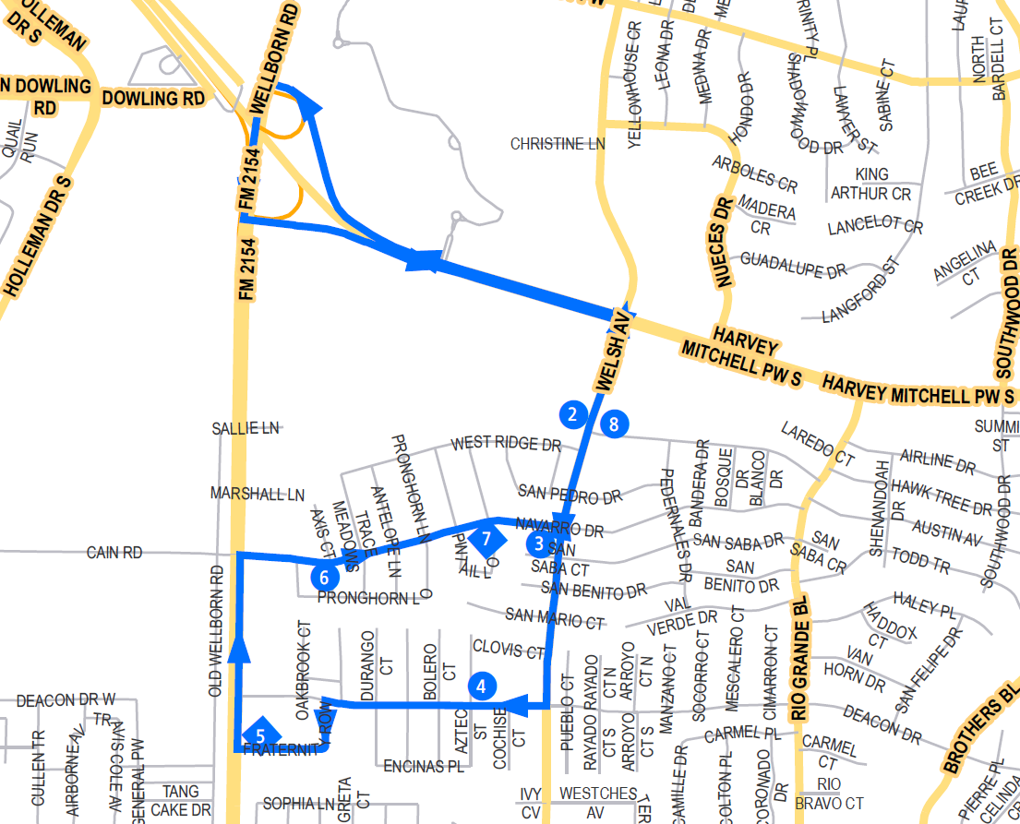
Current Route 34
Services South College Station around Frat Row and the Park and Ride at First Baptist Church
2 buses on route with 18 minute headways
Route 34 ridership places it in the bottom 3 among off campus routes
Notes:
Split route 40 due to construction, learned that efficiency of 40N is desirable. Route 40 services south holleman. 40S is not efficient as stand alone.

Slide 7
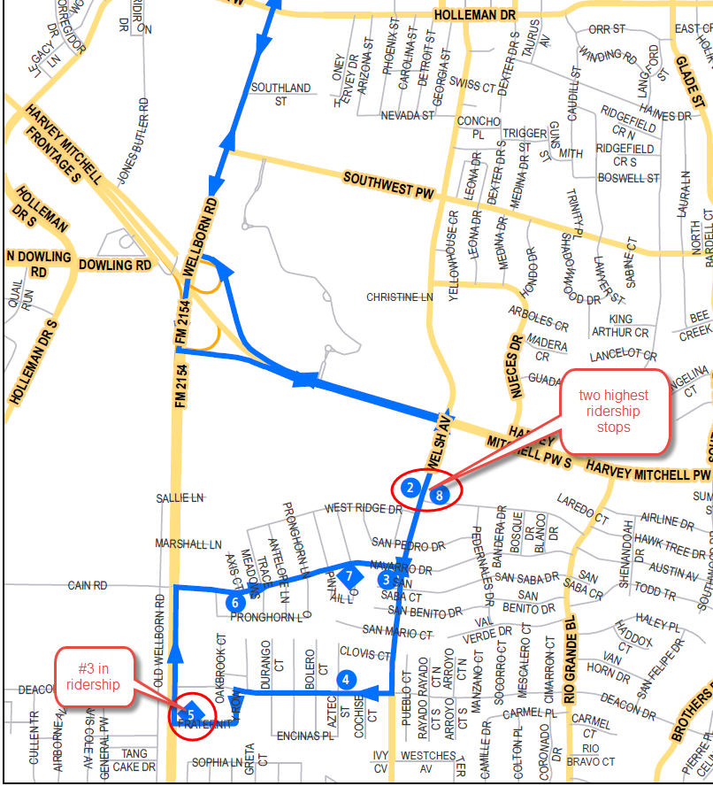
Current Route 34
Want to preserve highest ridership stops and maximize efficiency for entire route
Compared to Route 22, Route 34 carries about 1800 passengers/day with 3 buses while Route 34 carries about 850 with 2 buses
By adding The Barracks stop to Route 34, we can maximize efficiency and provide more timely service to all riders

Slide 8
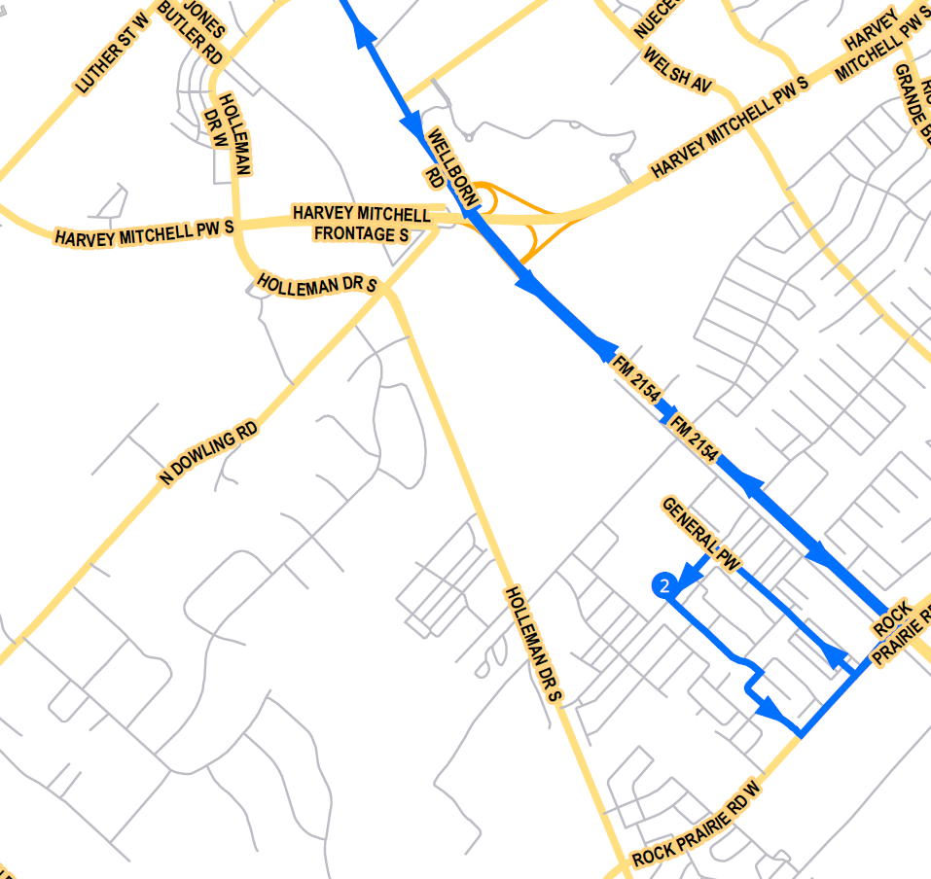
Current Route 40S
Services The Barracks in south College Station
2 buses on route with 22 minute headways
Route 40S ridership places it in the bottom 3 among off campus routes
Notes:
40s is a growing area and we want to add it to 34 to balance both routes, making them as one and more efficient.

Slide 9
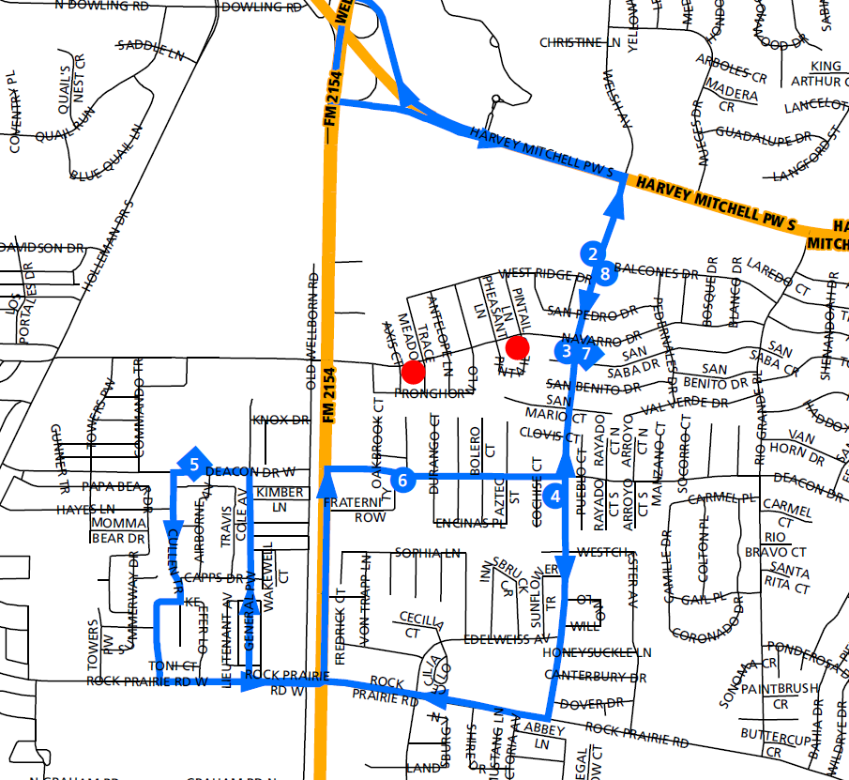
Proposed Route 34
Combine Routes 34 and 40S
3 buses on route with 15 minute headways
Reduces number of buses used and provides more frequent and efficient service
Moves current stops along Navarro to Welsh, resulting in .4 mile walk to new stop
Notes:
This route could be used in the future to serve HEB. We will monitor this combined route to ensure it is running efficiently with 3 buses.

Slide 10
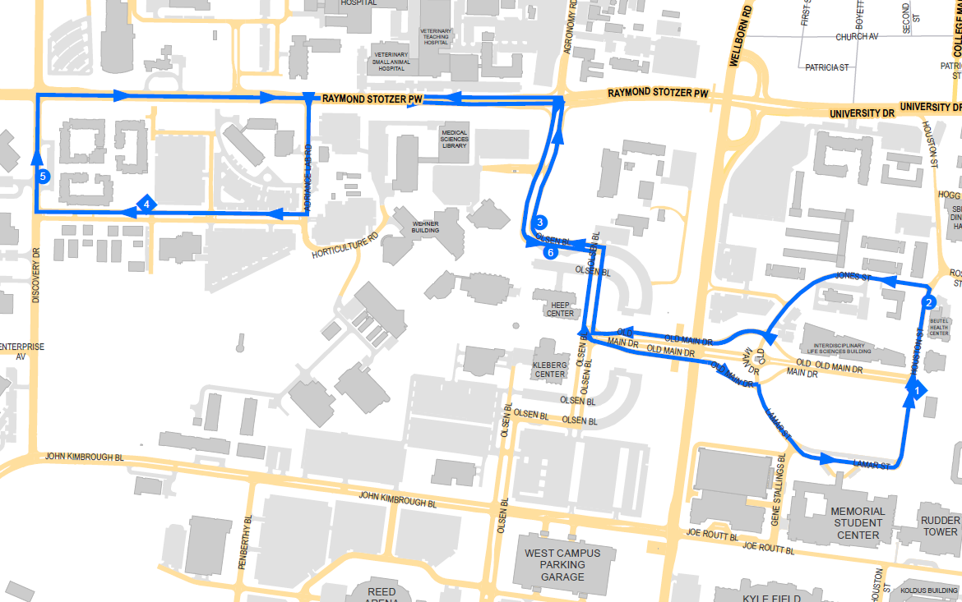
Current Route 03
Services areas between MSC and White Creek Apartments
3 buses on route with 7 minute headways
Notes:
State logic about combining 03 and 09.
White creek has peaks and valleys that should allow us to serve both areas better. Will provide more frequent service and should allow better service

Slide 11
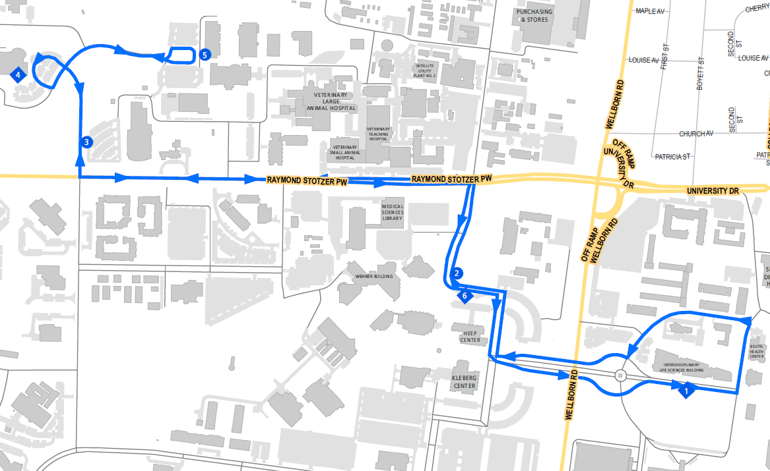
Current Route 09
Services areas between the MSC and Vet School
2 buses on route all day with 3rd bus running from 10a - 3p
10 and 7 minute headways
Notes:
Large undergraduate classes that create large passenger loads at one time needing to ride back to main campus. Needs more frequent service to help disperse passenger loads.

Slide 12
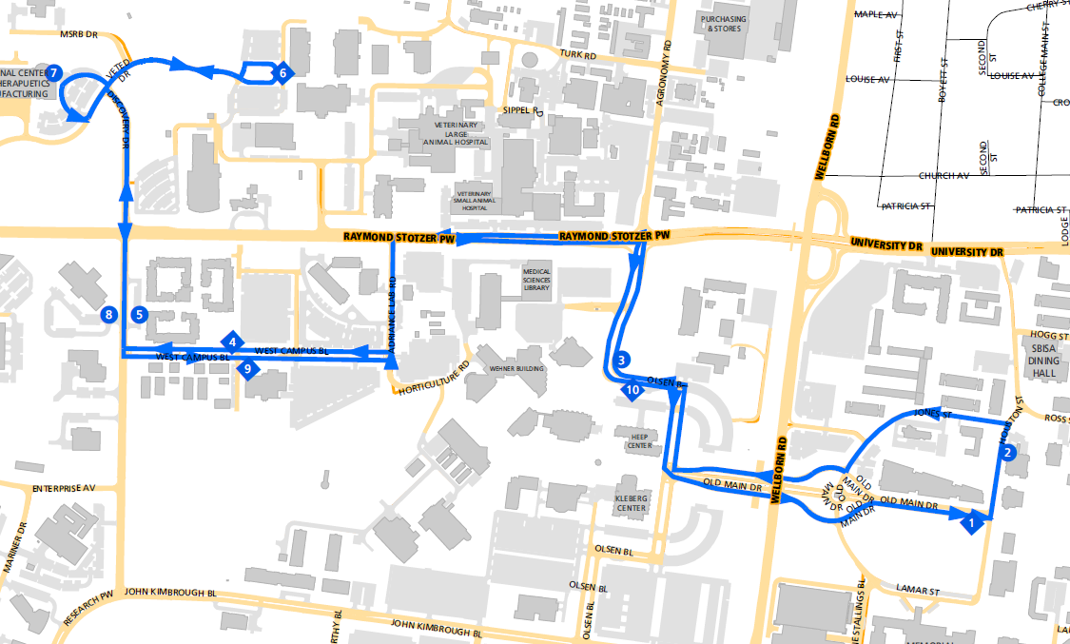
Proposed Route 03
Combine Routes 03 and 09 into one route
5 buses on route all day, with a 6th bus between 10a and 3p
6 minute headways with 5 buses and 5 minute headways from 10a - 3p
Service all areas with greater frequency and more capacity
Notes:
Looked at Passenger loads on both and times that they occur and the peaks are offset to allow for better service
Making this change, we believe this will work better and we will monitor to see if more service is needed at peak times.

Slide 13
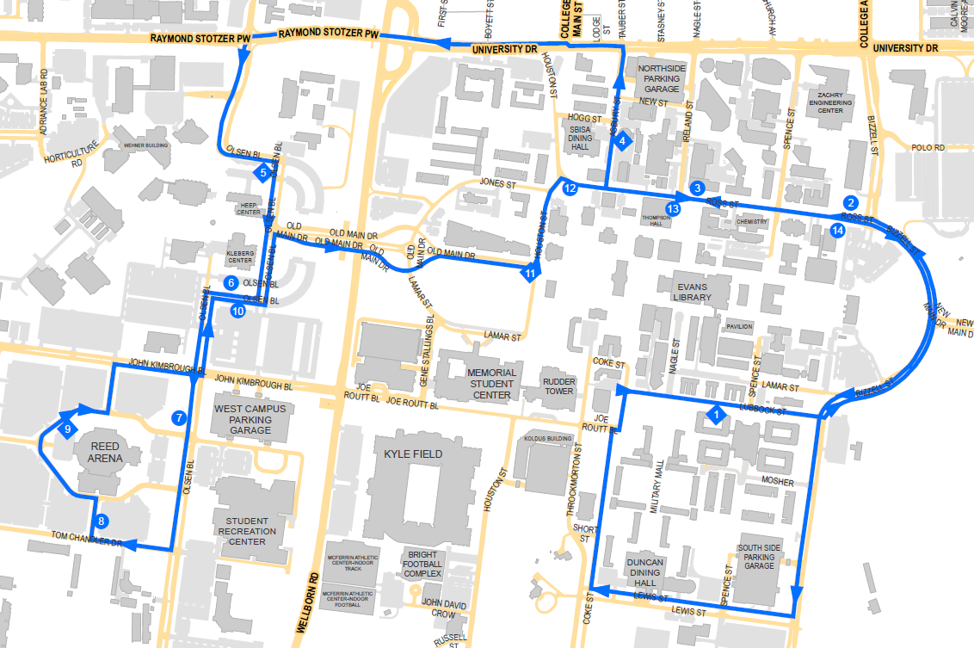
Polo Garage/Route 01
Route 01 has 4 buses all day and 5 buses from 7a - 10:30a and 5:30p - 7:30p
Total transit ridership is down about 5% from last fall
Route 01 ridership is down about 10% from last fall
About 1000 displaced parkers from Lot 50 to WCG and Reed Arena
Notes:
There is room on Route 01 for added capacity, we will monitor and make changes to service as necessary

Slide 14
Yearly Ridership
Each semester always starts off with very high ridership
Our service hours remain the same through the entire semester
Suggest two different service levels to match the ridership as semester continues
Notes:
Looking at this graph, historically, you will see the trend in ridership for the fall and the spring. You’ll see that the first 2 months of the fall start off at a peak service and the rest of the school year goes down from that point. We propose that we start off the beginning of the fall semester with added service and as ridership reduces, we will reduce service to match. With our data we can see where ridership falls off at certain times of the day on different routes. This change may be reduced service during the day or later in the evening. Ridership data will dictate where we would reduce our service hours.

Slide 15
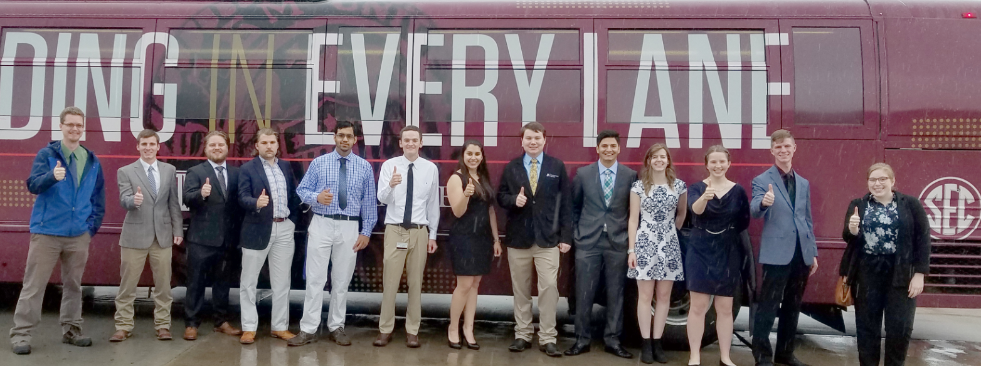
Justin Tippy
Transit Manager
jtippy@tamu.edu

