Slide 1
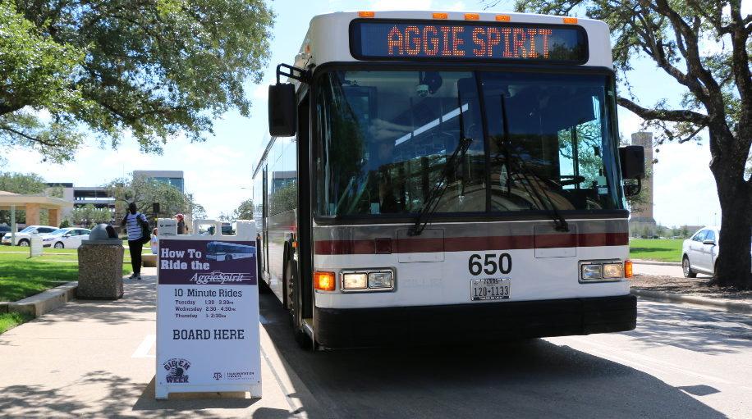
Transit Service Updates – Fall 2018
Insert image or graphic
Texas A&M Transportation Services

Slide 2
New Service for RELLIS Campus
Center for Infrastructure Renewal (CIR) – Feb 2018 with limited bus service from Wisenbaker to CIR
Blinn - August 2018 w/ estimated 2000 students
Blinn Team
Engineering Academy
TTI Headquarters – Fall 2018
Impact on Route 12 from Blinn Team and Engineering Academy moving to RELLIS
Shift bus resources from existing routes to provide new service for RELLIS Campus without increasing service hours

Slide 3
Reallocating Resources
Reviewed existing routes, number of buses per route, ridership data, time of day, etc.
Shift bus resources from multiple routes to create service to RELLIS – tested last fall and currently testing this semester
These reductions have resulted in 240 service hours per week being removed without impacting passengers
RELLIS service will add 224 hours per week
Combining Night Routes 03/05 and 12/25 with an additional savings of 60 service hours per week
This allows us to add those 60 hours back into daytime service as needed to cover demand
Notes:
Removed 5 buses from Routes 01, 06/08, 12, 15, 26, 35 and 40 from various times of the day…
26E am and pm
01F am and pm
15E am and pm
35F all day
40E all day

Slide 4
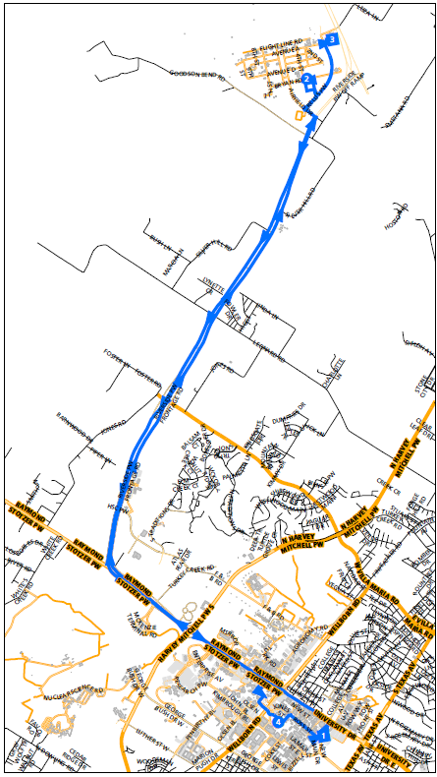
Route 47 RELLIS
3 buses 7am – 8pm
1 bus runs 8pm -11:30pm
1 hour roundtrip
20 minutes between buses
2 stops on campus at Old Main and Wisenbaker
2 stops at RELLIS at Blinn and CIR/TTI

Slide 5
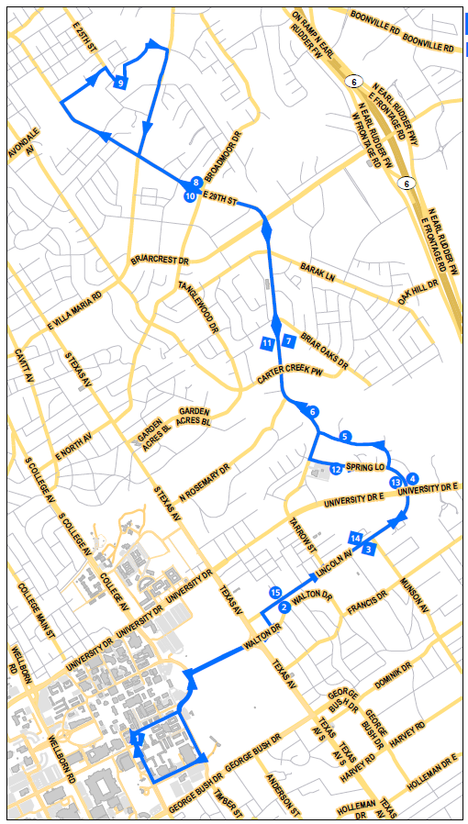
Route 12 Reveille
Current
4 buses 7am – 7pm
1 extra bus runs 7am – 11am
1 hour roundtrip
12 min between buses until 11am
After 11am, 15 min between buses
1 bus runs night route from 7pm-12am
55% of passengers boarding at Trigon exit bus at Blinn

Slide 6
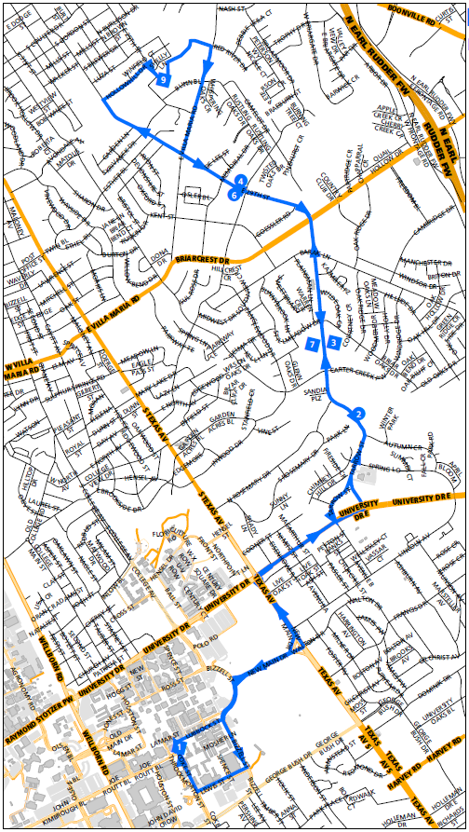
Route 12 Reveille
Proposed
2 buses 7am - 7pm
46 min roundtrip
23 minutes between buses
Lighter passenger loads between TAMU and Blinn with opening of RELLIS

Slide 7
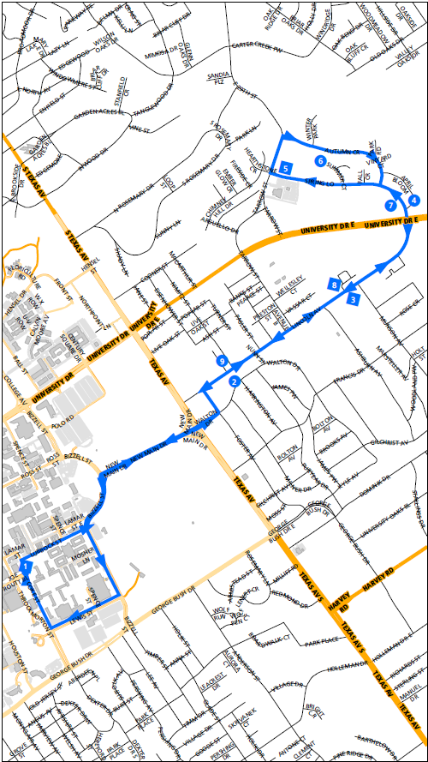
Route 25 Centerpole
Proposed
2 buses 7am - 7pm
30 min roundtrip
15 minutes between buses
These stops currently on Route 12 will see the same level of service with new Route 25

Slide 8
Night and Weekend
Route 12/25
1 bus 7pm - 11:30pm Mon-Fri
1 bus 9am - 6pm on weekends
1 hour roundtrip
Same route as current Route 12
Savings of 27 service hours per week by combining these routes on nights and weekends

Slide 9
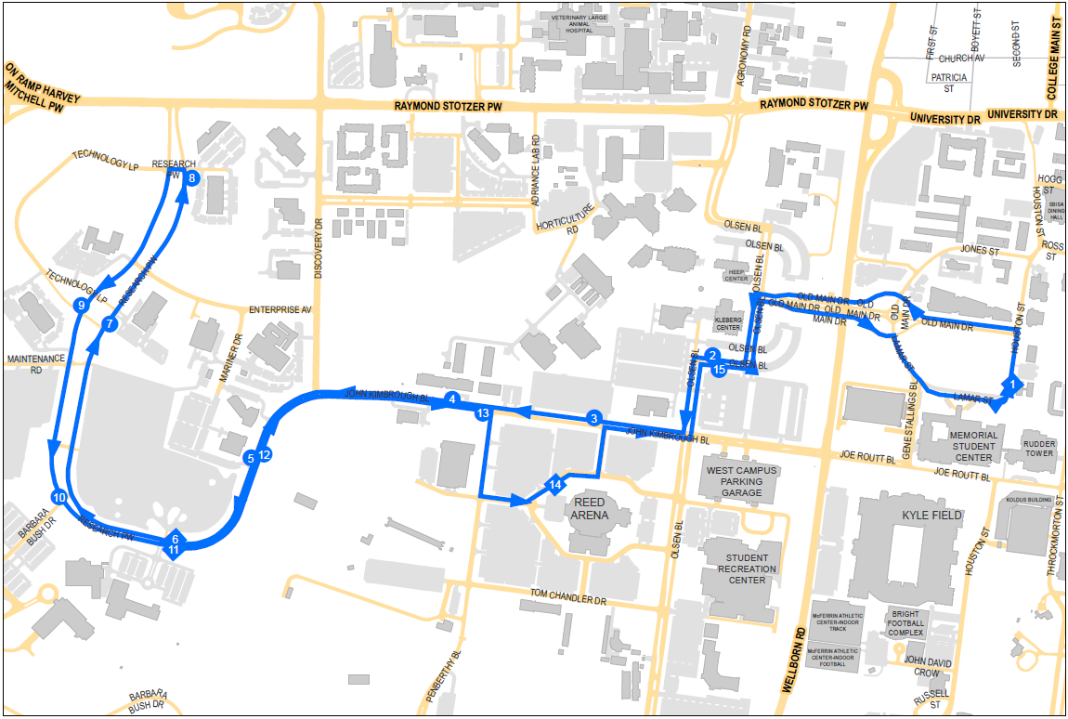
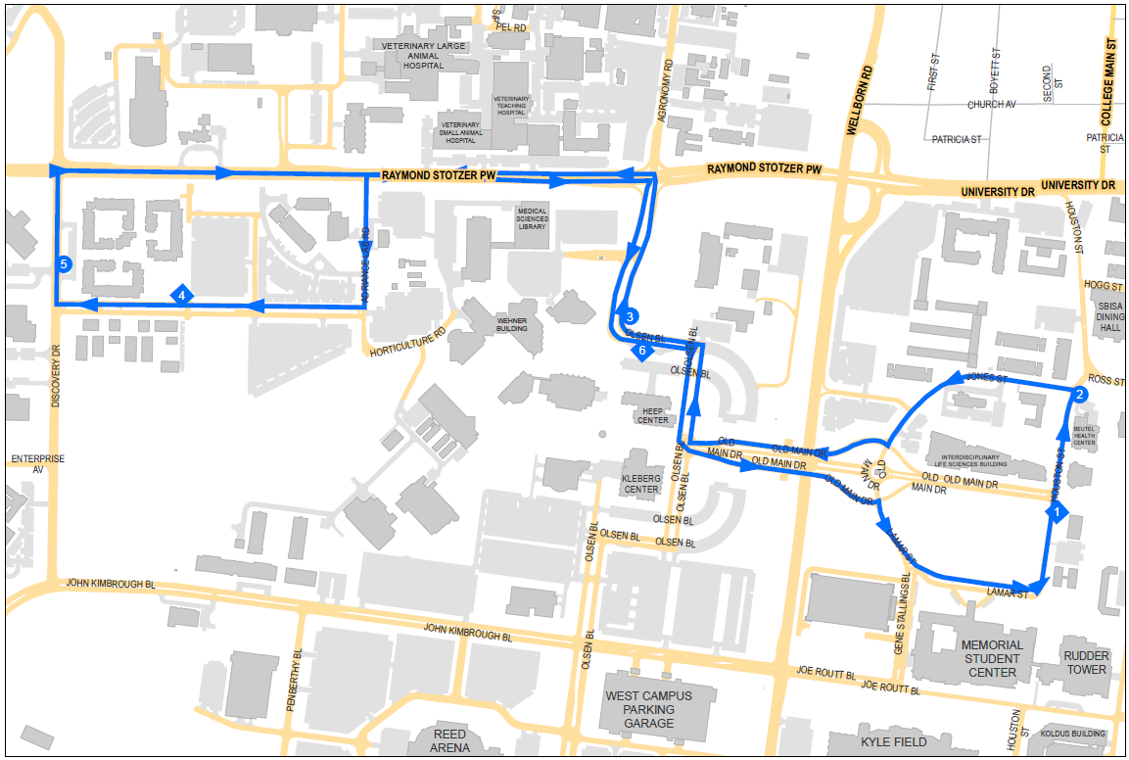
Night Routes
03 and 05
Current
1 bus on each route 7pm - 11:30pm nightly
Ridership on Route 05 averages less than 10 passengers per round
Ridership on Route 03 averages 20 passengers per round

Slide 10
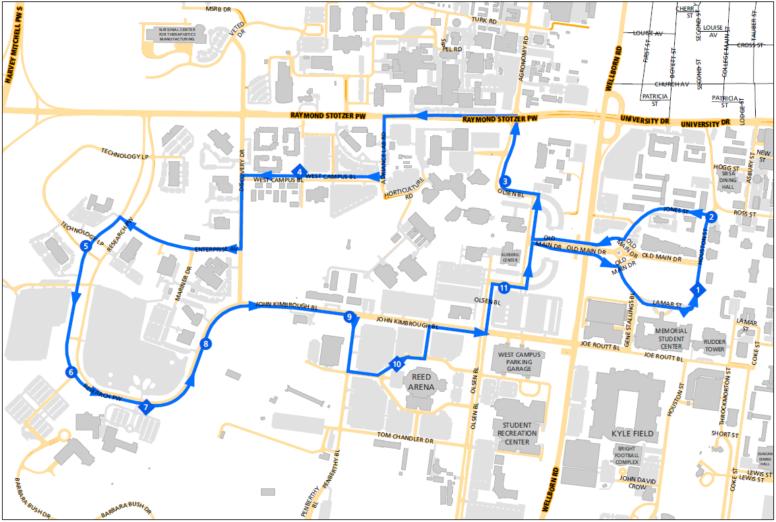
Night Route
03/05
Proposed
Extend day service on Route 03 until 9pm to offset heavier ridership to White Creek
Run 1 bus on combined routes as Night 03/05 from 7pm - 12:30am Mon-Fri
30 min roundtrip
Save 21 service hours per week by combining these routes

