Slide 1

Important Conversations:
Reserved Numbered Spaces
Kenneth Kimball & Therese Kucera
Texas A&M Transportation Services

Slide 2
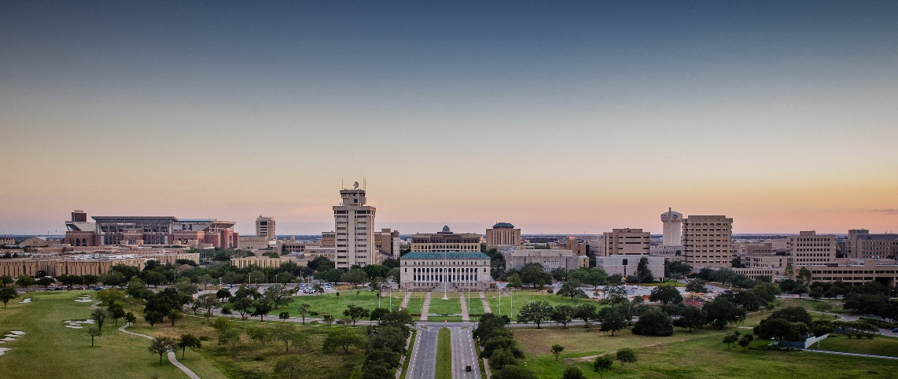
Introduction
As the university grows, Transportation Services would like to start the discussion about services or policies that create inefficiencies or are provided at no cost.
Continued university growth will make efficient use of our resources more and more important.
The purpose of these discussions is to bring up items of interest that could be modified, charged for or eliminated in order to accommodate more customers on campus.

Slide 3
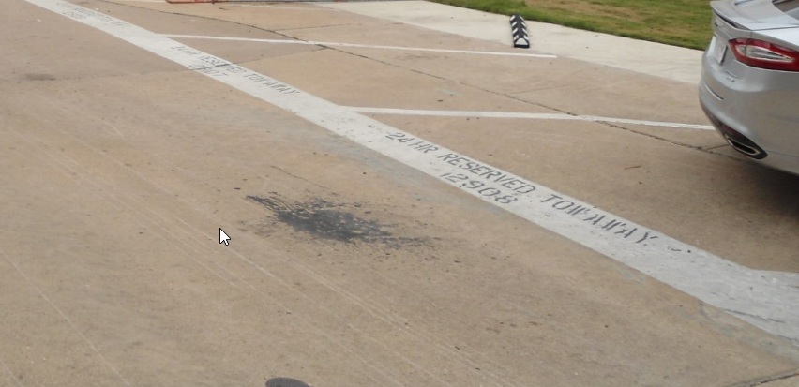
24-Hour Reserved Numbered Spaces (RNS)
There are over 2,100, RNS across campus in 28 surface lots and 2 garages.
RNS are only available to those faculty/staff who purchased them.
RNS are underpriced based on peer comparisons.

Slide 4
Reserved Surface

Slide 5
Reserved Garage

Slide 6
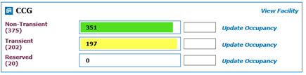
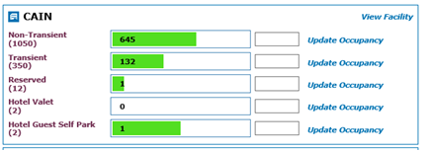
Notes on Occupancy
Central Campus Garage (CCG) is considered the model on how operate mixed-use garages.
Our parking system can handle the complicated task of properly allocating space for permit holders and visitors.

Slide 7
Garage Data
There are 231 Reserved Numbered Spaces (RNS) in University Center Garage (UCG) including the 1st level priority bay:
  4/15 @ 1:45 102 vacant RNS out of 231
  4/17 @ 1:45 110 vacant RNS out of 231
Wait List Data:
  1,879 people are on waitlist for UCG
  2,253 people are on waitlist for Northside Garage (NSG)
Over the years as RNS demand lessened we have eliminated some RNS in NSG and UCG (Price sensitivity major cause):
  NSG began with 1,720 RNS and now there are 469 (Faculty 218, Staff 134, Other 117)
  UCG began with 1,169 and now there are 231 (Faculty 47, Staff 93, Other 91)
  Southside Garage used to be all numbered spaces. RNS were removed in 2005

Slide 8
Garage Comparison
What if we manage like CCG?
Within CCG we have 385 physical spaces for visitor, business and regular permit sales. We are able to issue 472 permits (22.5% Oversell) and still meet our commitment to customers with permits and prescribed number of visitors. This oversell is lower than most student commuter lots due to staff needs.
In UCG, based on current oversell of non-RNS, we estimate being able to issue 110 more permits without reducing visitor capacity.
In NSG, based on current oversell of non-RNS, we estimate being able to issue 62 additional permits without reducing visitor capacity.

Slide 9
Lot Count Results
Fall & Spring
Peak Times and Days

Slide 10
Historic RNS Issues
Inefficient to Enforce:
    RNS are enforced for no permit or if space holder calls (605 citations last year).
    Officer administers space holder request or determines if ticket and/or tow is required; calls tow company if necessary.
    Officer begins completing associated paperwork and waits on scene for wrecker.
    Wrecker arrives, issues officer service number and clears space.
    Dispatch finalizes information and officer leaves scene; space holder notified that space is cleared.
Inappropriate Space Utilization:
    Customers park in their RNS but share the hangtag with another driver to park in AVP lots.
    Underutilized because not available to others after hours.
    Many are located in the center of campus near the front door creating traffic in highly congested pedestrian areas.

Slide 11
Campus Master Plan

Slide 12
Questions?

