Slide 1
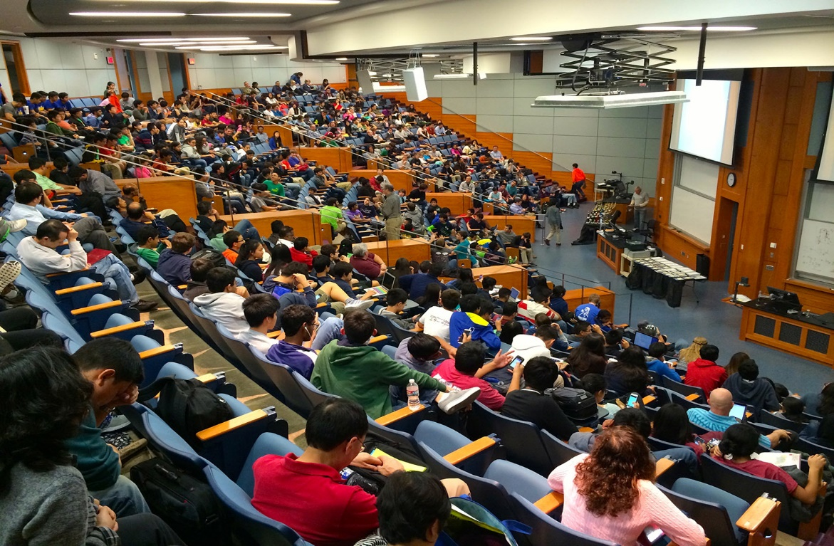
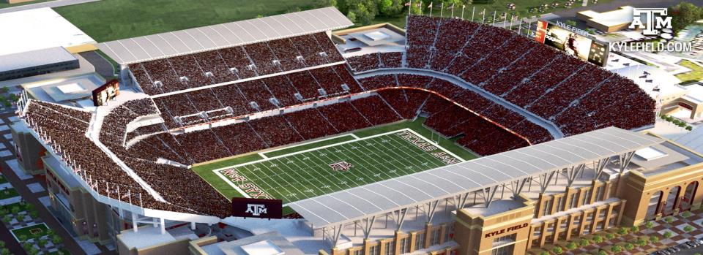
Two “Typical”
Aggie Days in One
Want to meet with us? Let us know what you think! Talk to us!
Tim Lomax, t-lomax@tamu.edu
Madison Metsker-Galarza, m-metsker-galarza@tti.tamu.edu
Texas A&M Transportation Institute

Slide 2
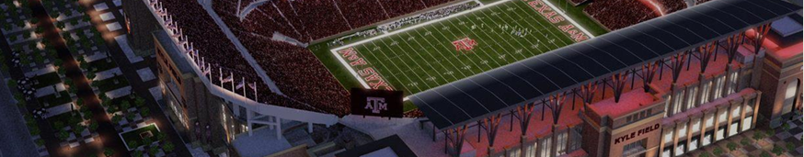
How Do WE Accomplish This?
We WANT professors to teach class – its why we’re here.
We WANT students to go to class – its why they’re here.
We WANT fans to come to the game.
Our approach: Help us, Help you
  Plan ahead, Know your options
  Don’t try to find a “hole” in the system – be part of the solution.
We need to communicate early and often – one united message.
  How do you want us to engage your community?
Flexibility will be key – this will not be a normal day.

Slide 3
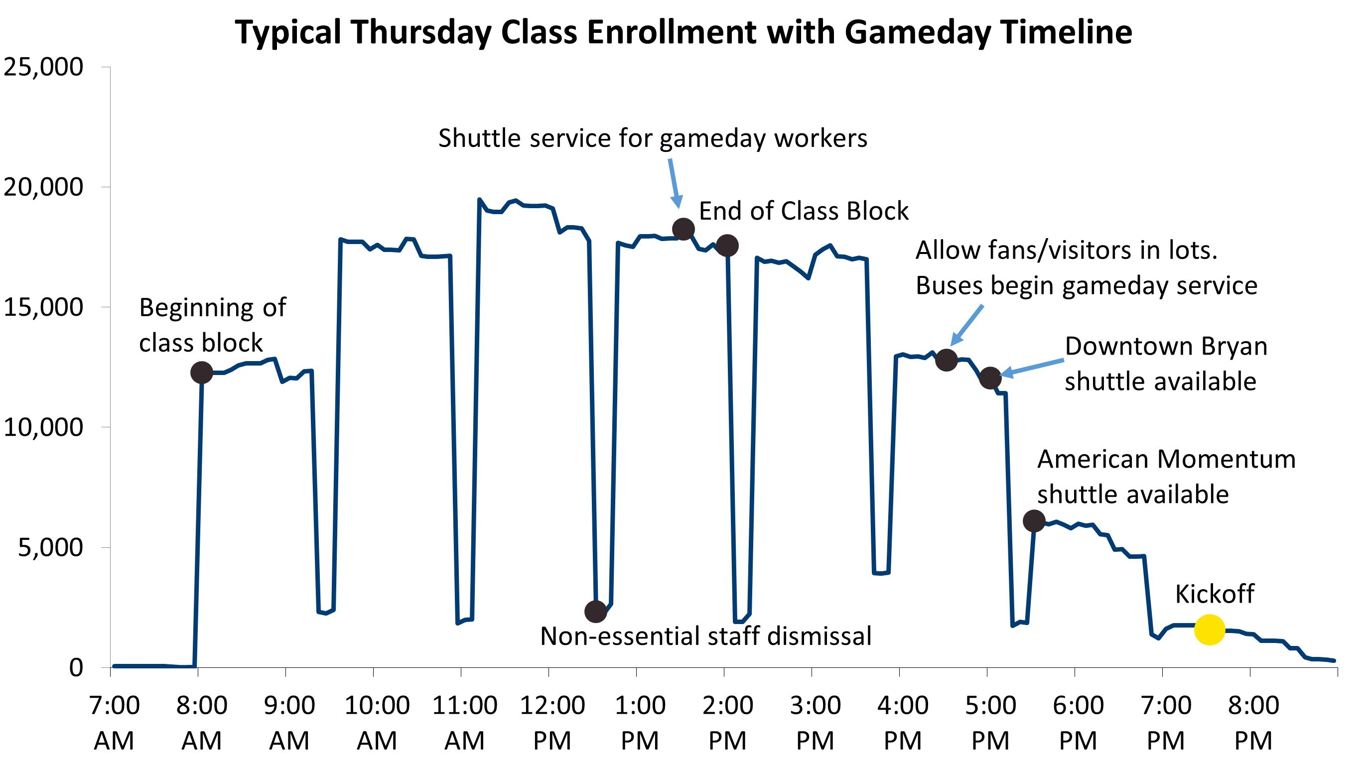
What Do “Two Typical Days in One” Look Like?
DRAFT DATA

Slide 4
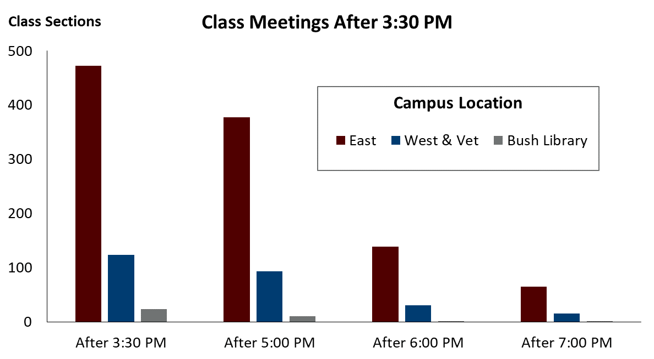
What Does a Typical Thursday Look Like After 3:35?
DRAFT DATA

Slide 5
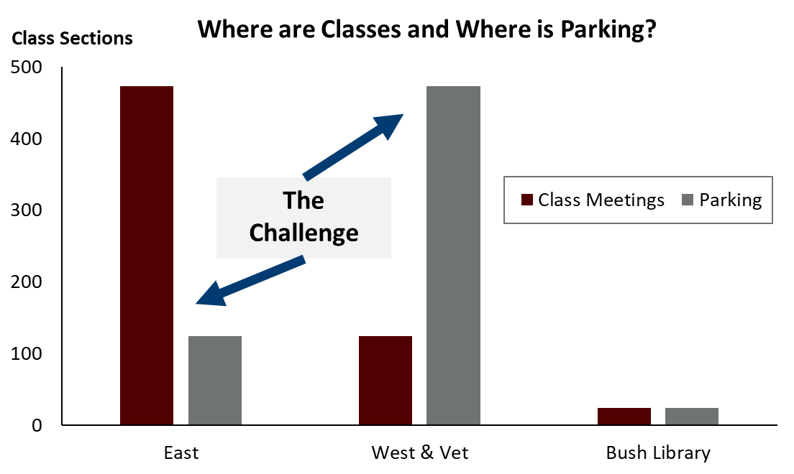
What Does a Typical Thursday Look Like After 3:35?
DRAFT DATA

Slide 6
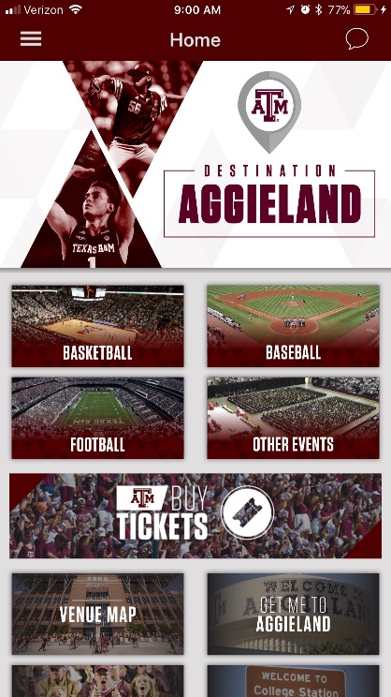

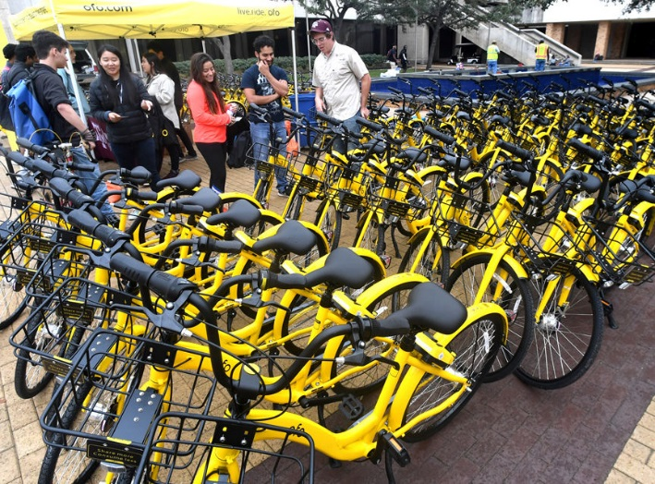
Know Your Options
Transit
ofo – Bike Share
Walking
Biking
Uber/Lyft
Carpool
Gameday Locker “Just an Idea”
Park Once for the Whole Day

Slide 7
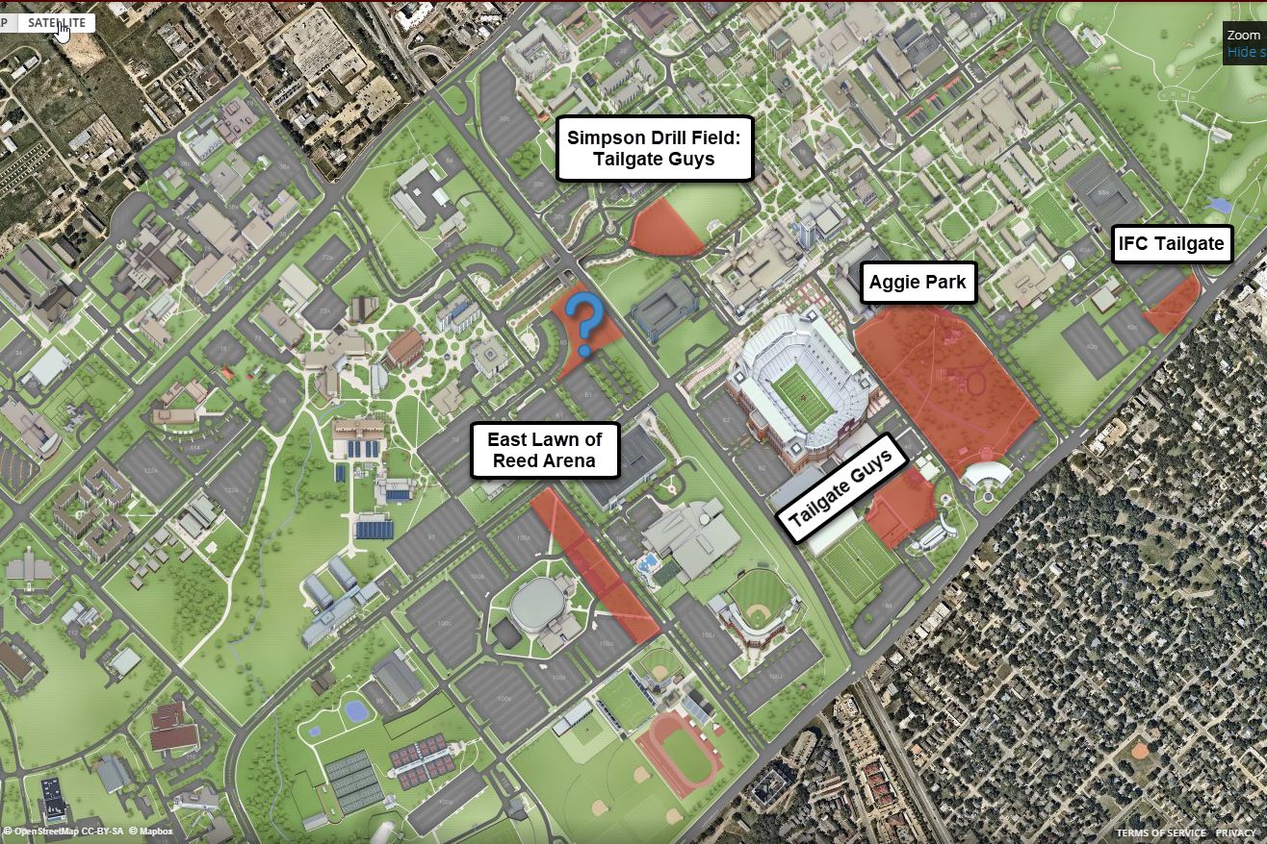
What Does Tailgating Look Like?
DRAFT IDEAS
Can load-in 7:00 pm Wednesday.
Can tailgate at 6:00 am on gameday BUT
Can’t park near tailgates until 4:30 pm.

Slide 8
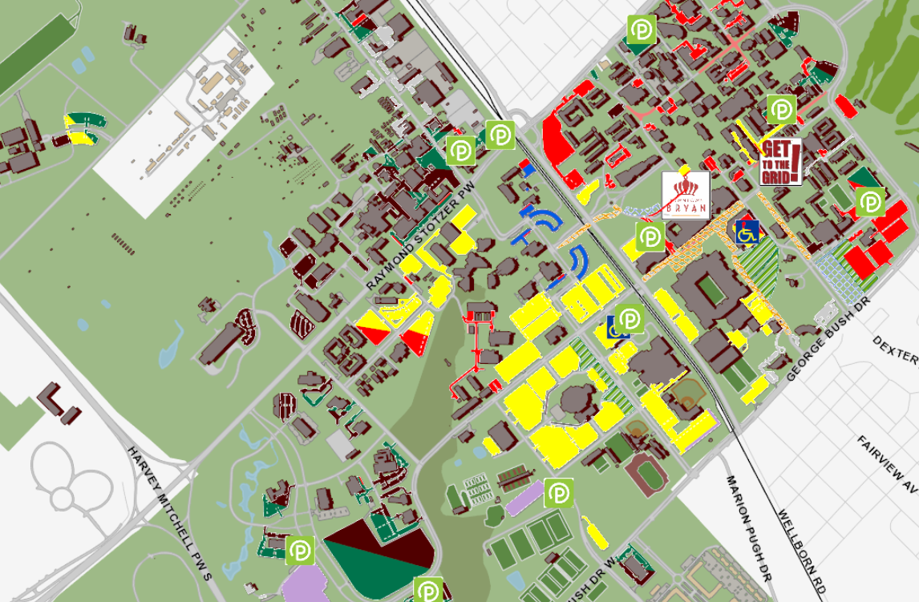
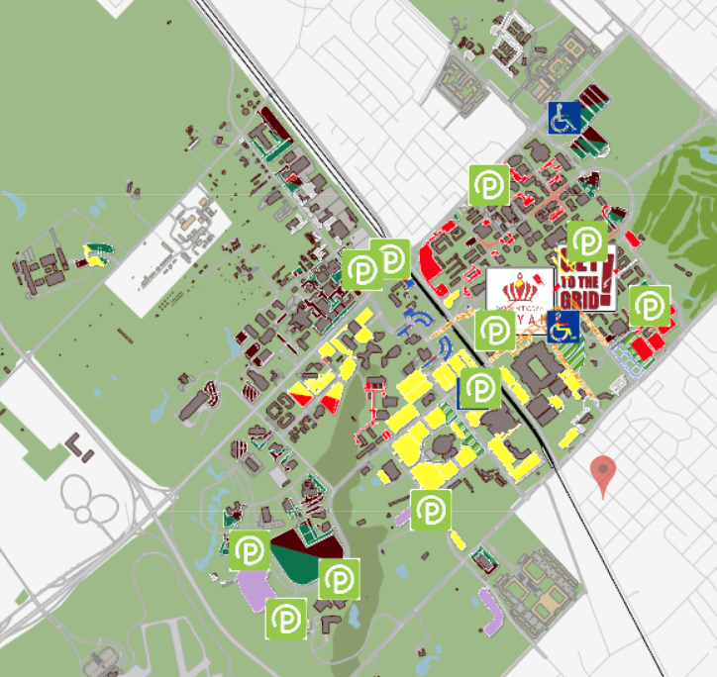
What Does GameTime Parking Look Like?
Yellow = 12th Man 10,000
Red = Dorm & Small Not Used
Green = Pay 5,000
Maroon = A&M Permit 5,000

Slide 9
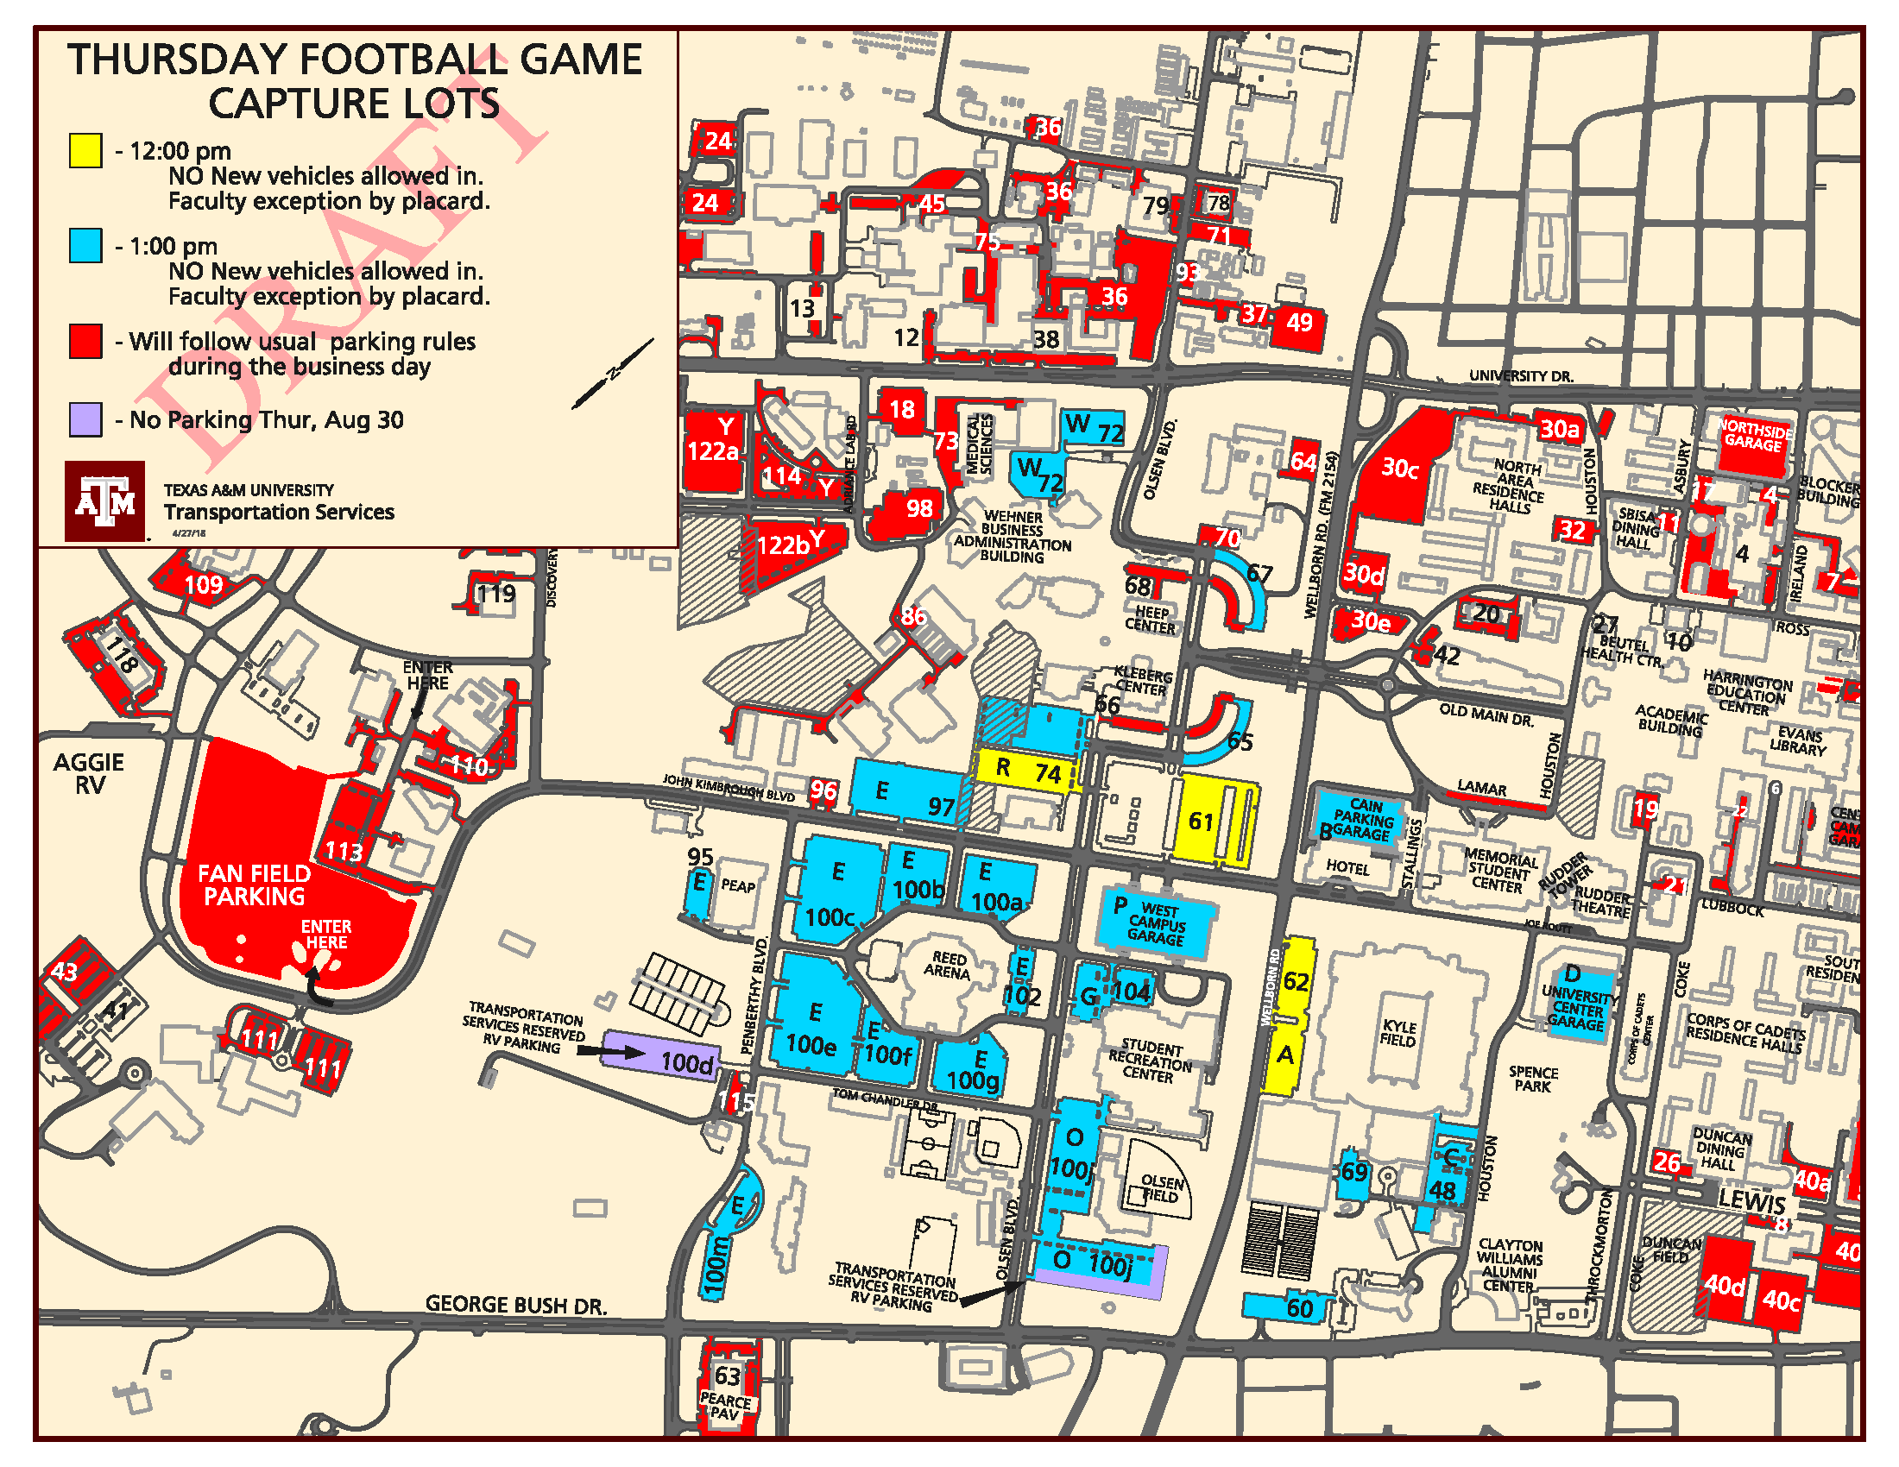
GameThursday Parking - Capture
Beginning in early morning - Staff will greet parkers to remind them about departure times.
At ‘capture time’ staff will prohibit new vehicles except those with placards.
Most of campus will follow usual rules during business day.

Slide 10
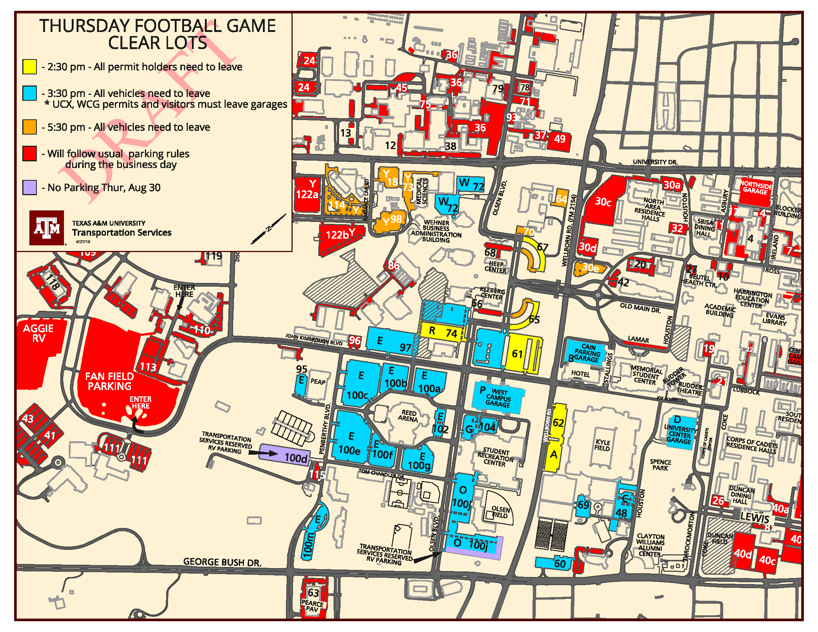
GameThursday Parking - Clear
Parking lots will ‘breathe’ – can park but may see additional vehicles.
Vehicles in yellow lots (after 2:30) may be moved to accommodate reserved space needs.

Slide 11
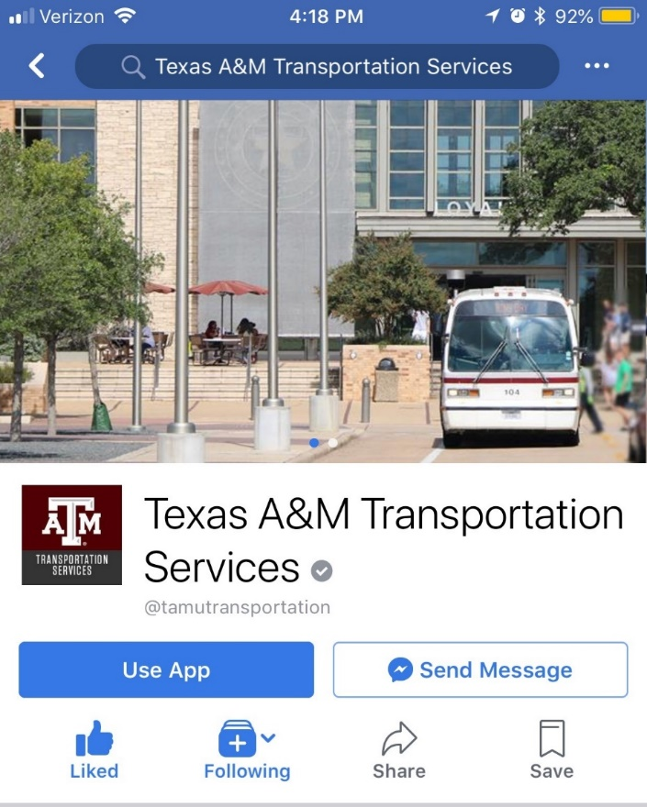
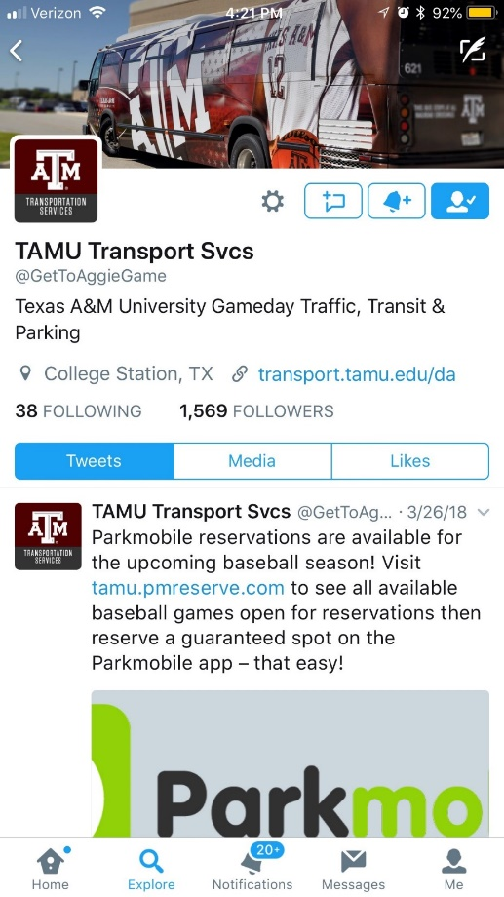
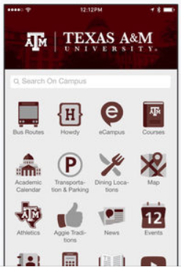
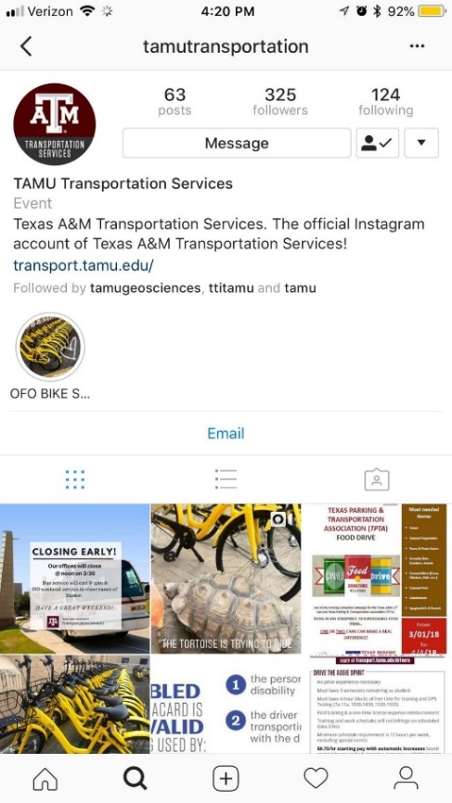
How Do We Engage Your Community?
Email
Twitter
Instagram
Facebook
Snapchat? “Just an Idea”
TAMU Mobile app
Destination Aggieland app
Transportation Services, 12th Man, and Athletics website

Slide 12
Let’s Talk!
Parking
Travel Options
Trip Planning
Engagement
What did we miss?
Tim Lomax
t-lomax@tamu.edu
Madison Metsker-Galarza
m-metsker-galarza@tti.tamu.edu
Texas A&M Transportation Institute

