Slide 1

Important Conversations:
Business and Campus Permit Follow up
Resident Student Permits
Kenneth Kimball & Therese Kucera
Texas A&M Transportation Services

Slide 2
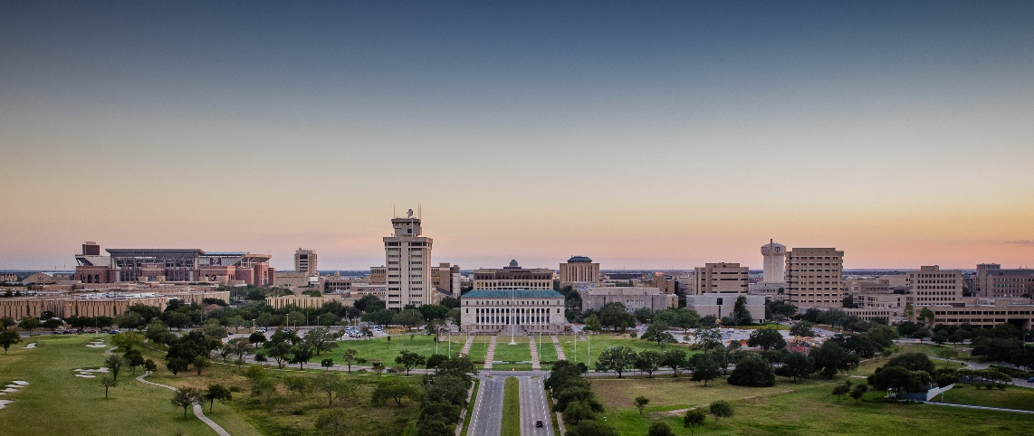
Introduction
As the university grows, Transportation Services would like to start the discussion about services or policies that create inefficiencies or are provided at no cost.
Continued university growth will make efficient use of our resources more and more important.
The purpose of these discussions is to bring up items of interest that could be modified, charged for or eliminated in order to accommodate more customers on campus.

Slide 3
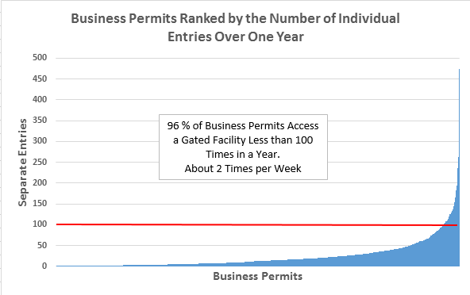
Notes:
2889 Issued today.

Slide 4
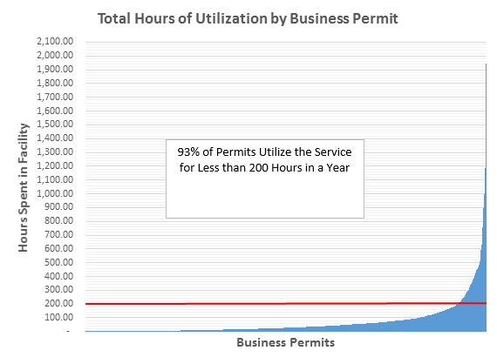
Notes:
Comparison: since September, we have had 600,000 transient transactions in our gated facilities
If transient spaces turnover 3x per day,

Slide 5
Graphical Notes on Entries and Duration
Entries:
  Those (90) accessing gated facilities more than 100 times during the year did so a total of 13,422 times. This represents 26% of the total number of times business permits accessed these facilities.
  In other words, 4% of business permits account for 26% of the entries.
Duration:
  Those (160) permits remaining in our gated facilities during the year for 200 hours or longer, spent 70,235 hours in our facilities. This represents 46% of all hours business permits spent in gated facilities.
  In other words, 7% of business permits account for 46% of the time.

Slide 6
Residential Student Parking Data
Discussion of Information Regarding Peer Data on Residential Parking Permits, Pricing and Policy

Slide 7
Residential Student Parking Data
Current annual costs for Texas A&M University residents are the same as for commuter parking.
  $485 for Garage Parking
  $300 for Surface Parking
The question was posed as to whether there was variable pricing or other requirements specific to resident students.
  SEC Schools
  Vision 2020 Peer Institutions

Slide 8
Residential Student Parking Data
Examples of Variable Pricing:
SEC
  Alabama $225 Residential vs. $220 Commuters
  Mississippi State $160 Residential vs. $149 Commuters
  Kentucky $448 Residential vs. $296 Commuters
  Ole Miss $300 Residential vs. $200 Commuters
Vision 2020 Peers
  UT Austin $280 to $796 Residential vs. $138 to $207 commuters
  UC Berkley $1,404 for Residential Permits vs $1,370 for Commuters
  UCLA $1,212 for Residential Permits vs $972 for Commuters
  Purdue does charge a residential premium, prices not provided.
  University of Georgia prices vary according to location. Residents pay more but amount not provided.

Slide 9
Residential Student Parking Data
Which Schools Prohibit Residents Vehicles On Campus?
  Ohio State University
  University California at Davis
San Diego State Limits Freshmen to hourly paid parking or summer permits.
All other institutions in the pool allow residents at the same price as commuters.

Slide 10
Questions/Discussion?

