Slide 1
Lot 60
Priority for Athletes
Debbie Hoffmann
Texas A&M Transportation Services

Slide 2
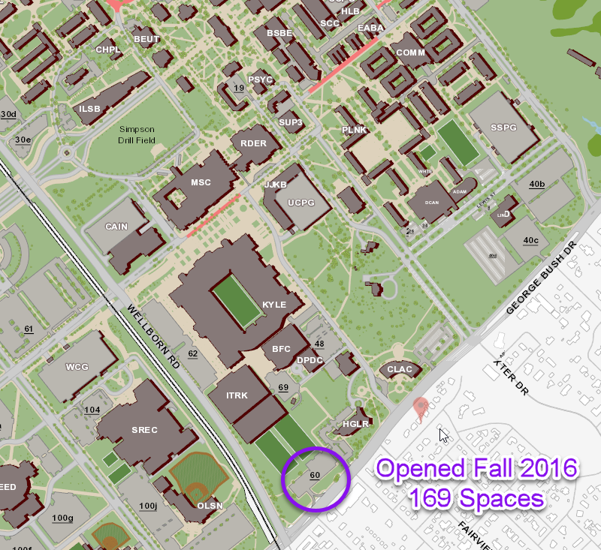
Opened Fall 2016
169 spaces

Slide 3
Waitlist
September 2016 –191 students waiting after initial assignments
were made.
October 10, 2016 –Waiting list was cleared and vacant spaces consistently averaged 95.
September 2017 – 885 students waiting after initial assignments
10/9 – offered 75 permits and 1 accepted
10/13 offered 100 permits and 3 accepted
10/23 offered 200 permits and 9 accepted
10/30 offered 218 and 18 accepted
Oct. 30, 2017 – Waiting list cleared.

Slide 4
Questions?

