Slide 1

Important Conversations:
Any Valid Parking on Gameday
Kenneth Kimball & Therese Kucera
Texas A&M Transportation Services

Slide 2
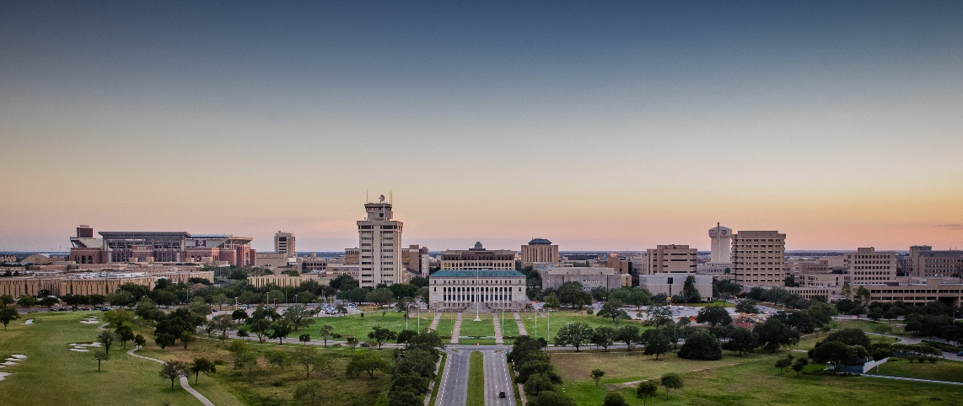
Introduction
As the university grows, Transportation Services would like to start the discussion about services or policies that create inefficiencies or are provided at no cost.
Continued university growth makes the efficient use of our resources very important.
The purpose of this discussions is to highlight services that could be modified, charged for or eliminated in order to accommodate more customers on campus.

Slide 3
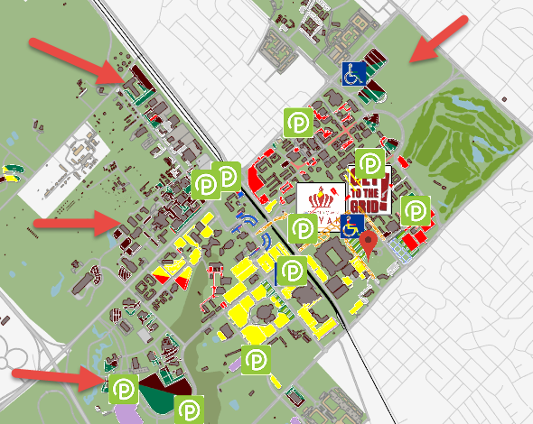
Maroon AVP Areas

Slide 4
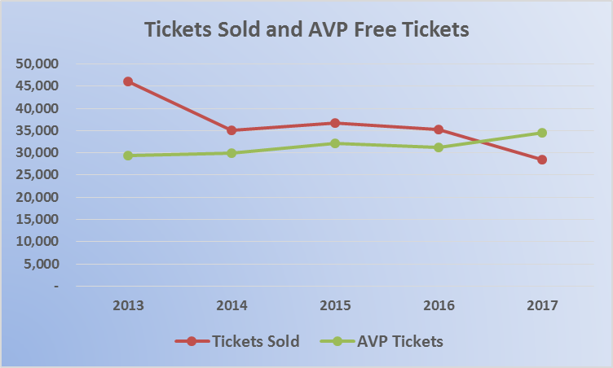
Gameday Parking
Notes:
Comparison: since September, we have had 600,000 transient transactions in our gated facilities
If transient spaces turnover 3x per day,

Slide 5
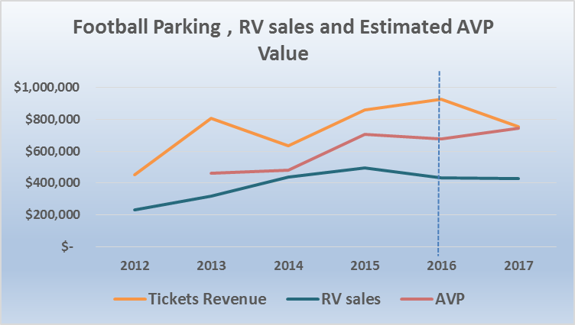
Gamday Revenue
Notes:
2,889 Issued today.

Slide 6
Discussion
According to TTI Research, a car not paying to park on gameday will carry on average ½ fewer riders than one required to pay to park.
With added growth and attendance, it will become important for this inefficiency to be addressed.
One consideration could be to limit or eliminate free, gameday parking for permit holders (Excluding for academic and research purposes). Thus, allowing us to serve more with our limited resources and help fund gameday services provided.

Slide 7
Questions?

