Slide 1
Transportation Services’ Role in the Campus Master Plan
Transportation Services Advisory Committee
September 6, 2017

Slide 2
Mobility is a critical part of experiencing Texas A&M University's large campus.
Moving the University's population across the large campus for daily activities creates an enormous amount of movement both on, and off campus. From on on-campus residents walking to class, to off-campus residents relying on the transit system, and service vehicles accessing buildings for deliveries and repairs, each of these systems must align harmoniously to create seamless, convenient, and safe experiences for all campus users.

Slide 3
Campus Master Plan
Relies on a hierarchical mobility structure focused primarily on pedestrian safety
Preferred travel modes for campus users are walking, biking, and on-campus transit
Vision to create a pedestrian-focused campus
Relocates vehicles away from the center
Mobility approach improves quality-of-life

Slide 4
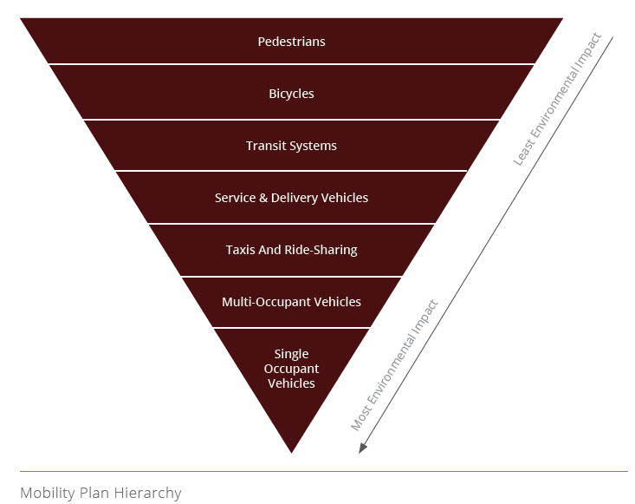
Mobility Plan Hierarchy

Slide 5
What is our role?
Strategically manage demand for parking
Align our business practices, reduce inefficiencies, and support upcoming initiatives of the new CMP
Prepare for elimination of central surface lot parking by implementing garage plan
Reexamine how spaces are currently being utilized with regard to 24-hour reserved, regular and visitor spaces
Notes:
Strategically managing demand for parking.
Align our business practices, reduce inefficiencies, and support upcoming initiatives of the new CMP.
Planned elimination of surface lot parking with garage parking.
Reexamine how spaces are currently being utilized with regard to 24-hour reserved, regular and visitor spaces. Examine ratios of parkers served per space in each category.
Re-evaluate parking privileges and pricing for various customer groups. Discuss efficiencies and ideas.
RELLIS Parking/Transit Support
Handicapped Parking Research/Results

Slide 6
What is our role?
Examine ratios of parkers served per space in each category
Re-evaluate parking privileges and pricing for various customer groups; discuss efficiencies and ideas
Notes:
Strategically managing demand for parking.
Align our business practices, reduce inefficiencies, and support upcoming initiatives of the new CMP.
Planned elimination of surface lot parking with garage parking.
Reexamine how spaces are currently being utilized with regard to 24-hour reserved, regular and visitor spaces. Examine ratios of parkers served per space in each category.
Re-evaluate parking privileges and pricing for various customer groups. Discuss efficiencies and ideas.
RELLIS Parking/Transit Support
Handicapped Parking Research/Results

