Slide 1

Transportation Services Advisory Committee
Review Bike District Plan Registration Recommendations
Alternative Transportation Manager Ron Steedly

Slide 2
Overview
History
Two recommendations for consideration next:
  Mandatory bike registration
  Registration fee
Communications Plan

Slide 3
History

Slide 4
History
2008 Bike Study conducted by Transportation Services.
2009 Interim Texas A&M President Bowen Loftin signs memorandum for mandatory Bike Registration on campus.
2009 Texas A&M Bicycle Program—Bicycle Rules and Regulations Plan implementation.
2010 Alternative Transportation Unit formalized to manage bicycles program and other alternative transportation initiatives at Texas A&M.
2010 TSAC endorses formal plan to register bikes on campus.
2010/2011 Voluntary free Bike Registration began.
2011 An informal bike champions committee consisting of faculty, students, and staff was established to gain insight from all stakeholders regarding the implementation of the plan. Mandatory bike registration recommended.
2015 Bicycle District Strategic Plan
Notes:
Note: There have been a number of committees and task forces assigned to address this topic throughout the years

Slide 5
Current University Rule for
Bike Registration and Parking Program
Rule 21.01.05.M3 Transportation Services (Approved March 4, 2010)
Rule Statement
Transportation Services is responsible for managing all parking, traffic and transportation-related activities on campus. Transportation Services is guided by state and federal statutes and regulations.
Official Rule Bike Registration and Parking Program
The President has delegated responsibility to Transportation Services to coordinate the Bike registration and parking program. This program promotes the safer operation of bicycles and aids in bike theft recovery.

Slide 6
Current Student Rule for Bike Registration
35.2 Bicycles
All bicycles should be registered with Transportation Services. Bicycles can be marked with an identifying number by the University Police Department to ensure proper return if recovered after theft or confiscation due to illegal parking or abandonment. All bicycles on university property must be operated in accordance with university rules and appropriate Texas motor vehicle laws.
After the close of the spring semester, all bicycles will be removed from the residence hall bicycle racks, except those racks specifically designated for storage during the break between semesters. Bicycles that appear to be abandoned in the racks or near other campus buildings or parking lots will be impounded by Transportation Services. In cases that result in the removal of the chain/lock, the owner will absorb the cost of replacement. http://student-rules.tamu.edu/rule35

Slide 7
Benefits of Bike Registration

Slide 8
Benefits of Bike Registration
Immediate notification to customers
Provides identifiable information of owner if removed, lost or stolen
Theft deterrent (preventative)
Allows the Alternative Transportation Unit to properly manage bicycles on campus in accordance with Bike District Plan.

Slide 9
Mandatory Bike Registration & Fee Discussion

Slide 10
Mandatory Bike Registration & Fee Discussion
Consider 2017-2018 school year implementation of mandatory registration for all bicycles on Texas A&M campus.
District plan recommends a one-time registration fee of $10 per bicycle.
Active enforcement through Alternative Transportation Unit
Consider requiring bike registration before bike can be retrieved.

Slide 11
Communications Plan
for Mandatory Bike Registration

Slide 12

Proposed: Communications
Begin communications of the mandatory requirement to register bikes on campus during the current semester leading up to the start of the 2017-2018 school year.
Communications to continue as a part of normal operations for years to come.

Slide 13
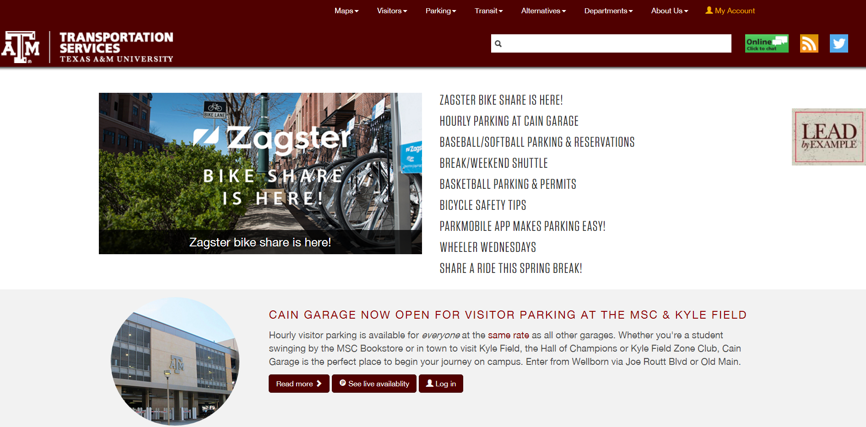
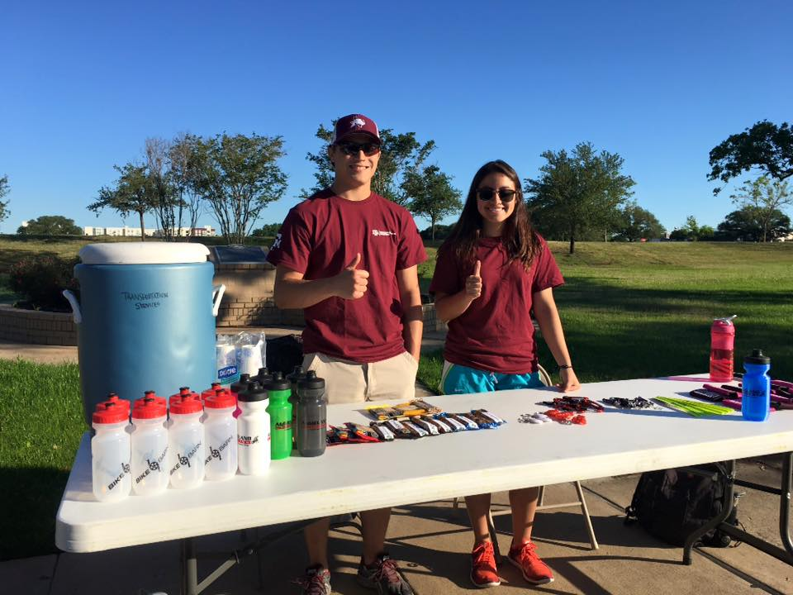
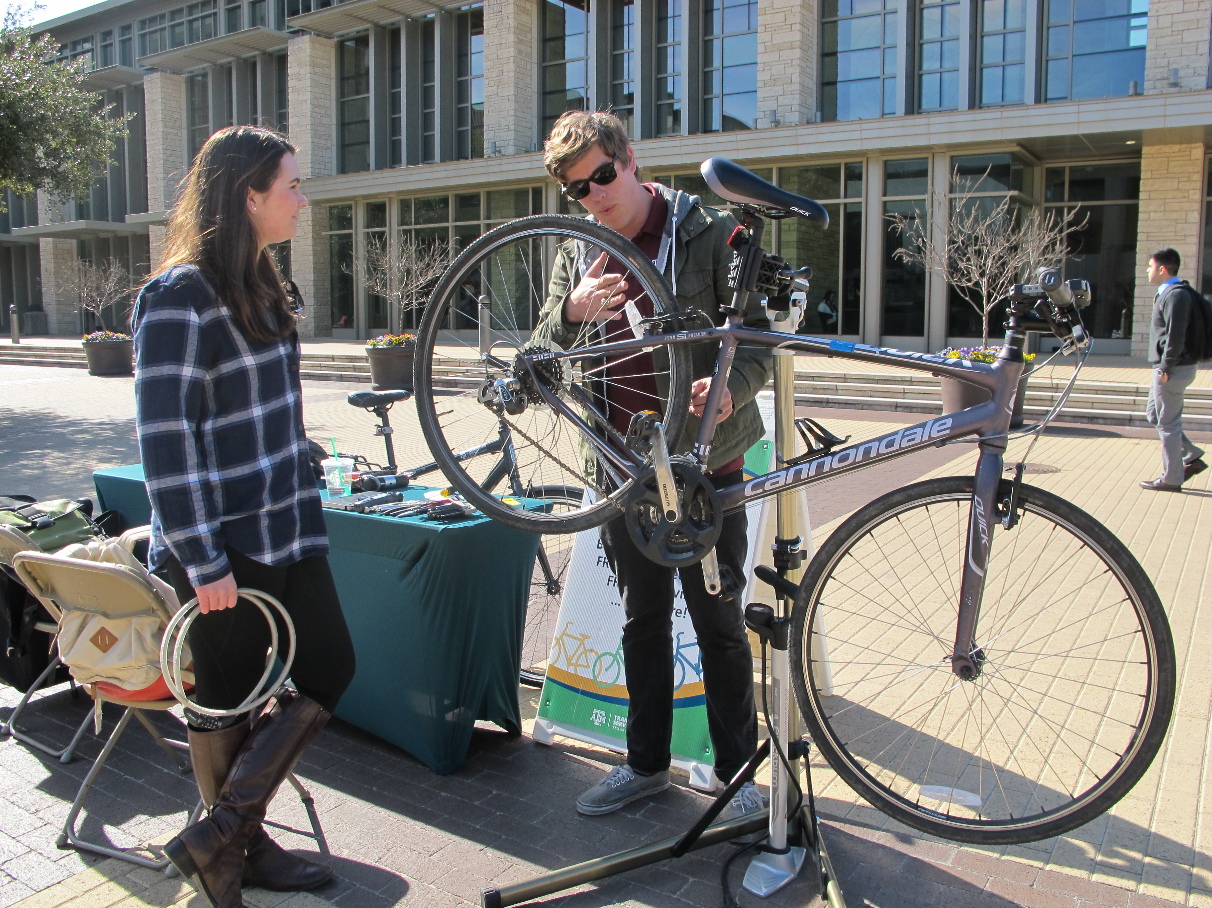
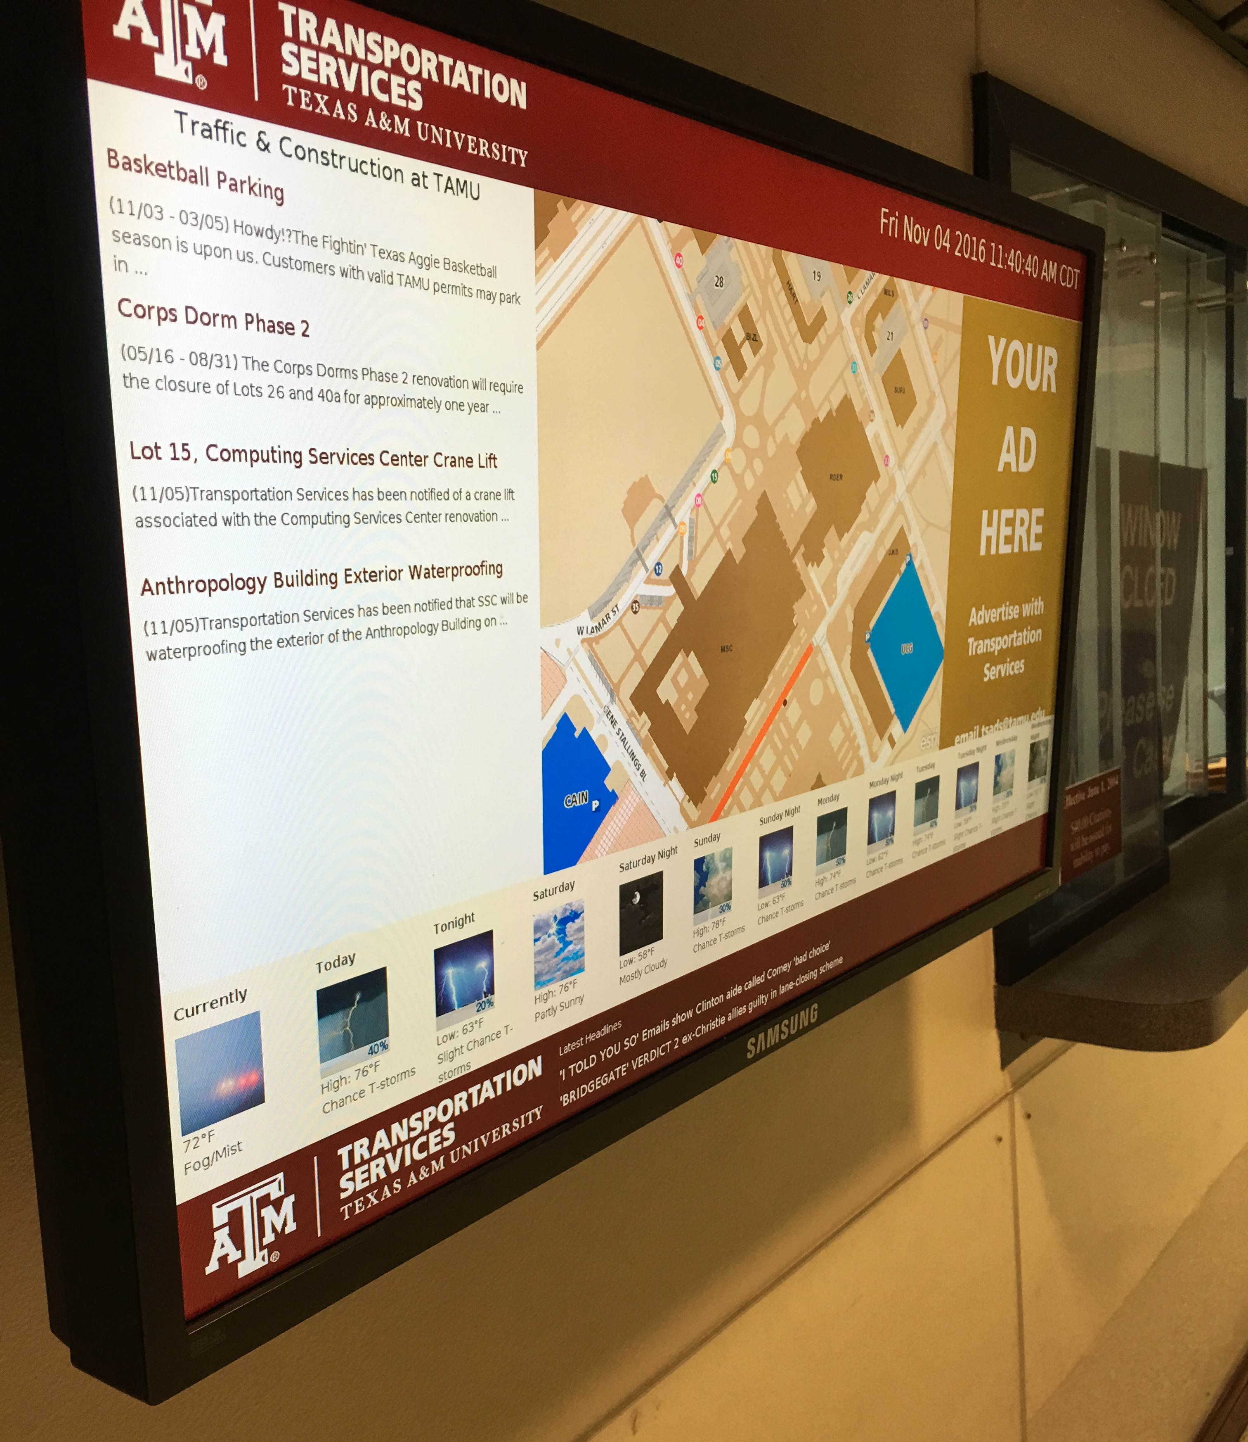
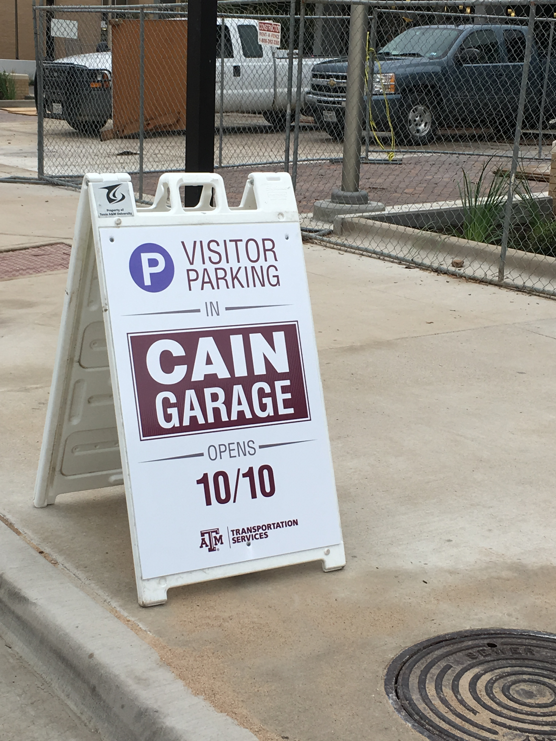


Proposed: Communications
Transport.tamu.edu website
Texas A&M mobile app
Digital signage
Signage at parking facilities
Social media accounts
Battalion news story
Texas A&M Today
Bulk mail notification
Presentations to campus organizations
New Student Conferences
Annual Day to Ride event (Refueling Stations)
Wheeler Wednesdays (weekly engagement with biking community)

Slide 14
Questions
Ron Steedly
rsteedly@tamu.edu

