Slide 1
Important Conversations
Retiree Permits
Kenneth Kimball & Therese Kucera
Texas A&M Transportation Services

Slide 2
Introduction
As the university grows, Transportation Services would like to start the discussion about services or policies that create inefficiencies or are provided at no cost.
Continued university growth will make efficient use of our resources more and more important.
The purpose of these discussions is to bring up items of interest that could be modified, charged for or eliminated in order to accommodate more customers on campus.

Slide 3
Current Statistics
As of Oct. 1, there are 1,286 Retiree Permits issued.
During FY17, retiree permits accessed our gated facilities 6,042 times.
At our current surface lot pricing, this would normally generate $385,800 annually. At garage rates it would be $623,710.
Retiree permits current cost is $0.

Slide 4
Is there Abuse?
Current Policy
“Persons who have officially retired from the Texas A&M University System are eligible for a retiree parking permit if they are not currently on the TAMUS payroll. This privilege is reserved for fully retired persons receiving no compensation from the university and is intended for your personal use only for occasional visits to campus. If you resume employment by the university, your retiree parking privileges will cease.”
http://transport.tamu.edu/Parking/retiree.aspx

Slide 5
Examples of Noted Abuse
Allowing working spouses, children or grandchildren to use the permit.
Not exchanging the free permit for the half-price working retiree permit when resuming employment.
Parking free on game day.
(It takes time to find and address abuse.)

Slide 6
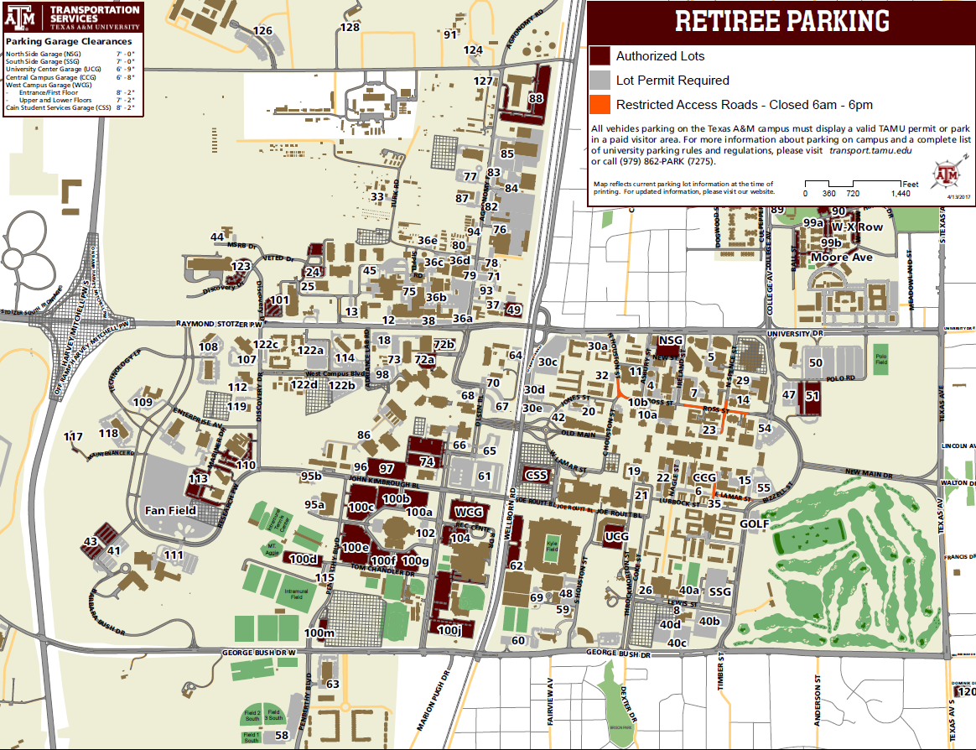

Slide 7
What do other universities provide?
Of the 17 universities interviewed, 6 or 35% do not charge for Retiree Permits.
7 or 41% limit permit access below the TAMU standard.
For the 65% that charge a fee, this cost ranges from $12 to $1,116 per year with an average of $198.
Policies of Interest:
UC San Diego has discounted pricing for use only 3 days a week and for only 10 days a year.
Georgia’s retiree permit only valid Fall and Spring.
All universities stress only for permit holder’s use.

Slide 8
Solutions/Changes
Eliminate the Retiree Permit
Charge some rate for the service
Limit access in some way such as only surface lots
Limit usage (certain days or hours)

Slide 9
Questions/Discussion?

Slide 10
Price and Access at other Universities
Alabama
Free
Available for use in all spaces except state-designated, area coordinator, or handicap
Florida
Free
Equivalent to a business permit, park at most of the lots
Georgia
Prorated at ½ price $180
Valid from Spring through Fall
Kentucky
$60 per year
Park in areas designated lot intermediate E/K permits

Slide 11
Price and Access at other Universities
Michigan
For that individual use only
Blue Parking: located close to U-M buildings
UCLA
$150 per year
UC- San Diego
$1,116 per year; $93 per month; $133 only 3 days a week; $58 for 10 days
Ohio State
$353.04 per year
Purdue
Free
Only A lot

Slide 12
Price and Access at other Universities
South Carolina
$12 per year
Only the faculty staff lots
Vanderbilt
Free
Park at 3 certain zones with no charge
Texas
50% of regular permit fee; Price range: $67-$267
F Surface/Garage, A, N, N+
For that individual use only
UC- Berkeley
$564 per year
C, F and S lots
For that individual use only

Slide 13
Price and Access at other Universities
Mississippi State
Gated: $312
Regular: $75
Ole Miss
$60 per year
Valid in any regular faculty/staff, open, visitor or Park-N-Ride zones
Missouri
$21 for individuals which have an appointment with the University of 50% or greater
$24 for less than 50%
Most of the lots

