Slide 1

Lot and Wait List Changes
Fall 2017
Transportation Services Advisory Committee
March 1, 2017

Slide 2
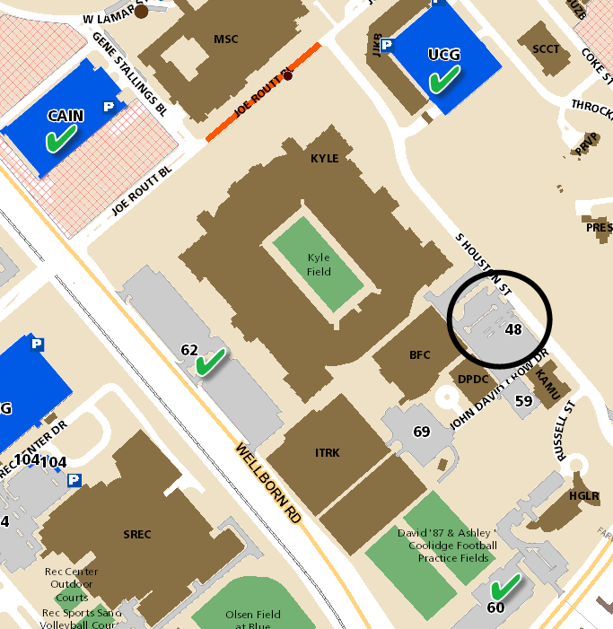
Proposed Effective Fall 2017
No Longer Graduate Student Selectable
Available to Faculty/Staff Only
Lot 48 (Bright Athletic Complex) - Currently only 7 G8’s in the lot and we have not put any new graduate students in the lot this year.
  Lot 60, 62, Cain Garage and University Center Garage are in the area and would still be a available for graduate students.

Slide 3
Proposed
No Longer Undergraduate Selectable
Fall 2017 available to Faculty/Staff/Graduate
Lot 18 (Med Sciences) – 76 graduate students still on the waitlist (2 seniors in the lot and they are both Disabled Veterans)
Lot 24 (New Vet School) – 251 staff and graduate students still on the waitlist (6 undergraduate renewals in the lot)
Lot 97 (Agrilife) – We are currently only offering permits to staff due to and increased demand with Ag 4 opening in May (currently 10 senior renewals in the lot)
Lot 111 (Bush School) – 70 staff and graduate students still on the waitlist (no undergraduates in the lot)
Lot 114 (School Public Health) – 32 graduate students still on the waitlist (17 senior renewals in the lot)

Slide 4
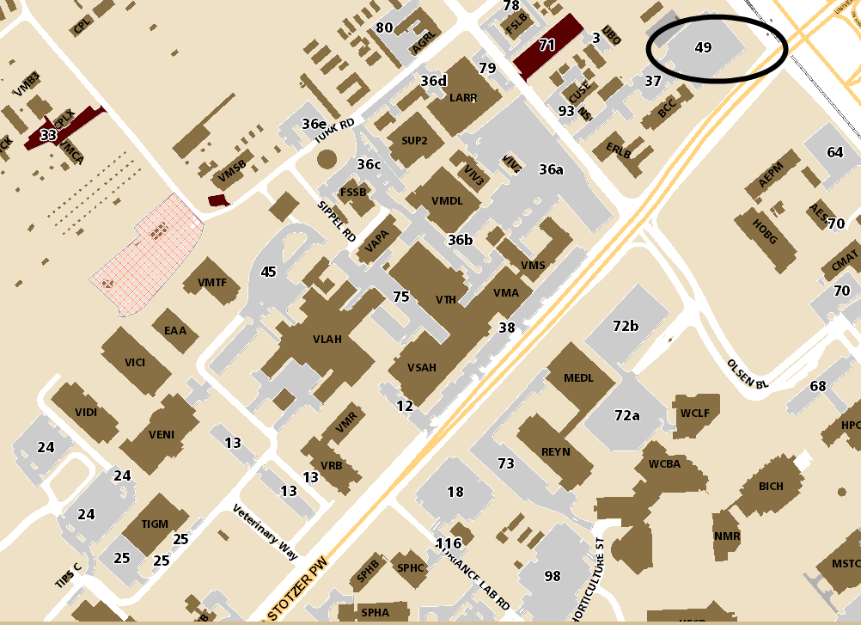
Lot 49 History
April 2015
changed from Any Valid Permit (AVP) to Lot 49 permit required
discussed we could reinstate AVP in the future if there was no demand

Slide 5
Lot 49 - Proposal
  The lot is currently underutilized with no waitlist (179 spaces and 139 active permits).
  Confirmed with the Vet School their 10 year plan does not include construction that would take other parking lots in the area offline.
  The University intends to utilize a 380 seat classroom in the nearby Vet building as swing space for random undergraduate classes in Fall 2017.
  Would help alleviate stress on the Transit system and better utilize the lot.
  Communication Plan:
    Send message to Lot 49 permit holders before registration alerting them of the change and informing them they can still park in the lot with a valid Texas A&M parking permit.
    Signs at the Lot

Slide 6
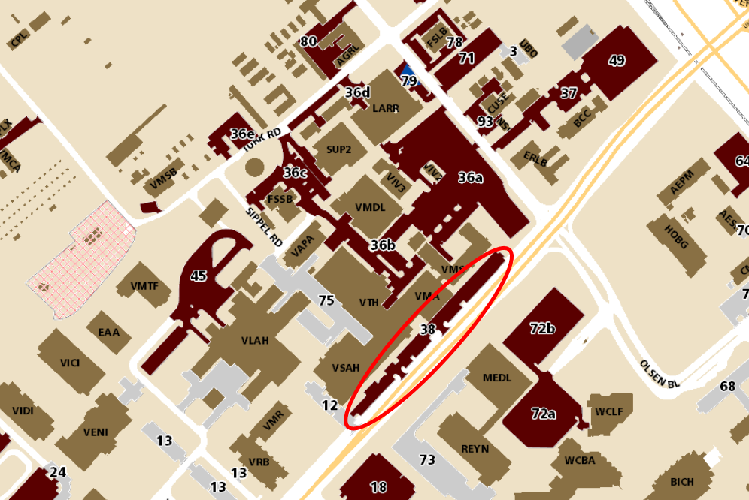
Lot 38 Business Parking

Slide 7
Questions?

Slide 8
Northside Garage
Football Parking
Fall 2017

Slide 9
Permits Valid in Garages on Football Gamedays
Northside Garage – Free to any valid A&M permit
Central Campus Garage – CCG permits only
Southside Garage – SSG permits only
University Center Garage – UCG permits only (no UCX permits)
West Campus Garage – WCR permits only (no WCG permits)
Cain Garage – Reserved – no A&M permits allowed

Slide 10
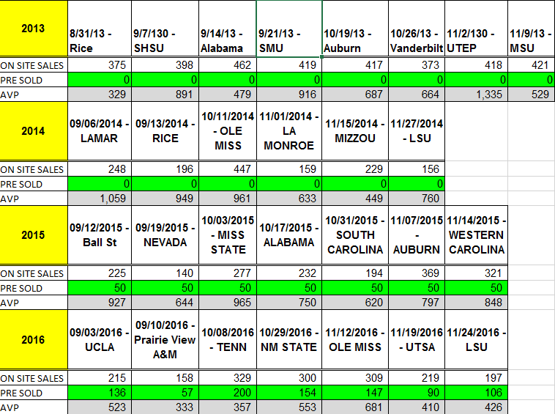
NSG Sales vs. AVP

Slide 11
TTI Data Collection
Northside Garage
  Oct 3, 2015 vs Mississippi State
  11am – 3 pm
  1240 vehicles surveyed
    280 cash
    960 AVP
  Vehicle occupancy ratio
    1.7 people per car AVP (free)
    2.2 people per car cash

Slide 12
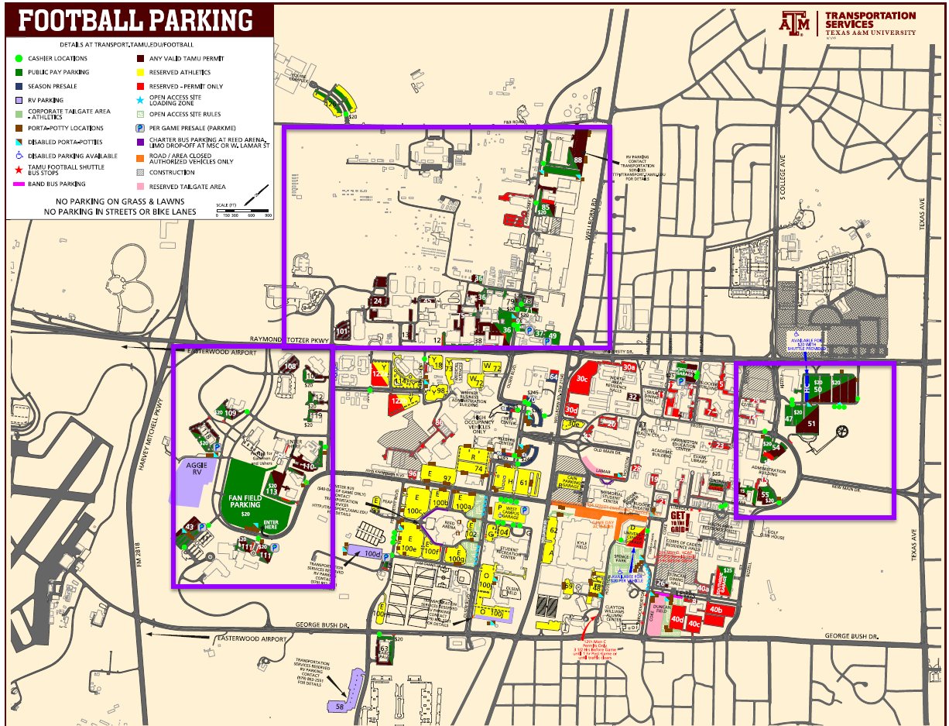
Other Lots Available for AVP Parking

Slide 13
Proposed NSG Gameday Parking
Effective 2017 Season
NSG permits park without paying
Prepaid and/or pay-upon-arrival parking
No longer allow other A&M permits to park for free

Slide 14
Questions?

