Slide 1

Donations for Citations
UPDATE
Transportation Services Advisory Committee
May 3, 2017

Slide 2
April 3 – April 14
133 citations reduced
$3135
People donated more that the required amount
Some people just came by to donate
LOTS of good articles

Slide 3
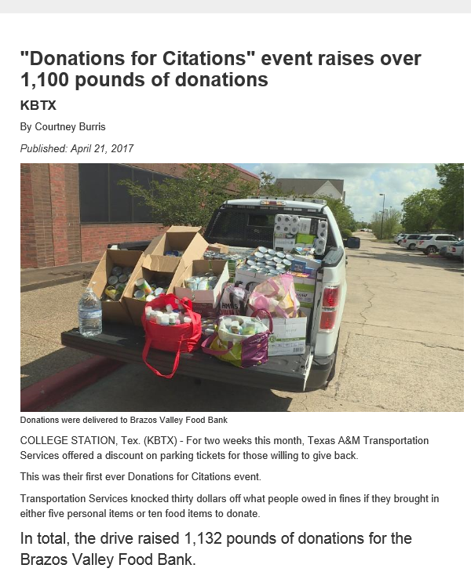
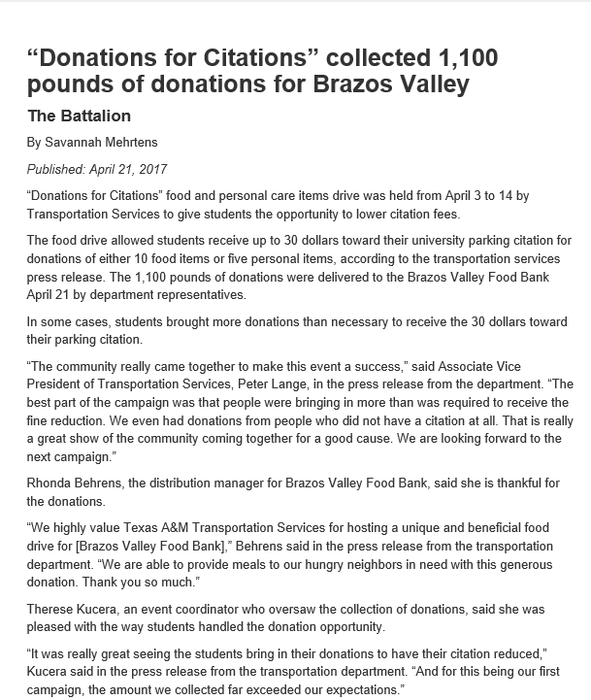
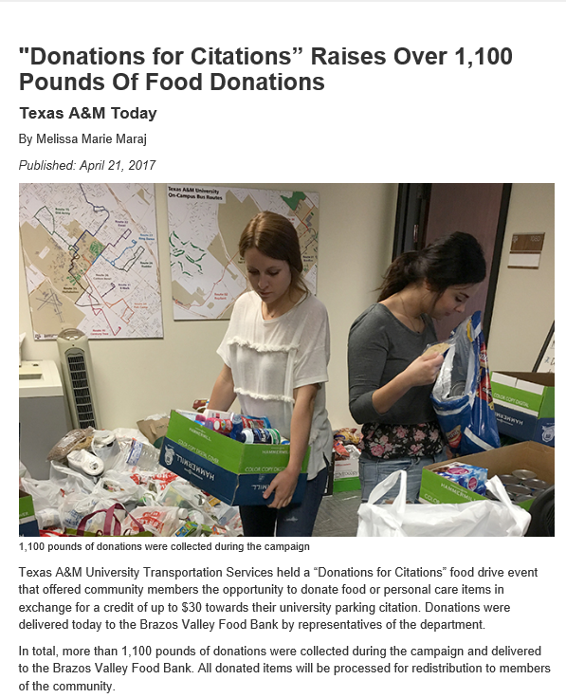

Slide 4
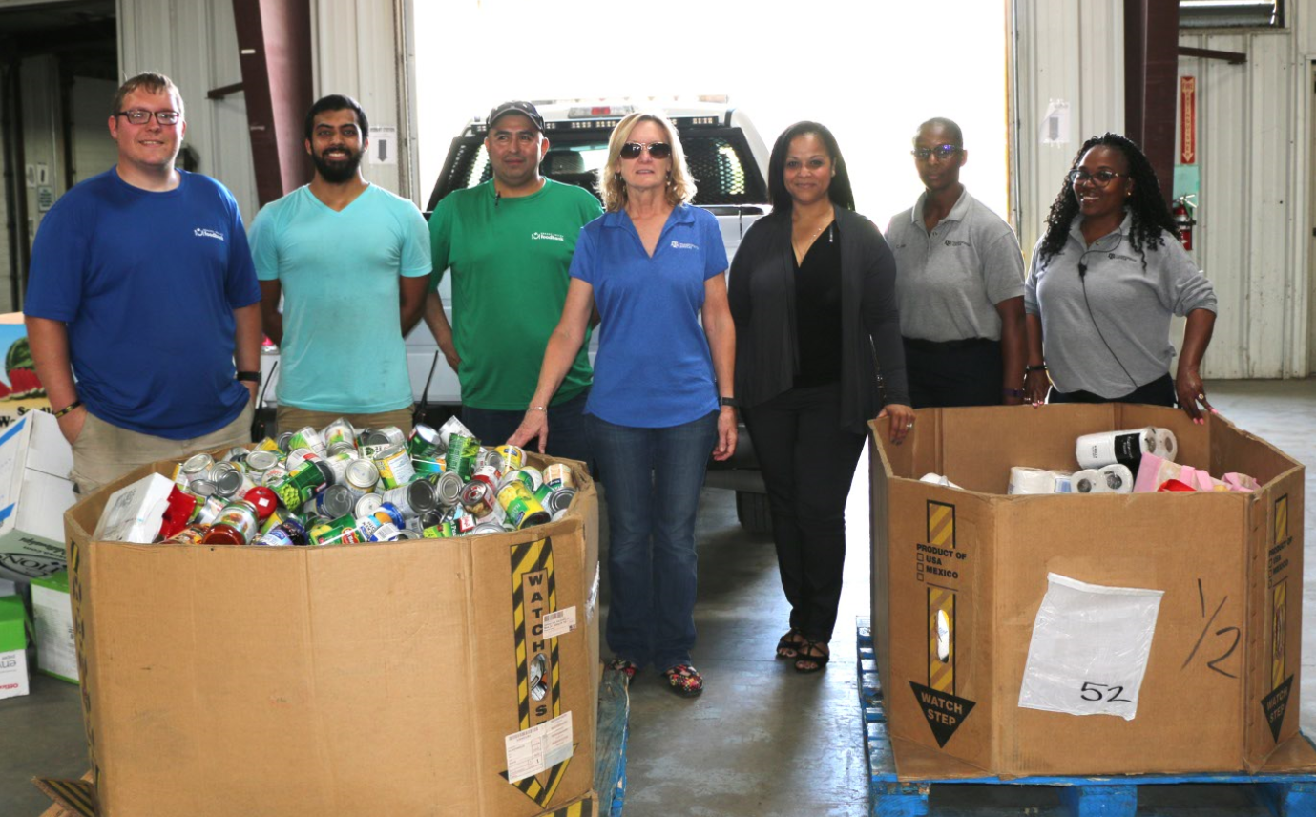
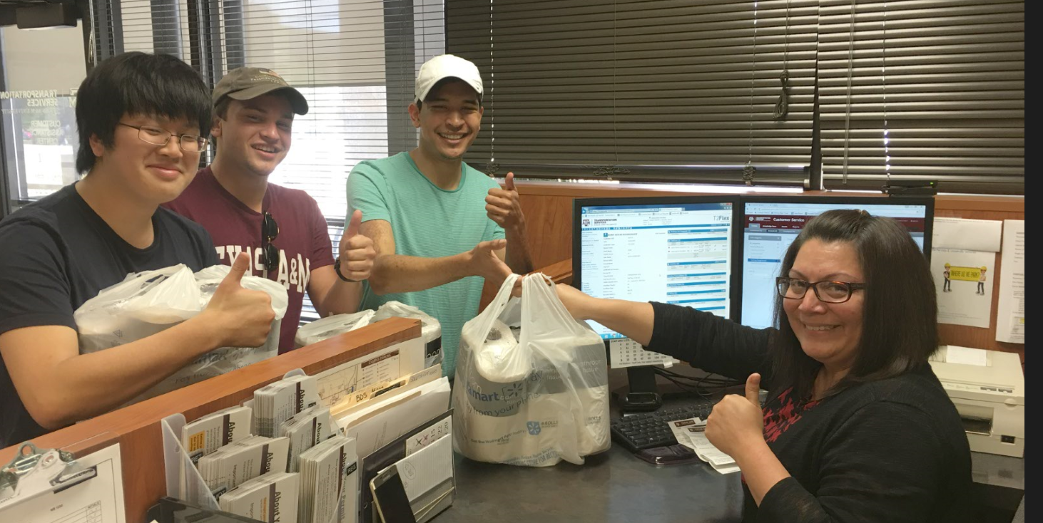

Slide 5
Self Releasing Boot
UPDATE
Transportation Services Advisory Committee
May 3, 2017

Slide 6
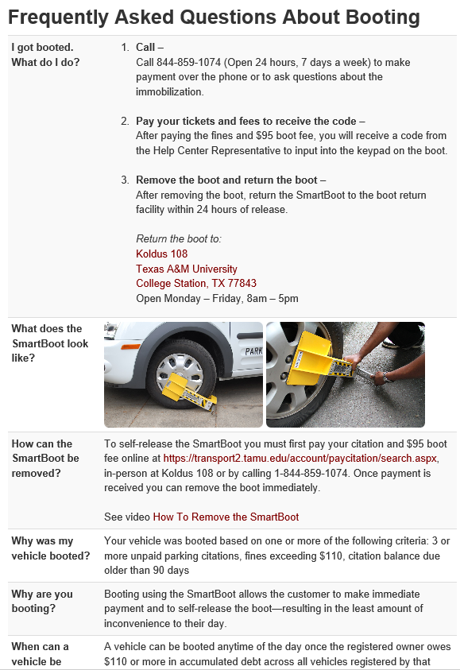
FAQ Page Added To Website

Slide 7
Statistics
April 26 first boot on the ground
As of May 2 at 4:30 pm, 13 vehicles have been booted
  10 paid and released
  2 still due
  1 Runaway
9 paid on line/1 paid in Koldus 108
  8 self releases
  2 assisted releases
Enforcement reports the boots are lightweight, easy to install and easy to remove.

Slide 8
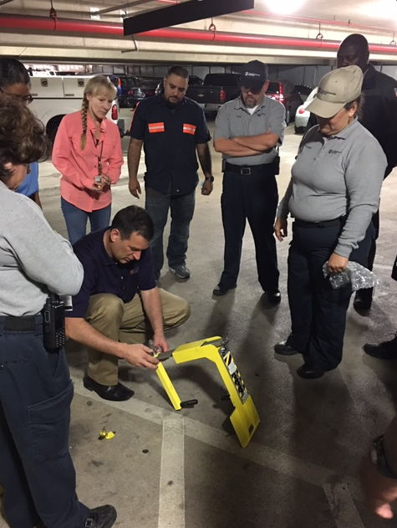
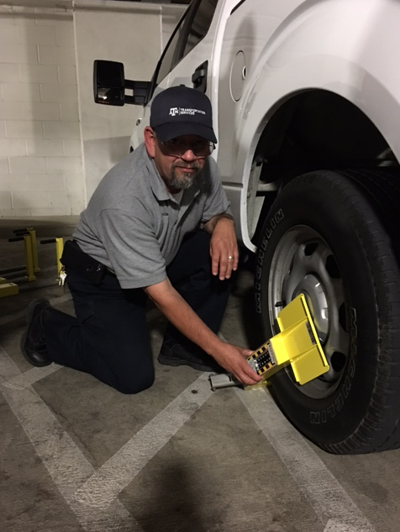
Training

