Slide 1
Citation Rate Increases
TSAC May 3, 2017

Slide 2
Citation Fine Schedule
(There is a $10 discount when paid within 14 days)

Slide 3
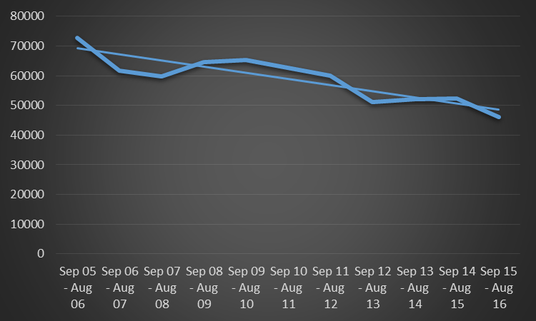
Annual Citations Written

Slide 4
Citation Analysis
Parking fines have not been adjusted since before 2005.
It is estimated that the proposed increases would generate between $175,000 and $225,000 in annual revenues.
This represents a 10 to 13% increase over current revenues from fines.
In FY 2016 Enforcement fell short of paying for its operation by $380,000.
The remaining shortfall will be satisfied by increases in 12th Man Foundation football parking rates.

Slide 5
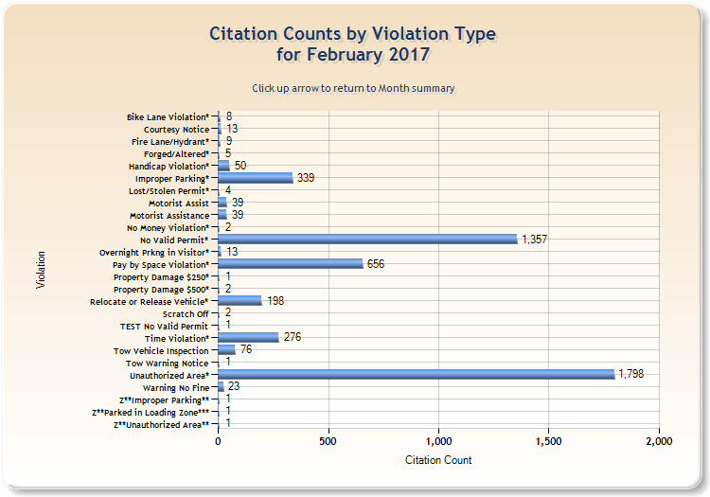

Slide 6
