Slide 1

Important Conversations
Business and Campus Permits
Kenneth Kimball & Therese Kucera
Texas A&M Transportation Services

Slide 2

Introduction
As the university grows, Transportation Services would like to start the discussion about services or policies that create inefficiencies or are provided at no cost.
Continued university growth will make efficient use of our resources more and more important.
The purpose of these discussions is to bring up items of interest that could be modified, charged for or eliminated in order to accommodate more customers on campus.

Slide 3
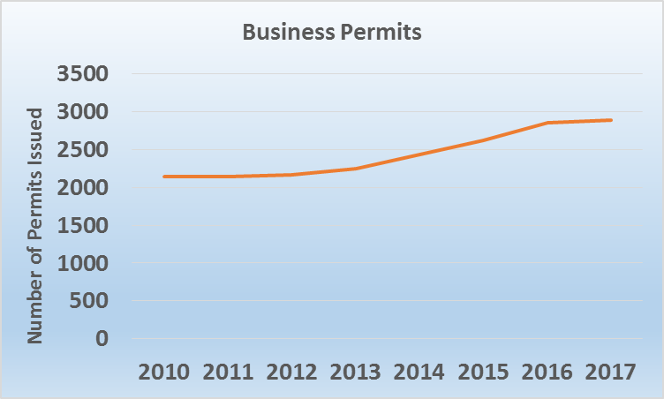
Notes:
2889 Issued today.

Slide 4
Permit Data
Notes:
Comparison: since September, we have had 600,000 transient transactions in our gated facilities
If transient spaces turnover 3x per day,

Slide 5
Permit Data

Slide 6
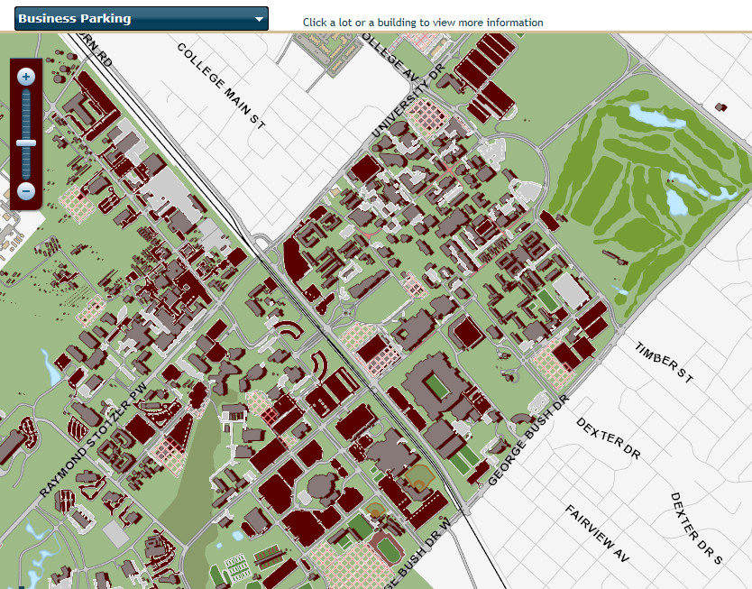

Slide 7
Details
Many departments purchase large quantities due to the low price ($38).
We have seen instances of business permits being provided to graduate students to park close to the building to come to work or go to class.
Many departments do not track who is using the permit.
The garage use equates to over $500k in visitor parking revenue.
Notes:
Actual revenue from sales of business permits was slightly over $100k in 2017.

Slide 8
Details
How do we balance the Campus Master Plan charge to minimize, not encourage travel on campus, with the need for mobility on our sprawling campus.
Fewer permits sold and visitors allowed in facilities based on expected Business Permit use.
Large degree of imbalance between wide degree of access and low price of Business Permit.

Slide 9
Peer Data
Many universities (SEC Vision 20/20) do not offer this product (an additional access permit). Staff must use lot assigned or timed parking.
Georgia Tech charges $295 in addition to cost of annual permit for access to ungated areas for only 2.5 hours.
University of Florida has a similar offering for $122 annually.
University of Georgia charges $150 on top of permit cost for limited access.
At LSU, departments who deem their employees need to move about campus must purchase a full price permit for each secondary location.
Notes:
Georgia Tech Annual Individual Permit: $795 (Business Permit is 37% of permit pricing) TAMU is 13%.

Slide 10
Discussion Topics
Campus permits have the same access as Business Permits.
Price according to level of service?
Price garage access higher than surface, as with normal permits?
Better tracking of checking out permits for proper use?

Slide 11
Questions/Discussion?

