Slide 1

RETIREE PERMITS
Transportation Services Advisory Committee
March 4, 2015

Slide 2
Retiree Permits
Persons who have officially retired from the Texas A&M University System are eligible for a retiree parking permit if they are not currently on the TAMUS payroll. This privilege is reserved for fully retired persons receiving no compensation from the University and is intended for your personal use only for occasional visits to campus.
Notes:
This is not a University Policy or University benefit. This was suggested to our department years ago, implemented and is subsidized by other permit holders.

Slide 3
Working Retirees
In honor of their service, in 2009 Transportation Services instituted half-price parking options for TAMU System employees who have officially retired and have returned to work on the College Station campus.
*************************************
Various ungated surface lots and unnumbered spaces in garages.

Slide 4
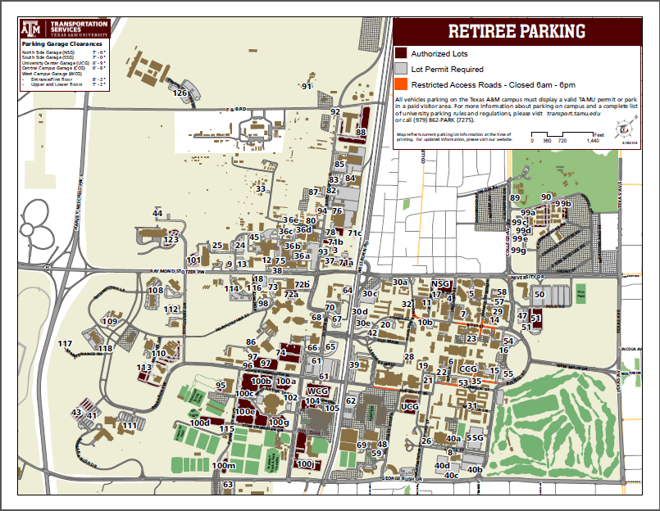
1174 Retiree
permits issued

Slide 5
Examples of Misuse
Each year we find approximately 10 students using Retiree permits belonging to relatives and parking in garages to attend class on a daily basis– Recently we discovered 4 instances totaling $1,937 in lost revenue.
We have found retired employees give permits to family members to come to work daily
We have A&M retirees that come back to work and park daily in garages with their complimentary Retiree permit
Notes:
This is not something we “look for” on a daily basis. We look through reports as time allows.
These are the ones we find parking in the garages. We have no way to find those misusing in our surface lots.
Just earlier this week, we found 6 employees that received their complimentary permit in August and are working again….using their Retiree permits.

Slide 6
Other Universities
University of Texas – 50% of permit fee held at time of retirement
TCU – no Retiree permit
University of Kansas - $85
Oklahoma State – free
Iowa State – used to offer for free, but now only offer normal permits to retirees due to abuse.
Kansas State - $35 valid in garages “after hours”

Slide 7
Other Universities
Baylor – free
Georgia Tech - $50 for any ungated, non-residential parking zone (not refundable)
University of Houston – free and valid in “economy” lots
University of Alabama – free in surface lots only
University of Georgia – half price
Ole Miss - $40
Mississippi State - $283 (gated lot)

Slide 8
University of Nebraska
Retired Faculty/Staff Eligibility
Effective July 1, 2006, no free parking permits will be issued to retired non-Emeriti faculty or staff. Retired faculty or staff that received a free parking 2005-06 permit will be grandfathered for 10 years and will continue to receive a regular non-reserved parking permit at no charge for a maximum of 10 years. Failure to renew the permit in any one year will invalidate their eligibility.
The permit is non-transferable. It must be used by the individual it is issued to. If the permit is used by a spouse, family member or anyone else the permit will be revoked and the individual will forfeit renewal eligibility.
Emeriti faculty can purchase a reserved parking permit at a $20 per month discount from the regular reserved permit cost. Availability of reserved parking will be based on demand of active faculty or staff members.

Slide 9
Thoughts on Proposed Plan
University-adopted philosophy all users pay to park
Grandfather current permit holders in for free for a few years with no garage access and charge new retirees
Nominal fee for Any Valid Permit areas only
Implement half-price, working retiree permit for non-working retirees, maybe not in garages
Many want game day parking

