Slide 1
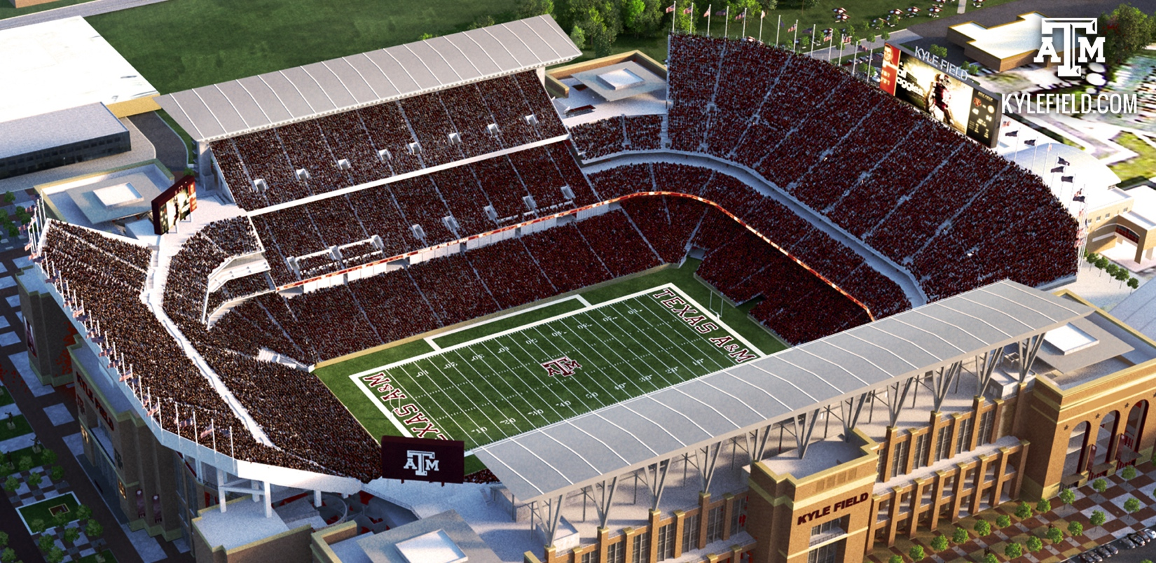
Kyle Field Transportation Plan
2015

Slide 2
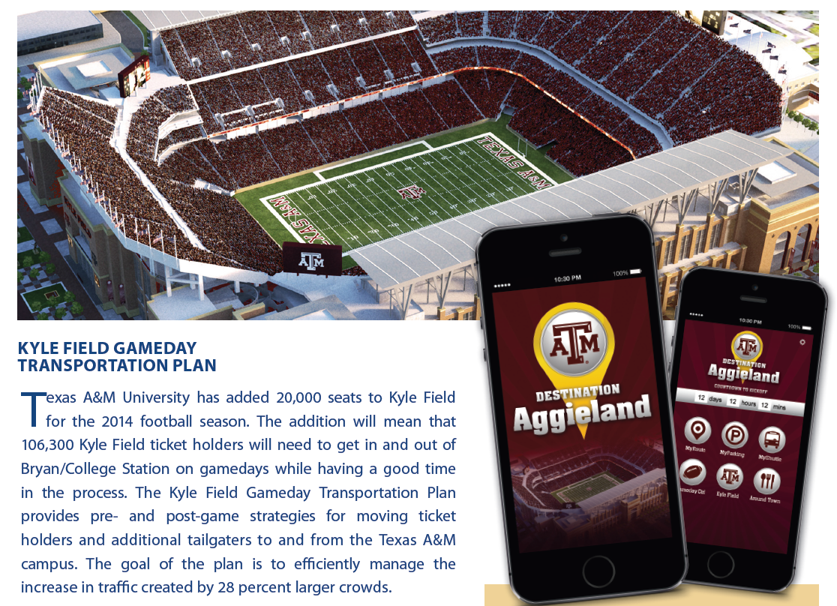
Award of Excellence
2015 Parking Program of the Year
Texas Parking and Transportation Association

Slide 3
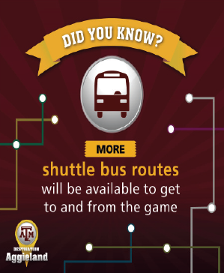
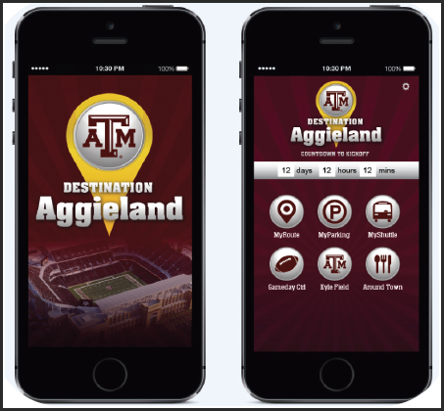
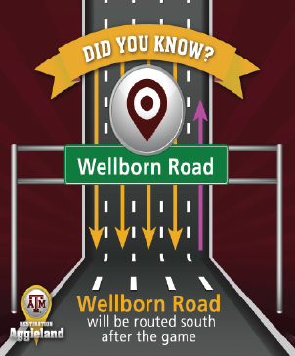
2015 Outstanding Marketing & Communication Program
International Parking Institute
Destination Aggieland: An App to Enhance Gameday

Slide 4
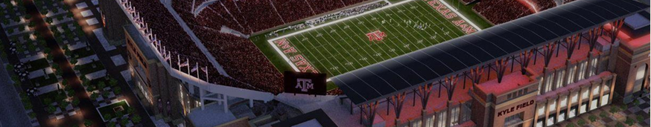









Our Partners Were Critical to the Plan’s Success
Transportation Services, Marketing & Communications, Athletics, Student Affairs, Police, etc.
Safety & law enforcement agencies

Slide 5


What Did We
Accomplish in 2014?
Integrated game operations, traffic & community

Slide 6
What Did We
Accomplish in 2014?
Handled huge crowds with the same or less congestion as in 2013
cleared within
2 hours

Slide 7

What Did We
Accomplish in 2014?
  2013
  8 games
  6 games
  2014
  157k parked cars
  128k parked cars
  111k bus riders
  164k bus riders

Slide 8

What Did We
Accomplish in 2014?
Awareness of dining, hotel and
entertainment options

Slide 9
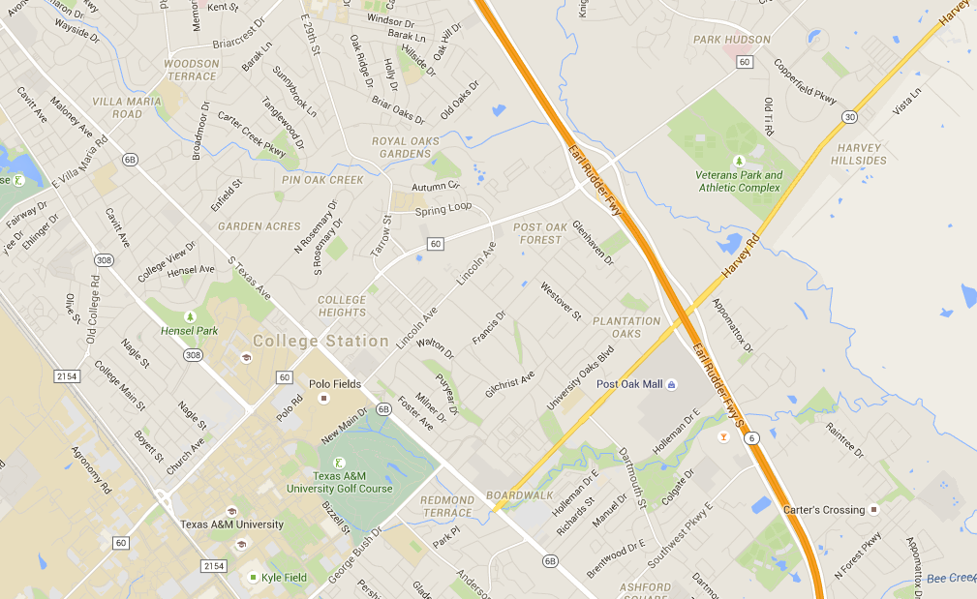


2015 Get to the Grid!
Free gameday shuttles from Momentum Plaza

Slide 10
2015 Get to the Grid!
Buses will run 3.5 hours pre game, 1.5 hours post game
3 buses will run during the game
16 buses total on route
Buses will be accessible for persons with disabilities
Officer support will be provided for traffic
Location can support 1,000 – 1,200 vehicles

Slide 11
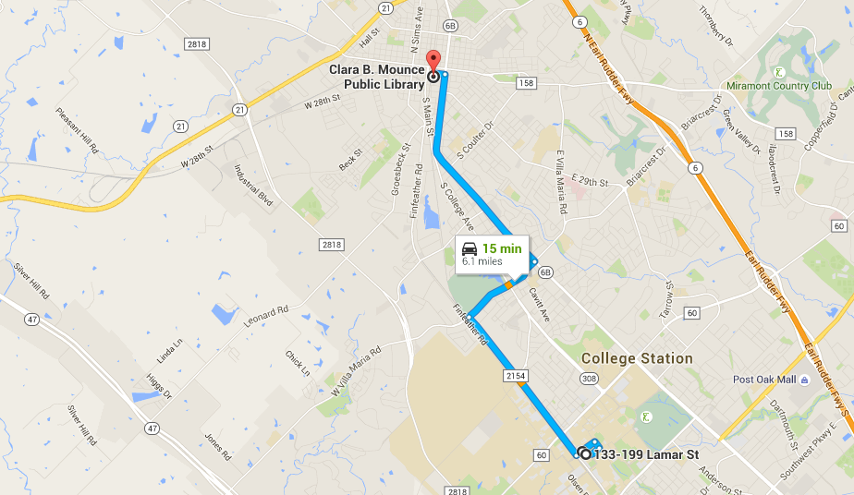

2015 Downtown Bryan Shuttle

Slide 12
2015 Downtown Bryan Shuttle
Buses will run 2 hours pre game, 1 hour post game
2 buses will run during the game
6 buses total on route
These buses will be contract buses and not accessible for those with disabilities –Lot 50 has disabled parking and accessible shuttle
Buses will pick up at Bryan Library

Slide 13
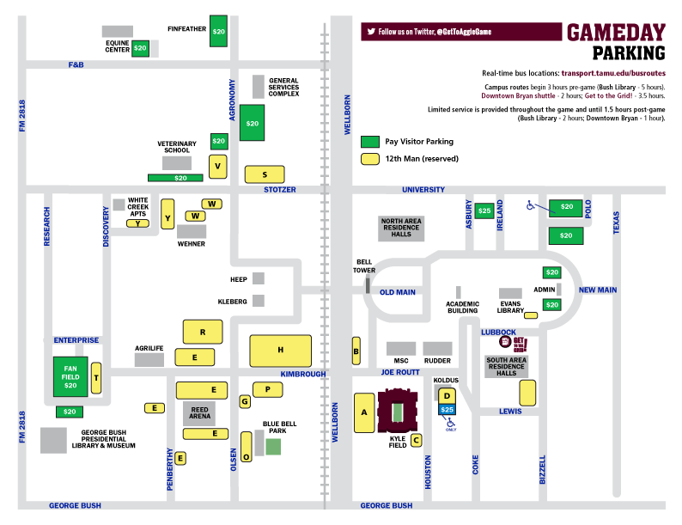
2015 12th MAN
2015 PUBLIC PAID

Slide 14

2015 PREPAID PAID

Slide 15

What to Expect in 2015
Powered by CrowdTorch
Notes:
These give an overview of the app designed by CrowdTorch.
Apple Store or Google Play

Slide 16
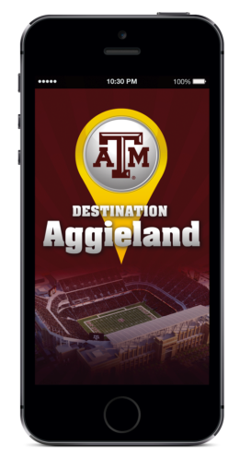
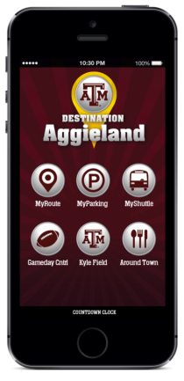
2015 Destination Aggieland App
Updated by Transportation Services
Year-round info
IBM – In-stadium app
Still coordinated with:
gameday.12thman.com
Powered by CrowdTorch

Slide 17
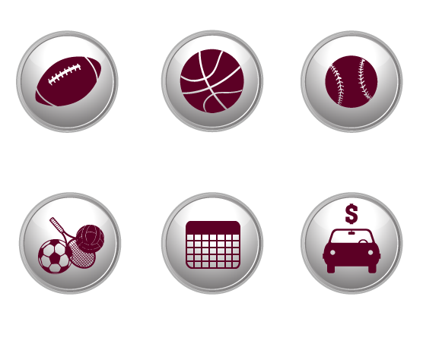
———————— App FEATURES

Slide 18

———————— App FEATURES

Slide 19
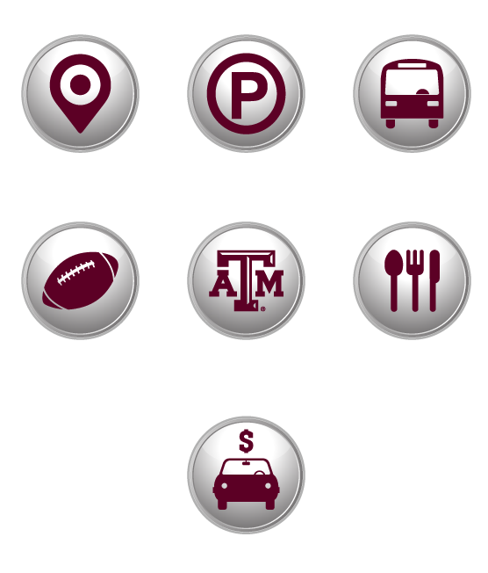
———————— App FEATURES

Slide 20

Lessons Learned
General approach should help other big events
  Several times each year we are a “metro suburb”

Slide 21
What Else Is Needed?
Upgraded cameras, controllers, software and cabinets
  College Station investment
  $5 million
  Chancellor Sharp - $1 million
Ideas being studied
  Wellborn Road – automate some of contraflow operation
  Message signs, cameras, software
  FM 2818 – additional southbound capacity

Slide 22
What Else Is Needed?
Park and ride lot(s)?
  American Momentum Bank
  Downtown Bryan (Library)
Traffic Management Center and staff
  Not just about football!
  Operations can overcome infrastructure problems
  Find problems before they happen
  Communicate and coordinate with partners
  Provide greater awareness of congestion, safety, public works issues

Slide 23
What Else Is Needed?
Communicating with fan base –
Not ‘there’ yet
Have any ideas?
Who should
we talk to?
We need your help!

