Slide 1
Bicycle Action Plan

Slide 2
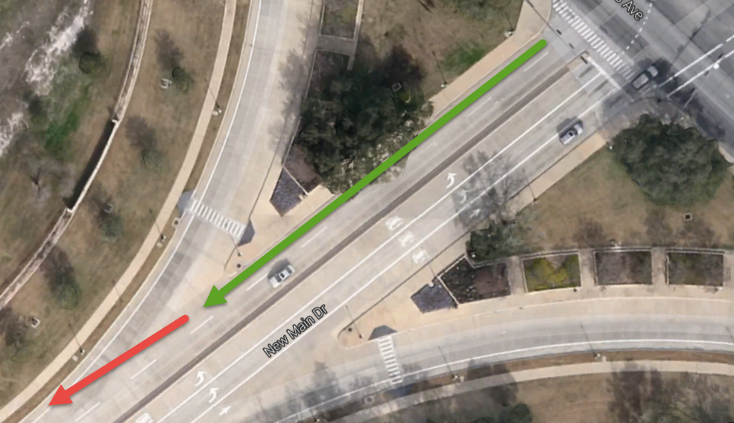
Old Main and Texas
Shared lane marking and guide lines to bike lane

Slide 3
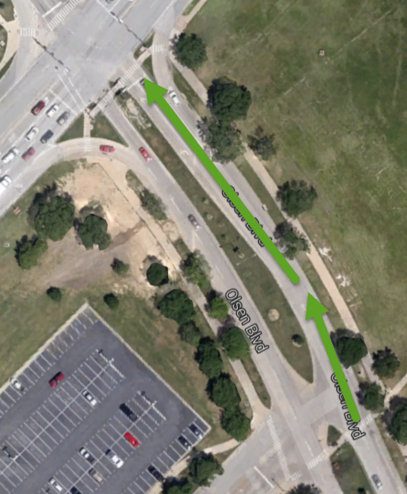
Olsen and University
Shared markings after bike lane ends to intersection

Slide 4
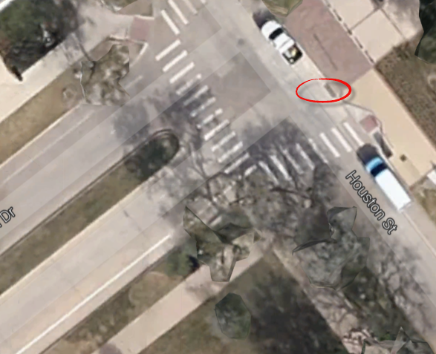
New Main and Houston
One way sign “Except Bicycles” so they know they can use contraflow bike lane headed south

Slide 5
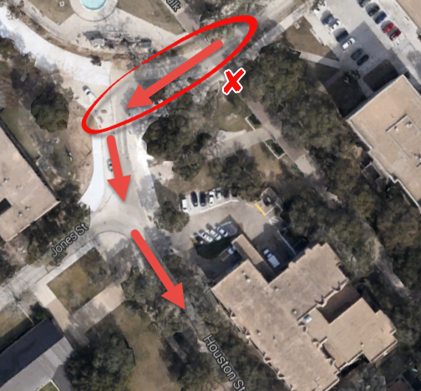
Bicycle Way Finding
Sign areas to keep bicycles on the streets
Route bikes off Ross onto Houston to head to MSC rather than using Military Walk

Slide 6
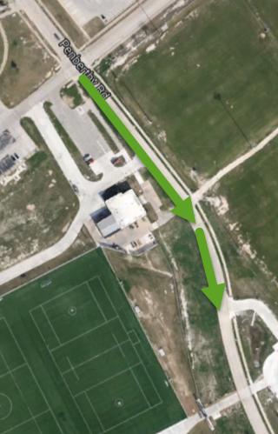
Penberthy and Chandler
Add shared markings between the area where the bike lane ends and begins again closer to George Bush

Slide 7
Questions?

