Slide 1
Kyle Field Gameday Transportation Solutions Status Report & Request for Comments
May 7, 2014
Transportation Services Advisory Committee Meeting
Texas A&M Transportation Institute
(with TAMU Transportation Services, City of College Station, City of Bryan, BCS Chamber of Commerce, Convention and Visitors Bureau, Downtown Bryan Association, TAMU Athletics, 12th Man Foundation, TxDOT, Law Enforcement Agencies)

Slide 2
Today’s Topics
Parking
Pedestrians
Bus Stops

Slide 3
Design Day Parking Demand
For 2013 Alabama game:
35% students; 40,000 tailgaters; 10,400 off-campus parking
Car RVs in Car RV
Spaces Spaces Spaces
2013 20,200 500 210
(3,350 car
spaces used)
Future:
Lower percentage of students – 31,012 tickets
All-weather spaces
More shuttle bus riders – [Restaurants, hotels, charters (tour, local)]
New RV Parking Area (return car spaces for car parking)

Slide 4
Gameday Parking Changes 2013→ 2015
4/17/14
North of Campus
Equine Center
419 (0)
0(300)
Agronomy/ Vet School
Northgate/ University Gardens
493(395)
0(300)
West Campus
Main Campus
East of Campus
1772 (80)
148(1612)
Includes New RV Field
0(200)
Added Spaces New(Converted)
South of Campus
Not shown:
Campus spaces lost to construction: 1900
0(600)
Notes:
Totals:
On-campus
new 2432
existing made available 2490
Off-campus
existing made available 1100

Slide 5
Design Day Parking Demand
Design Day – Alabama-style game
30% students; 40,000 tailgaters; 12,000 off-campus
Car spaces RV in Cars RV spaces
2013 Used 20,200 570 140
2014 Need 25,000 860
2015 Need 24,700 860
2015 Supply 23,500 860
So:
We need more bus riders; every space/every game
(“Need” includes a 5% buffer – which we don’t have!)

Slide 6
Estim. Cost for Parking Expansion
Facility | Improvement | Spaces¹ | Year | Cost (000s)
Fan Field | Gravel | 2300^{t} | 2014 | $1,000
Enterprise Field | Gravel | 600^{t} | 2014 | 270
RV Field | Add pads; add 150 RV spaces | 300 RV^{t} | 2014 | 280
Permanent RV Field | Permanent reinforced gravel with utilities | 700 RV | 2015 | 14,000
RV Field² | Convert to car parking field | 1600^{t} | 2015 | 375
_________ ¹ t – temporary for gameday use until permanent spaces become available ² Must be preceded by construction of Permanent RV Field

Slide 7
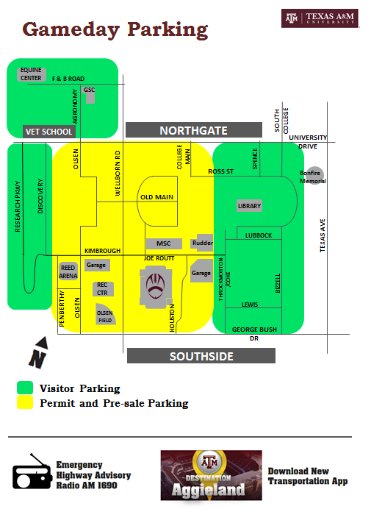
Simple Gameday Parking Message

Slide 8
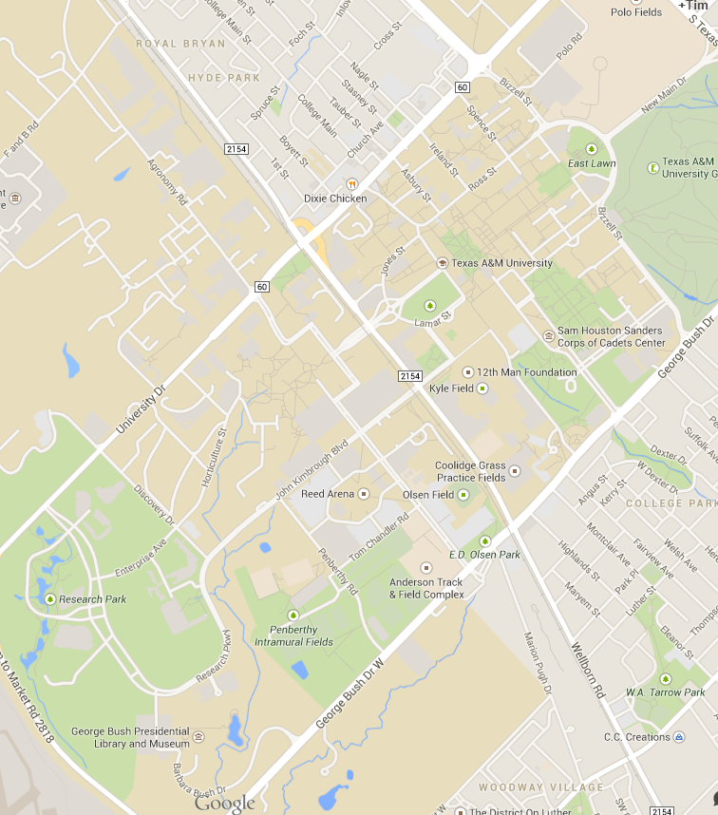
12th Man Parking (Example)
Visitor Pre-Sale Parking
(Example)
Work In Progress!

Slide 9
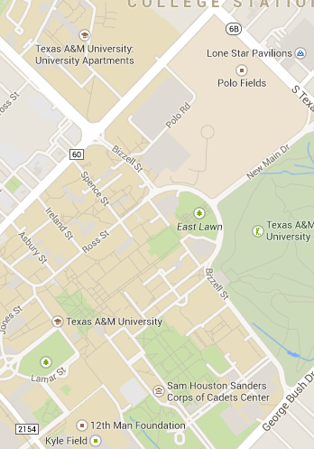
Main Campus
Gameday Parking (Example)
$15 parking
$20 parking garage

Slide 10
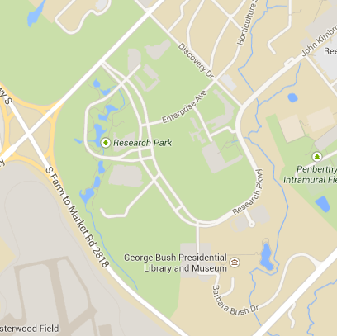
West Campus Gameday Parking Entry Points
(Example)
Consolidated Entry Location on Mariner for:
>Fan Field
>Lot 113
>Lot 110
Recommended Changes:
>Raise Fan Field Parking to $15
>West Campus Parking is “Arrive First-Paved Lot”
RV
Goal: Reduce traffic on Research Parkway to maintain bus speeds

Slide 11
Visitor Gameday Parking
(Example)
$15 parking
$20 parking garage

Slide 12
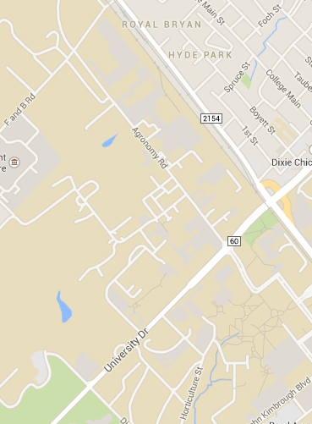
Vet School Area
Gameday Parking Entry Points (Example)

Slide 13
Kyle Field Gameday Pedestrian Improvements
Eliminate conflict between pedestrians and West Campus Garage traffic

Slide 14
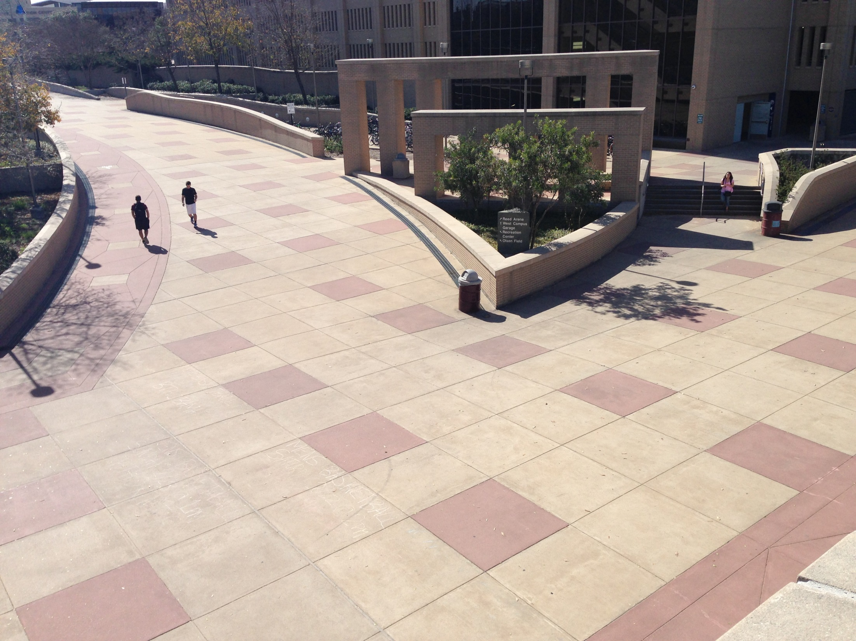
West Campus Garage
All Other Lots
Pickard Pass at West Campus Garage

Slide 15
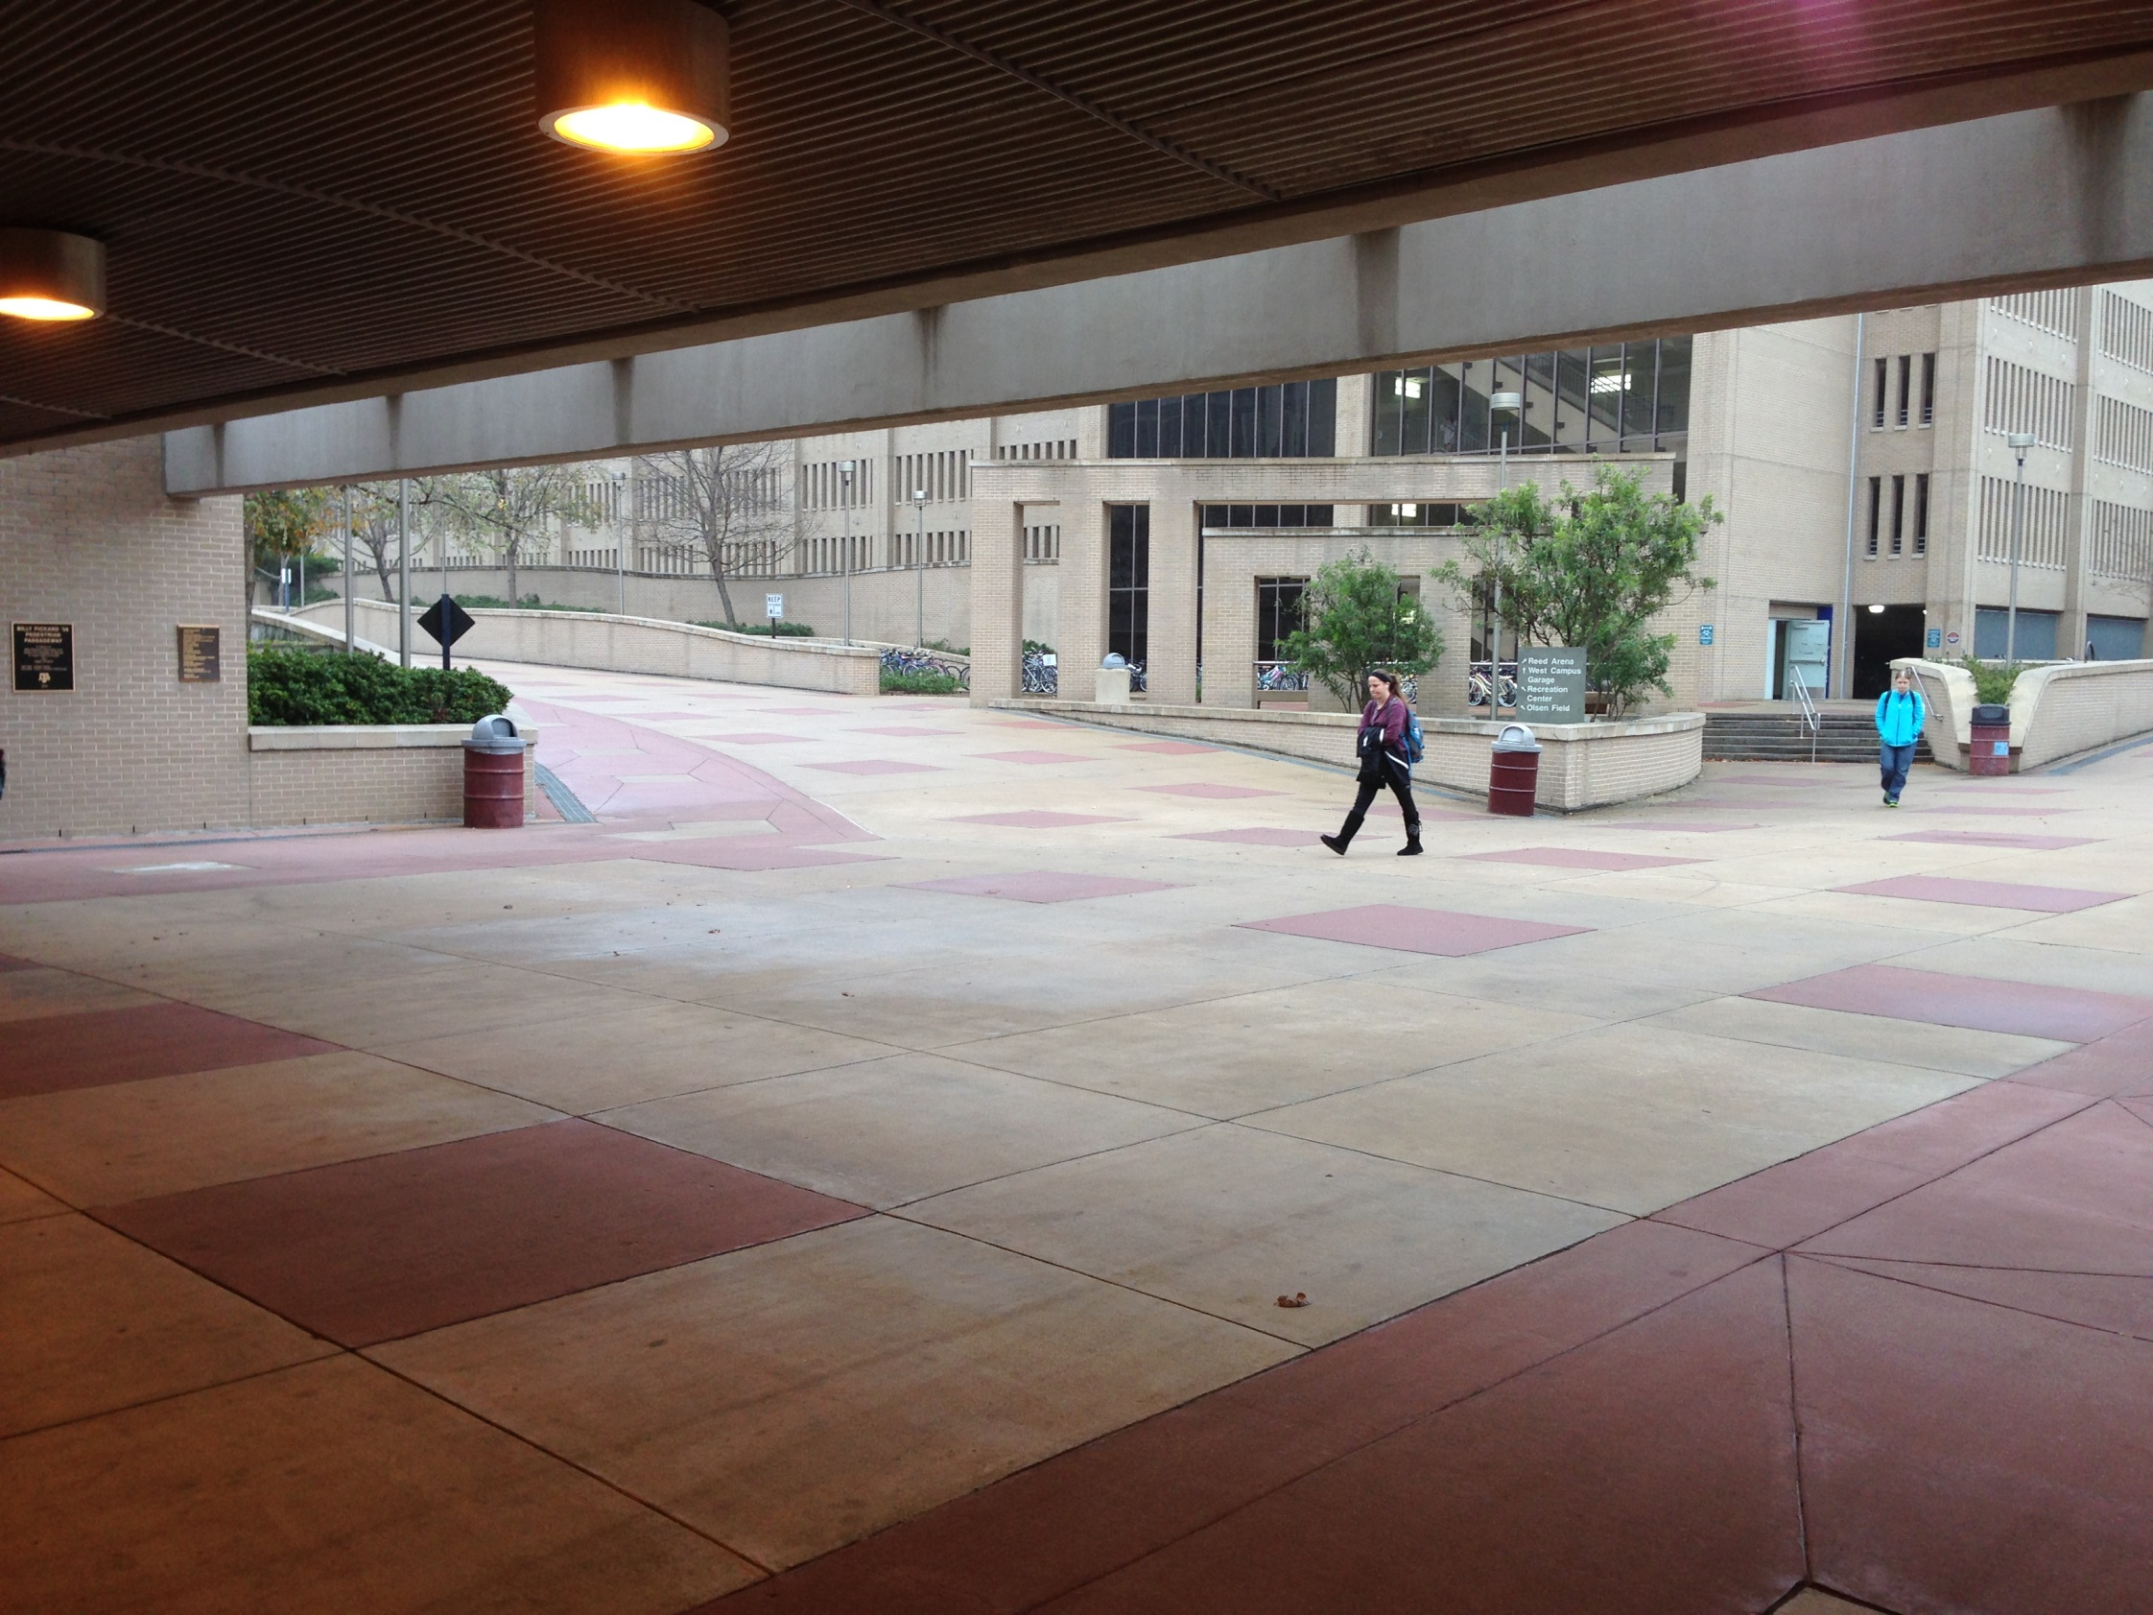
West Campus Garage
All Other Lots
Pickard Pass at West Campus Garage

Slide 16
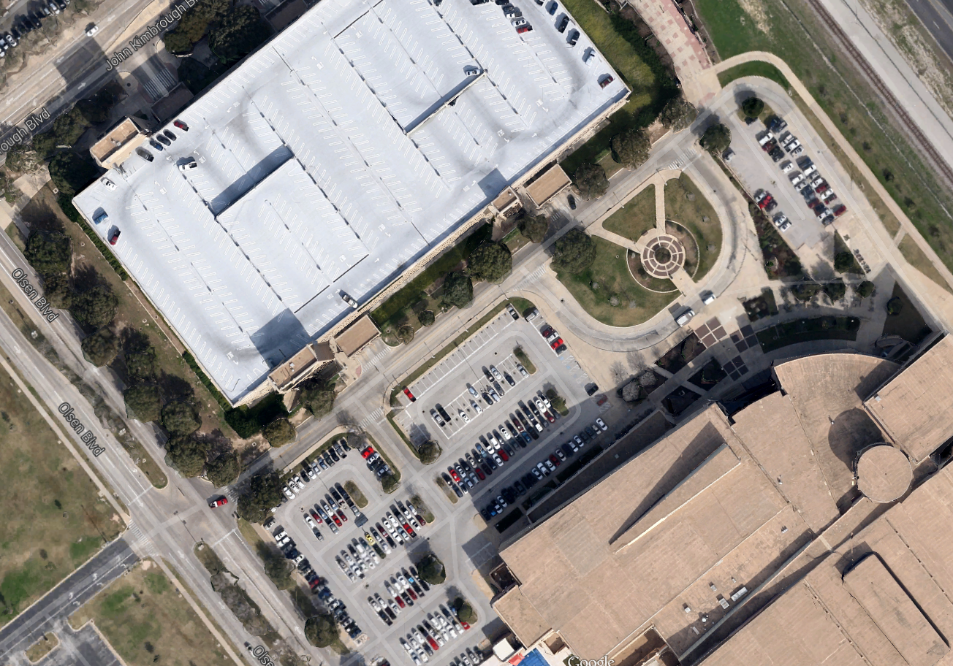
Construction Fencing
New, Wider Pedestrian Path
Garage vehicle traffic
Remove front row of parking on gamedays.
Pickard Pass Extension: Aerial View

Slide 17
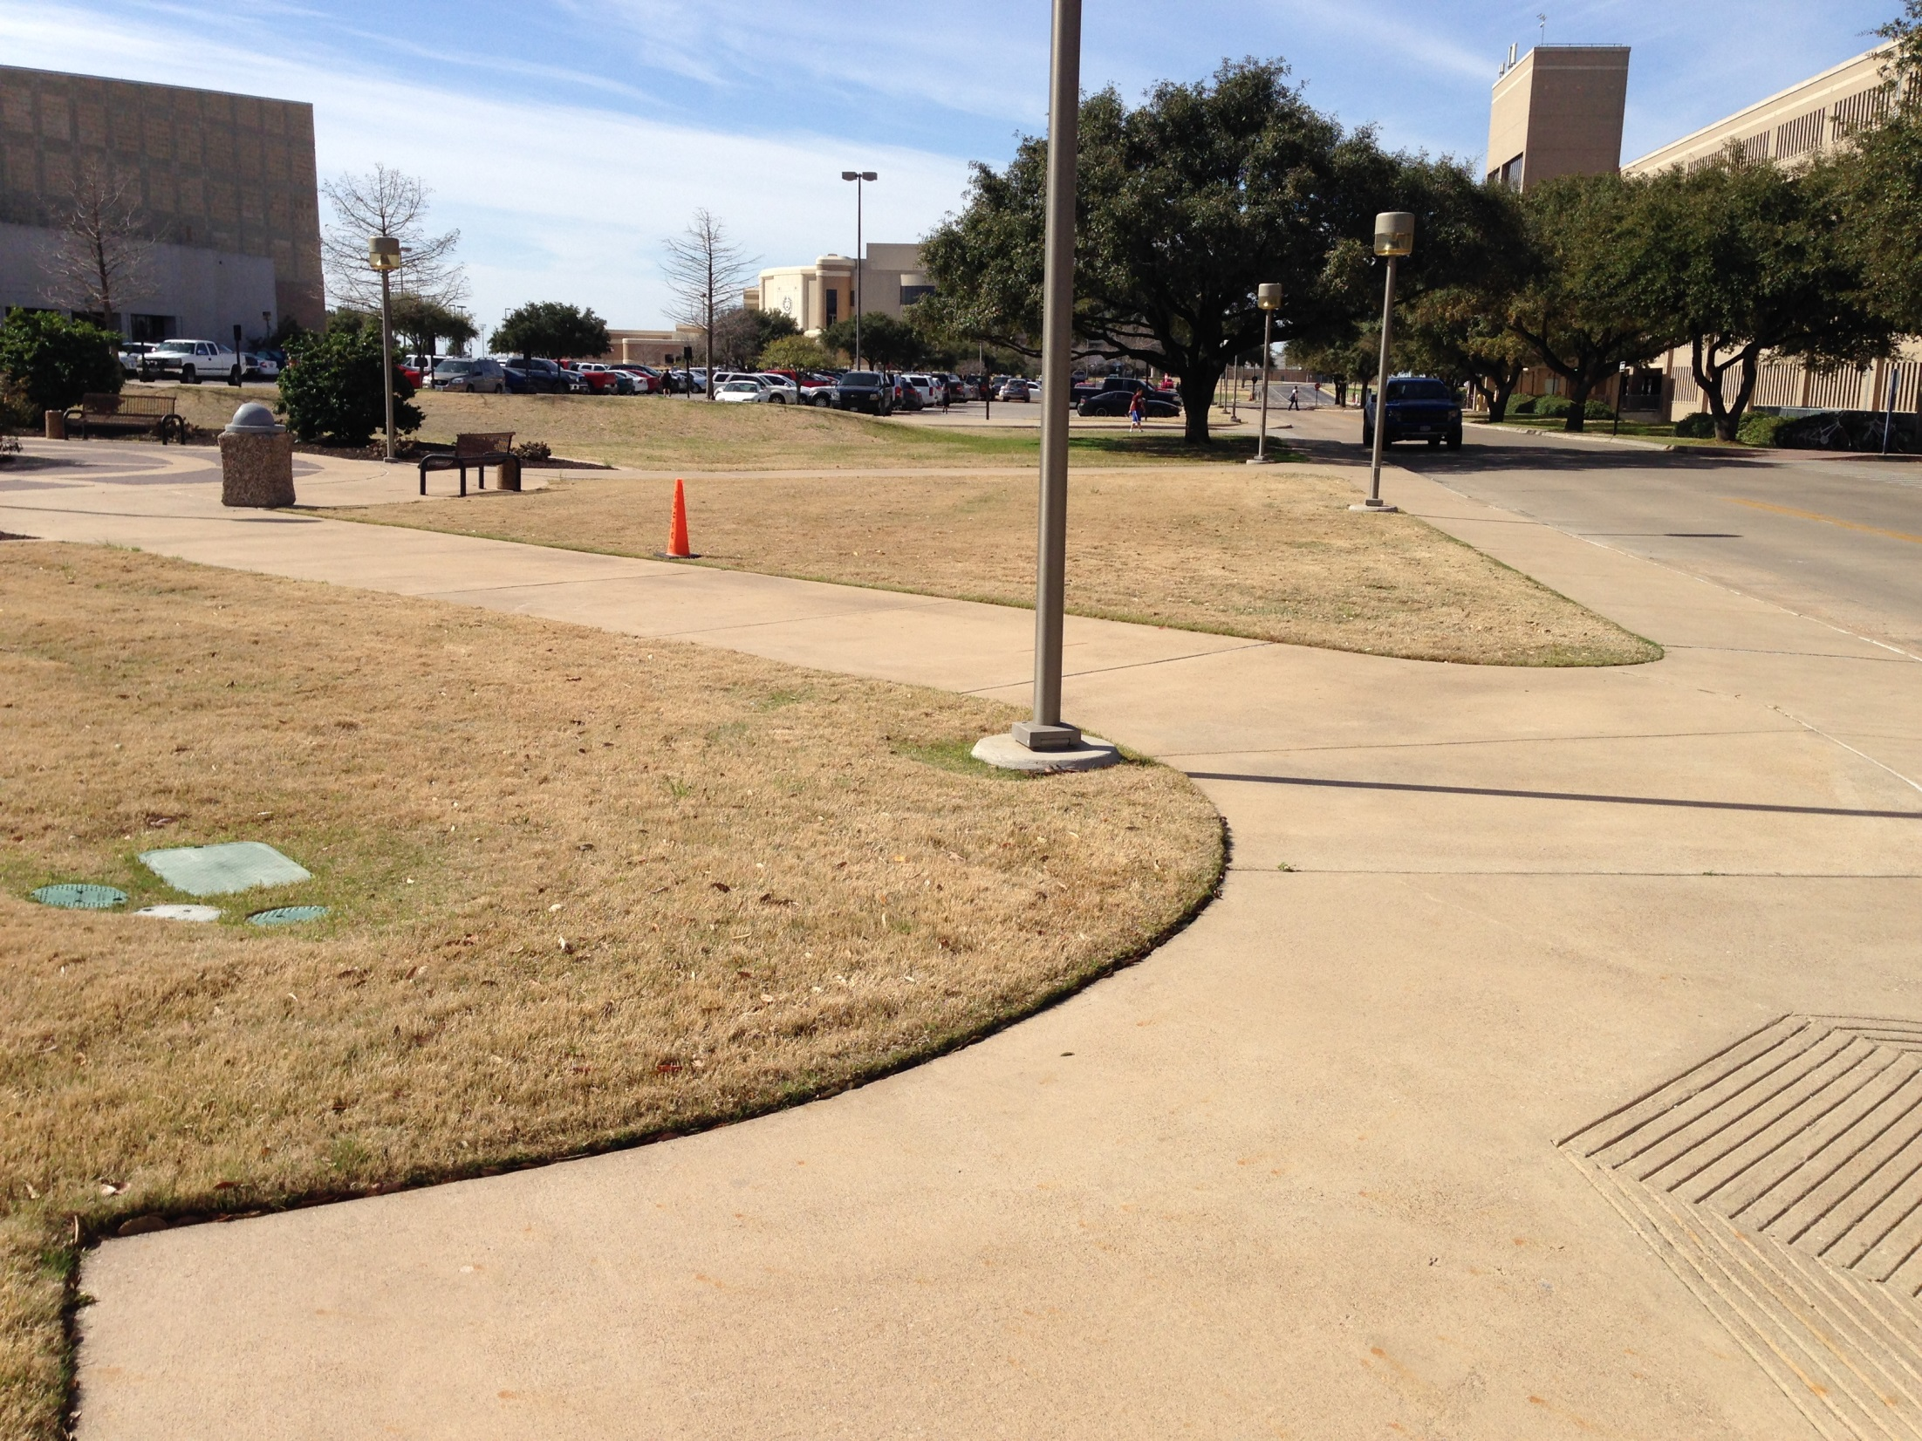
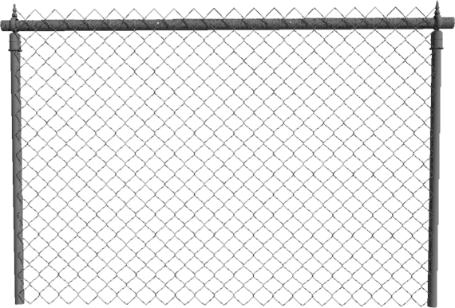
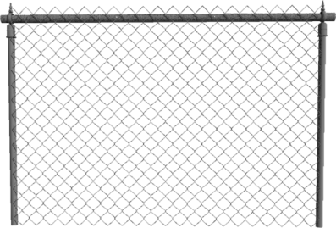
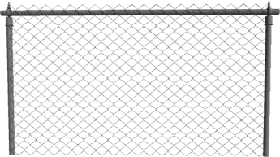
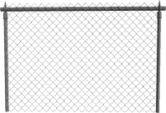
Prune low-hanging tree limbs.
Approximate Construction Fence Location
Relocate light posts.
Looking West Near the Rec Center Plaza

Slide 18
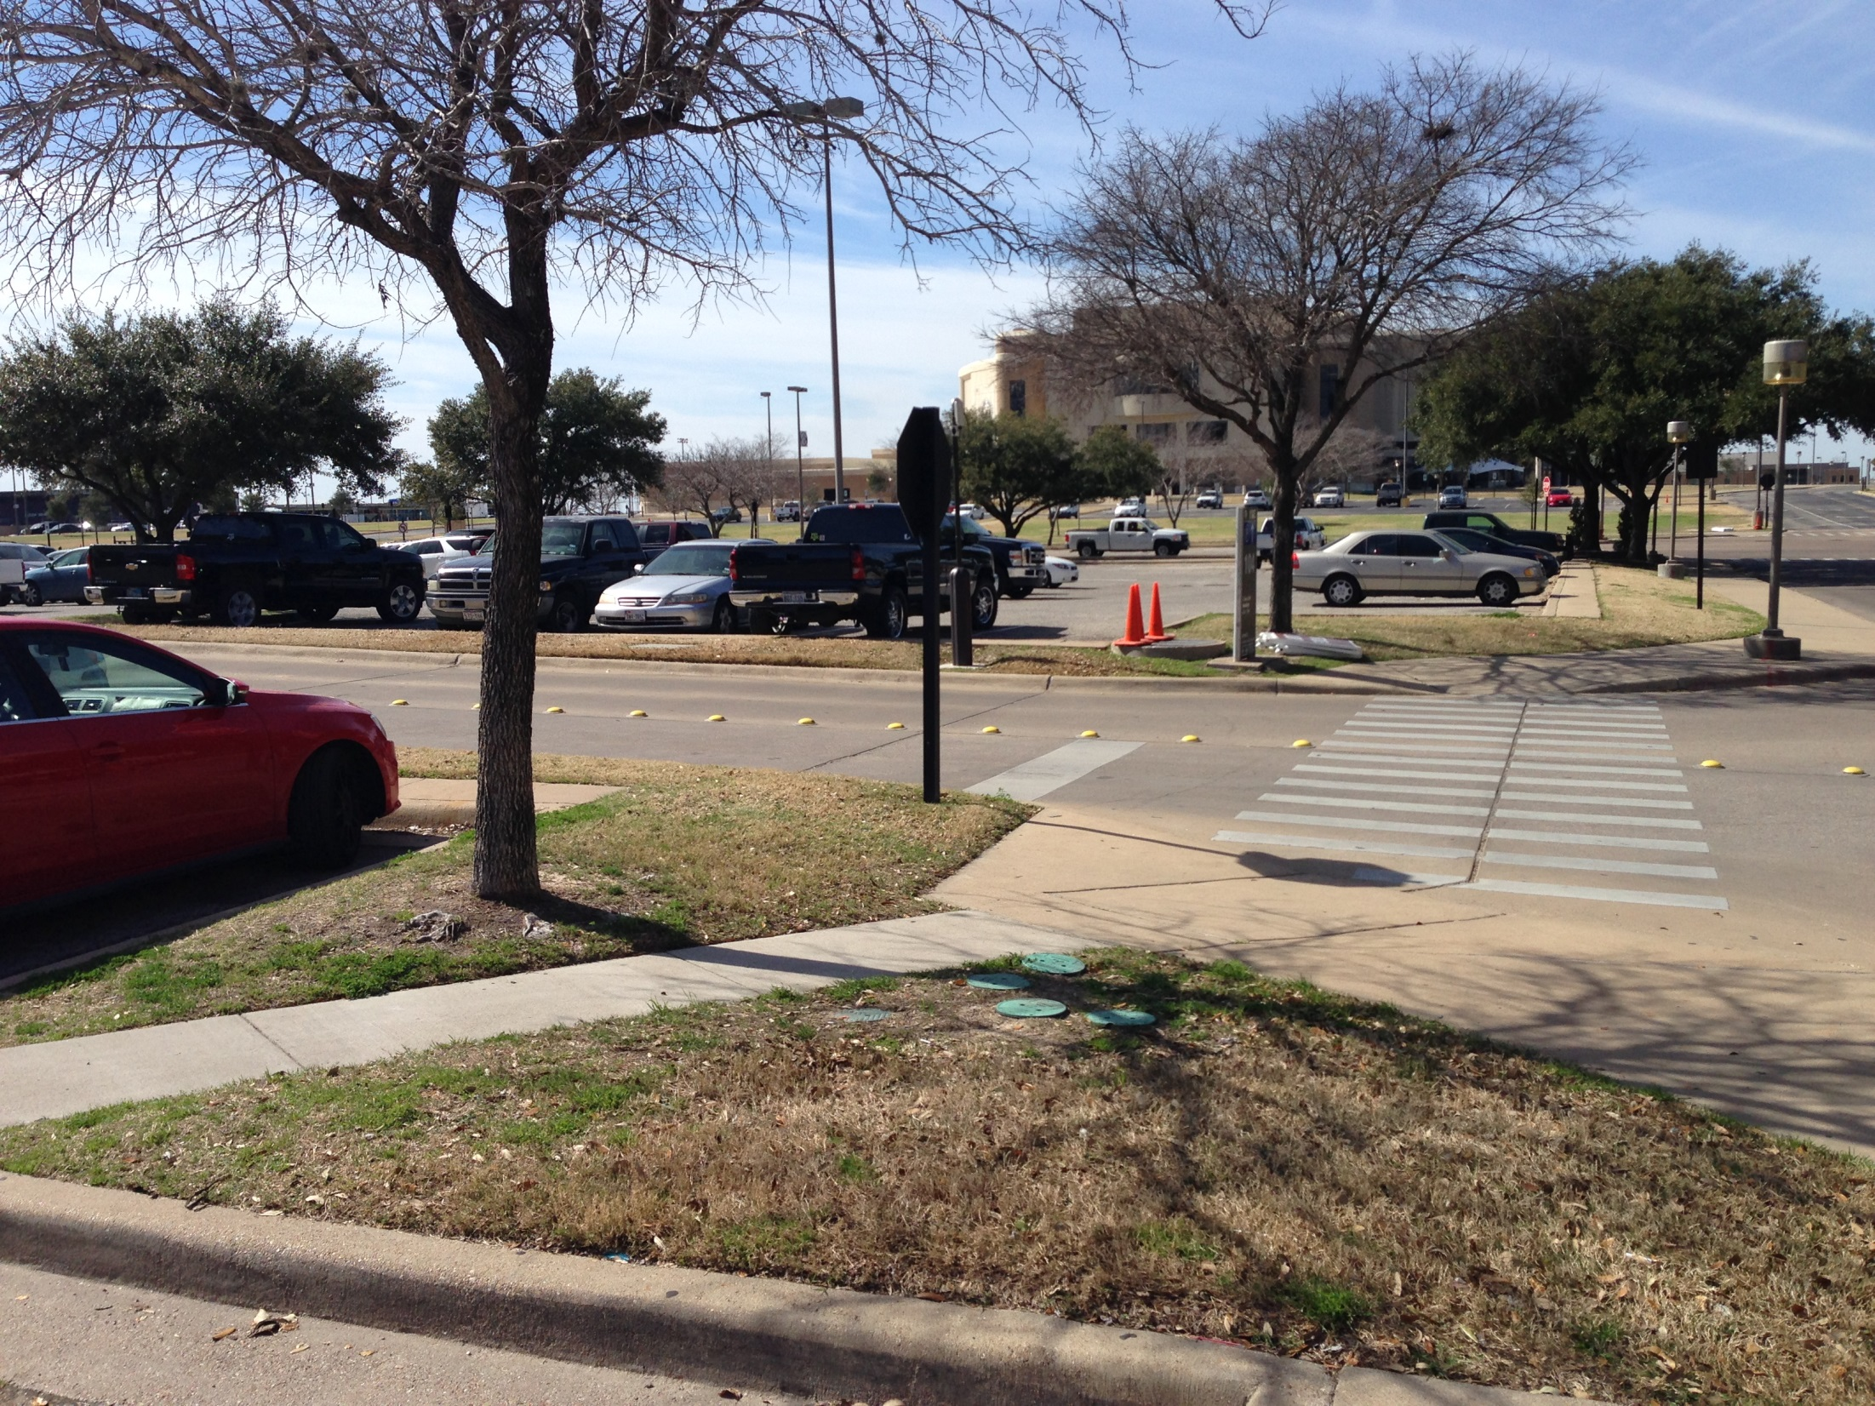
Accommodate necessary signs and camera.
Remove and replace small trees.
East View from Lot 104

Slide 19
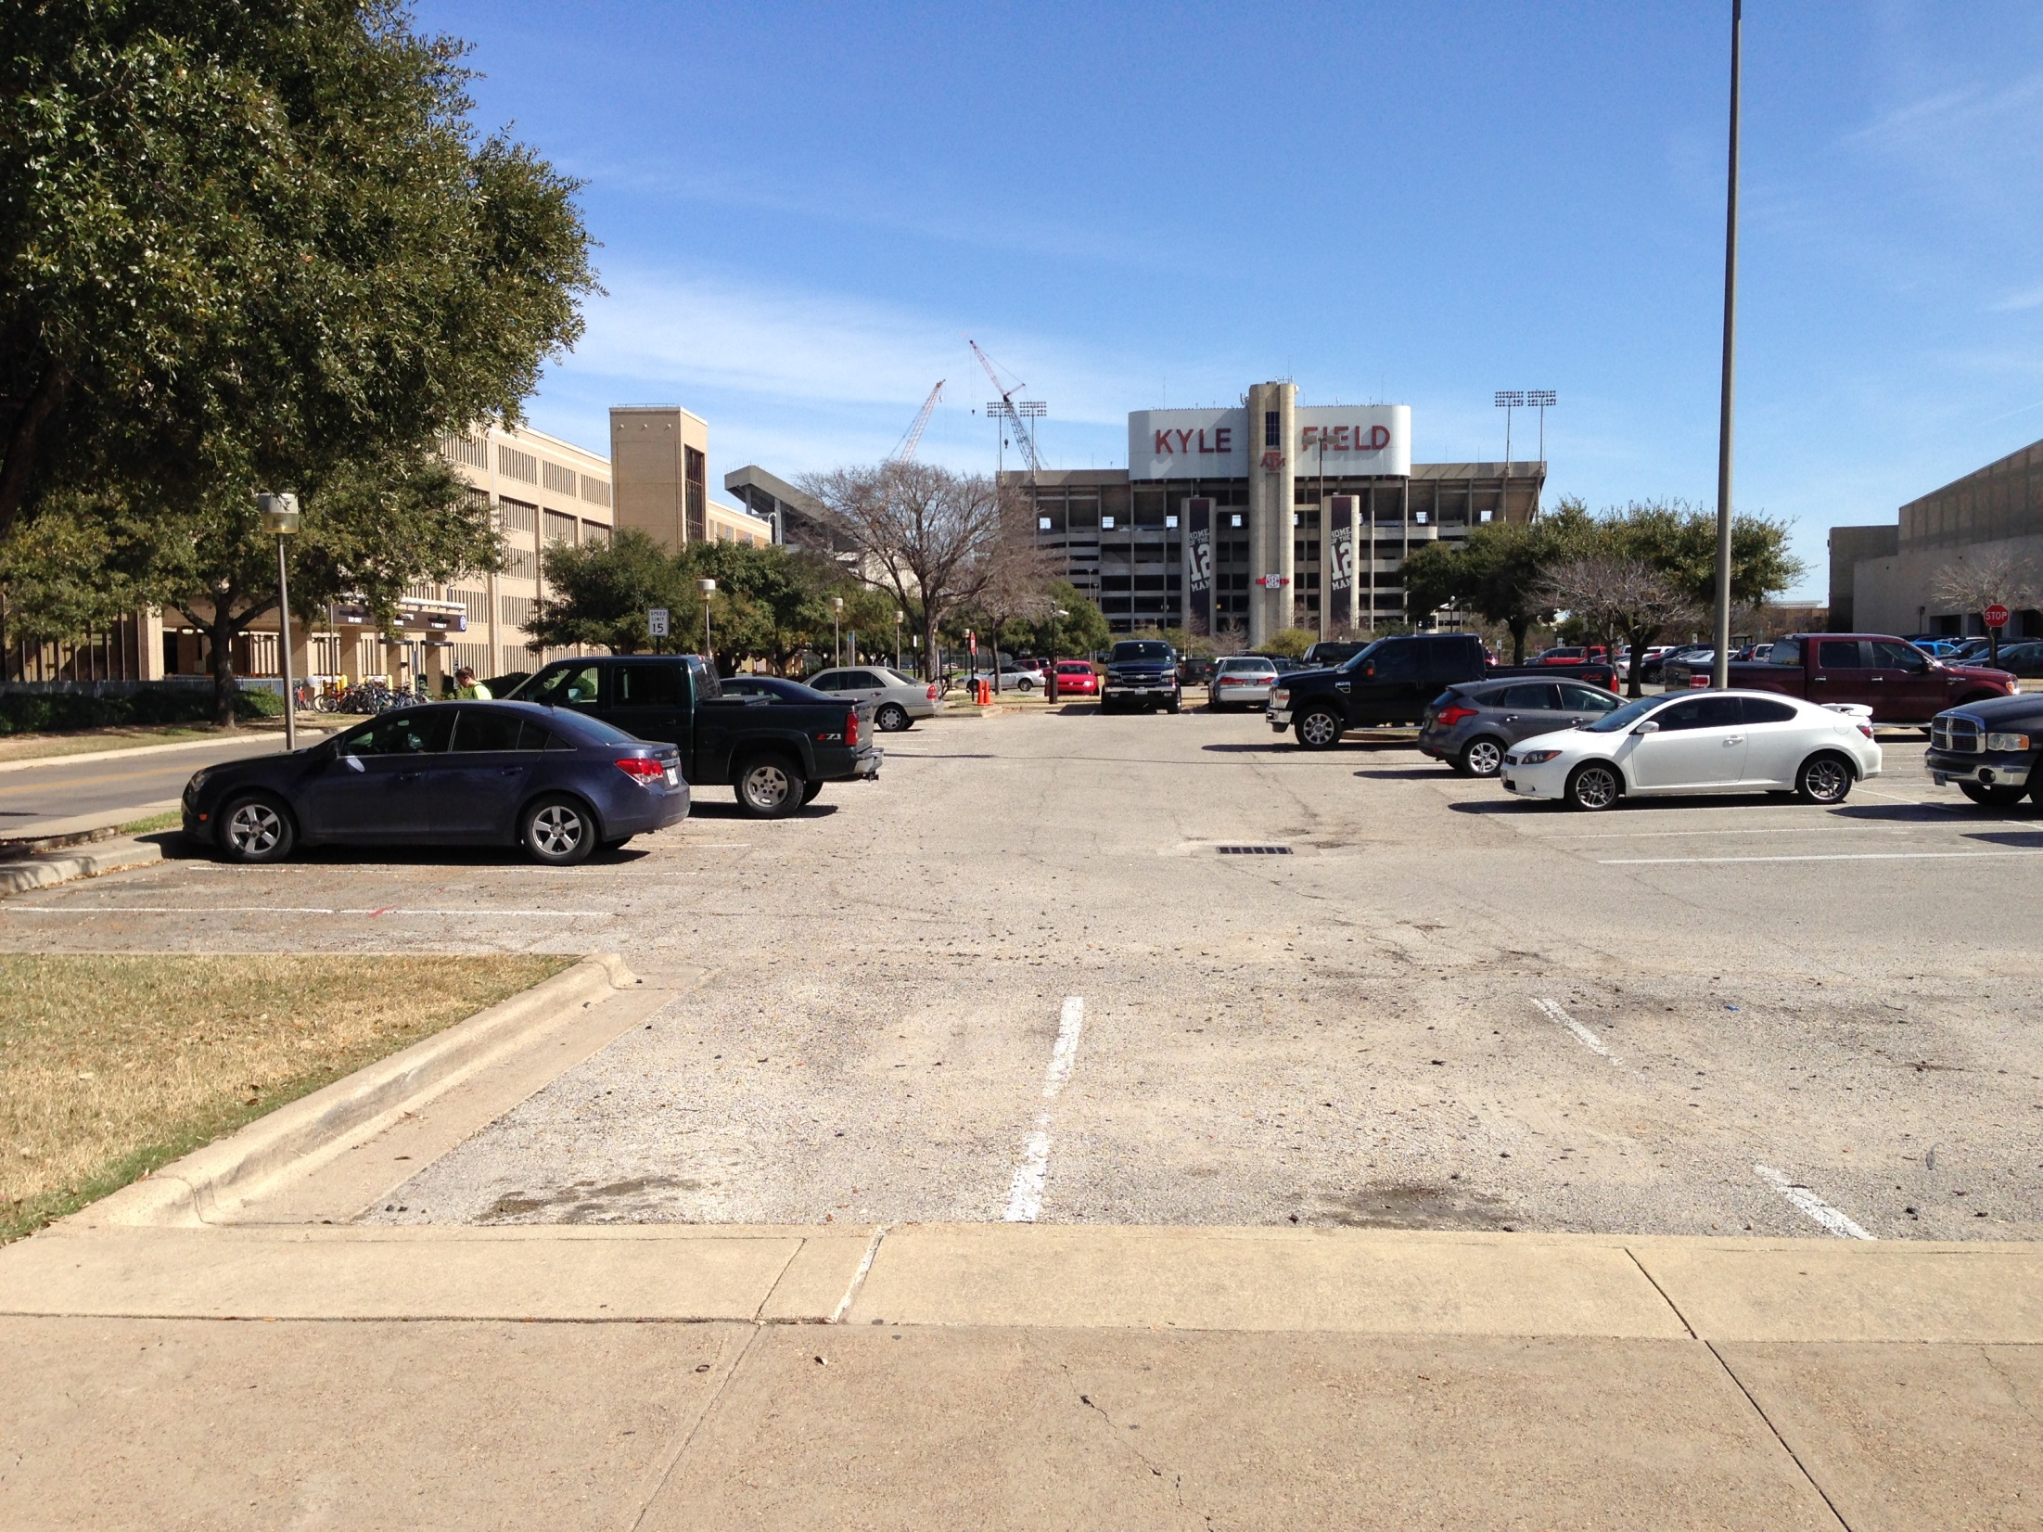
Shift path to maintain large tree.
South of West Campus Garage, Looking East from Olsen Boulevard

Slide 20
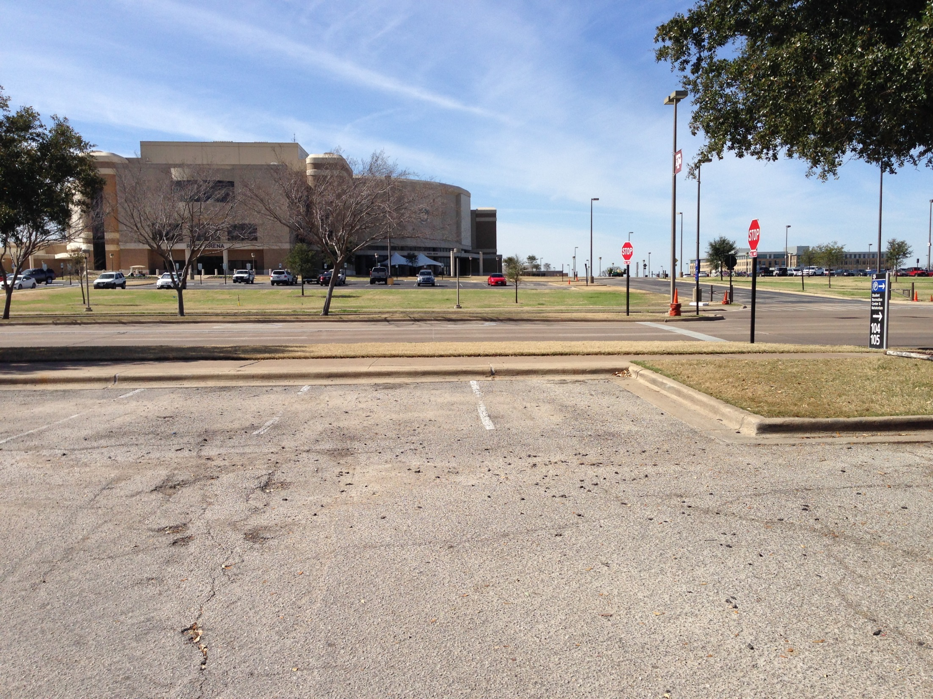
Remove curbs, replace with textured walkway;
Use bollards on non-gamedays.
Looking west toward Olsen Boulevard

Slide 21
New North Endzone Bus Stop
Serve west campus routes
Reduce pedestrian volume
Improve gameday experience for mobility impaired visitors

Slide 23
Go With the… Maps

Slide 24
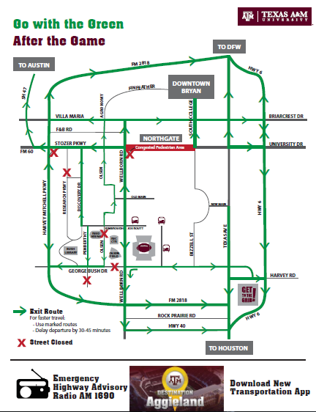

Slide 25
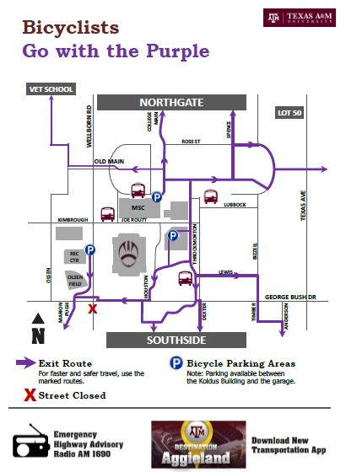

Slide 26
