Slide 1

Proposed Changes for Spring and Fall 2015

Slide 2
Ideas for Spring 2015
Reduce Service on Fridays to Match Demand
  Data shows a 25% drop in ridership on Fridays
  Drop bus from routes with 5 buses
  Reduce buses running between 10:30am and 2:30pm
Extend Day Service to Ease Overcrowding
  During transition from day service to night service, off campus routes unable to handle capacity
  Extend a few day shift buses two rounds per off campus route to increase capacity from 6pm to 8pm
Add Bus to Route 36
  Additional bus on this route to increase capacity

Slide 3
Reduce Service on Fridays to Match Demand
First 4 weeks of last 4 semesters
 | Spring 13 | Fall 13 | Spring 14 | Fall 14
M-TR average | 38586 | 49463 | 43569 | 53179
Friday | 27046 | 35681 | 29470 | 38710

Slide 4
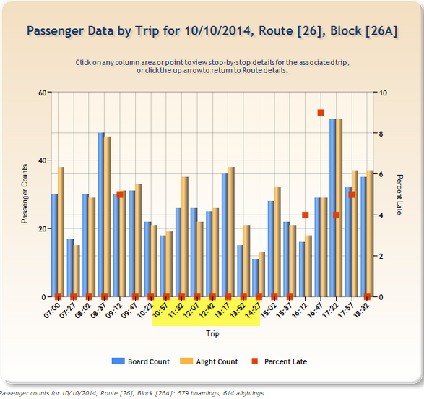
Reduce Service on Fridays to Match Demand

Slide 5
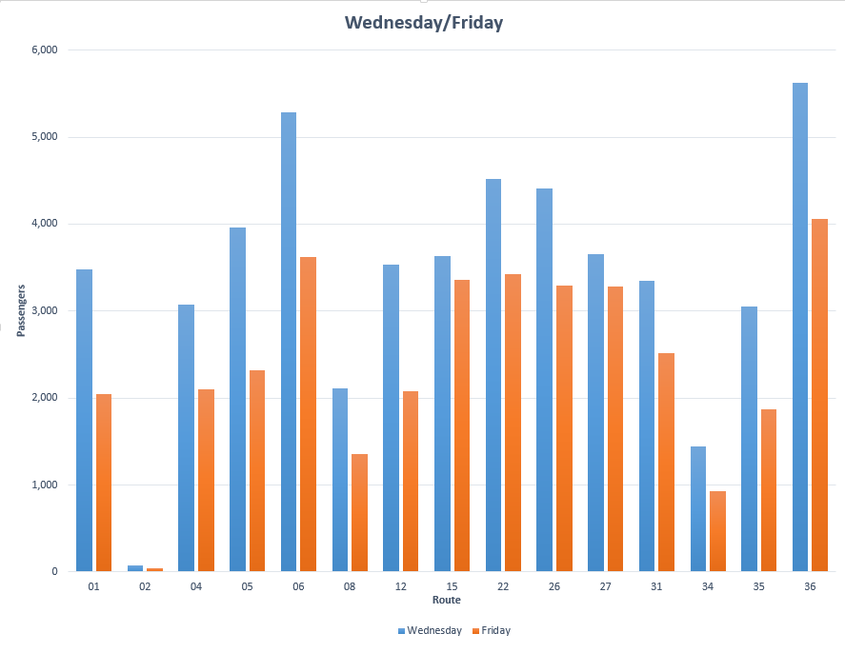
Reduce Service on Fridays to Match Demand
Notes:
Comparison of Wednesday vs Friday on all routes

Slide 6
Extend Day Service to Ease Overcrowding
Current |  |  |  |  |  |  |  | Proposed for Spring 15
 | Trigon | Brentwood | Trails @ Wolf Pen Creek | Redstone | Taos | Trigon |  | Trigon | Brentwood | Trails @ Wolf Pen Creek | Redstone | Taos | Trigon
A | 17:57 | 18:05 | 18:12 | 18:15 | 18:20 | 18:27 | A | 17:57 | 18:05 | 18:12 | 18:15 | 18:20 | 18:27
B | 18:04 | 18:12 | 18:19 | 18:22 | 18:27 | 18:34 | B | 18:04 | 18:12 | 18:19 | 18:22 | 18:27 | 18:34
C | 18:11 | 18:19 | 18:26 | 18:29 | 18:34 | 18:41 | C | 18:11 | 18:19 | 18:26 | 18:29 | 18:34 | 18:41
D | 18:18 | 18:26 | 18:33 | 18:36 | 18:41 | 18:48 | D | 18:18 | 18:26 | 18:33 | 18:36 | 18:41 | 18:48
E | 18:25 | 18:33 | 18:40 | 18:43 | 18:48 | 18:55 | E | 18:25 | 18:33 | 18:40 | 18:43 | 18:48 | 18:55
A | 18:32 | 18:40 | 18:47 | 18:50 | 18:55 | 19:02 | A | 18:32 | 18:40 | 18:47 | 18:50 | 18:55 | 19:02
C | 18:46 | 18:54 | 19:01 | 19:04 | 19:09 | 19:16 | B | 18:39 | 18:47 | 18:54 | 18:57 | 19:02 | 19:09
E | 19:00 | 19:08 | 19:15 | 19:18 | 19:23 | 19:30 | C | 18:46 | 18:54 | 19:01 | 19:04 | 19:09 | 19:16
 |  |  |  |  |  |  | D | 18:53 | 19:01 | 19:08 | 19:11 | 19:16 | 19:23
 |  |  |  |  |  |  | E | 19:00 | 19:08 | 19:15 | 19:18 | 19:23 | 19:30
 |  |  |  |  |  |  | night bus leaves at 1910
 |  |  |  |  |  |  | B | 19:14 | 19:22 | 19:29 | 19:32 | 19:37 | 19:44
 |  |  |  |  |  |  | C | 19:21 | 19:29 | 19:36 | 19:39 | 19:44 | 19:51
 |  |  |  |  |  |  | D | 19:28 | 19:36 | 19:43 | 19:46 | 19:51 | 19:58
 |  |  |  |  |  |  | E | 19:35 | 19:43 | 19:50 | 19:53 | 19:58 | 20:05
 |  |  |  |  |  |  | B | 19:49 | 19:57 | 20:04 | 20:07 | 20:12 | 20:19
 |  |  |  |  |  |  | night bus leaves at 2010

Slide 7
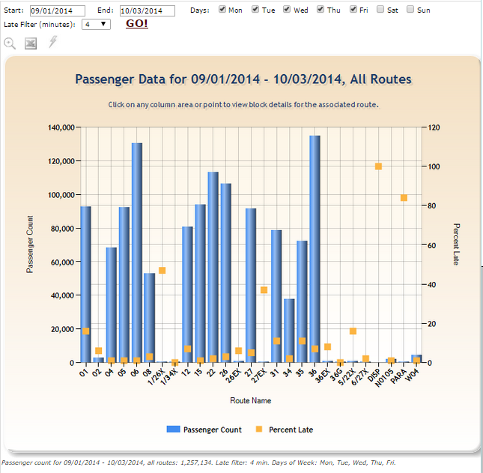
Add Bus to Route 36

Slide 8
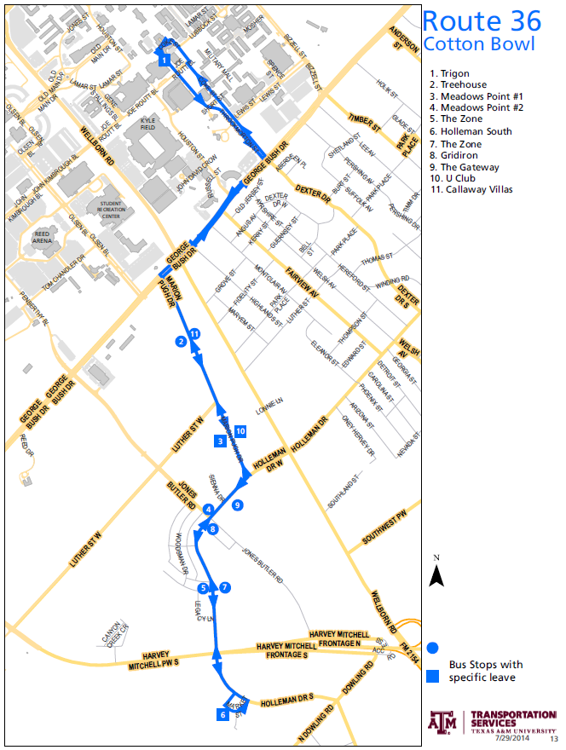
Add Bus to
Route 36

Slide 9
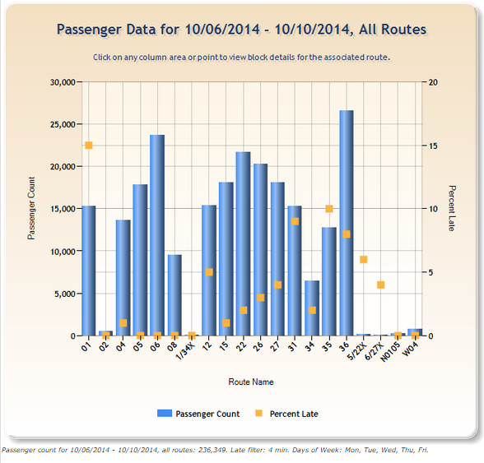
Add Bus to Route 36

Slide 10
Ideas for Fall 2015
Route 05 - Split Route and Create New Route
  Existing route is the longest on campus route
  Overcrowded and difficult to adhere to schedule
  White Creek Dorms open Fall 2015 – 1200 beds
  Split into two routes making both efficient
Shift On/Off Campus Buses Based on Demand
  Off campus ridership is highest early morning/late afternoon/evening
  On campus ridership is highest during the day
  Shift buses from off campus to on campus based on the ridership demand

Slide 11
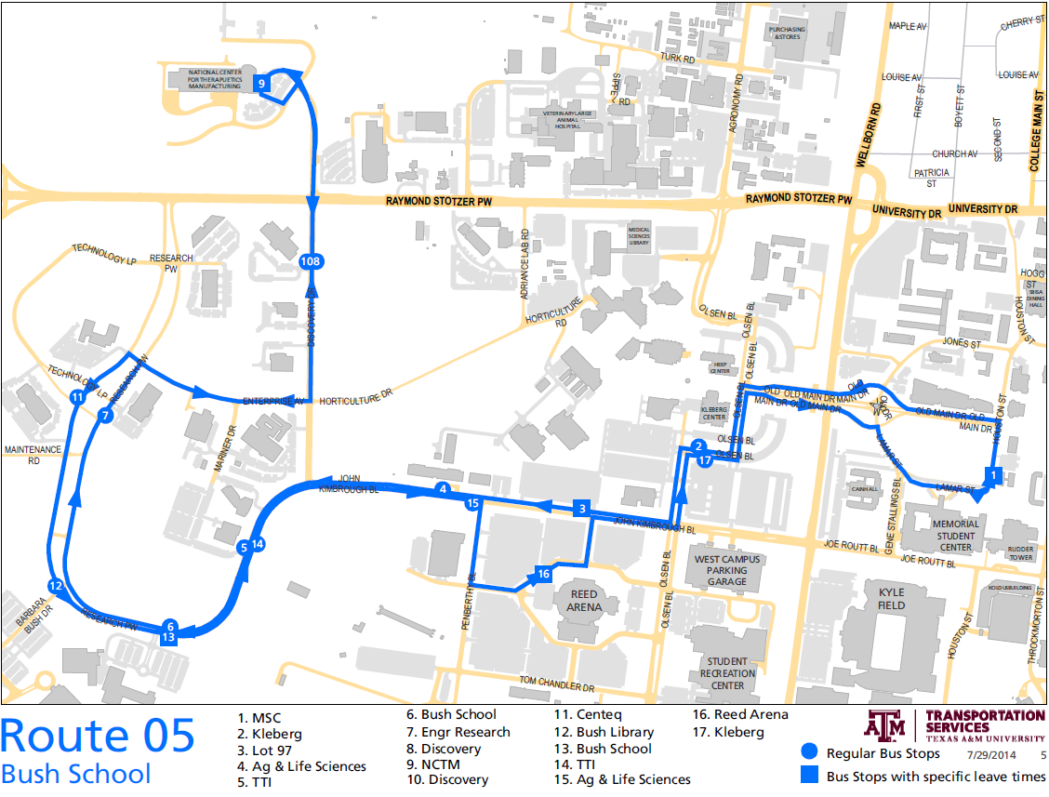
Existing Route 05

Slide 12
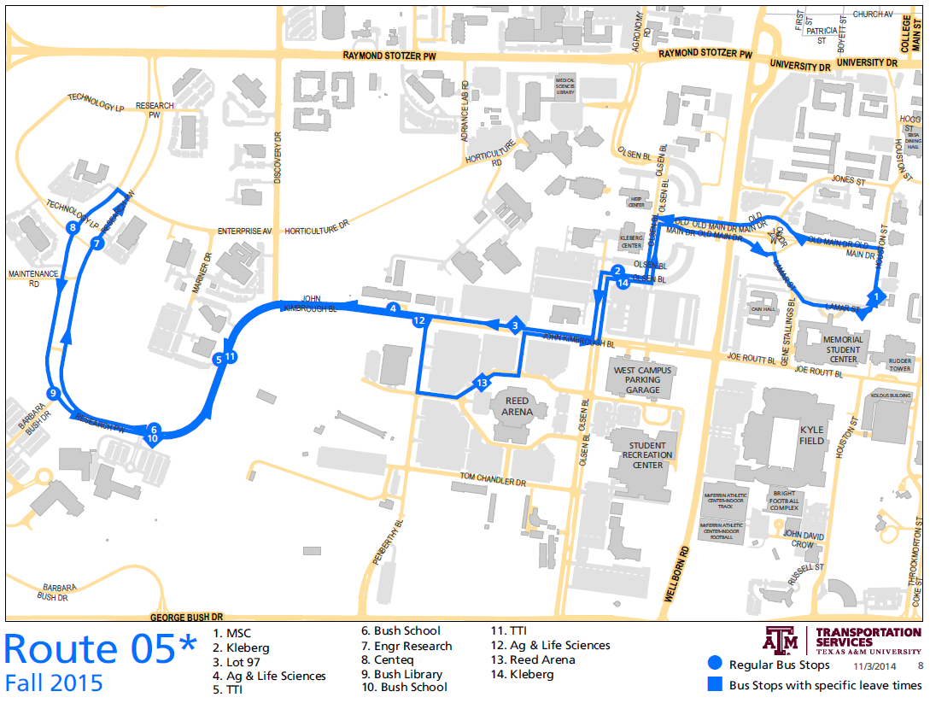
New Route 05

Slide 13
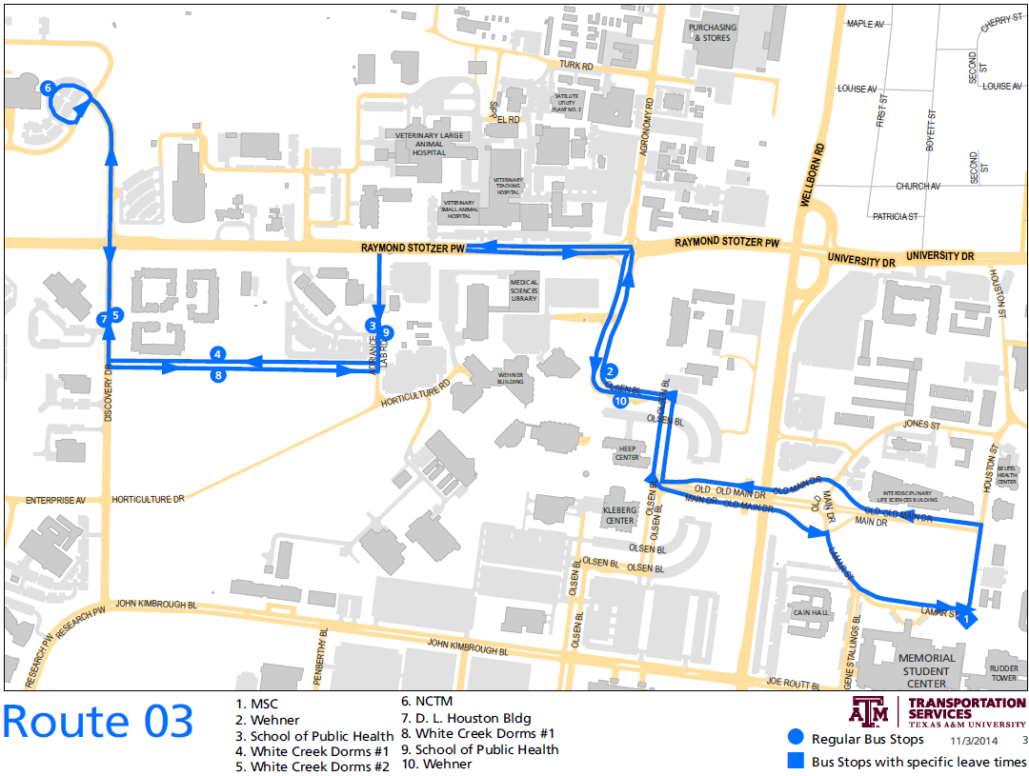
New Route 03

Slide 14
More for Fall 2015 or Sooner
Route 04
  Century Square is the new development on the corner of University and South College
  Calvin Moore will go away at some point
  Reviewing options to rework route to service The Gardens

