Slide 1
Wellborn Underpass Update
Transportation Services
Advisory Committee
March 6, 2013

Slide 2
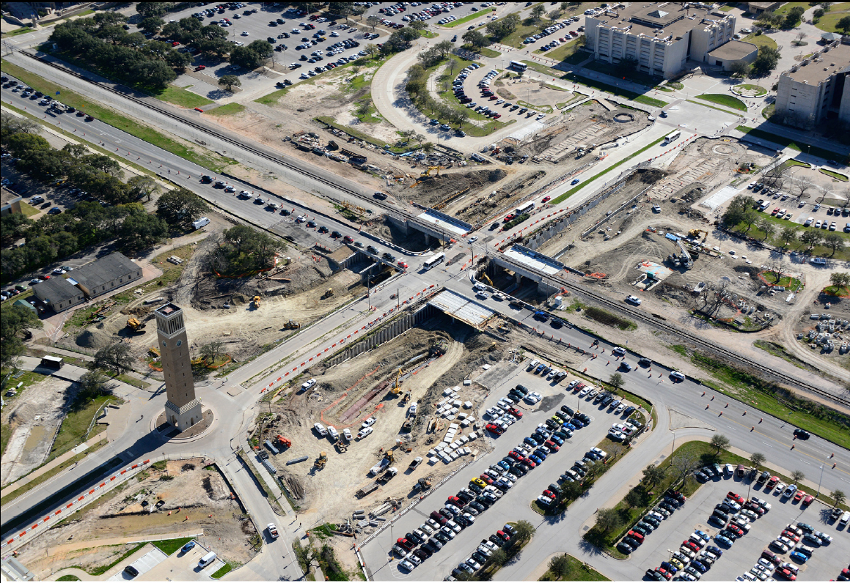
Aerial View – February 2013
Notes:
The RR structure is complete, only waterproofing and final ballast required

Slide 3
View Looking East from West Campus
Notes:
The last half of the Wellborn bridges will be poured this week

Slide 4
View looking Southwest from Main Campus

Slide 5
View Looking South along Wellborn Road
Notes:
The cantilever wall is being put in place which divides the pedestrian sidewalk from the vehicular underpass, on right of photo.
The panel façade is being installed along the Old Main retaining wall. Brick will be installed as early as this month.

Slide 6
Questions?

