Slide 1
Proposed Bus Route Changes for Fall 2014
Open Forum
Monday, November 25, 2013
Aggie Spirit
Notes:
Aggie Spirit is mass transit and our routes and stops should be associated to the places where large numbers of students are living. For Fall 2014, we are proposing the combining of some routes and modifying routes and stops on others. Probably the most significant proposed changes will be on Routes 33 and 34.

Slide 2
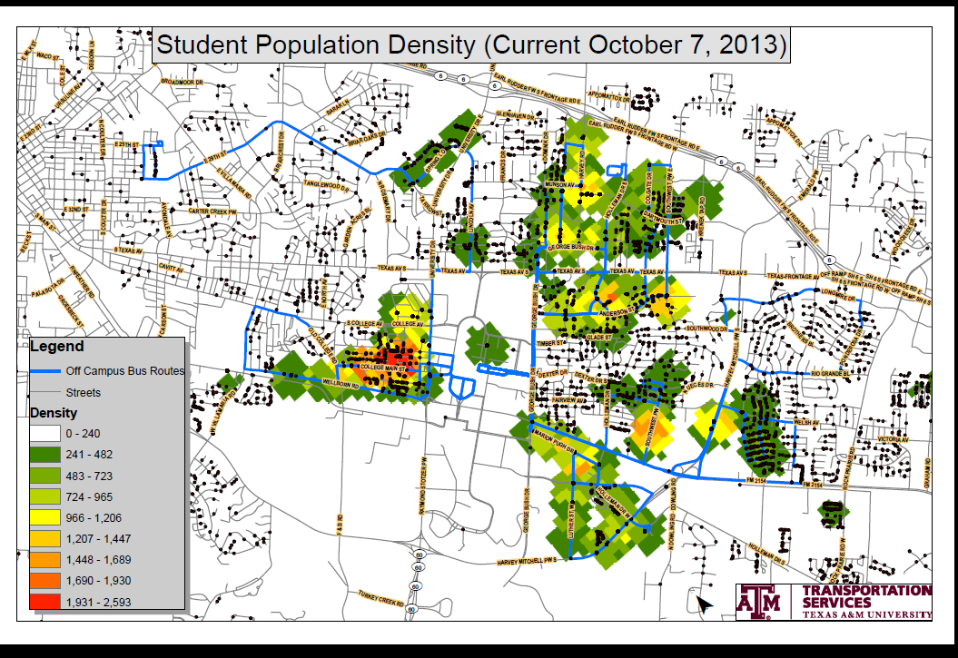
Student Population Density Map (10/2013)
Notes:
This is a recent Student Population Density Map of the community. Green is low student population density, yellow/red is high student population density. We are able to use this data, coupled with our ridership data, to make the best decisions for route placement to service the bulk of our student population.

Slide 3
Proposed Off Campus Route Changes
Route 31
Route 33
Route 34
Route 35
Route 36
Notes:
We are proposing changes to Route 31. Combining Routes 33 and 34. Routes 35 and 36 will be affected with the opening of the Jones Butler extension to Penberthy.

Slide 4
Off Campus Ridership 09/08/13 – 09/24/13
* Extra Buses
4 Buses
3 Buses *
5 Buses *
5 Buses *
4 Buses *
4 Buses
2 Buses
2 Buses
4 Buses
4 Buses *
Notes:
This is a snapshot of ridership for a two week period last month for all off campus routes and also a snapshot of a two week period in fall 2012. Right away, you see that we are carrying more passengers this year than last. The routes with extra buses running at peak times during the day are noted with an asterisk. Notice the lower ridership on Routes 33 and 34. These two routes tend to be inefficient because of lower ridership and the number of buses on both routes.

Slide 5
Ridership for Route 31- Elephant Walk 09/08/13 – 09/24/13
Notes:
This is an example of a route that could have been considered for elimination not all that long ago based on ridership numbers. However, The Woodlands and Campus Village, fairly new apartment complexes at the corner of 2818 and SW Parkway, revived the route. It’s notable that we pick up the largest ridership on the last three stops of the route. Note specifically the very low ridership route. We are proposing the elimination of one stop and will be asking passengers to walk a short distance from two other stops. We know the residents may be up in arms, but our data says few people ride daily except for the last three stops.

Slide 6
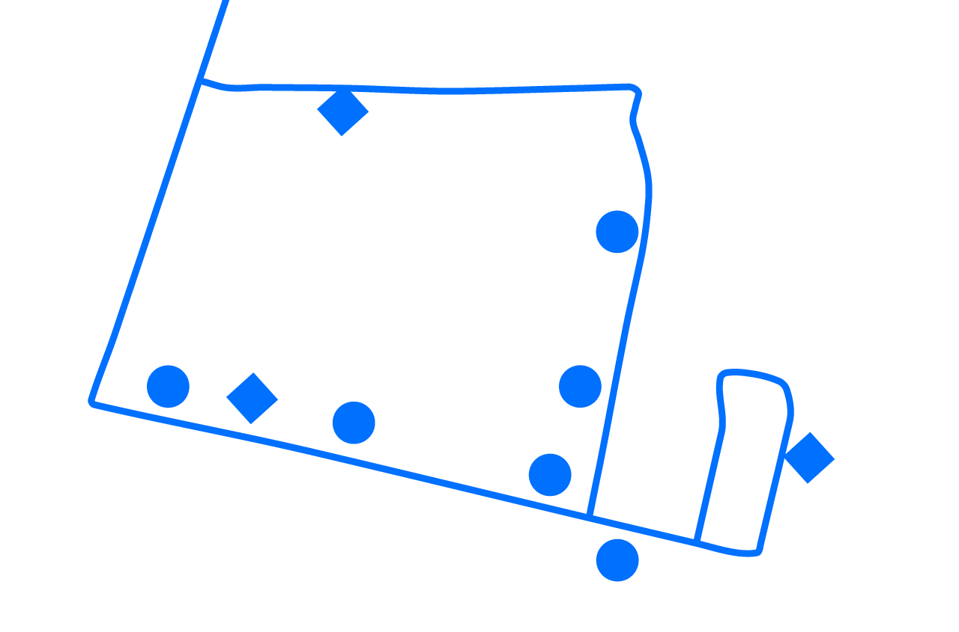
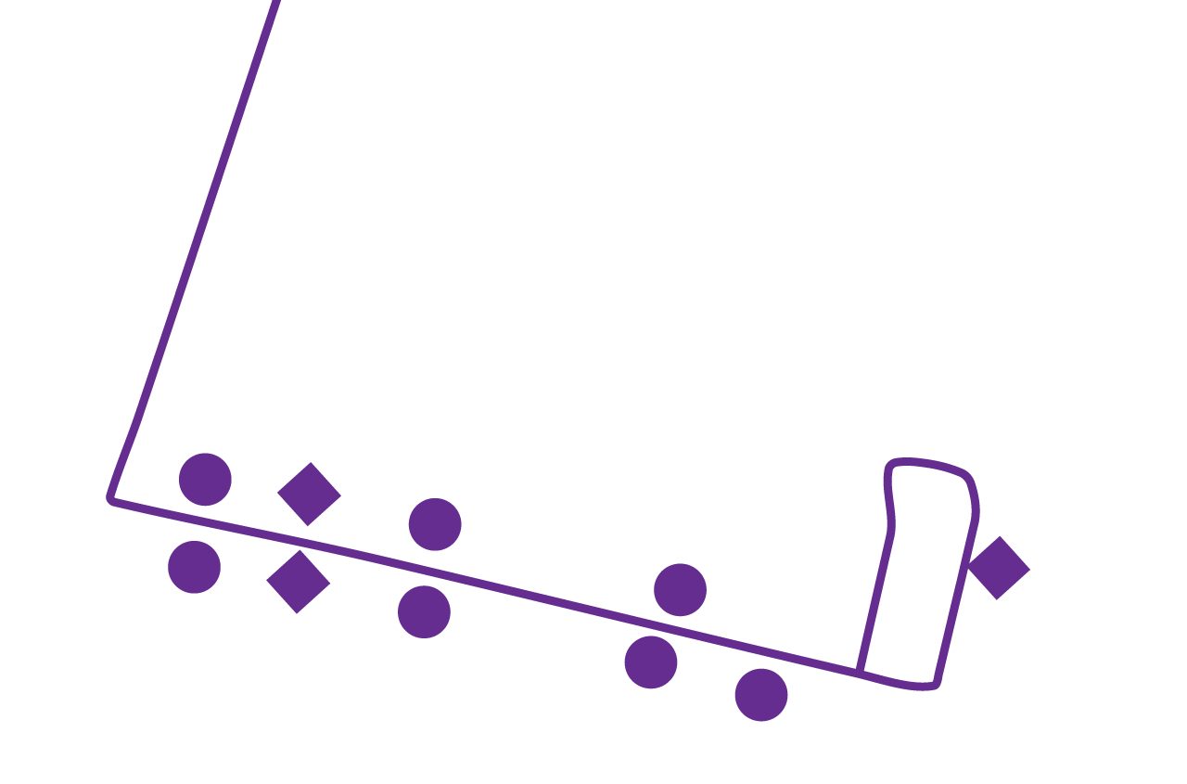
31
580 yds
31 Proposed
WELSH
Notes:
Route 31 services South College Station and apartment complexes along Southwest Parkway running 4 buses every 7 minutes. Again, our largest ridership is on the last three stops. The heaviest is our last stop which services The Woodlands and
Campus Village, and those students must cross Southwest Parkway to catch the bus. The stop at Oney Hervey does not have sidewalk access to Southwest Parkway. Options for these residents would be to park at the Park N Ride at the First Baptist Church on Welsh or the Wal-Mart PNR on Longmire. Passengers from the other two stops at Willow Rock and Renaissance Park can utilize the sidewalks from their complexes to the stop on Southwest Parkway. WR is a 4 minute walk and RP is a 3 minute walk to the stop on SW Parkway. By bringing this route down Southwest Parkway, turning around and coming back up SW Pkwy, we are able to make stops on both sides of the street preventing students from crossing the busy street to catch the bus. Additionally, we are eliminating the worst right turn we have on any of our routes.

Slide 7
Notes:
The ridership data and this density map show us that many students are leaving the duplexes and single family dwellings to move to large apartment complexes. This directly affects our ridership. This map shows areas around Routes 33 and 34. This data supports relocating our routes to the more highly populated student living areas within the community.

Slide 8
Route 33 & 34 Ridership 09/08/13 – 09/24/13
Notes:
These two routes are our lowest off campus ridership. Highest ridership is picking up at the PNR at First Baptist Church on Welsh. This stop has 20% of the ridership of the 20 stops from these two routes combined.

Slide 9
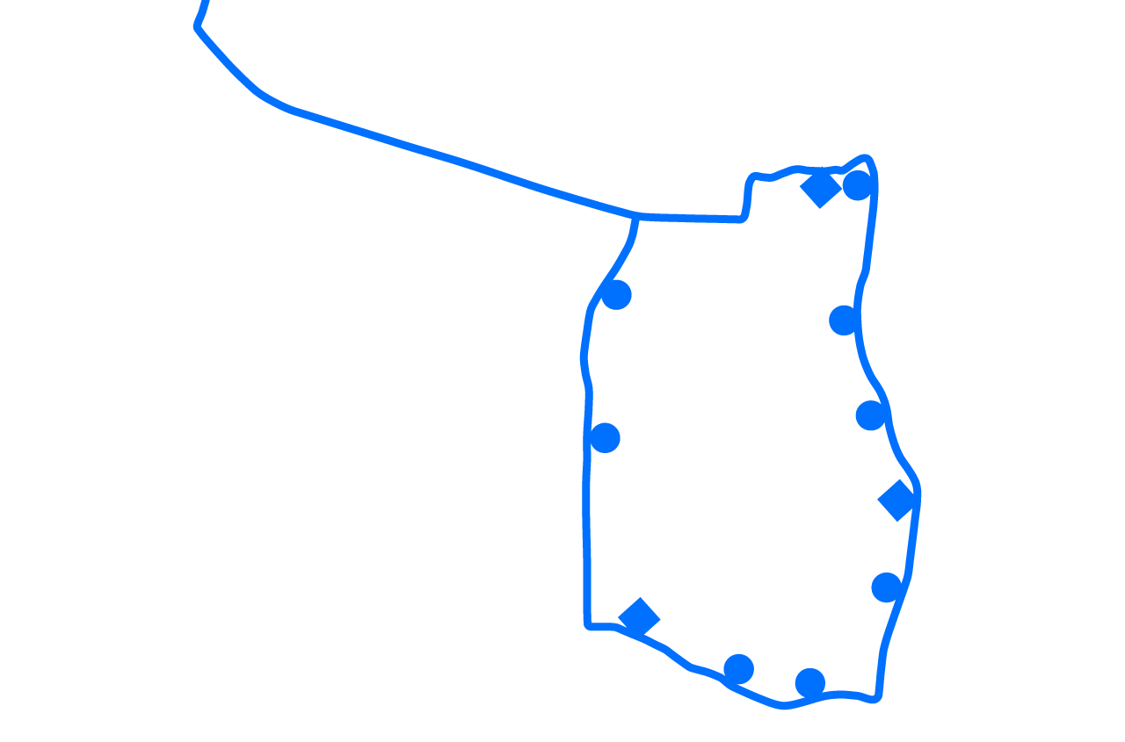
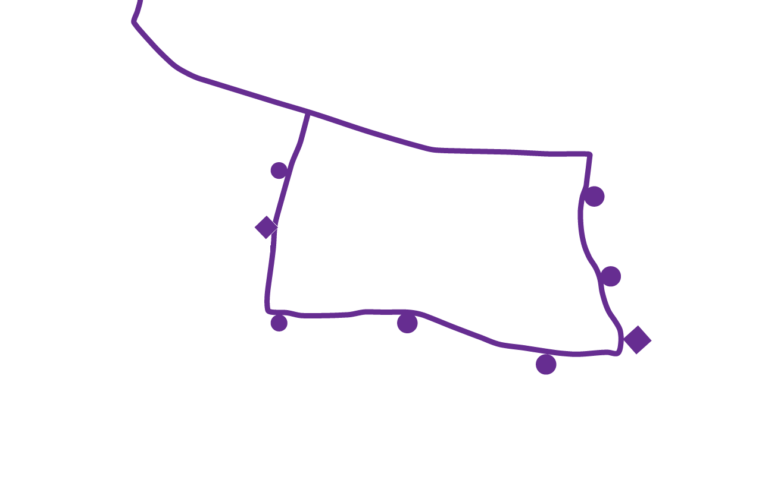
33/34 Proposed
Park N Ride
757 yds
WELSH
704 yds
Park N Ride
34
33
880 yds
1144 yds
Notes:
This is the biggest proposed change we have for you today. Based on our ridership data, we must make a change. We have to be smarter with our resources and make these 2 routes run efficient. Currently on Route 33, we run 2 buses every 18 minutes. On Route 34, we run 2 buses on route every 18 minutes. One option is to remove 1 bus from each route with 36 minute service. We feel like this would drive ridership down to the point needing to eliminate both routes. Or, we could combine. By combining these two routes, we eliminate stops, but they are within walking distance via sidewalks to new stops in less than 7 minutes. Another option for these students is using one of two PNR options. The Park N Ride at the First Baptist Church on Welsh is heavily used and the newest PRN at Wal-Mart seems to be popular also. We feel like these students have the option of walking to the nearest stop or to drive to the PNR of their choice. We will go from 4 to 3 buses but with improved timing from 18 minute service to 14 minute service. It’s also notable that from Wal-Mart to campus will typically be a 10 minute trip. Those at Doux Chene are currently the first pick up stop and have an 18 minute ride. By walking to the Longmire Stop (Wal-Mart) or driving to the Wal-Mart PNR, they have a 10 minute trip to campus. If we keep the extension on 34, the route would increase from a 36 minute route to 42 minutes

Slide 10
Ridership for Route 35 – Hullabaloo 09/08/13 – 09/24/13
Notes:
Changes to this route are due to opening of Jones/Butler connecting to Pennberthy. Route 35 currently uses 4 buses providing 7 minute service on a 28 minute route.

Slide 11
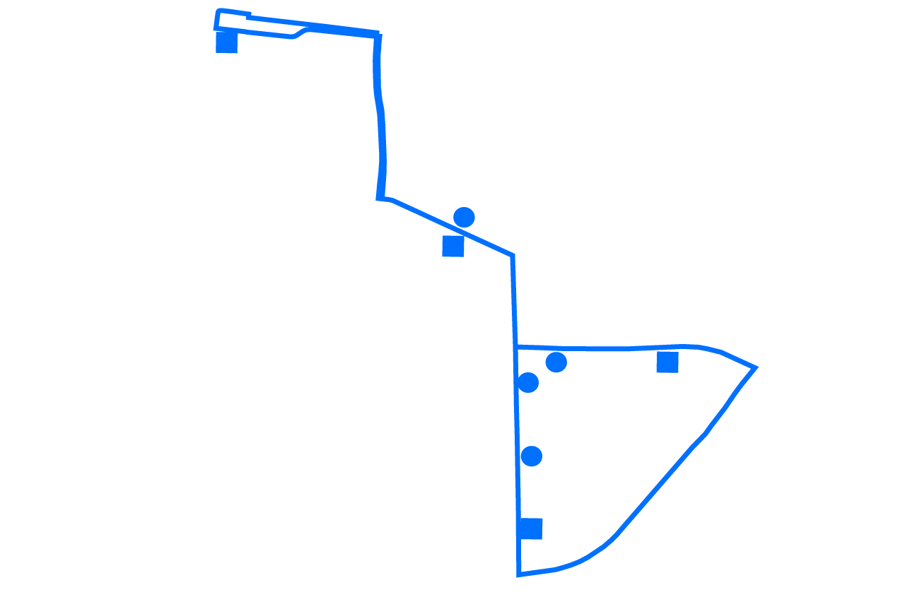
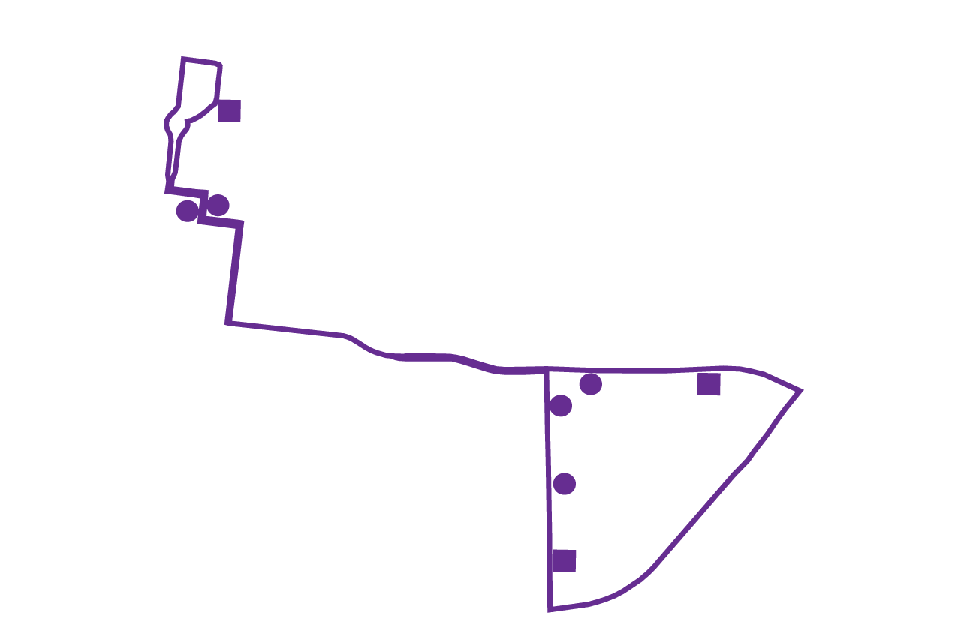
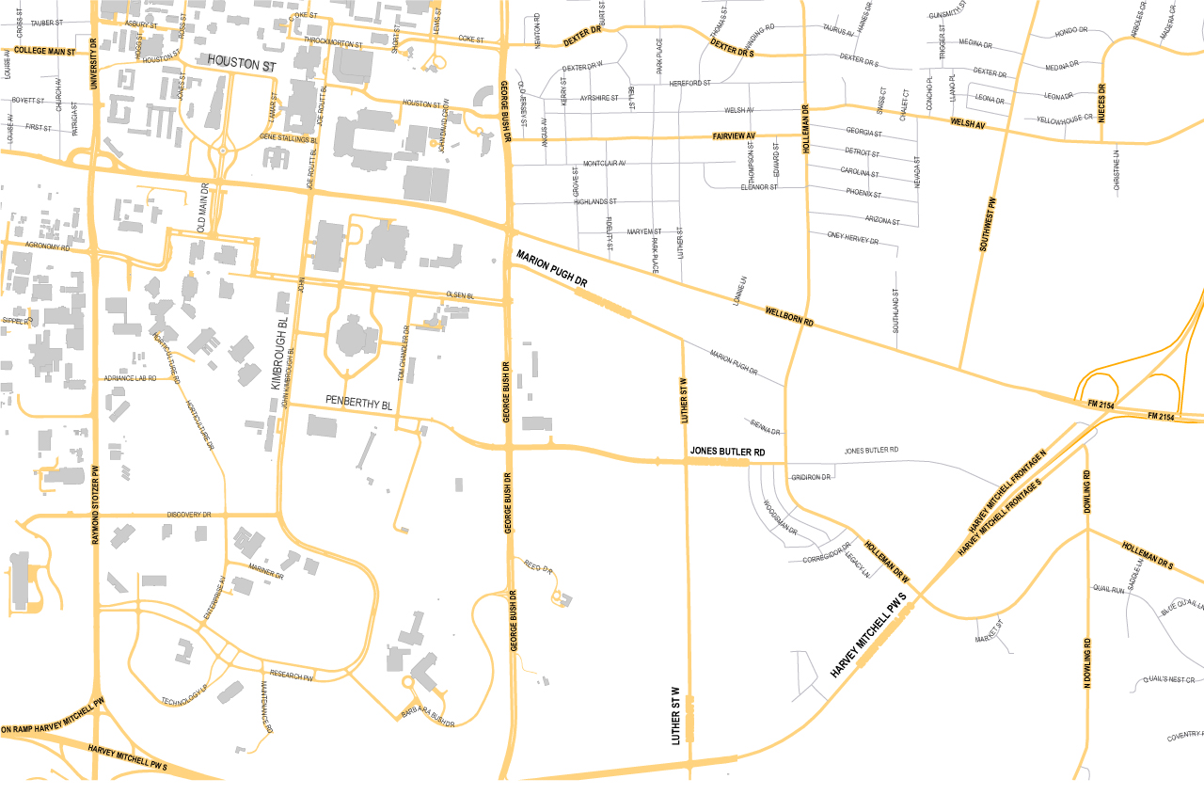
35
35 Proposed
Notes:
With the opening of Jones Butler connecting to Penberthy, we are moving Route 35 to utilize this new road and provide stops at Kleberg and services the MSC. Route 35 will not go to the Trigon. We will leave 4 buses on this route.

Slide 12
Ridership for Route 36 – Cotton Bowl 09/08/13 – 09/24/13
Notes:
Currently, we run 4 buses on Route 36 providing 28 minute service.

Slide 13
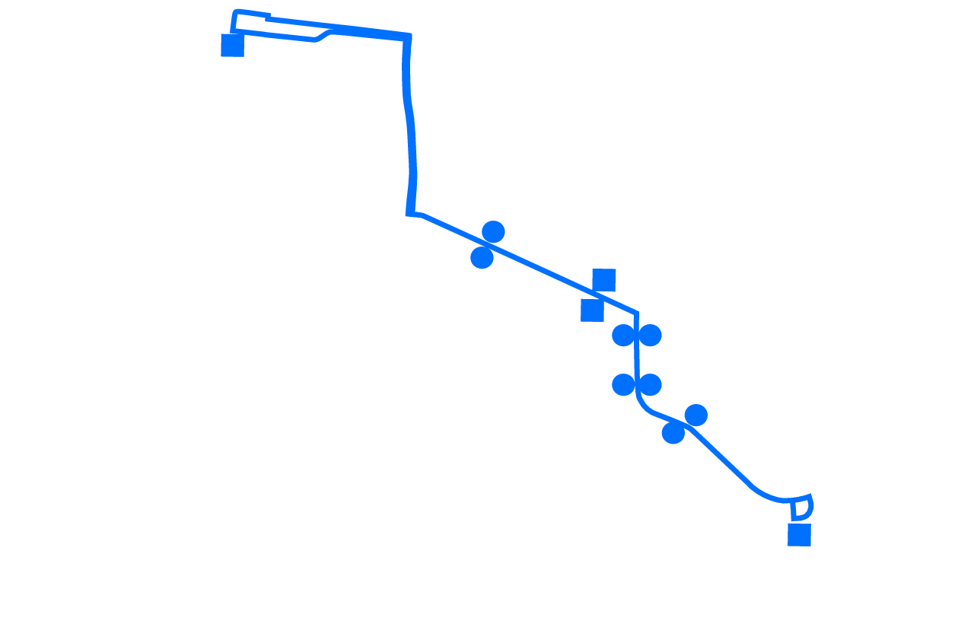
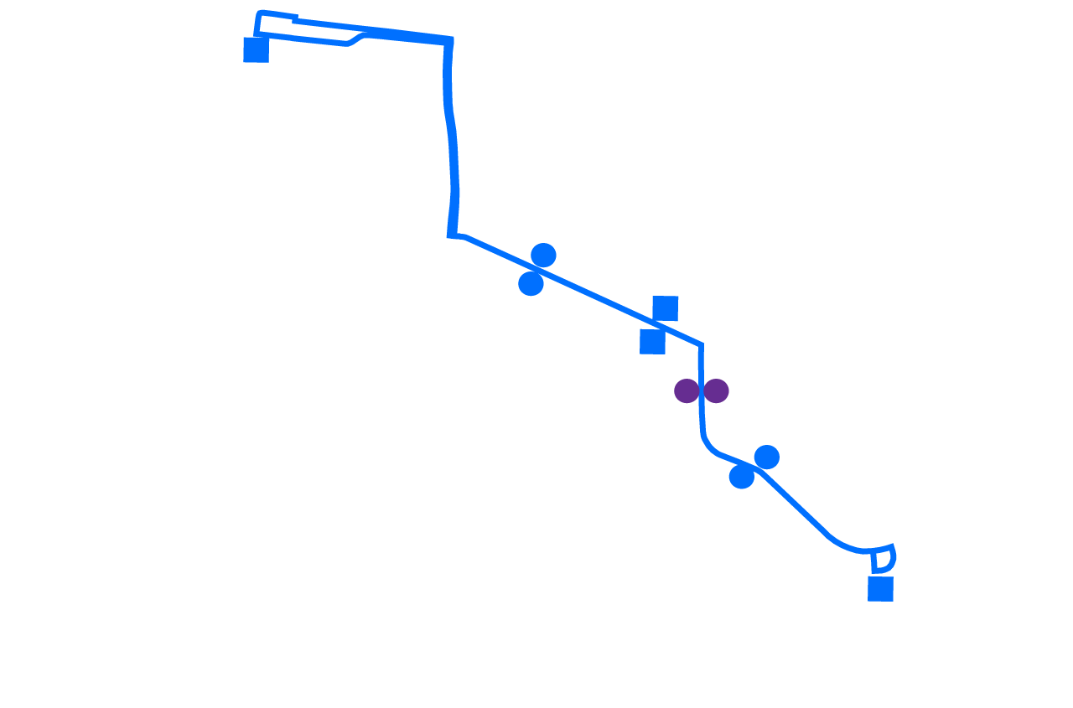
36
Notes:
We will continue to run Route 36 as is but combine stops at Jones Butler and Holleman for more efficiency. We will increase from 4 to 5 buses on this route to handle capacity and will reduce it to 6 minute service. With the opening of Jones Butler, there will be a shift in traffic. Currently, Routes 35 and 36 both used Marion Pugh, but some of this traffic is like to shift to Jones Butler.

Slide 14
Questions?
Notes:
Any questions?

