Slide 1

Slow Moving Vehicle (SMV)
Task Force
Presented to
TSAC
February 6, 2013

Slide 2
Team Members
Sponsor
  Dr. Rodney P. McClendon
    Vice President for Administration
Team Leader
  Mr. Peter Lange
    Executive Director, Transportation Services

Slide 3
Team Members
Dr. Michael Benedik
  Dean of Faculties and Associate Provost
  Designee for the Provost and Executive Vice President for Academic Affairs
Dr. Jonathan Coopersmith
  Associate Professor, Department of History
  Designee for the Speaker of the Faculty Senate

Slide 4
Team Members
Mr. Bill Cox
  Assistant Director, University Center Complex
  Designee for the Vice President of Student Affairs
Mr. Les Fiechtner
  Director, Student Services for the Professional Program, College of Veterinary Medicine
  Representing the University Staff Council

Slide 5
Team Members
LTC(R) Jeff Gardner
  Director, Sanders Corps Center
  Designee for the Vice President of Student Affairs
Ms. Kristi Hosea
  Master Police Officer
  Representing the University Police Department

Slide 6
Team Members
Mr. Steve Miller
  Assistant Athletic Director for Events and External Services
  Designee for the Director of Athletics
Mr. Dan Mizer
  Senior Associate Director, Department of Residence Life
  Designee for the Vice President of Student Affairs

Slide 7
Team Members
Mr. John Salsman
  Director, Environmental Health and Safety
  Representing Environmental Health and Safety
Mr. Rod Weis
  Resident Vice President
  Representing Compass Group USA

Slide 8
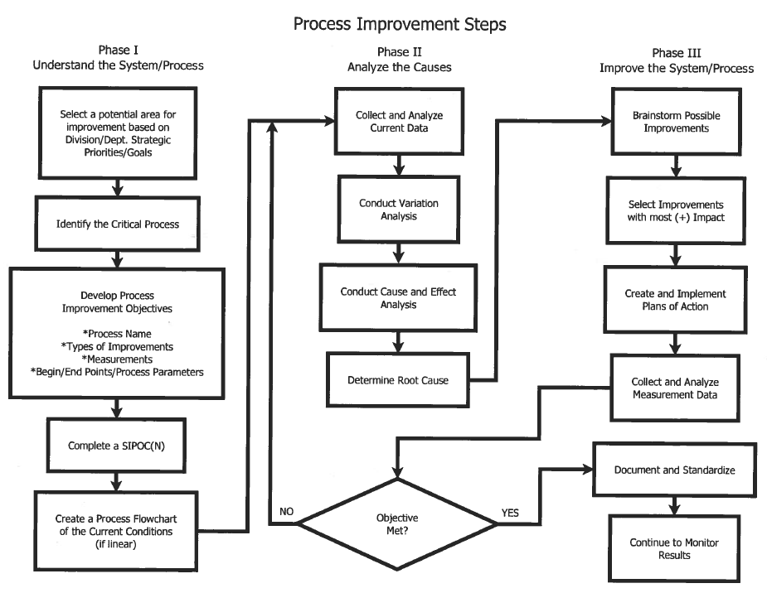
Process Improvement

Slide 9
Copywriting
Drafts, edits, polishing of copy on the three process sections has been ongoing for the last three weeks.
Next Steps
  Engage facilities coordinators and building proctors
  Engage other potential stakeholders

Slide 10
Questions
Questions?
Contact Info:
  rsteedly@tamu.edu
  979-847-2453

Slide 11
Storyboard Follows

Slide 12
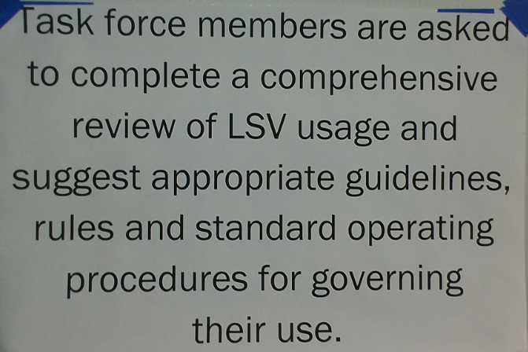

Slide 13
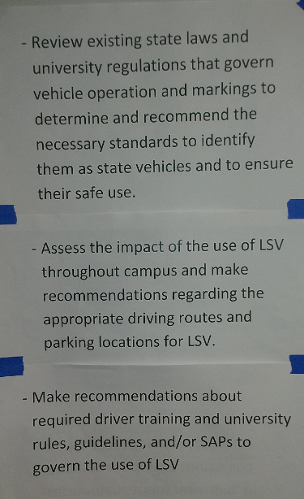

Slide 14
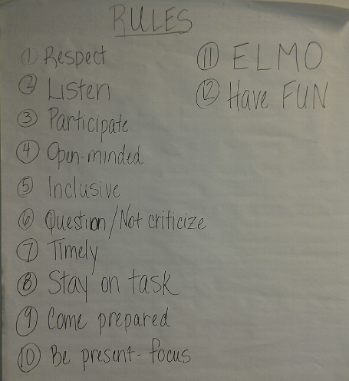

Slide 15
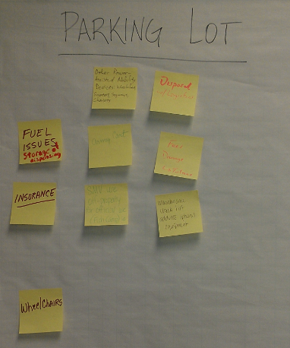

Slide 16
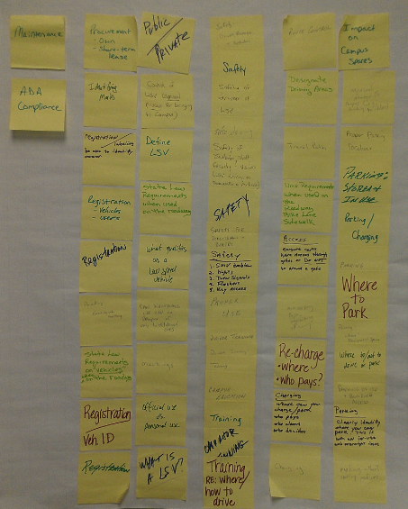

Slide 17
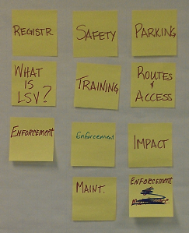

Slide 18
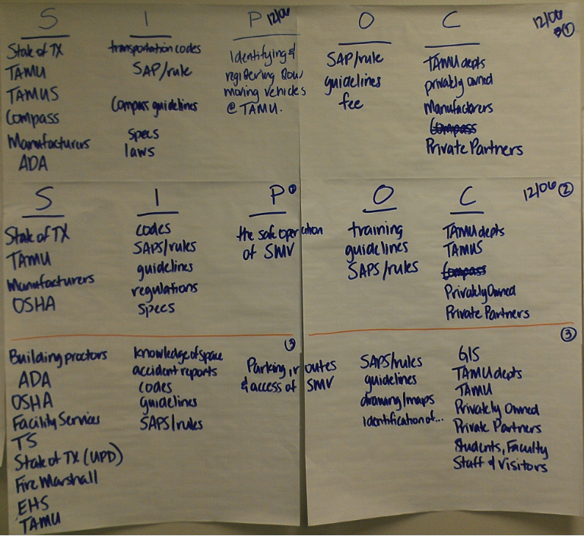

Slide 19
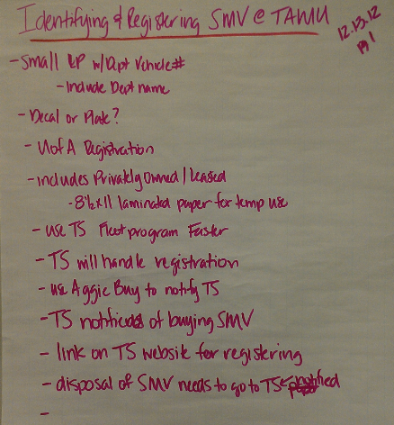

Slide 20
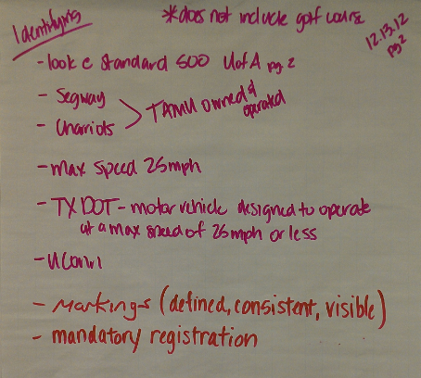

Slide 21
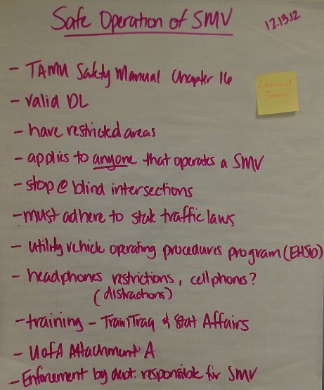

Slide 22
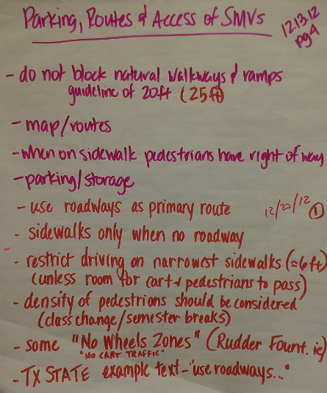

Slide 23
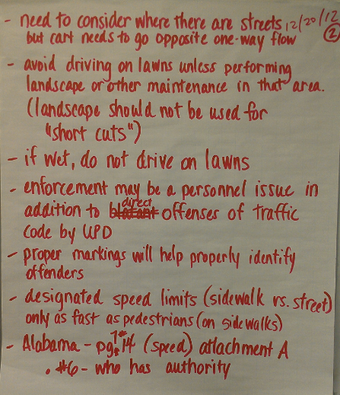

Slide 24
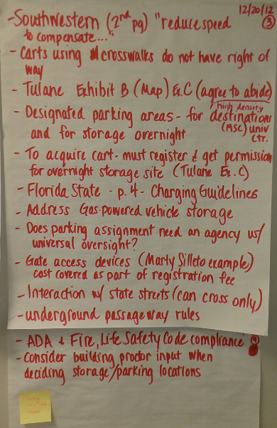

Slide 25
