Slide 1
SEC Game Day Parking Survey Overview
Transportation Services Customer Advisory Committee
March 7, 2012

Slide 2
Content
Schools Surveyed
Highlights of Data
Parking
RV
Transit
Common Threads
Good Ideas
Unique Aspects

Slide 3
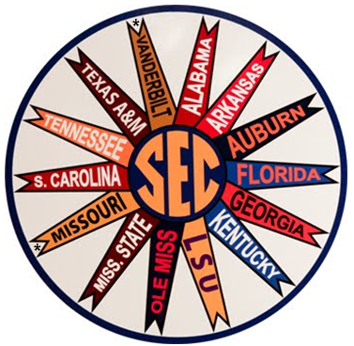
12 Schools Surveyed
* Not yet able to interview Missouri or Vanderbilt.

Slide 4
Highlights of Parking Data
Athletic Dept. manages donor parking areas at 10 of 12 schools (not at A&M or Alabama)
Friday night set up/parking allowed in donor lots at 8 schools (A&M allows after 5PM)
Non-donor parking areas managed by:
No one (3) -- Police Dept. (1)
Parking Dept. (7) -- Fairgrounds (1)

Slide 5
Highlights of Parking Data Cont.
Paid public parking ranges from $10 (A&M) - $50 (USC) per game; 4 schools have no paid public parking (free if not parking in donor lots)
Number of paid parking spaces available ranges from 200 (LSU) – 8400 (A&M)
Entry to paid public parking lots restricted to Game Day at all schools that have paid parking
6 schools allow game day parking on grass (even in inclement weather)

Slide 6
Highlights of Parking Data Cont.
Georgia allows overflow parking on intramural softball fields and have intentions of selling entire campus in 2 yrs. (currently all free outside of donor parking)

Slide 7
Summary of Public Paid Parking
 | Auburn University | Louisiana State University | Mississippi State University | University of Alabama
Cost: | Free | $40 (200) | $20 (5400) | $20
Managed By: | No One | Parking | Athletics | Parking
 | University of Arkansas | University of Florida | University of Georgia | University of Kentucky
Cost: | Free | Free | $20 | $20
Managed By: | Parking | No One | Parking | Parking
 | University of Mississippi | University of South Carolina | University of Tennessee | Texas A&M University
Cost: | Unknown | $30-$50 | $25 | $10, $15 and $20 (8400)
Managed By: | Approved Fundraising Groups | Fairgrounds | Parking | Transportation Services

Slide 8
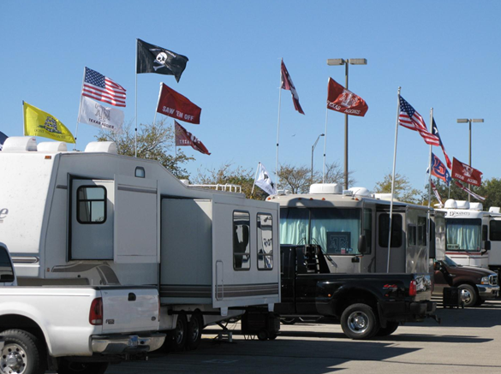
Highlights of Donor RV Parking Data
10 of 12 school provide RV parking for donors (UA & USC)
Athletic Dept. manages RV donor parking areas at 6 of 12 schools (Parking-3; Physical Plant-1; Fairgrounds-1)
Auburn allows Thursday arrivals due to dedicated RV area; all others report no arrivals allowed before Friday in donor RV lots (9AM; 10AM; 2PM; 5 PM; 5:30PM; 6PM (3); 6:30PM)
All but Tennessee report strict application of arrival time policies
3 of 12 schools have hook ups in some donor RV parking spaces (MSU-82; USC-300; UT-50)
Georgia – RV’s are “just a blip on the radar” (40 spaces)

Slide 9
Highlights of Public RV Parking Data
6 of 12 schools offer public RV parking
No arrivals allowed before Friday at on-campus RV parks
A&M and Miss. State have hook ups in some public RV parking spaces (A&M-97, on-campus; MSU-150, off-campus)
Arkansas has NO on-campus RV operation; all off-campus and privately-owned

Slide 10
Summary of Public Paid RV Parking
 | Louisiana State University | Mississippi State University | University of Alabama | University of Florida | University of Georgia
Spaces/Cost: | 200/$100 per night | 150 (off-campus; private) | 100 (off-campus; private) | 470/$450 per season | 70/$100 per night
Details: | 4-5 vehicle spaces; no hook ups | Hook ups | Unknown | 40’x17’; no hook ups | “just fit”; no hookups
 | University of Kentucky | University of Mississippi | University of South Carolina | Texas A&M University
Spaces/Cost: | 35-40/free | Unknown/$50 per night | Unknown (off-campus; private) | 383/ $90-150 per game weekend
Details: | 4-6 vehicle spaces; no hook ups | Vacated Wal-Mart & Whirlpool parking lots; no hook ups | Unknown | 4-6 vehicle spaces; 97 w/ hook ups

Slide 11
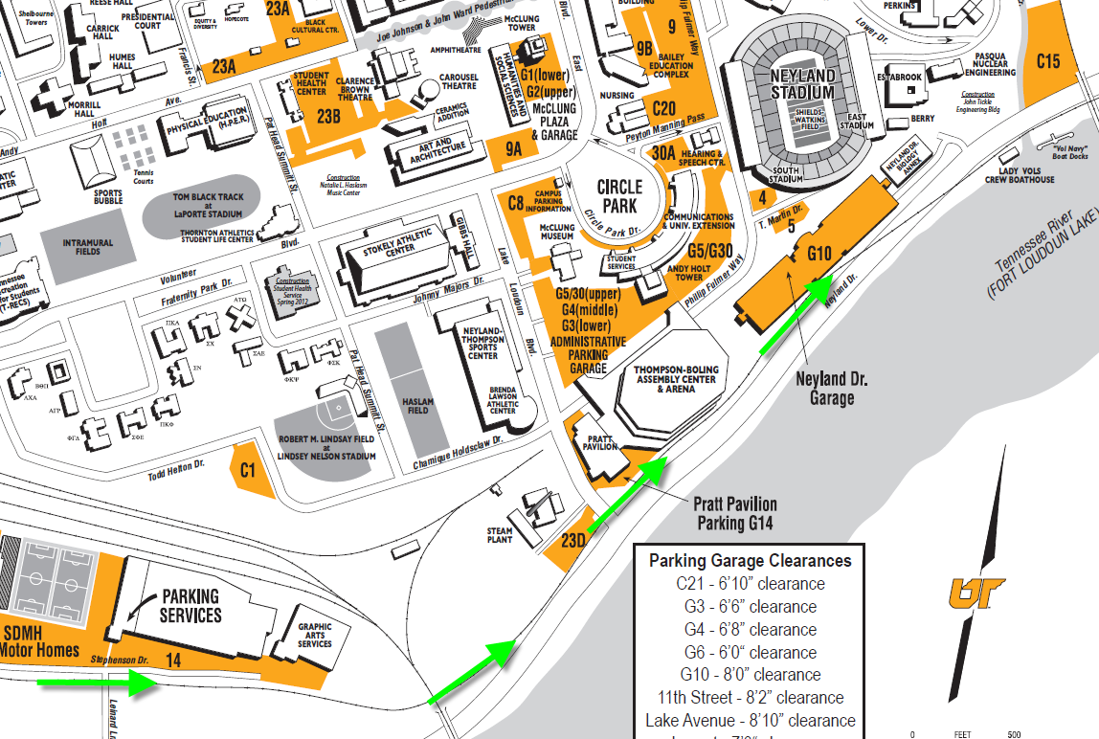
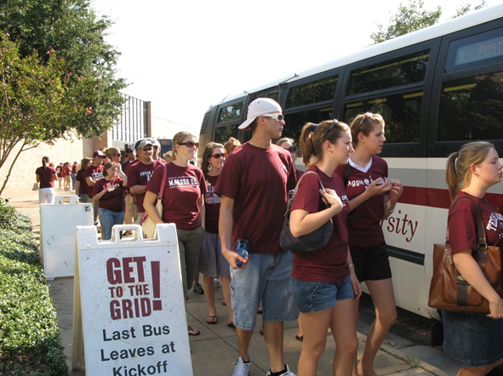
Highlights of Transit Data
6 of 12 schools offer free on-campus shuttle service; varying from golf carts for disabled only to limited bus service from most remote locations. A&M has the most comprehensive on-campus shuttle service with 5 routes
Only A&M runs off-campus game day routes other than park-and-ride (3 others offer park and ride shuttle service)
Shuttle service funded by:
Transportation Dept. (6) -- Athletics (3)
City or local transit authority (3)
Tennessee has shuttle service from RV parking area via rail car

Slide 12
Common Threads
11 of 12 (USC stadium is off-campus) schools require vacating lots but offer no or very limited arrangements for university employee or student parking on game day (UT assures parking in resident areas and some employee lots; A&M accommodates all students and employees with permits)
8 of 12 schools report communication to university employees or students regarding vacating lots for game day via signs, flyers or PMB’s (A&M and Auburn only ones using email)
All schools report towing some number of cars the night before and/or on game day

Slide 13
Common Threads Cont.
All allow vehicles only in parking areas; no tents or other tailgate equipment
Most manage post-game traffic collaboratively and comprehensively, including traffic-direction and changing the direction of travel from usual configuration
Most lock down roads near stadium several hours before kick off

Slide 14
Good Ideas
Low-powered radio station (5-9 miles) broadcasting game day parking info; station ID on signs and published in game day info – Kentucky
High-definition aerial photo taken of 1-mile radius from stadium; disc shared with athletics, police, parking ($3500) – Kentucky
Shuttle fans in from off-site- A&M (free); Alabama ($10); Kentucky ($2); Tennessee ($5)
Trailers are restricted to one area only - LSU

Slide 15
Unique Aspects
Arkansas’ transportation department charged all costs (including per space fee plus wages and food for workers) back to Athletics
Ole Miss RV parking is managed by Physical Plant and location is off-campus at vacated Wal-Mart and Whirlpool buildings
South Carolina stadium is off-campus at fairgrounds
Arkansas confiscates parking pass if donor arrives before posted time then administers one game or up to season-long suspension

Slide 16
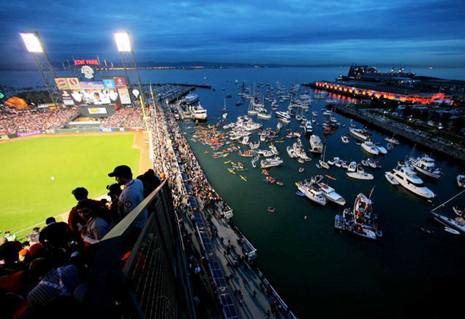
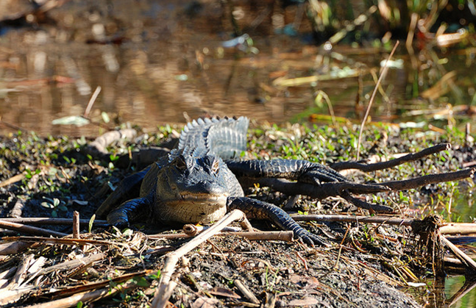
Unique Aspects Cont.
Tennessee has marina tailgate parking
Florida requires customers in donor RV lots to attend 4 of 7 home games to be eligible to renew
“Don’t feed the Gators!” - Florida

Slide 17
SEC Game Day Parking Survey Overview
Transportation Services Customer Advisory Committee

