Slide 1
Rec Center Parking Changes
Effective Spring 2013
TSAC, October 3, 2012

Slide 2
History
Requests from Rec Sports to prevent long term parking in lot north of the Rec Center to leave closest parking available for short term guests
Plan developed in collaboration with Rec Sports
Presentation to TSAC April 2012 – decided to use LPR technology in this lot
Equipment ordered and implementation set for Spring 2013 to limit parking to 2 hours on weekdays from 6AM – 5PM

Slide 3
Fixed LPR
Pros
Encourages turnover of lot for Rec Center customers
Automated notification of stays over 2 hours
Includes scofflaw screening
Provides pictorial evidence when vehicles are in violation
Cons
May limit full utilization of spaces
Customers desiring to stay > 2 hours must park in an area other than 100h
Not all vehicles/plates will be able to be ‘read’
Easy to manipulate (cover portion of LP or cover camera)
Will require frequent enforcement
Cost: $80K LPR installation
Maintenance: Current PBS upkeep, camera & infrastructure upkeep

Slide 4
Communication Plan
Signage
Public Service Announcements
  TAMUTimes
  Faculty, Staff and Students – Bulk email
  Rec Center Membership email
  Rec Center Screens
Website

Slide 5
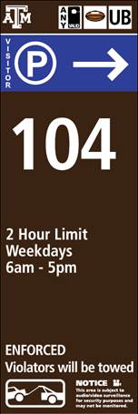
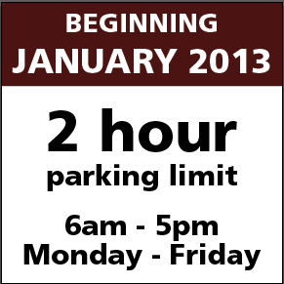
Signage

Slide 6
Public Service Announcement
SCOPE OF PROJECT:
In order to ensure that Lot 104 ( formerly 100h) is used for Rec Center customers only, a 2 hour limit for the lot Monday – Friday, 6 AM – 5PM, will be in effect beginning with the spring semester of 2013.
This will allow permit holders to park in lot 104 for two hours or allow individuals without a permit to purchase parking for two hours at the pay-by-space machines in the lot.
ALTERNATE PARKING:
Rec Center customers without a valid permit may pay to park in lot 100g or West Campus Garage should more time be needed http://transport.tamu.edu/parking/maps/visitor.pdf
Customers with any valid permit may also park in any section of lot 100 and in West Campus Garage after 4:00 pm M-F for free.

Slide 7
Questions?

