Slide 1

Parking Garage Feasibility Study
TSAC
December 5, 2012

Slide 2
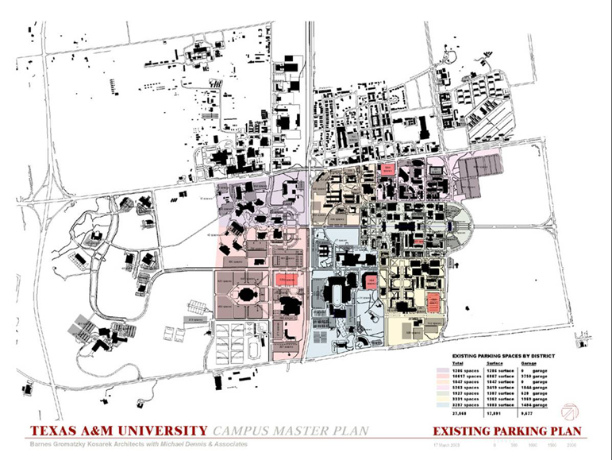

Study Elements
$32,500,000 garage project in the 2015 System Capital Plan
Existing Masterplan
How big should the garage be?
Where should garage be placed?

Slide 3
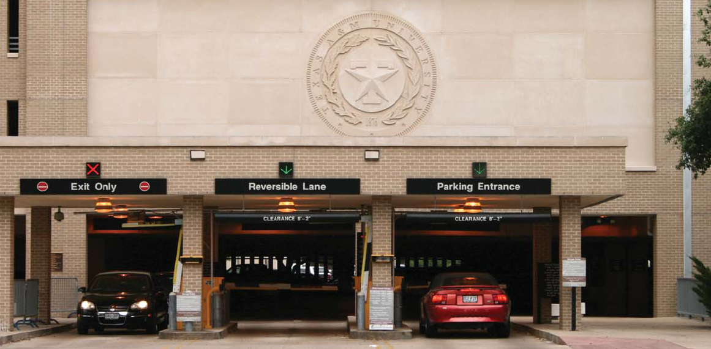
Study Elements
Campus supply / demand
Site assessment studies
Opinions of cost
Next steps

Slide 4
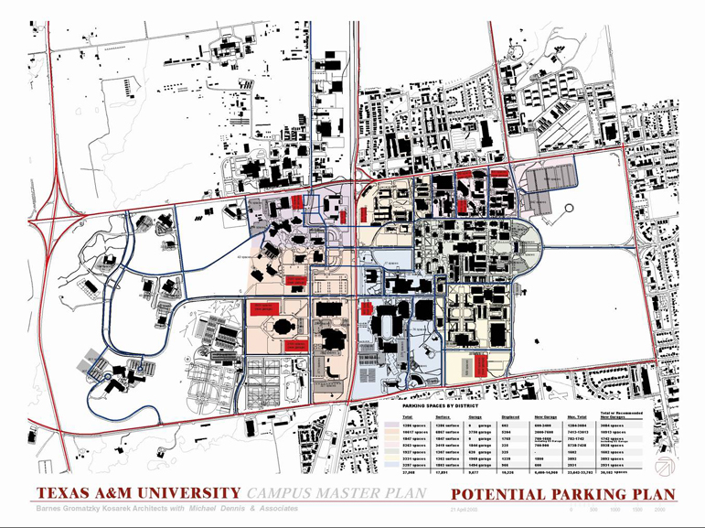
Campus Masterplan

Slide 5
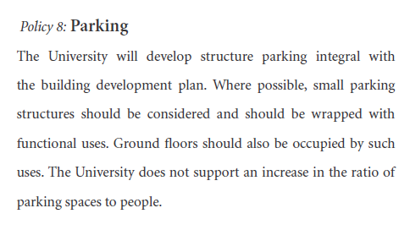
Supply / Demand Study
Park+ model
Existing deficiencies
Latent demand
Five year planning horizon

Slide 6
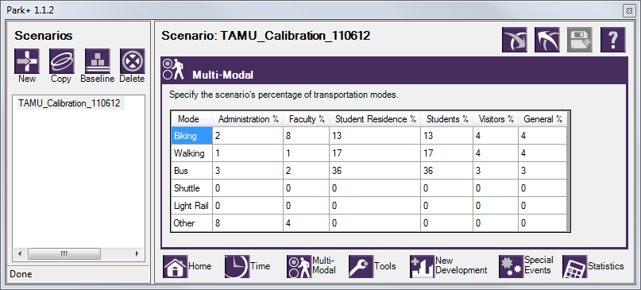
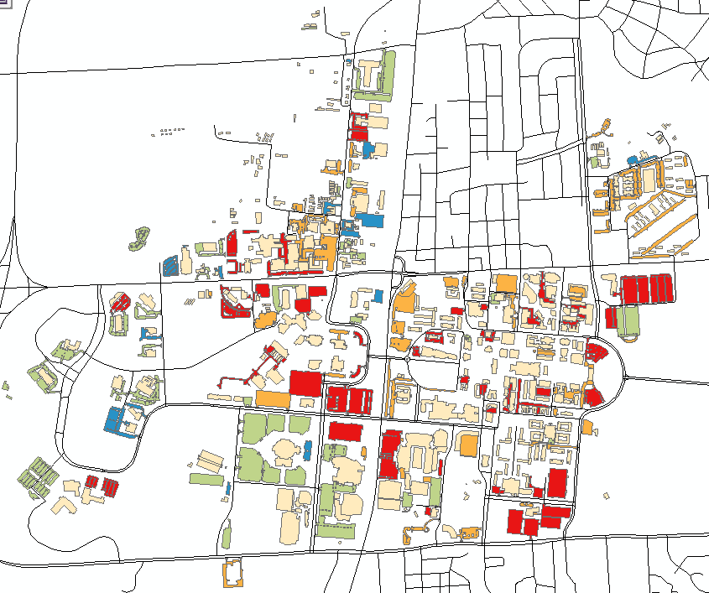

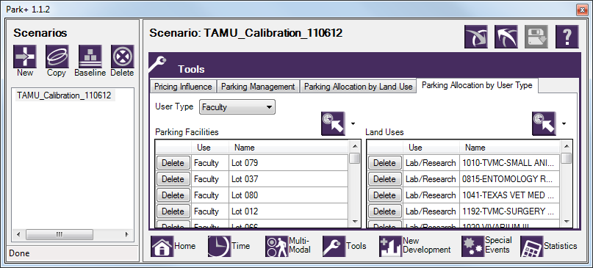
Supply / Demand Study

Slide 7
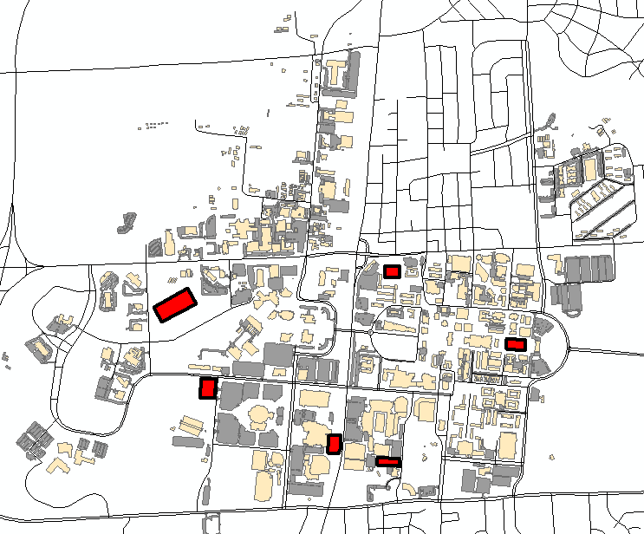
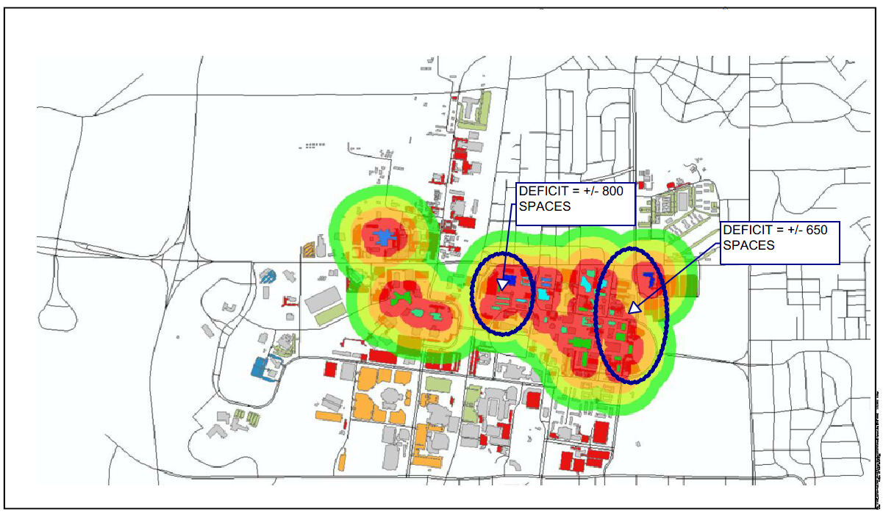
Supply / Demand Study

Slide 8
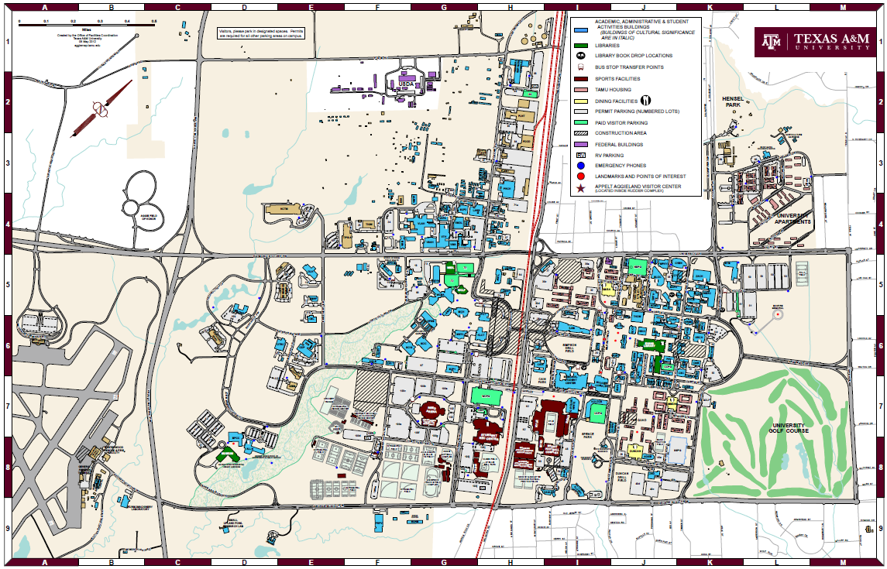
Site Assessments

Slide 9
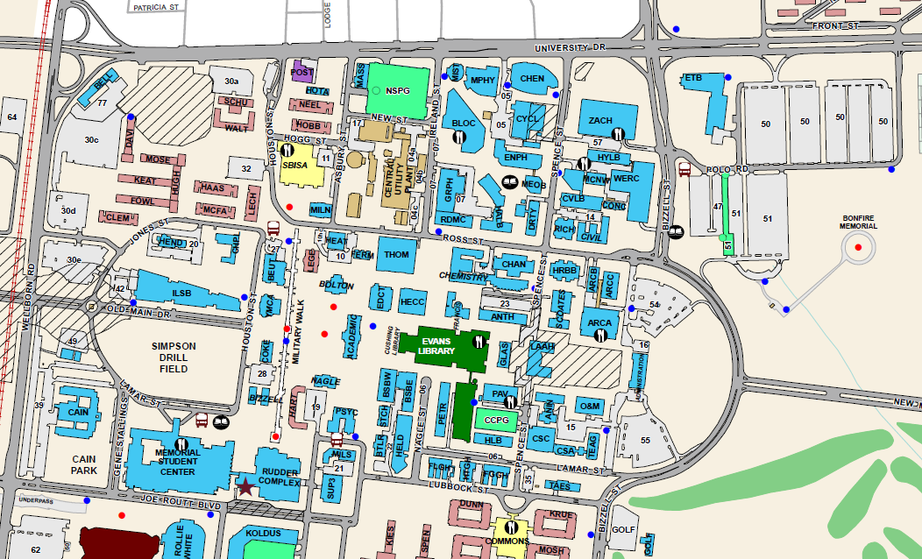
Site Assessments

Slide 10
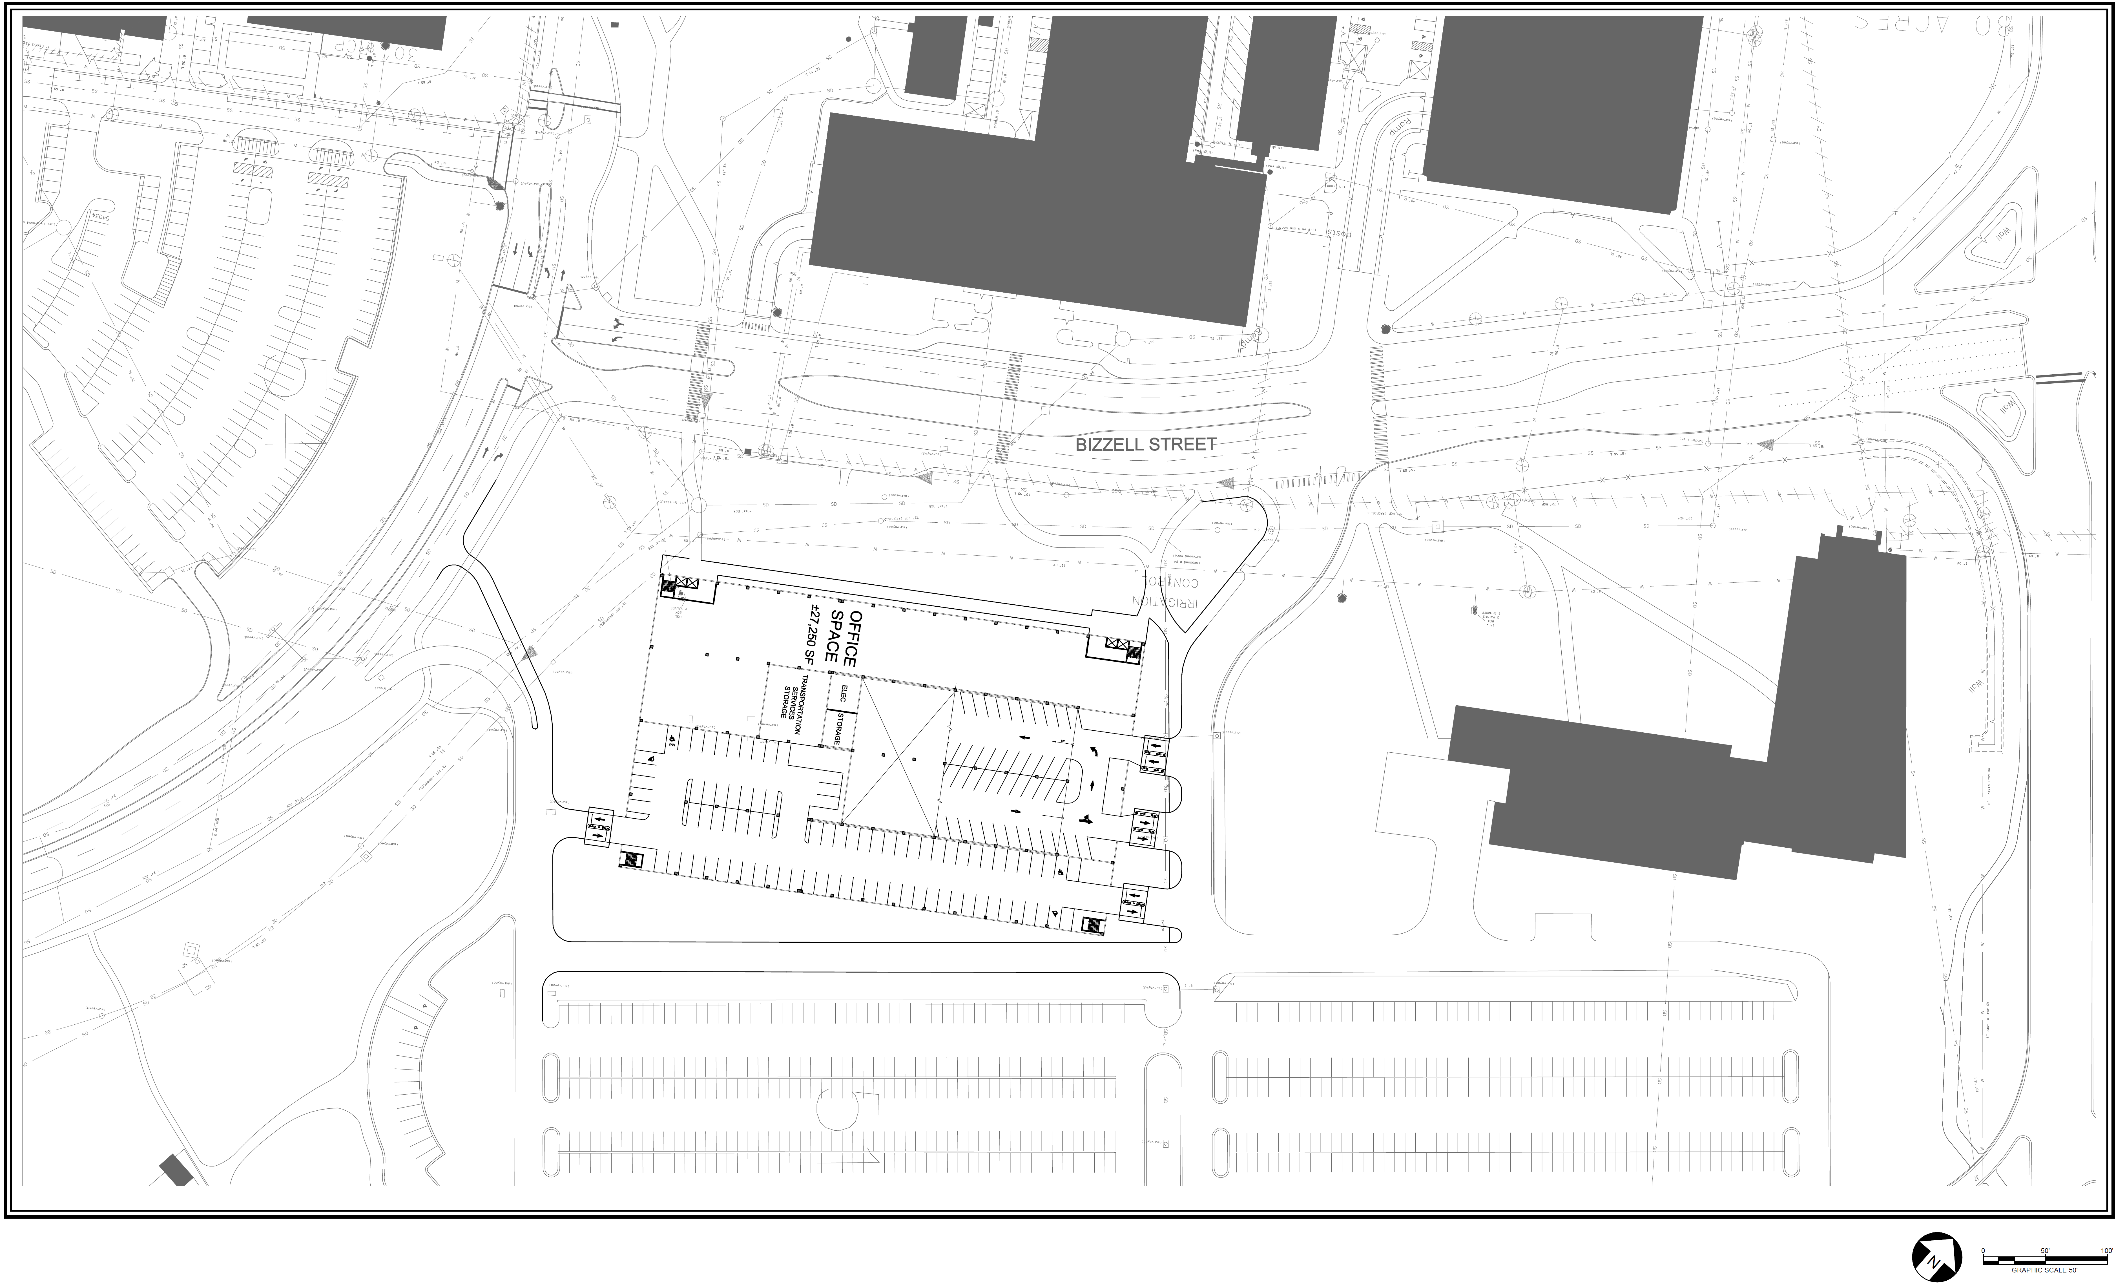
Lot 47 Garage

Slide 11
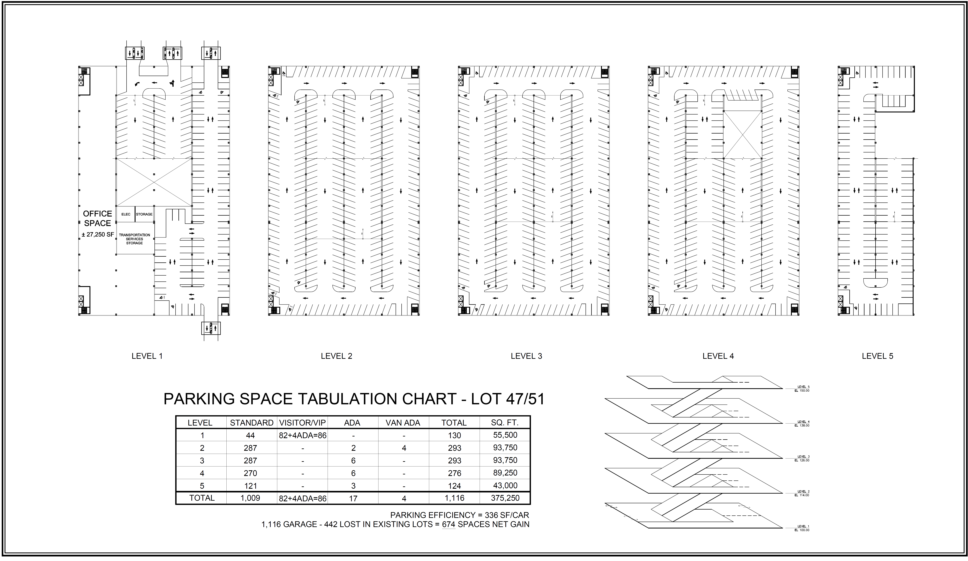
Lot 47 Garage

Slide 12
Lot 47 Garage
1,116 spaces, 336 sf/space, 5- levels above grade, 4-bay Parking Structure with ± 27,250 SF of proposed office space. 674 net spaces are provided
Summary of Lot 47 Structure:
Five parking levels at and above existing Lot 47 and a portion of Lot 51
Four 58-ft wide parking bays (double loaded)
Two-way head parking in first floor bay utilizing 10’ wide spaces
One-way angled controlled access parking
Segregated first floor bay entry / exit from the North and South loop roads
Single controlled access entry /exit from the North loop road
Parking on the ramp with flat end bay parking
“Pros” of Lot 47 Structure:
Provides efficient long-span construction parking that meets the future deficiency needs
Entry / exit location is off two-way loop roads and adjacent to the existing engineering area surface lots
Allows for a flexible and usable office space component on the ground floor
Provides for segregated and separately controlled first floor bay
Provides visitor parking in excess of what is currently provided
Apparent consistency with the University Master Plan
Avoids major existing utilities
“Cons” of Lot 47 Structure:
Potential pedestrian/vehicular conflict at the entry / exit gates
Parking on sloped ramps
Integrating office space into existing parking area is more costly than standalone office space in another building type

Slide 13
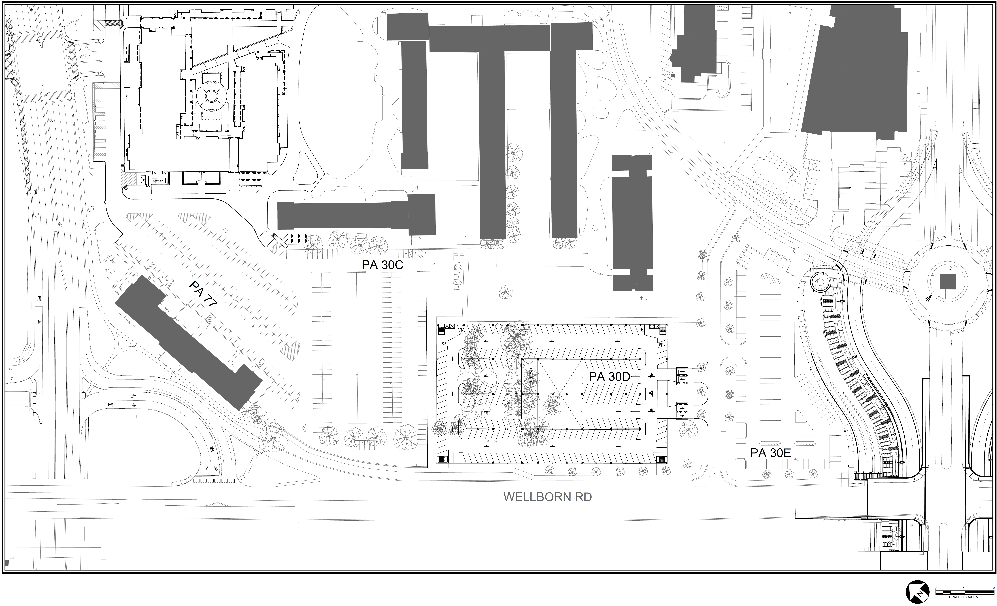
Lot 30d Garage

Slide 14
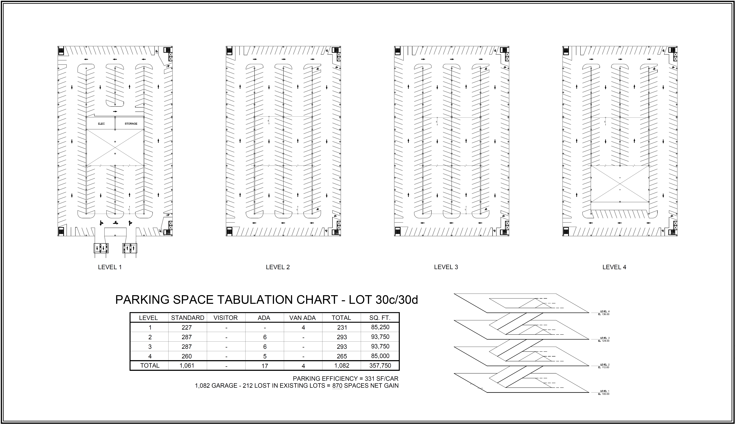
Lot 30d Garage

Slide 15
Lot 30d Garage
1,082 spaces, 331 sf/space, 4- levels above grade, 4-bay Parking Structure. 870 net spaces are provided
Summary of Lot 30d Structure:
Four parking levels at and above existing Lot 30d and a portion of Lot 30c
Four 58-ft wide parking bays (double loaded)
One-way angled controlled access parking
Single controlled access entry /exit from the South loop road
Parking on the ramp with flat end bay parking
“Pros” of Lot 30d Structure:
Provides efficient long-span construction parking that meets the future deficiency needs
Entry / exit location is off two-way loop roads and adjacent to the existing Northside area surface lots
Provides parking on the perimeter of campus
Apparent consistency with the University Master Plan
Avoids major existing utilities
No pedestrian/vehicular conflict at the entry / exit gates
“Cons” of Lot 30d Structure:
Minor utilities (water, storm sewer, and sanitary sewer will need to be relocated)
Existing trees will need to be removed
The existing storm drainage area will need to be “structured” and “spanned” by the proposed garage
Parking on sloped ramps

Slide 16
Campus Masterplan

Slide 17
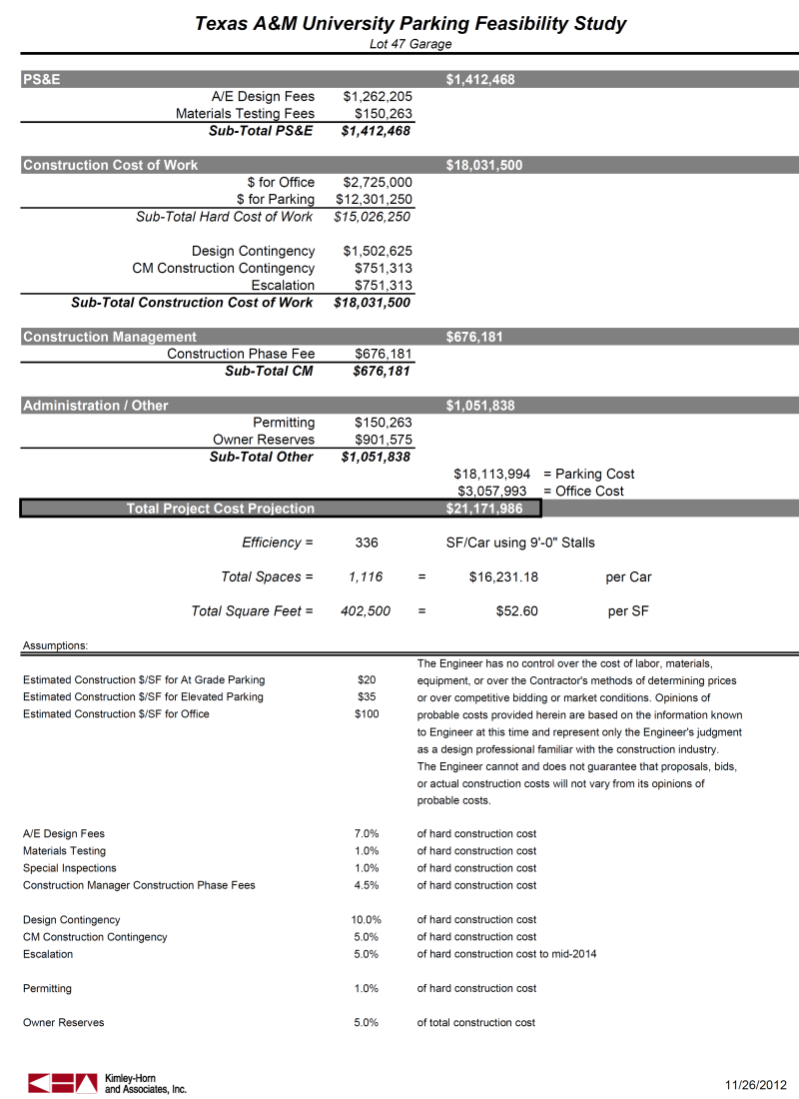
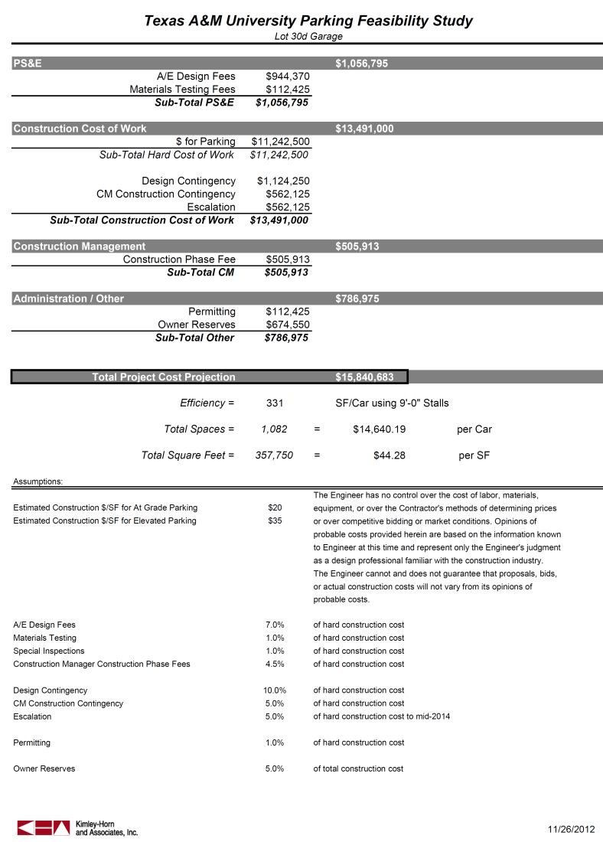
Opinions of Cost
$21,171,986
+
$15,840,683
=
$37,012,669

Slide 18
Next Steps
Begin project programming
Begin conceptual and final design for projects

