Slide 1
TSAC Meeting
February 01, 2012

Slide 2

Fleet
  80 buses
Employees
  275 student drivers
  20 budgeted drivers
  8 supervisors
  2 assistant managers
  1 administrative assistant
  1 senior office assistant
Services
  Fixed Routes
    16 routes (7 on-campus/9 off-campus)
  Charters
Fiscal Year 2011
  Fixed Route Ridership
    4,917,172 rides
  Charters
    2,592 done
  Expenses
    Fuel: $1,110,058
    Maintenance: $1,143,406
    Oil: $44,155

Slide 3
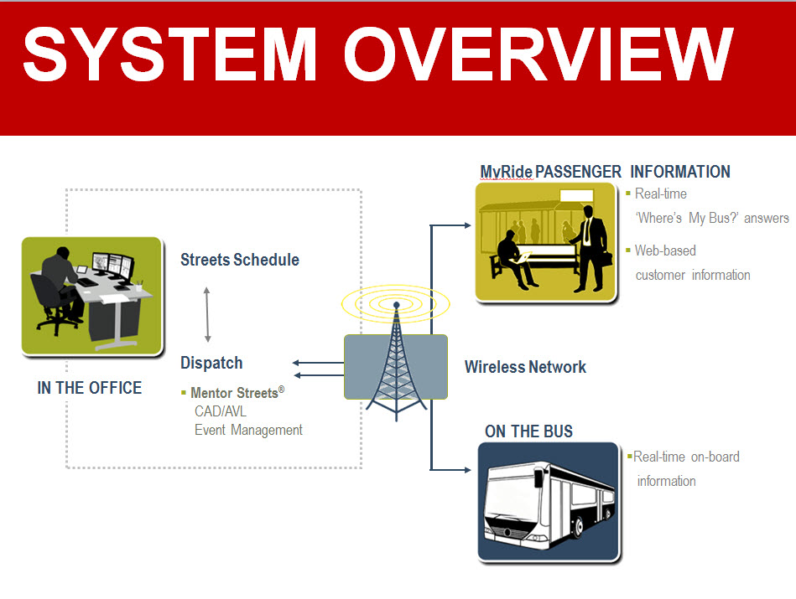
Mentor

Slide 4
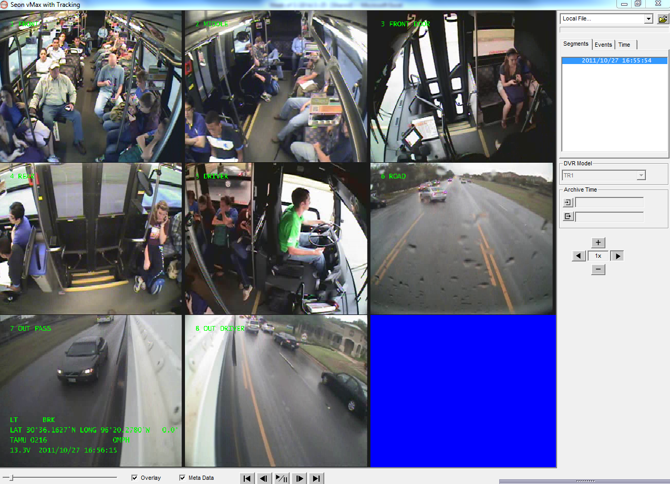
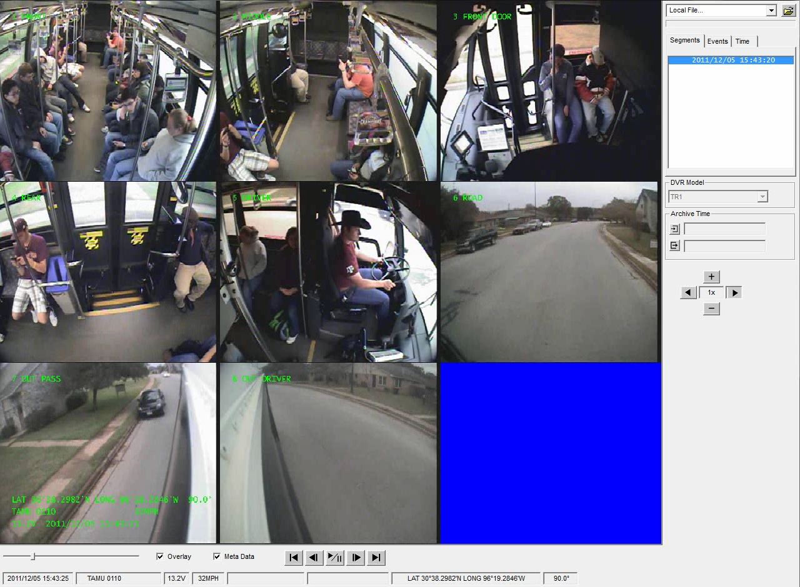
Camera Footage

Slide 5
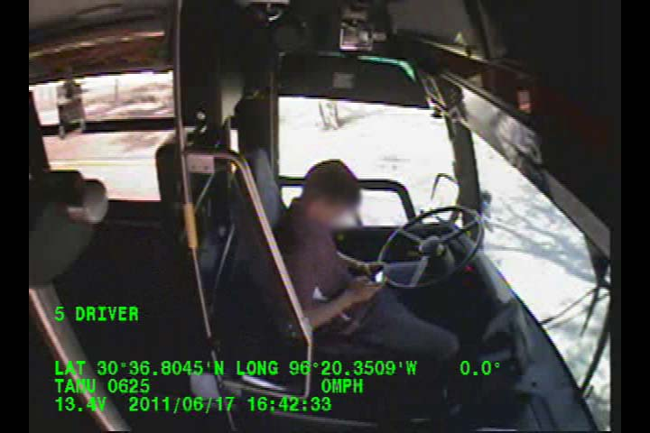
Camera Footage

Slide 6
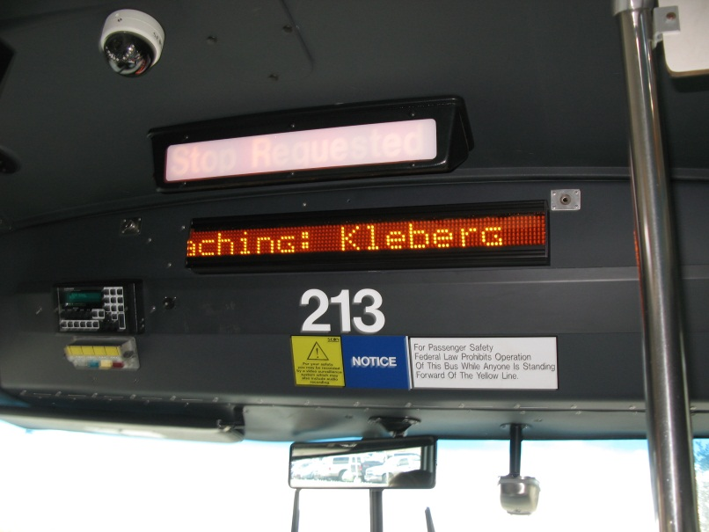
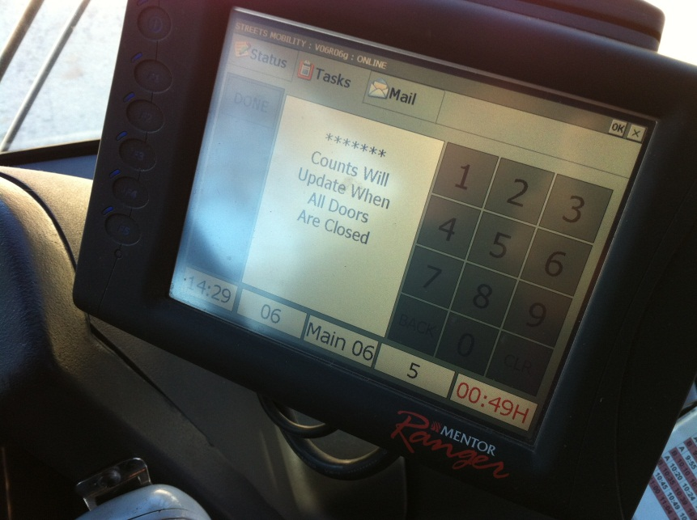
Mentor Software/Equipment
Ranger-on board computer terminal
APC-Automated Passenger Counters

Slide 7
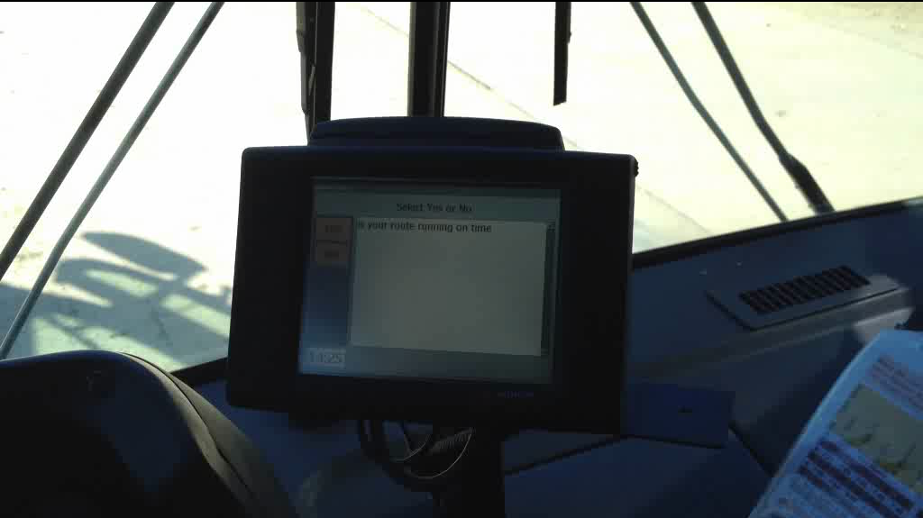
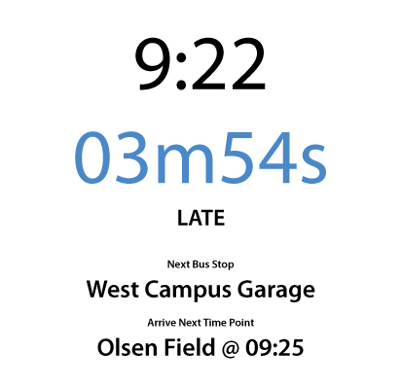
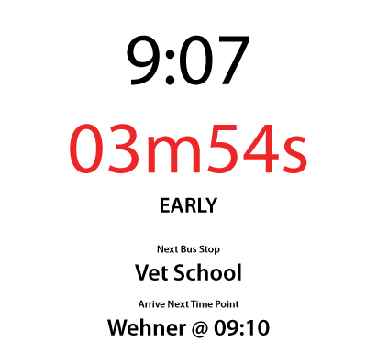
Mentor Software/Equipment

Slide 8
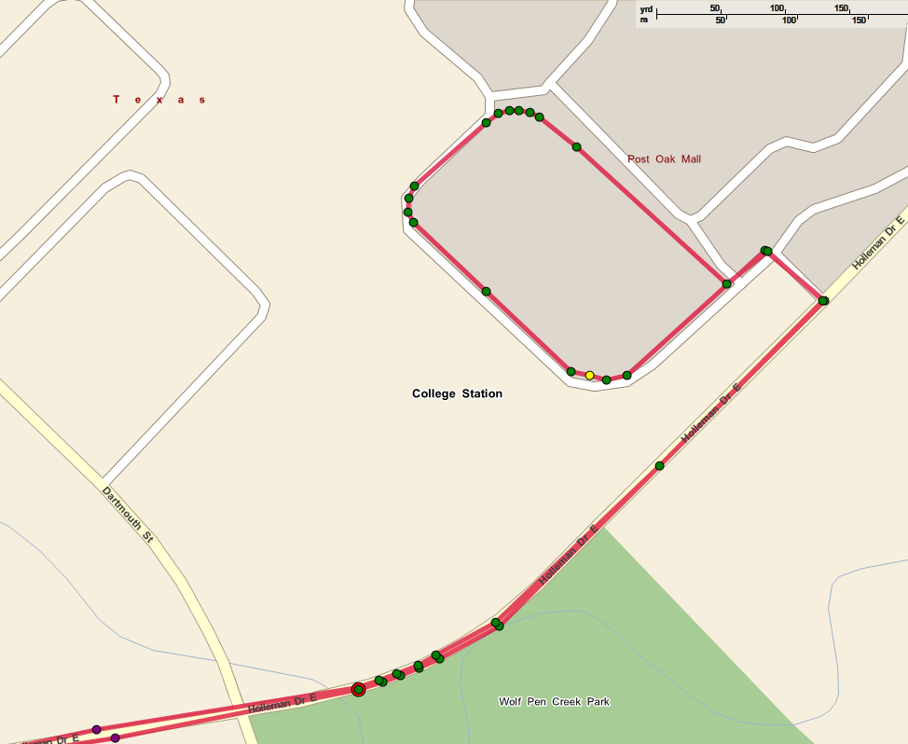
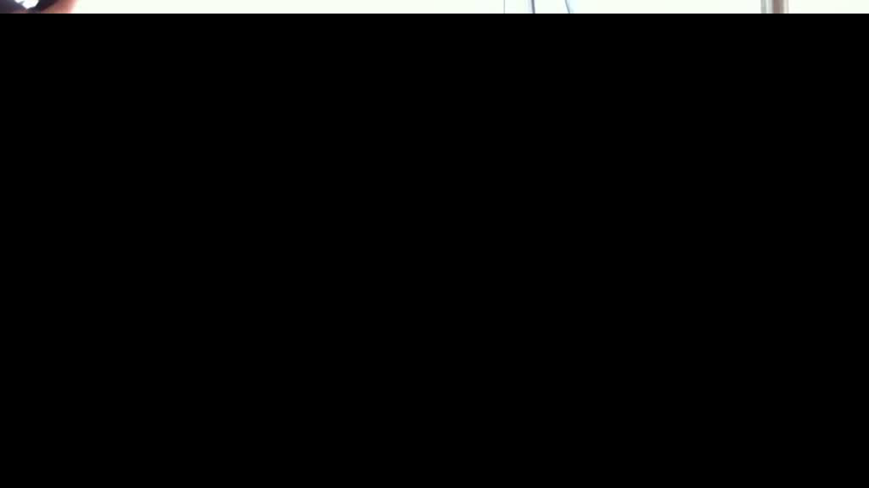
Interior Stop Annunciator

Slide 9
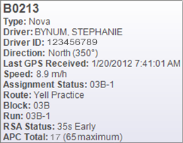
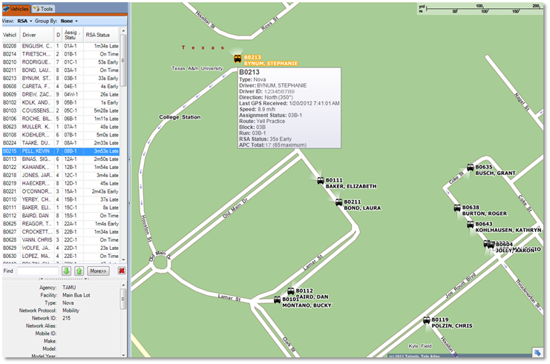
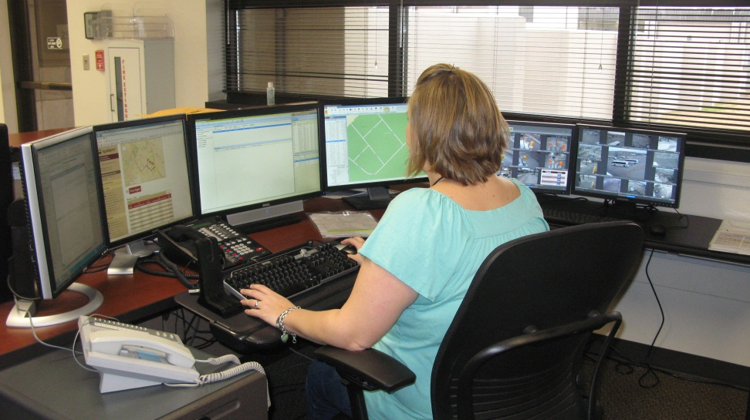
Dispatch App/Tracking of Bus Units

Slide 10
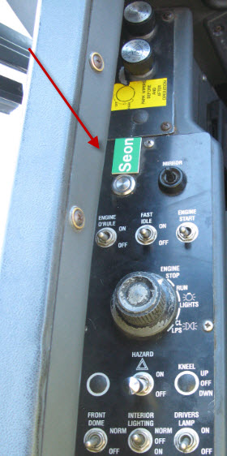
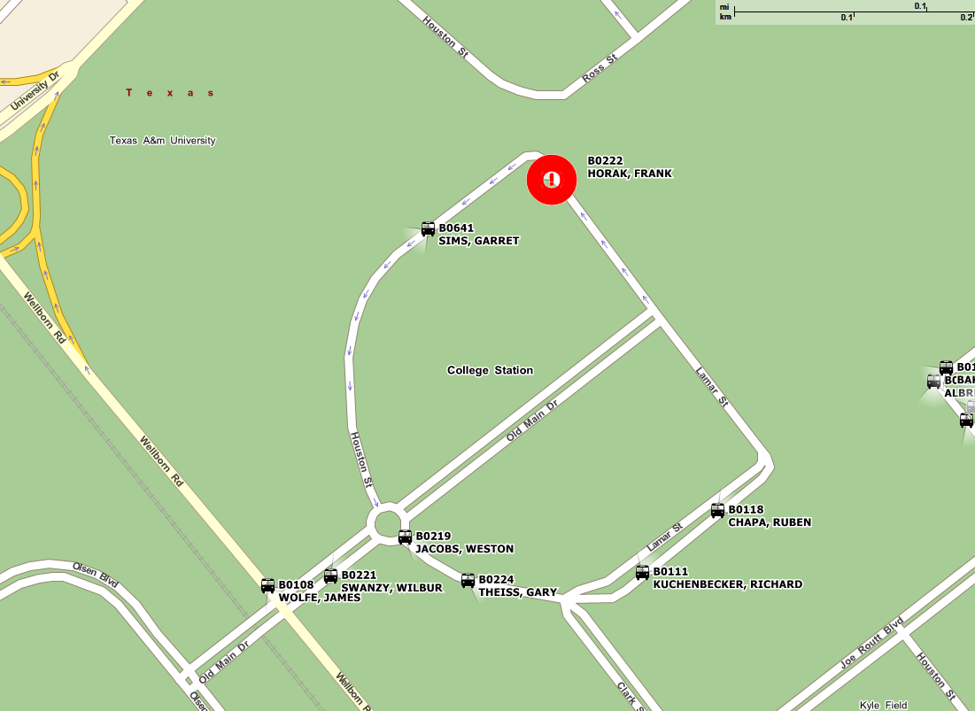
Driver Alerts & Dispatch

Slide 11
MSC Route Schedule Adherence

Slide 12
Route 36:Passengers and Late Buses

Slide 13
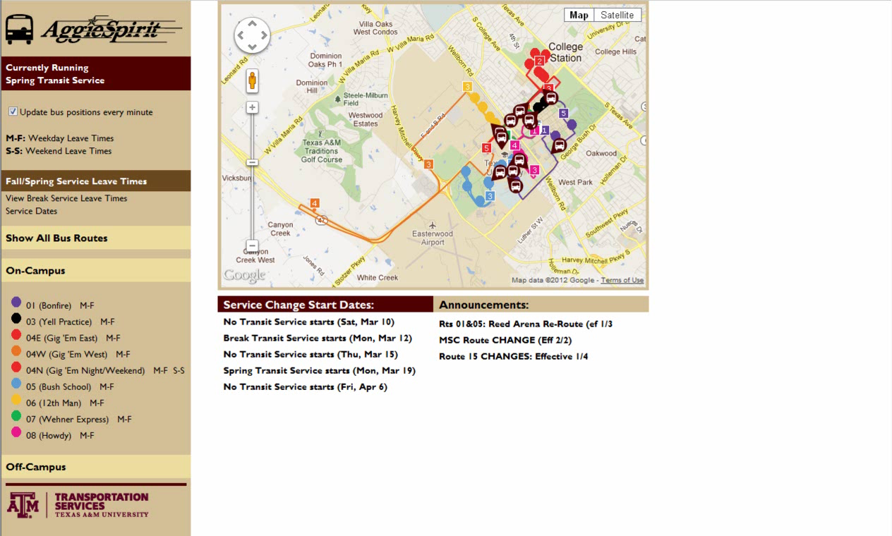
Customer View
Transportation Services Site (transport.tamu.edu)

Slide 14
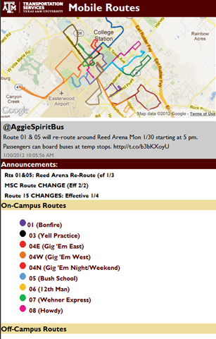
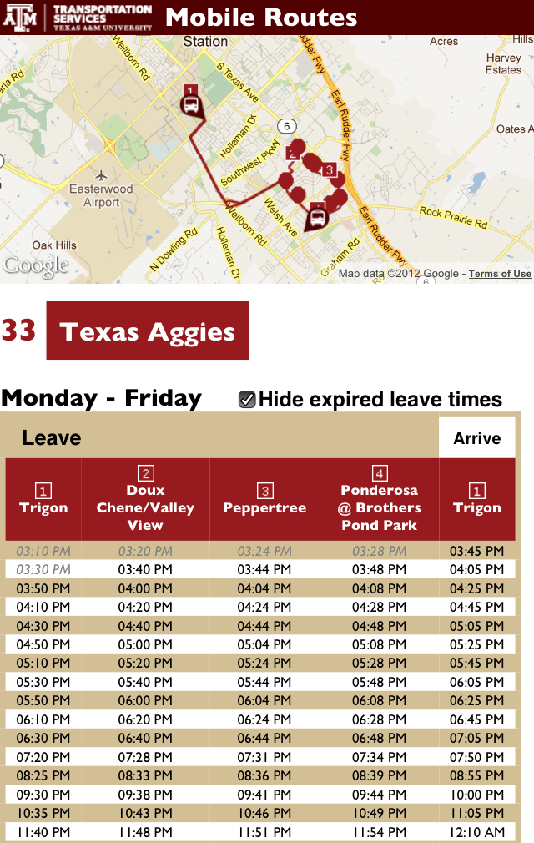
Customer View
Mobile Site (m.tamu.edu)

Slide 15
Mentor & Transit’s Future
Route Planning
  Timing of routes
  Route mapping options
  See patterns of RR crossings, high/low traffic times, etc.
  Determine number of units per route
Improve Transit Service

Slide 16
Questions?
Lana Wolken
hwolken@tamu.edu
Justin Tippy
jtippy@tamu.edu
Randy Davidson
ardavidson@tamu.edu

