Slide 2
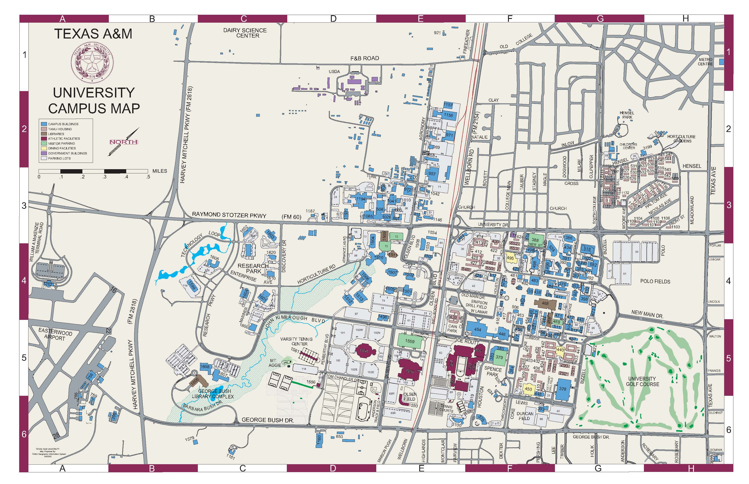

Slide 3
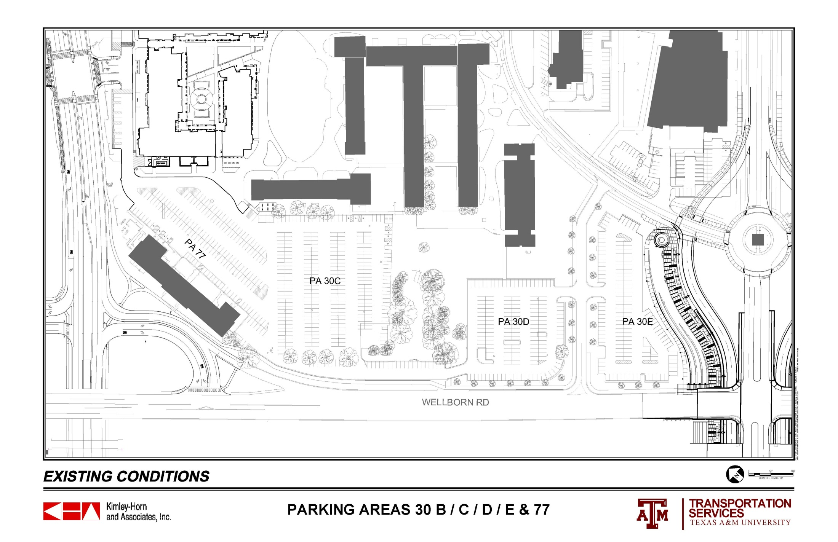
 |  | 30 A | 30 B | 30 C | 30 D | 30 E | 77 | TOTALS
ORIGINAL COUNT |  | 109 | 57 | 366 | 151 | 217 | 153 | 1053
CURRENT COUNT |  | 109 | 18 | 351 | 151 | 134 | 148 | 911

Slide 4
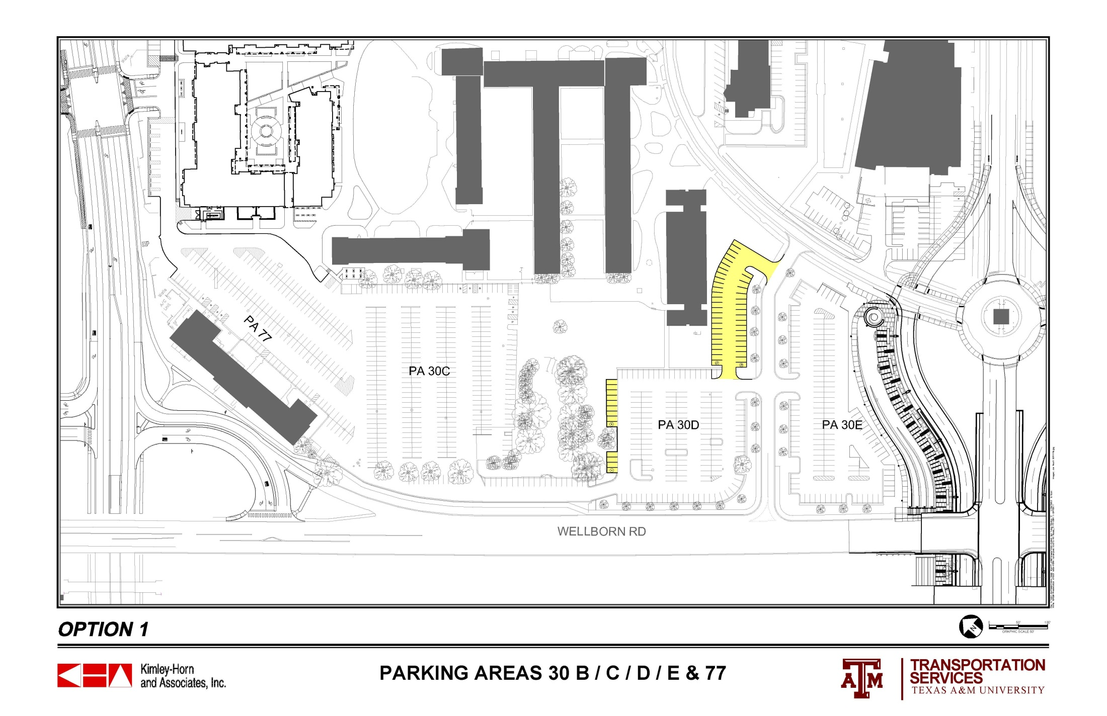
 |  | 30 A | 30 B | 30 C | 30 D | 30 E | 77 | TOTALS
ORIGINAL COUNT |  | 109 | 57 | 366 | 151 | 217 | 153 | 1053
CURRENT COUNT |  | 109 | 18 | 351 | 151 | 134 | 148 | 911
OPTION 1 |  | 109 | 18 | 351 | 203 | 134 | 148 | 963

Slide 5
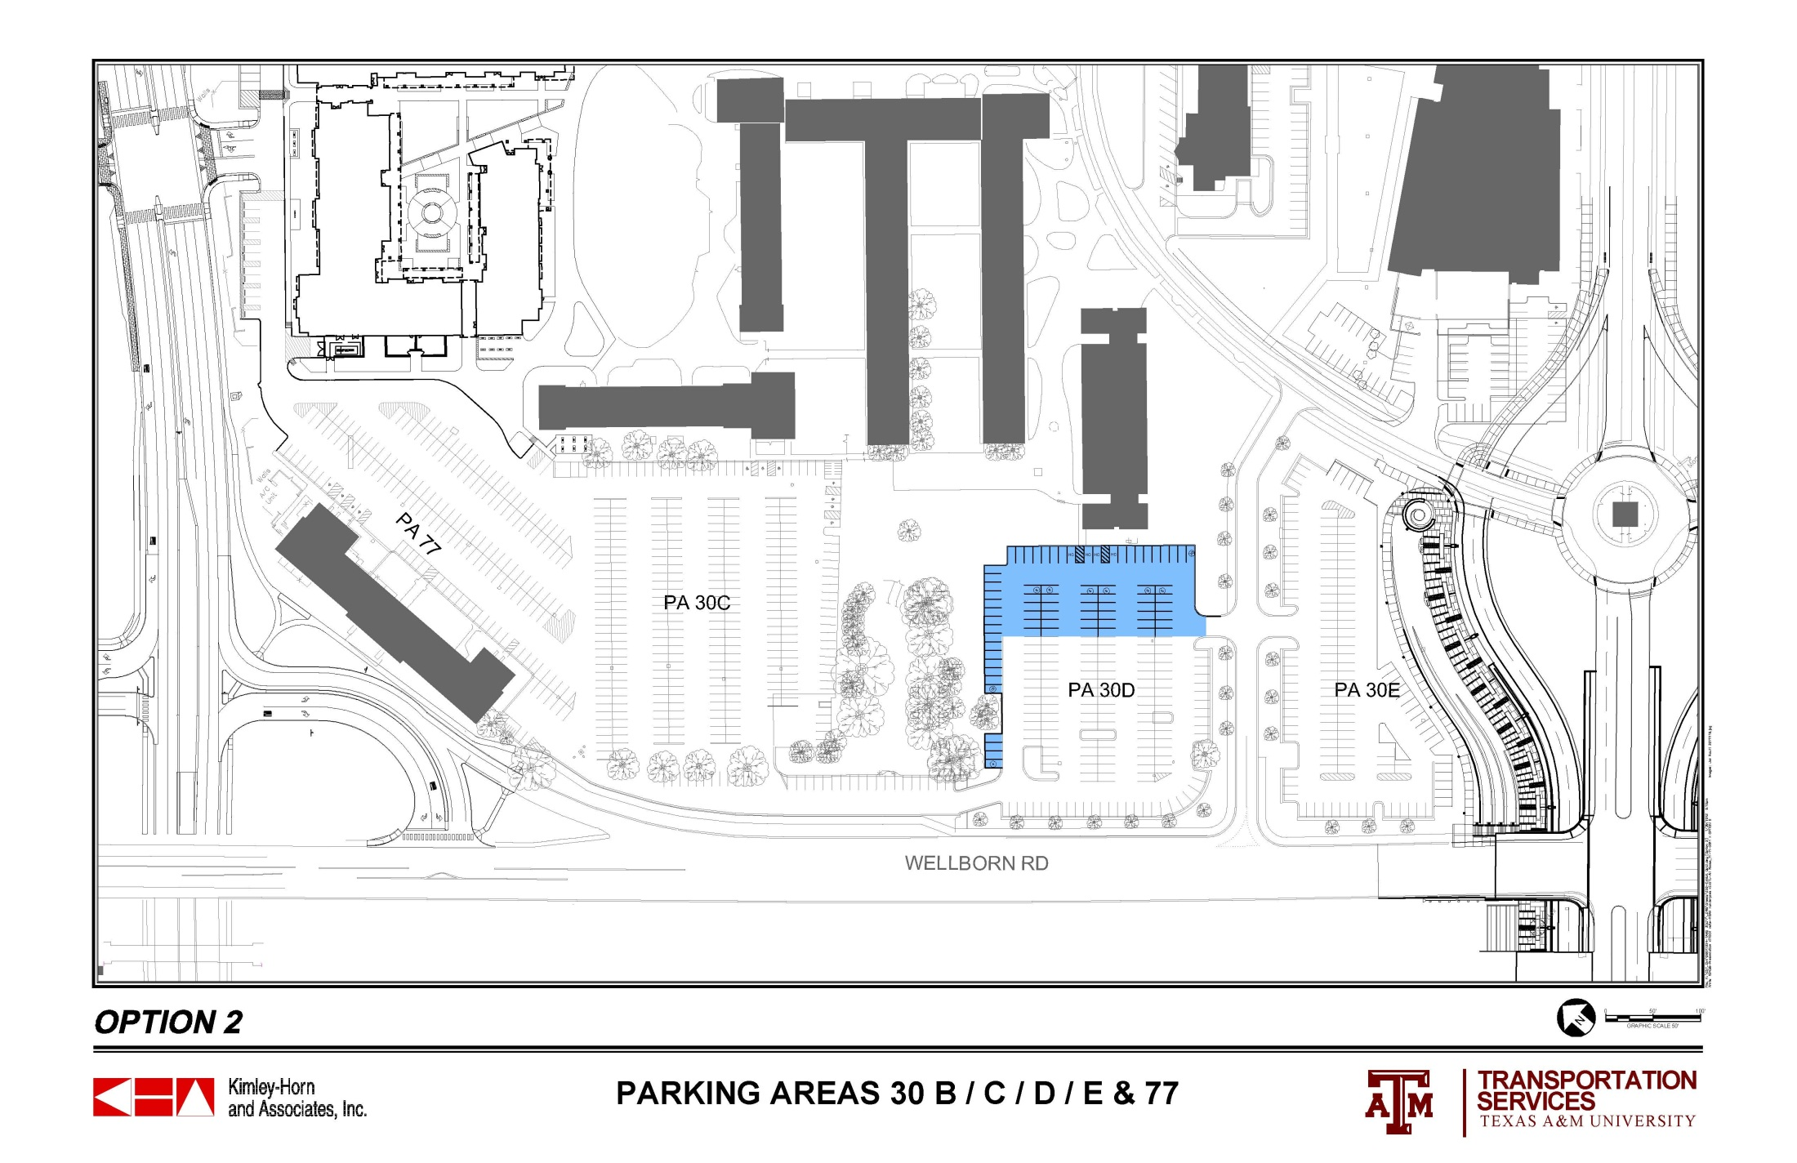
 |  | 30 A | 30 B | 30 C | 30 D | 30 E | 77 | TOTALS
ORIGINAL COUNT |  | 109 | 57 | 366 | 151 | 217 | 153 | 1053
CURRENT COUNT |  | 109 | 18 | 351 | 151 | 134 | 148 | 911
OPTION 2 |  | 109 | 18 | 351 | 204 | 134 | 148 | 964

Slide 6
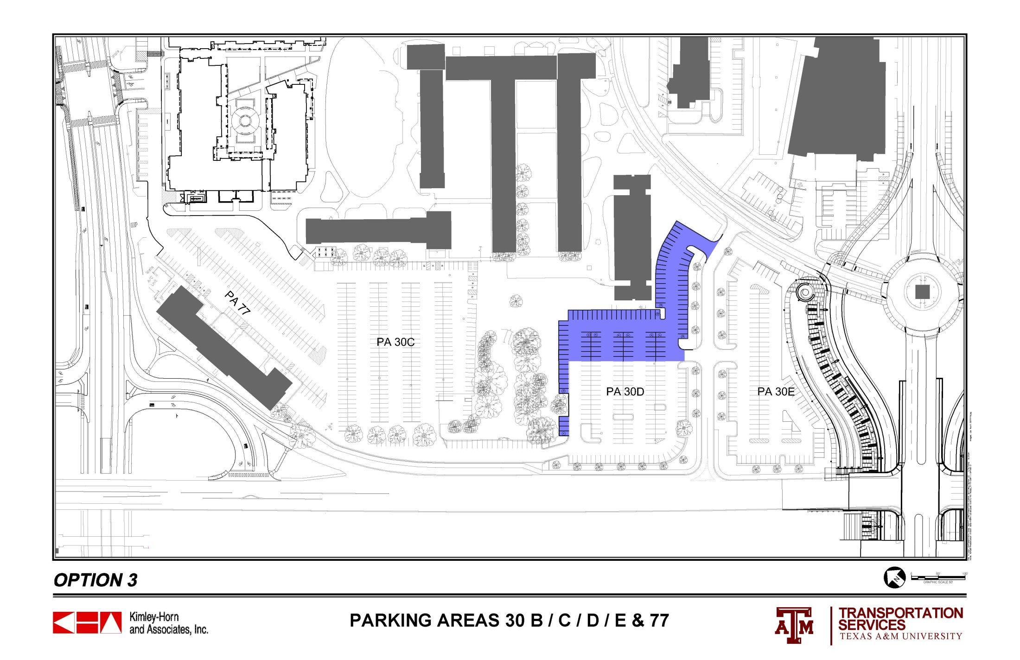
 |  | 30 A | 30 B | 30 C | 30 D | 30 E | 77 | TOTALS
ORIGINAL COUNT |  | 109 | 57 | 366 | 151 | 217 | 153 | 1053
CURRENT COUNT |  | 109 | 18 | 351 | 151 | 134 | 148 | 911
OPTION 3 |  | 109 | 18 | 351 | 238 | 134 | 148 | 998

Slide 7
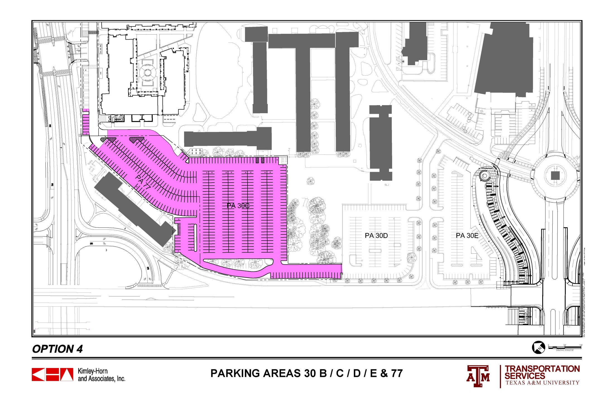
 |  | 30 A | 30 B | 30 C | 30 D | 30 E | 77 | TOTALS
ORIGINAL COUNT |  | 109 | 57 | 366 | 151 | 217 | 153 | 1053
CURRENT COUNT |  | 109 | 18 | 351 | 151 | 134 | 148 | 911
OPTION 4 |  | 109 | 26 | 384 | 149 | 134 | 92 | 894

Slide 8
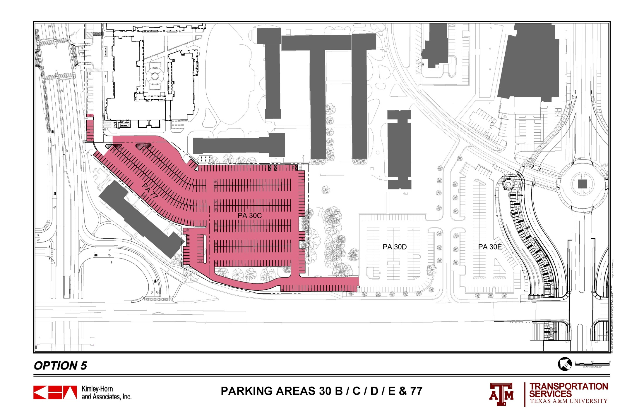
 |  | 30 A | 30 B | 30 C | 30 D | 30 E | 77 | TOTALS
ORIGINAL COUNT |  | 109 | 57 | 366 | 151 | 217 | 153 | 1053
CURRENT COUNT |  | 109 | 18 | 351 | 151 | 134 | 148 | 911
OPTION 5 |  | 109 | 26 | 390 | 151 | 134 | 94 | 904

Slide 9
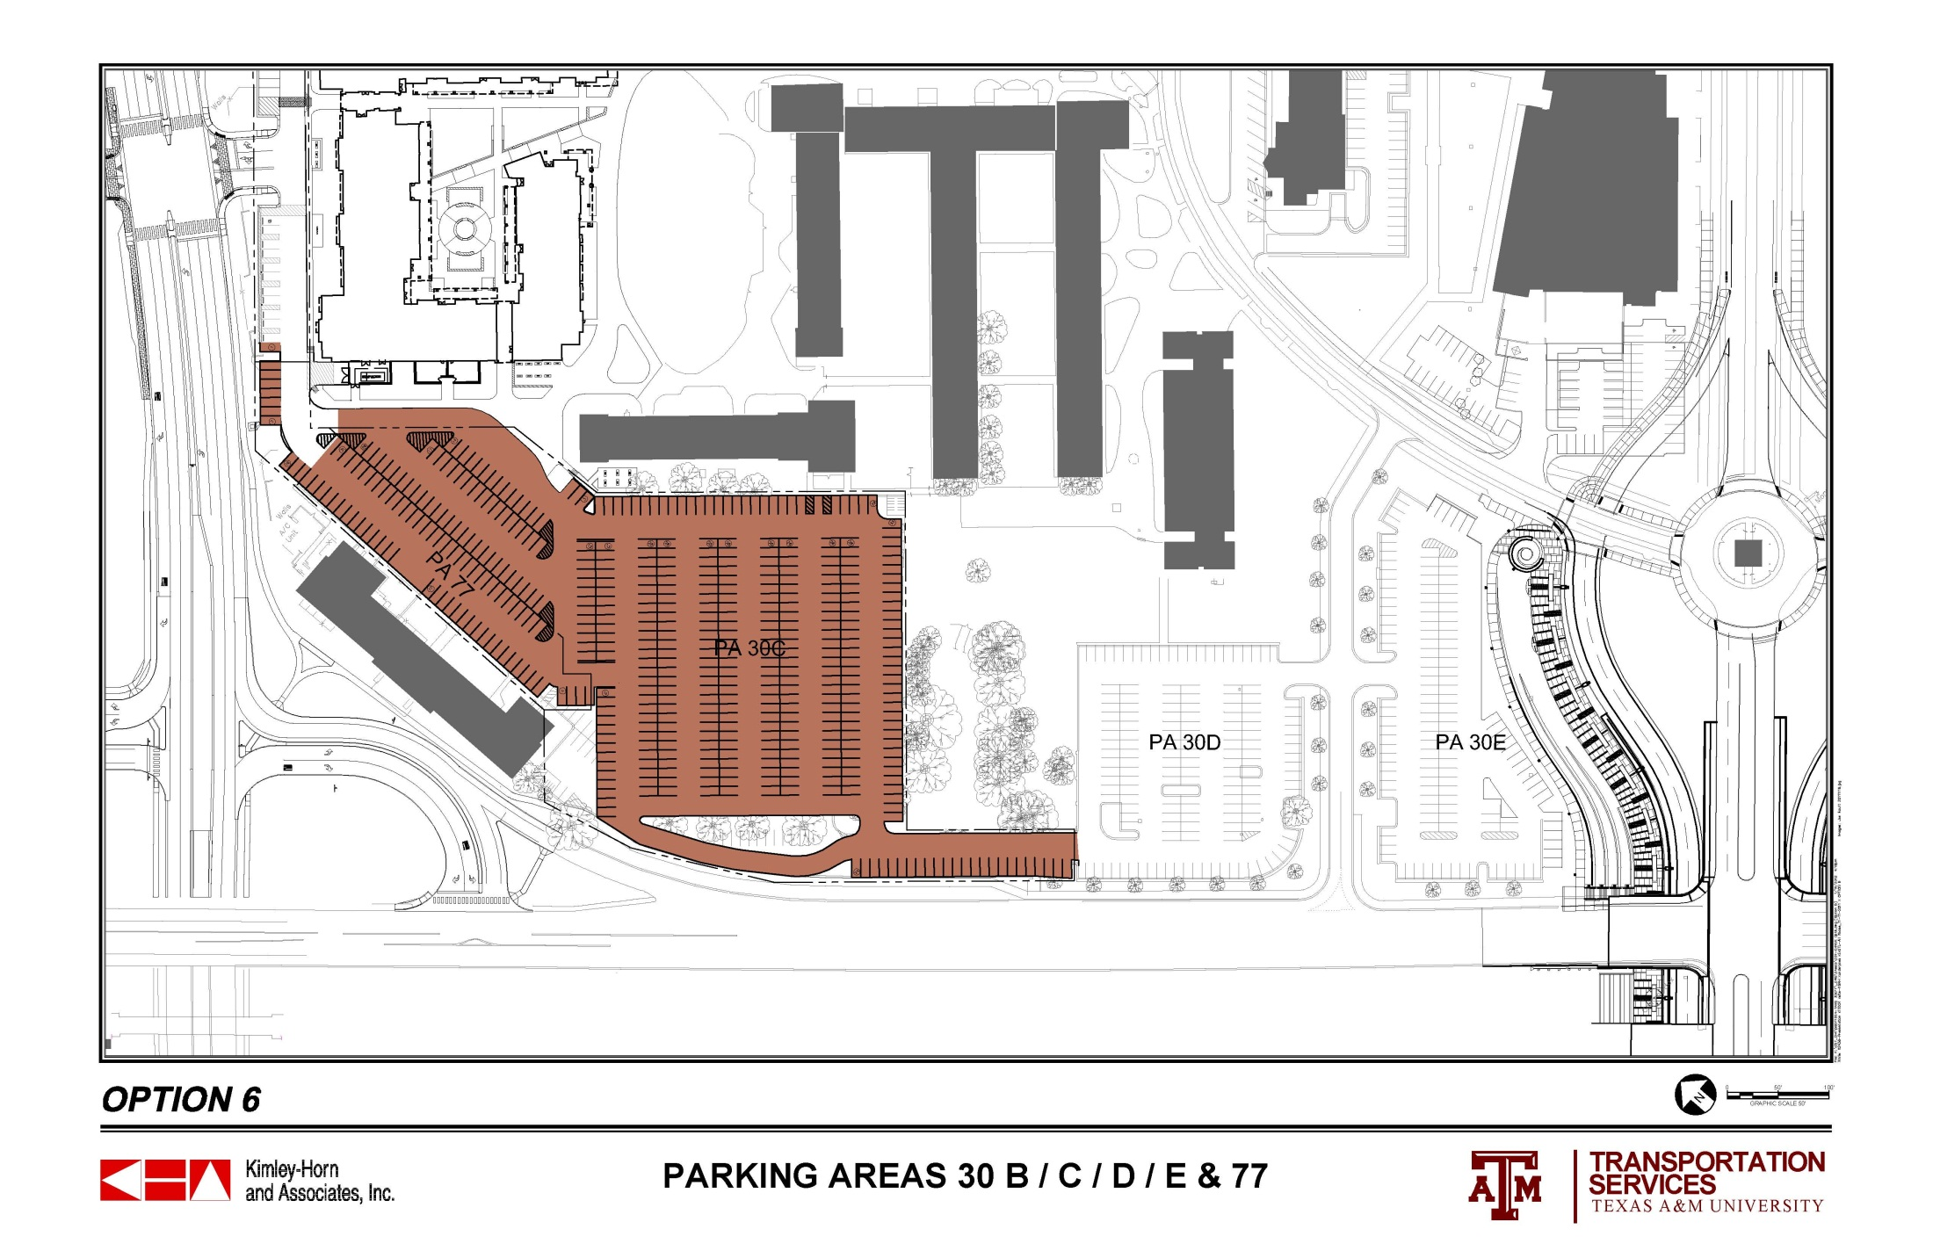
 |  | 30 A | 30 B | 30 C | 30 D | 30 E | 77 | TOTALS
ORIGINAL COUNT |  | 109 | 57 | 366 | 151 | 217 | 153 | 1053
CURRENT COUNT |  | 109 | 18 | 351 | 151 | 134 | 148 | 911
OPTION 6 |  | 109 | 19 | 410 | 149 | 134 | 73 | 894

Slide 10
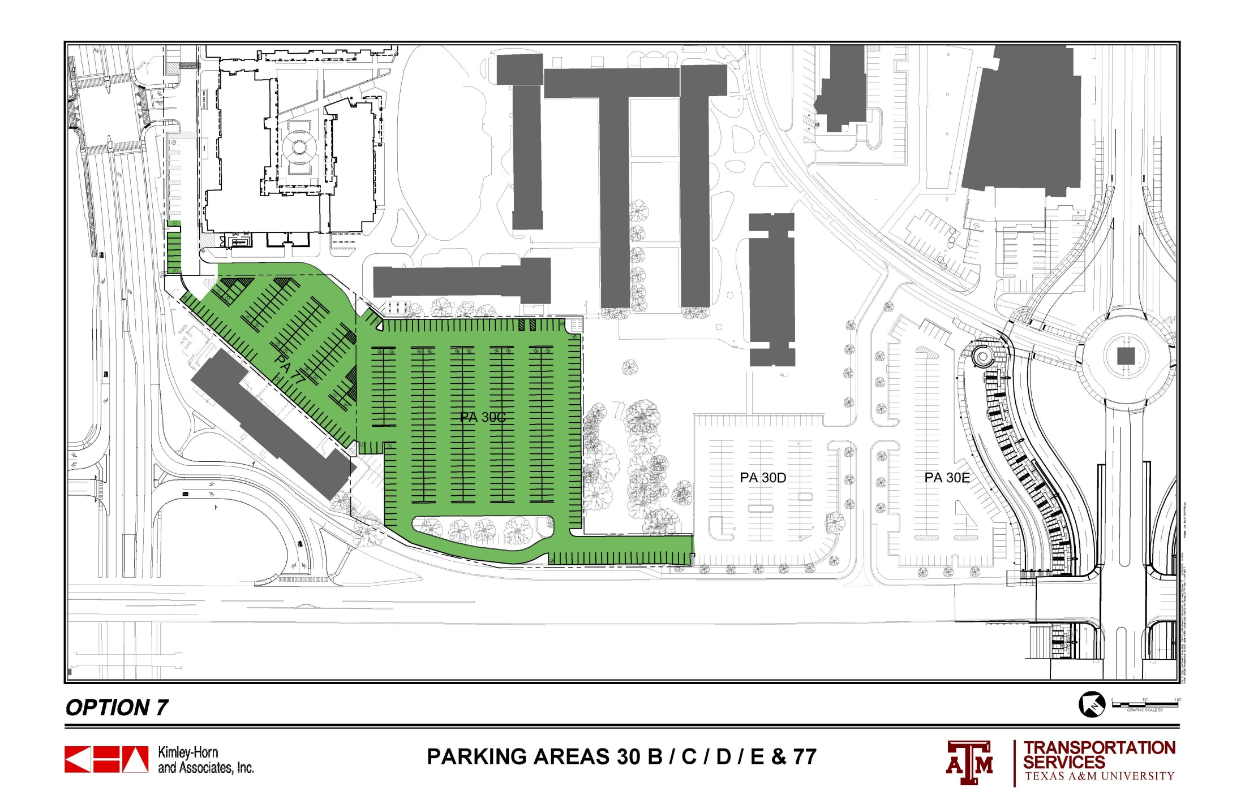
 |  | 30 A | 30 B | 30 C | 30 D | 30 E | 77 | TOTALS
ORIGINAL COUNT |  | 109 | 57 | 366 | 151 | 217 | 153 | 1053
CURRENT COUNT |  | 109 | 18 | 351 | 151 | 134 | 148 | 911
OPTION 7 |  | 109 | 26 | 339 | 149 | 134 | 100 | 857

Slide 11
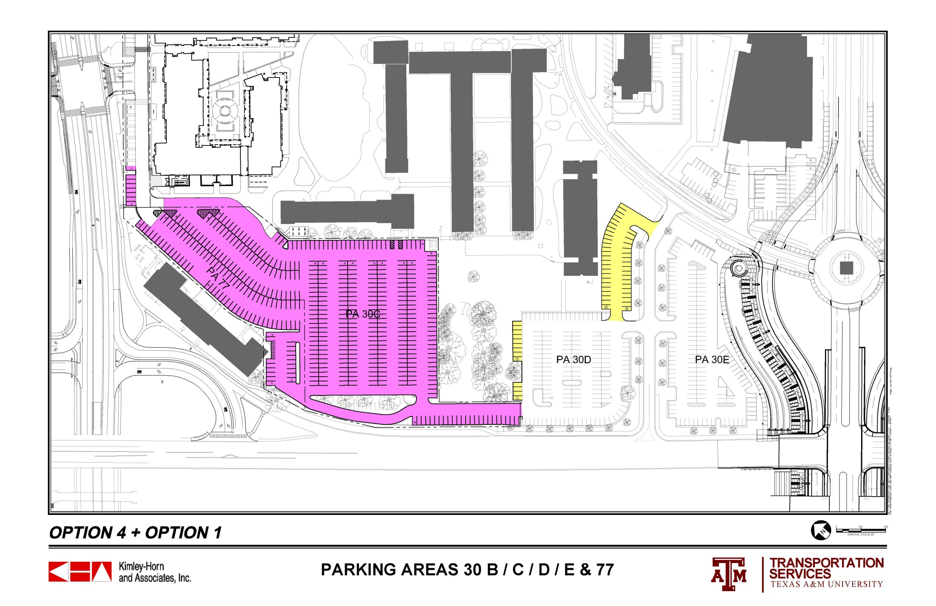
 |  | 30 A | 30 B | 30 C | 30 D | 30 E | 77 | TOTALS
ORIGINAL COUNT |  | 109 | 57 | 366 | 151 | 217 | 153 | 1053
CURRENT COUNT |  | 109 | 18 | 351 | 151 | 134 | 148 | 911
OPTION 4 + OPTION 1 |  | 109 | 26 | 384 | 201 | 134 | 92 | 946

Slide 12
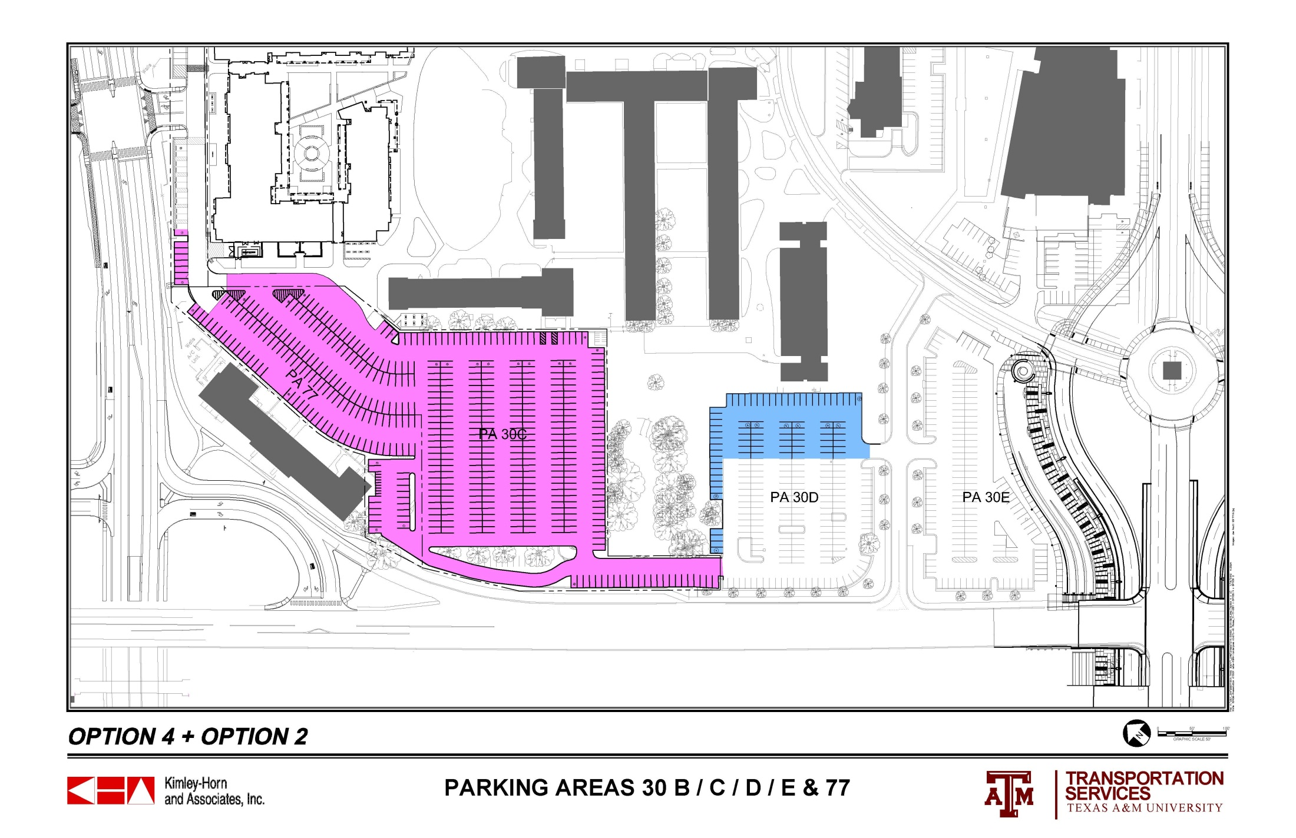
 |  | 30 A | 30 B | 30 C | 30 D | 30 E | 77 | TOTALS
ORIGINAL COUNT |  | 109 | 57 | 366 | 151 | 217 | 153 | 1053
CURRENT COUNT |  | 109 | 18 | 351 | 151 | 134 | 148 | 911
OPTION 4 + OPTION 2 |  | 109 | 26 | 384 | 204 | 134 | 92 | 949

Slide 13
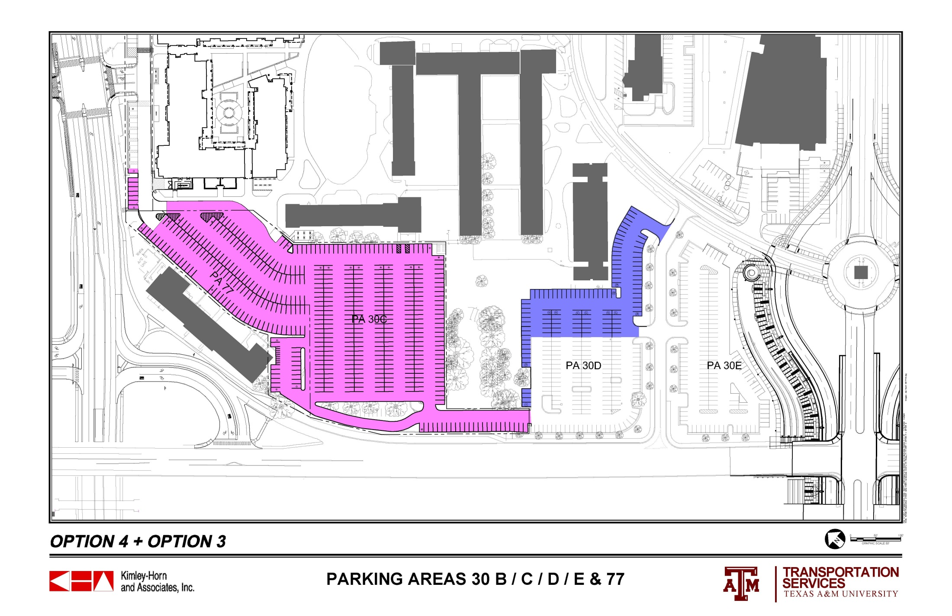
 |  | 30 A | 30 B | 30 C | 30 D | 30 E | 77 | TOTALS
ORIGINAL COUNT |  | 109 | 57 | 366 | 151 | 217 | 153 | 1053
CURRENT COUNT |  | 109 | 18 | 351 | 151 | 134 | 148 | 911
OPTION 4 + OPTION 3 |  | 109 | 26 | 384 | 238 | 134 | 92 | 983

Slide 14
 |  | 30 A | 30 B | 30 C | 30 D | 30 E | 77 | TOTALS
ORIGINAL COUNT |  | 109 | 57 | 366 | 151 | 217 | 153 | 1053
CURRENT COUNT |  | 109 | 18 | 351 | 151 | 134 | 148 | 911
OPTION 4 + OPTION 8 A |  | 109 | 26 | 377 | 239 | 134 | 92 | 977

Slide 15
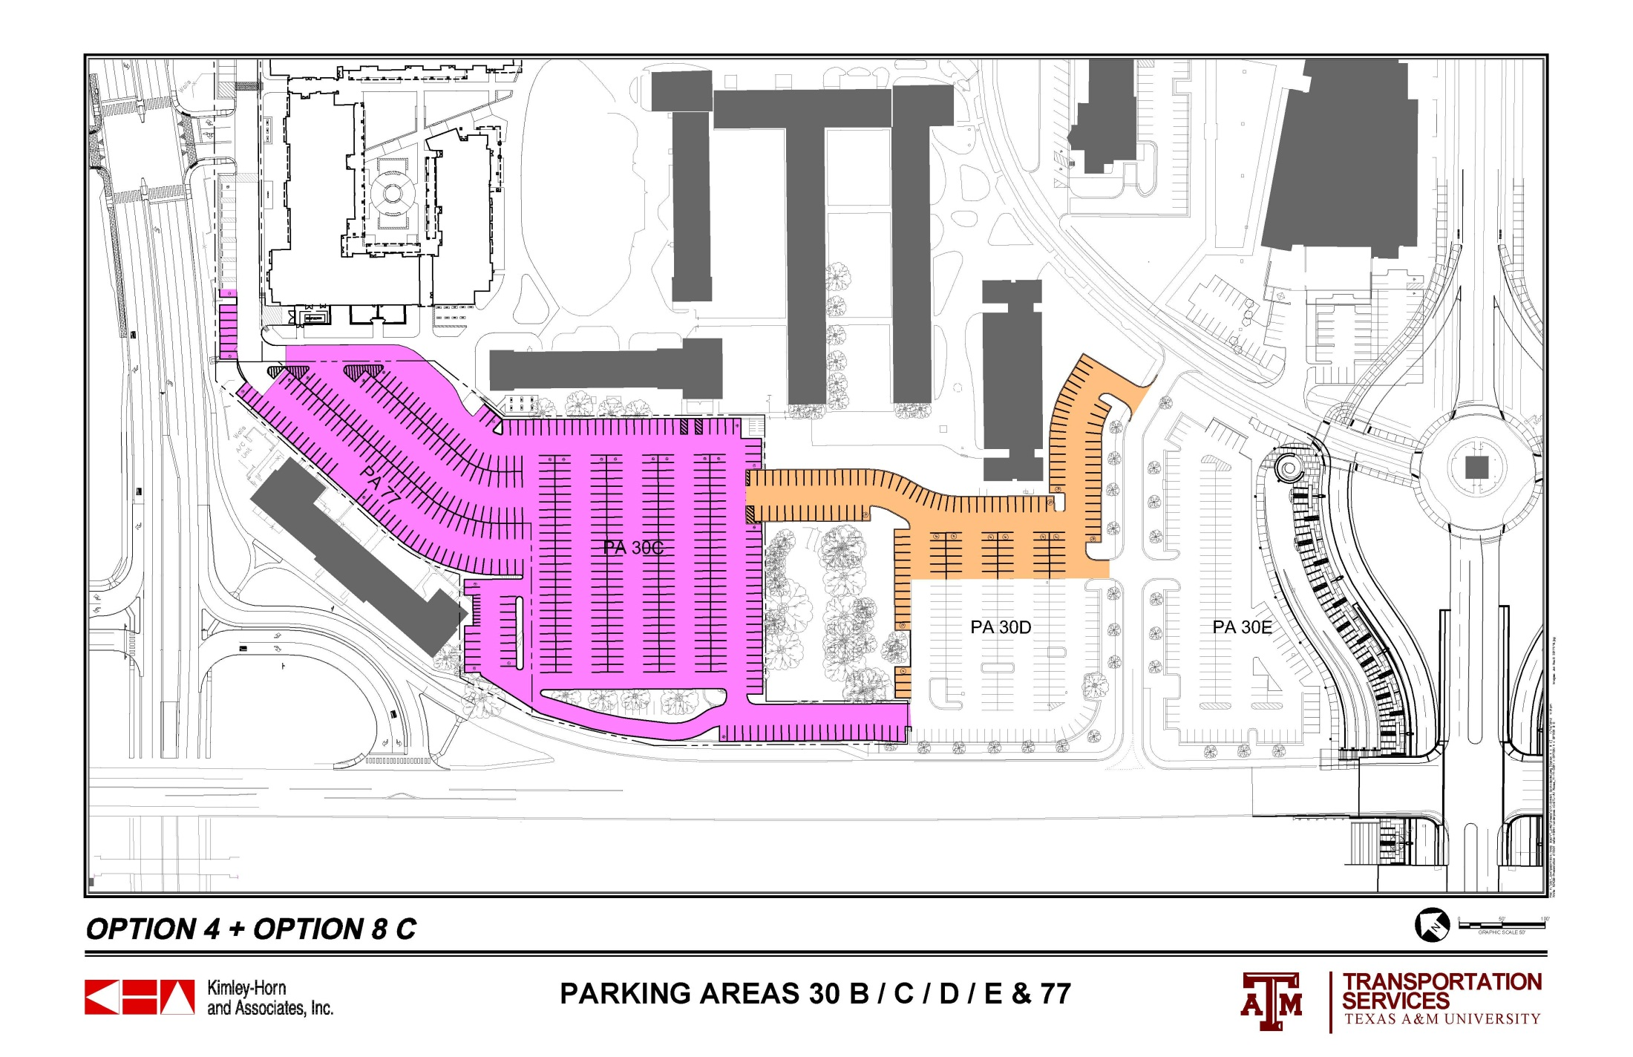
 |  | 30 A | 30 B | 30 C | 30 D | 30 E | 77 | TOTALS
ORIGINAL COUNT |  | 109 | 57 | 366 | 151 | 217 | 153 | 1053
CURRENT COUNT |  | 109 | 18 | 351 | 151 | 134 | 148 | 911
OPTION 4 + OPTION 8 C |  | 109 | 26 | 377 | 268 | 134 | 92 | 1010

Slide 16
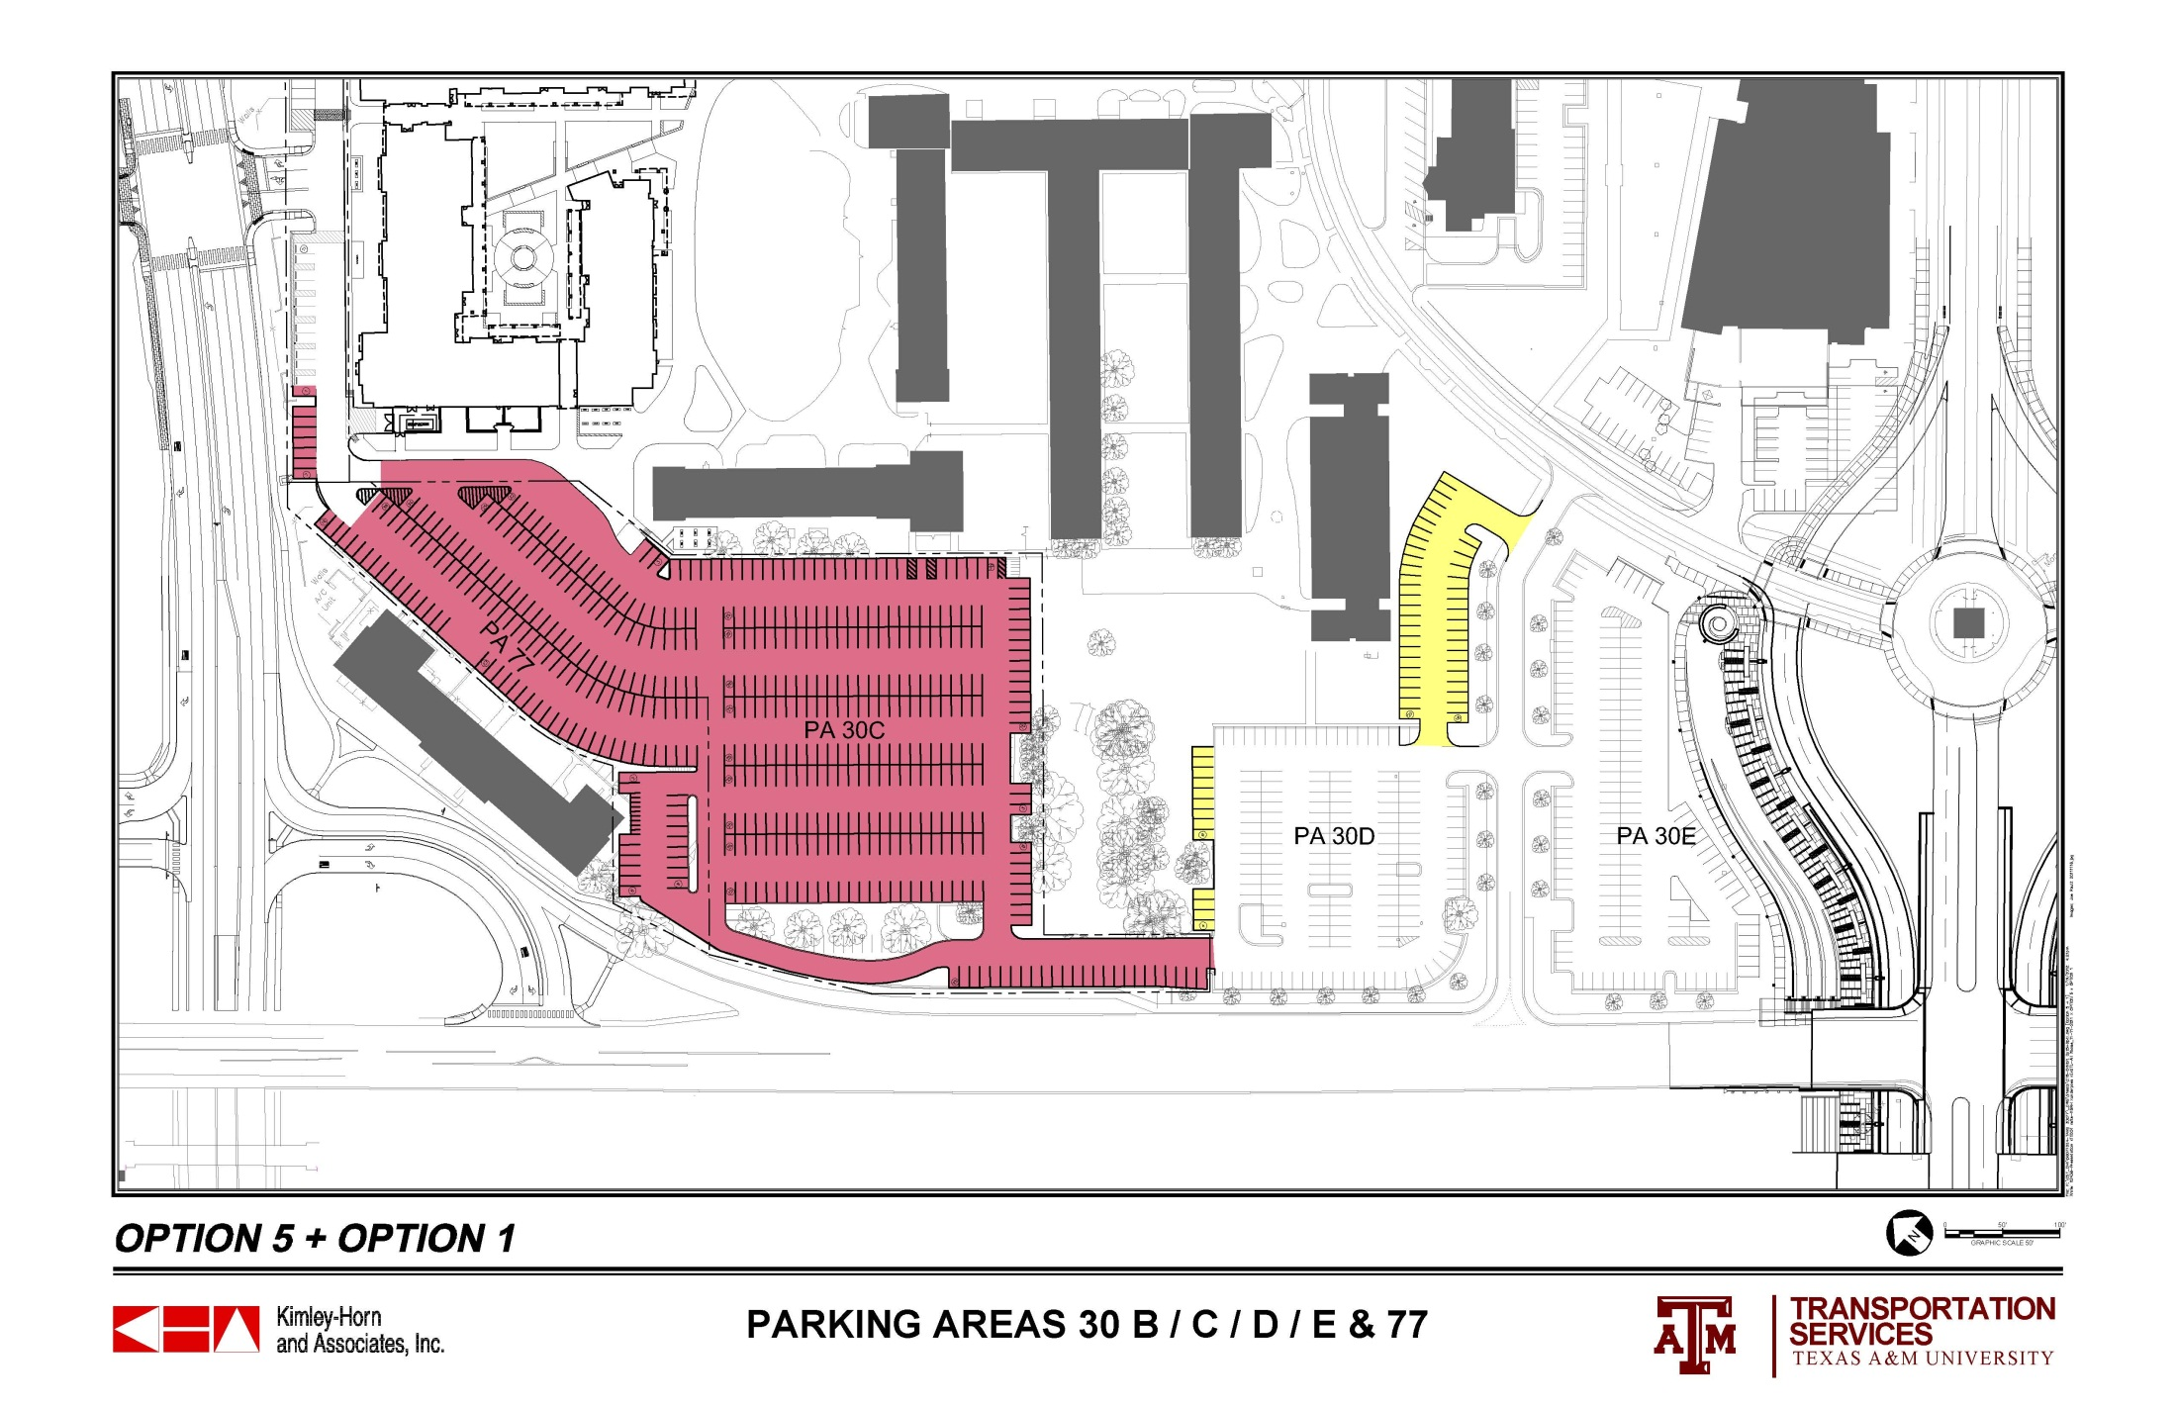
 |  | 30 A | 30 B | 30 C | 30 D | 30 E | 77 | TOTALS
ORIGINAL COUNT |  | 109 | 57 | 366 | 151 | 217 | 153 | 1053
CURRENT COUNT |  | 109 | 18 | 351 | 151 | 134 | 148 | 911
OPTION 5 + OPTION 1 |  | 109 | 26 | 375 | 201 | 134 | 92 | 937

Slide 17
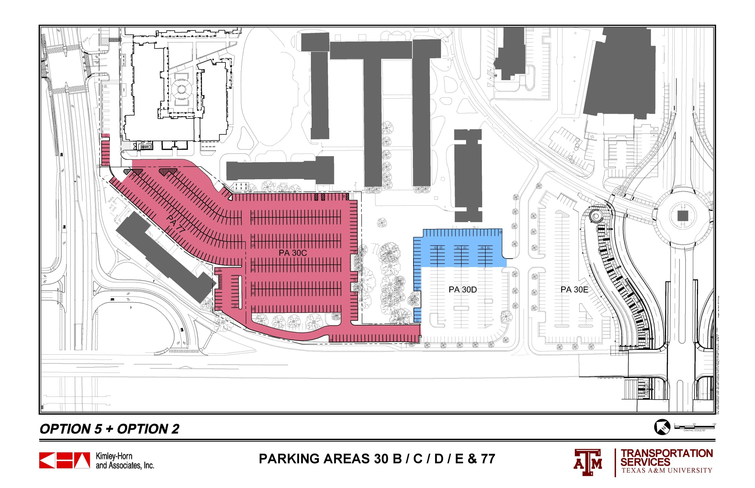
 |  | 30 A | 30 B | 30 C | 30 D | 30 E | 77 | TOTALS
ORIGINAL COUNT |  | 109 | 57 | 366 | 151 | 217 | 153 | 1053
CURRENT COUNT |  | 109 | 18 | 351 | 151 | 134 | 148 | 911
OPTION 5 + OPTION 2 |  | 109 | 26 | 375 | 204 | 134 | 92 | 940

Slide 18
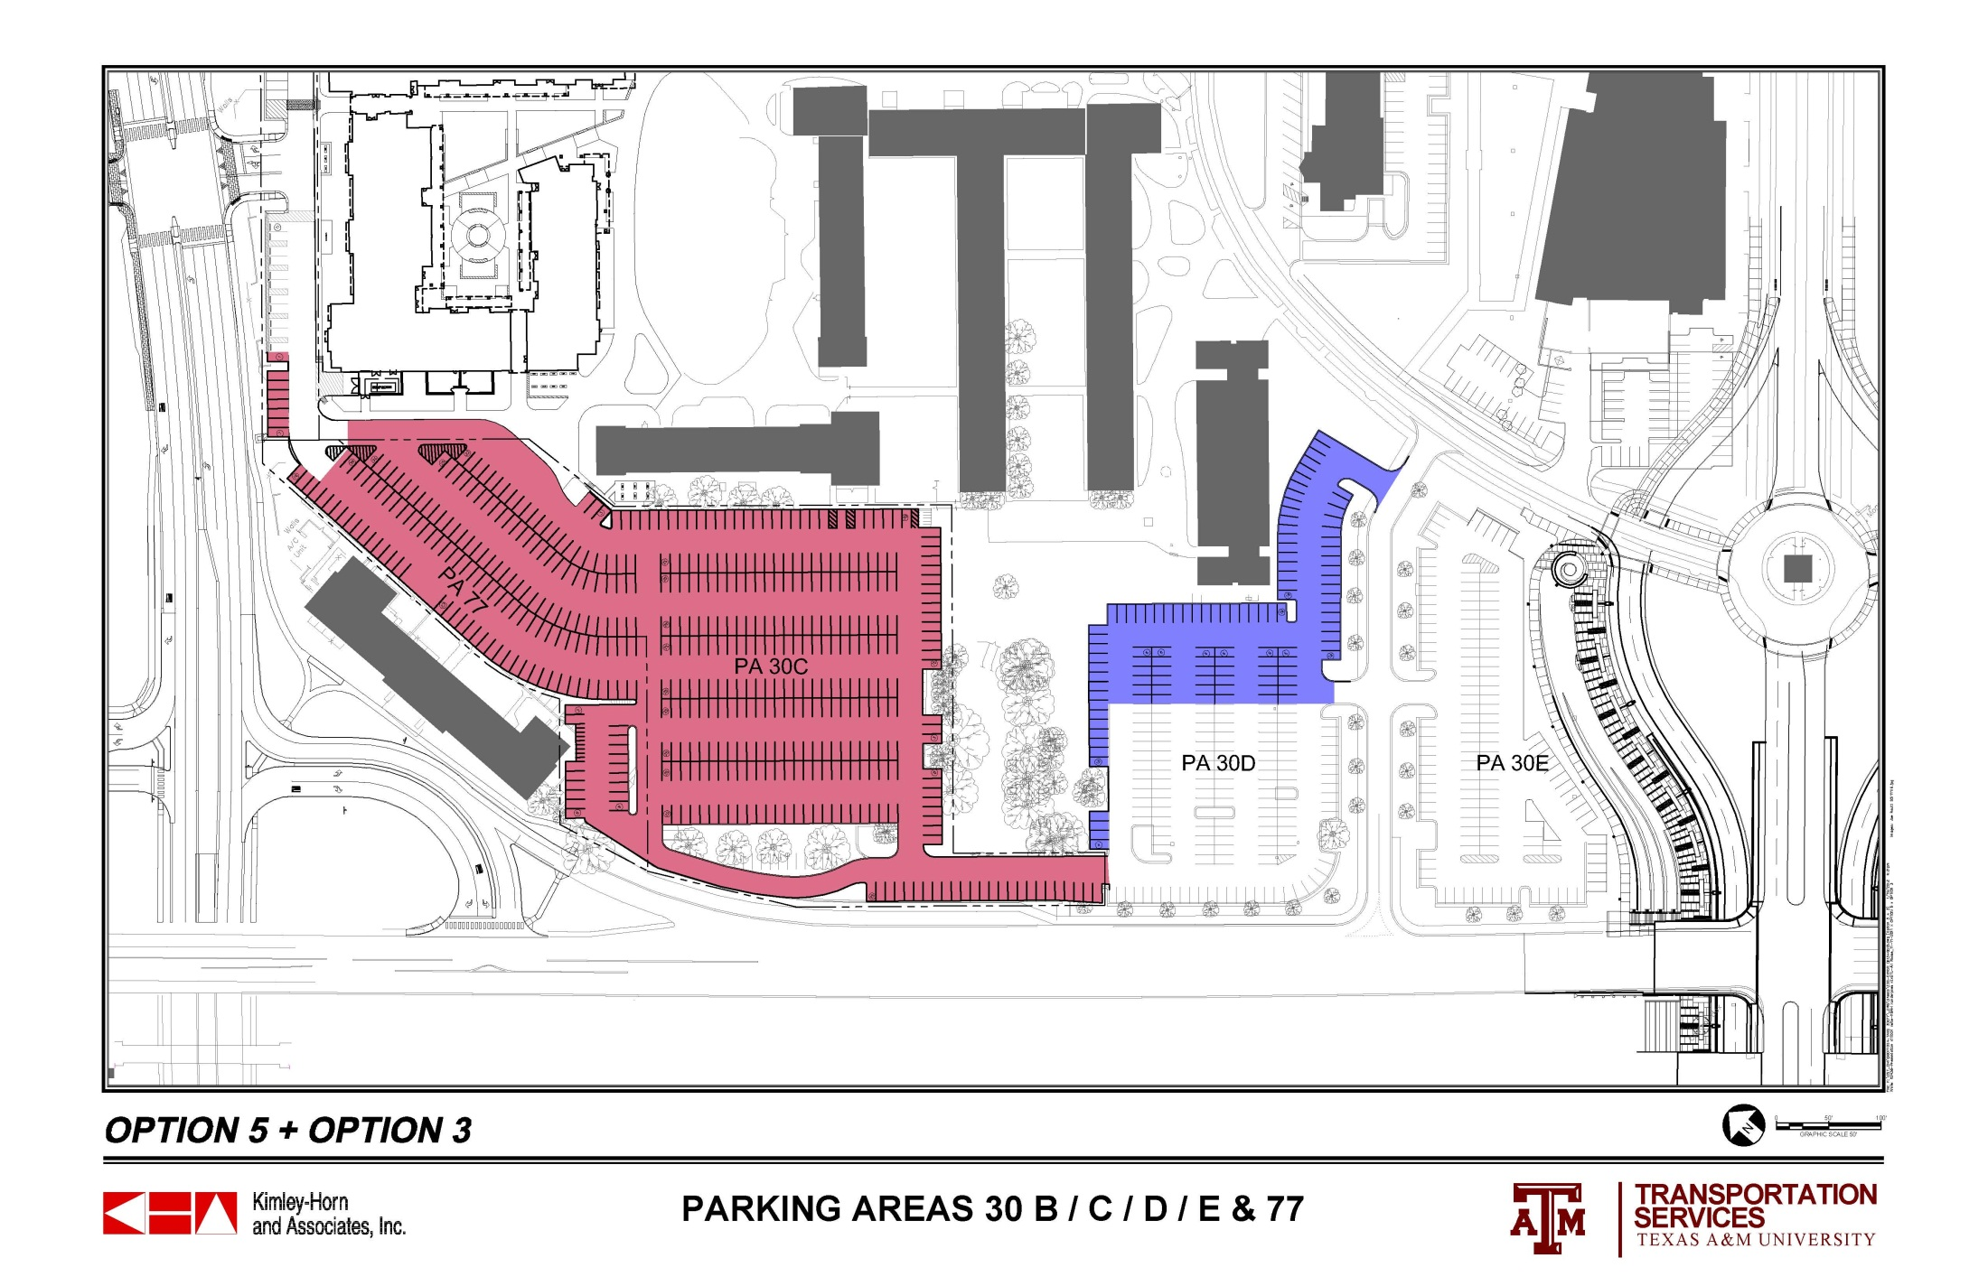
 |  | 30 A | 30 B | 30 C | 30 D | 30 E | 77 | TOTALS
ORIGINAL COUNT |  | 109 | 57 | 366 | 151 | 217 | 153 | 1053
CURRENT COUNT |  | 109 | 18 | 351 | 151 | 134 | 148 | 911
OPTION 5 + OPTION 3 |  | 109 | 26 | 375 | 238 | 134 | 92 | 974

Slide 19
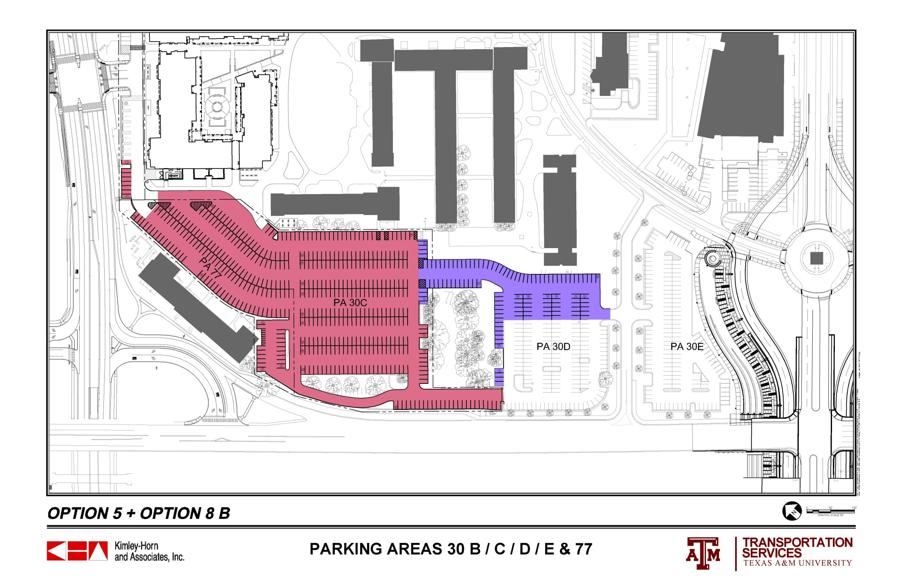
 |  | 30 A | 30 B | 30 C | 30 D | 30 E | 77 | TOTALS
ORIGINAL COUNT |  | 109 | 57 | 366 | 151 | 217 | 153 | 1053
CURRENT COUNT |  | 109 | 18 | 351 | 151 | 134 | 148 | 911
OPTION 5 + OPTION 8 B |  | 109 | 26 | 367 | 235 | 134 | 92 | 963

Slide 20
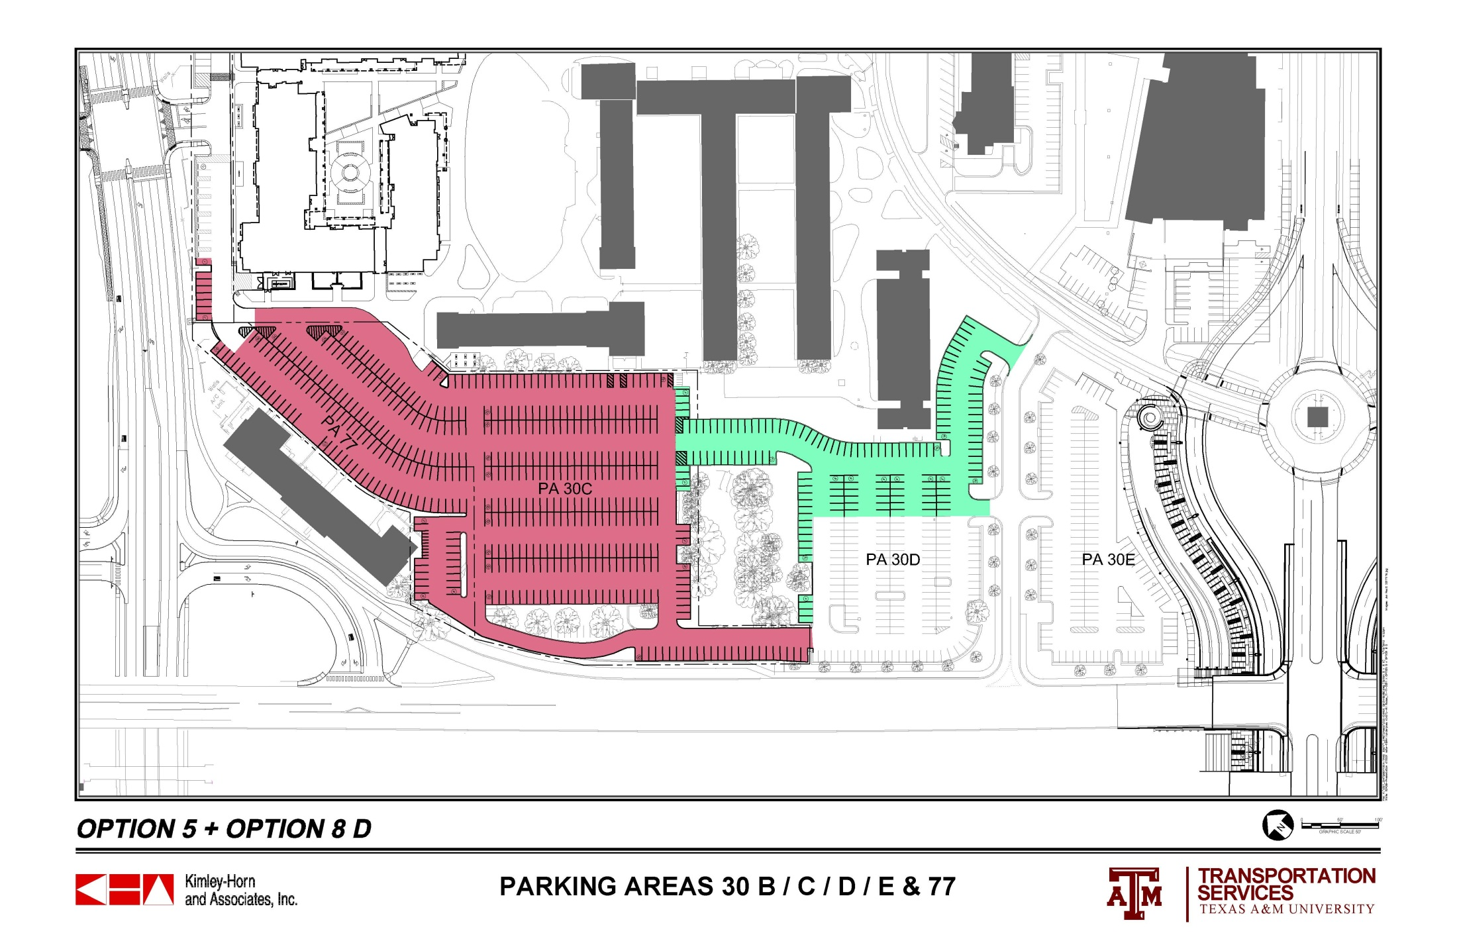
 |  | 30 A | 30 B | 30 C | 30 D | 30 E | 77 | TOTALS
ORIGINAL COUNT |  | 109 | 57 | 366 | 151 | 217 | 153 | 1053
CURRENT COUNT |  | 109 | 18 | 351 | 151 | 134 | 148 | 911
OPTION 5 + OPTION 8 D |  | 109 | 26 | 367 | 268 | 134 | 92 | 996

Slide 21
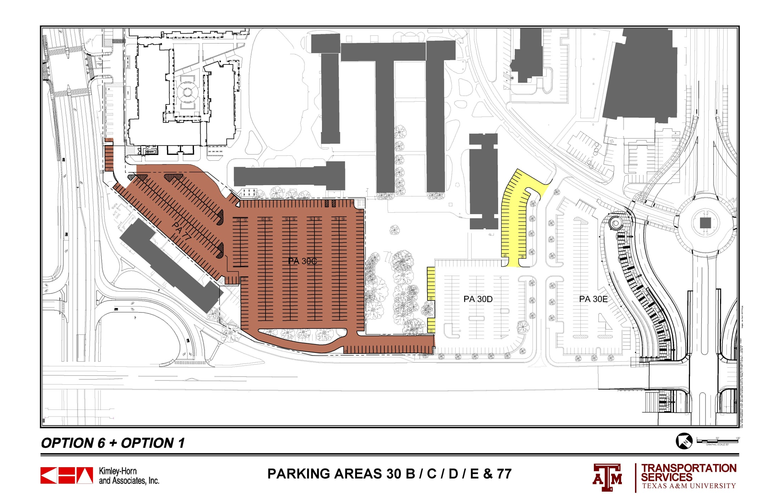
 |  | 30 A | 30 B | 30 C | 30 D | 30 E | 77 | TOTALS
ORIGINAL COUNT |  | 109 | 57 | 366 | 151 | 217 | 153 | 1053
CURRENT COUNT |  | 109 | 18 | 351 | 151 | 134 | 148 | 911
OPTION 6 + OPTION 1 |  | 109 | 19 | 410 | 201 | 134 | 73 | 946

Slide 22
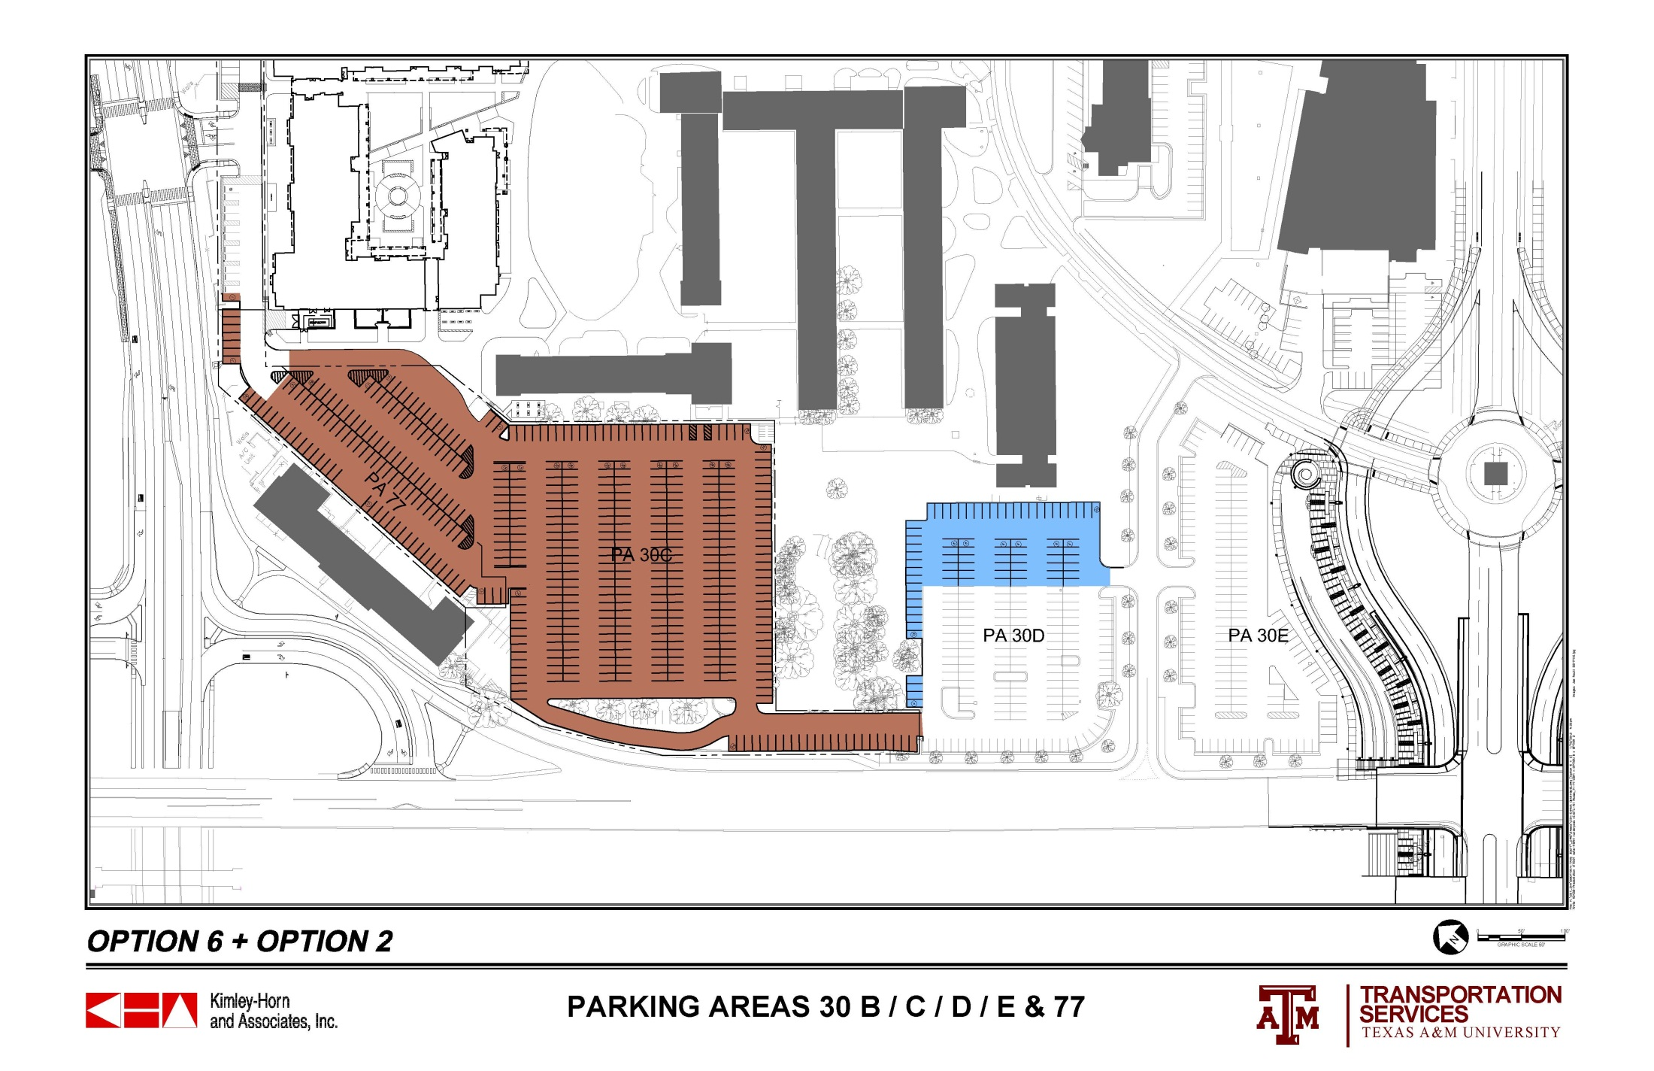
 |  | 30 A | 30 B | 30 C | 30 D | 30 E | 77 | TOTALS
ORIGINAL COUNT |  | 109 | 57 | 366 | 151 | 217 | 153 | 1053
CURRENT COUNT |  | 109 | 18 | 351 | 151 | 134 | 148 | 911
OPTION 6 + OPTION 2 |  | 109 | 19 | 410 | 204 | 134 | 73 | 949

Slide 23
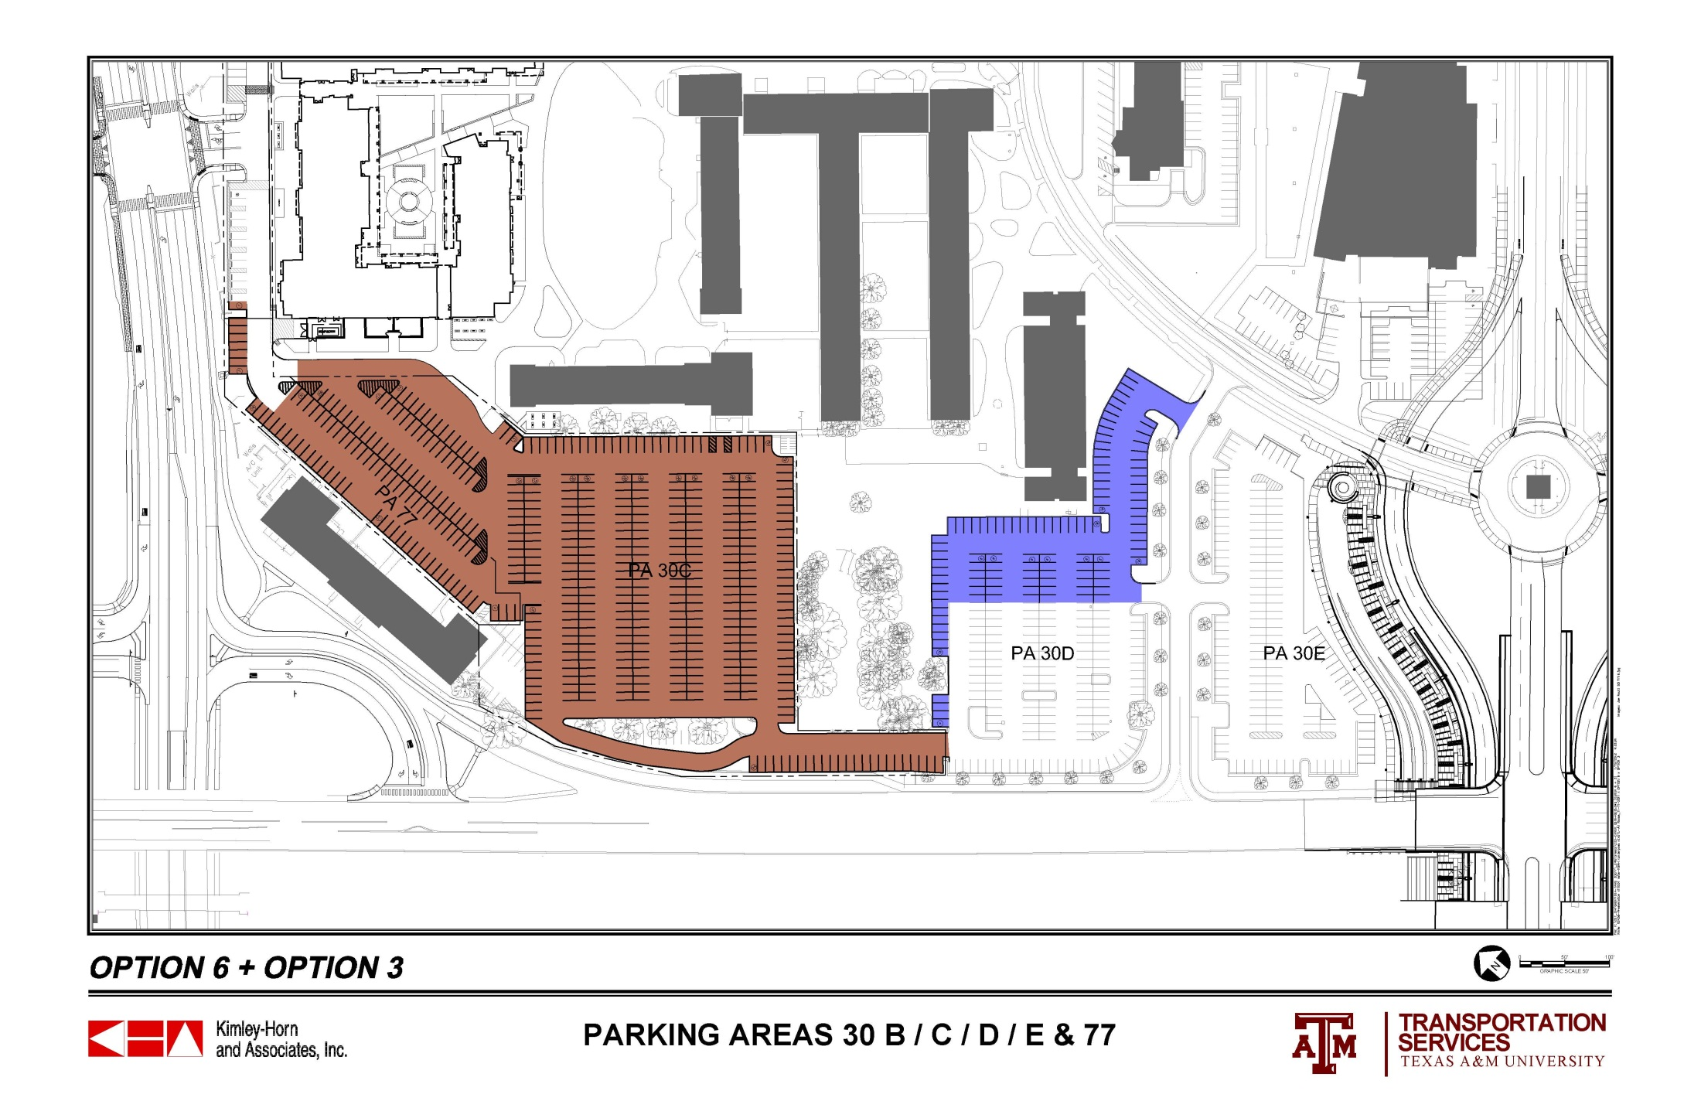
 |  | 30 A | 30 B | 30 C | 30 D | 30 E | 77 | TOTALS
ORIGINAL COUNT |  | 109 | 57 | 366 | 151 | 217 | 153 | 1053
CURRENT COUNT |  | 109 | 18 | 351 | 151 | 134 | 148 | 911
OPTION 6 + OPTION 3 |  | 109 | 19 | 410 | 238 | 134 | 73 | 983

Slide 24
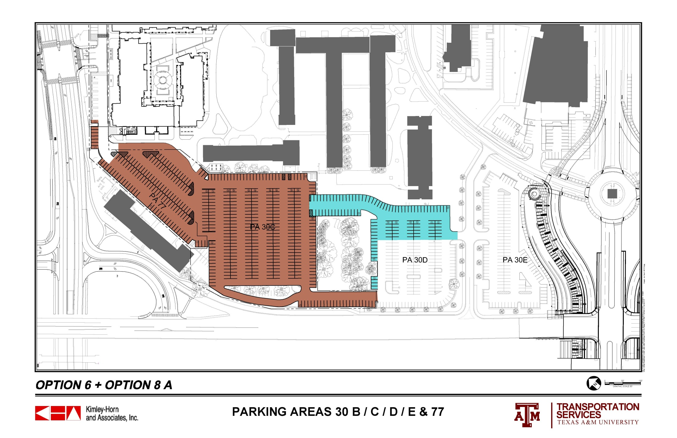
 |  | 30 A | 30 B | 30 C | 30 D | 30 E | 77 | TOTALS
ORIGINAL COUNT |  | 109 | 57 | 366 | 151 | 217 | 153 | 1053
CURRENT COUNT |  | 109 | 18 | 351 | 151 | 134 | 148 | 911
OPTION 6 + OPTION 8 A |  | 109 | 19 | 403 | 239 | 134 | 73 | 977

Slide 25
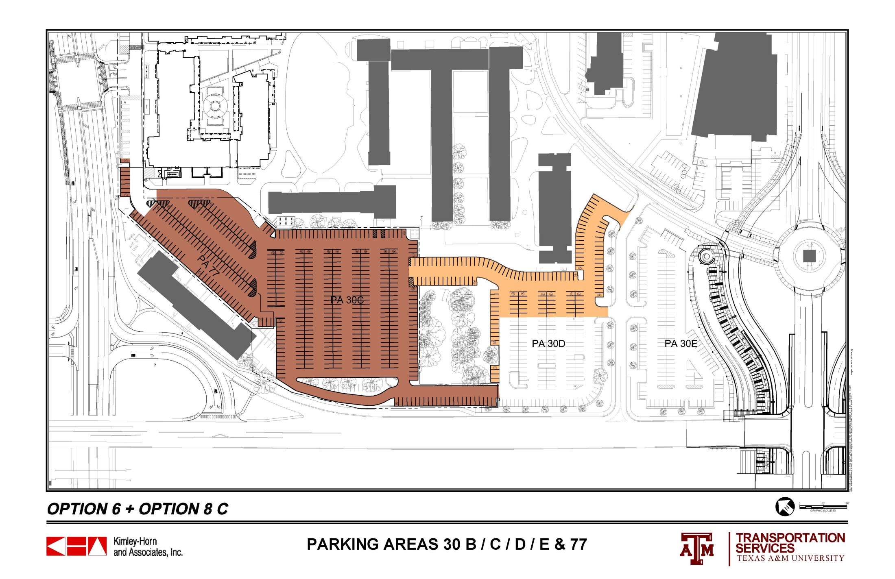
 |  | 30 A | 30 B | 30 C | 30 D | 30 E | 77 | TOTALS
ORIGINAL COUNT |  | 109 | 57 | 366 | 151 | 217 | 153 | 1053
CURRENT COUNT |  | 109 | 18 | 351 | 151 | 134 | 148 | 911
OPTION 6 + OPTION 8 C |  | 109 | 19 | 403 | 272 | 134 | 73 | 1010

Slide 26
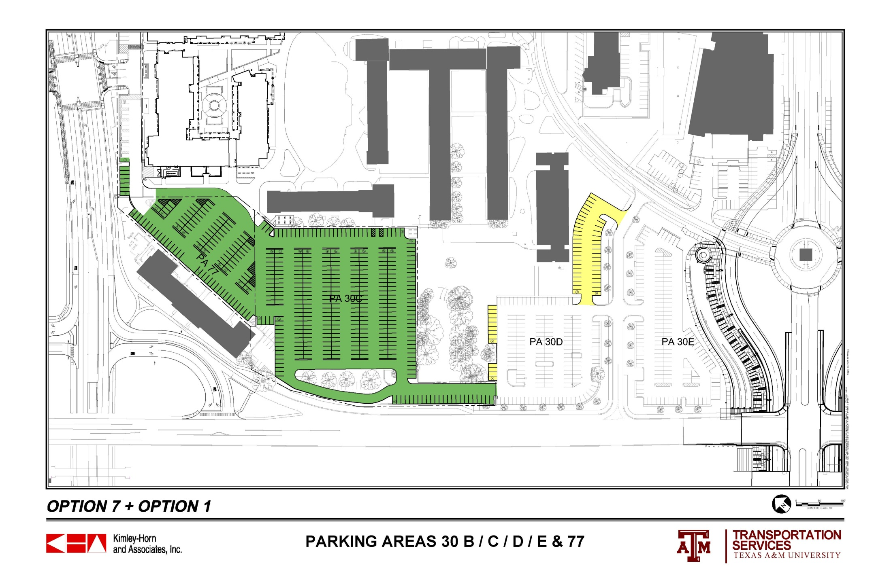
 |  | 30 A | 30 B | 30 C | 30 D | 30 E | 77 | TOTALS
ORIGINAL COUNT |  | 109 | 57 | 366 | 151 | 217 | 153 | 1053
CURRENT COUNT |  | 109 | 18 | 351 | 151 | 134 | 148 | 911
OPTION 7 + OPTION 1 |  | 109 | 26 | 339 | 201 | 134 | 100 | 909

Slide 27
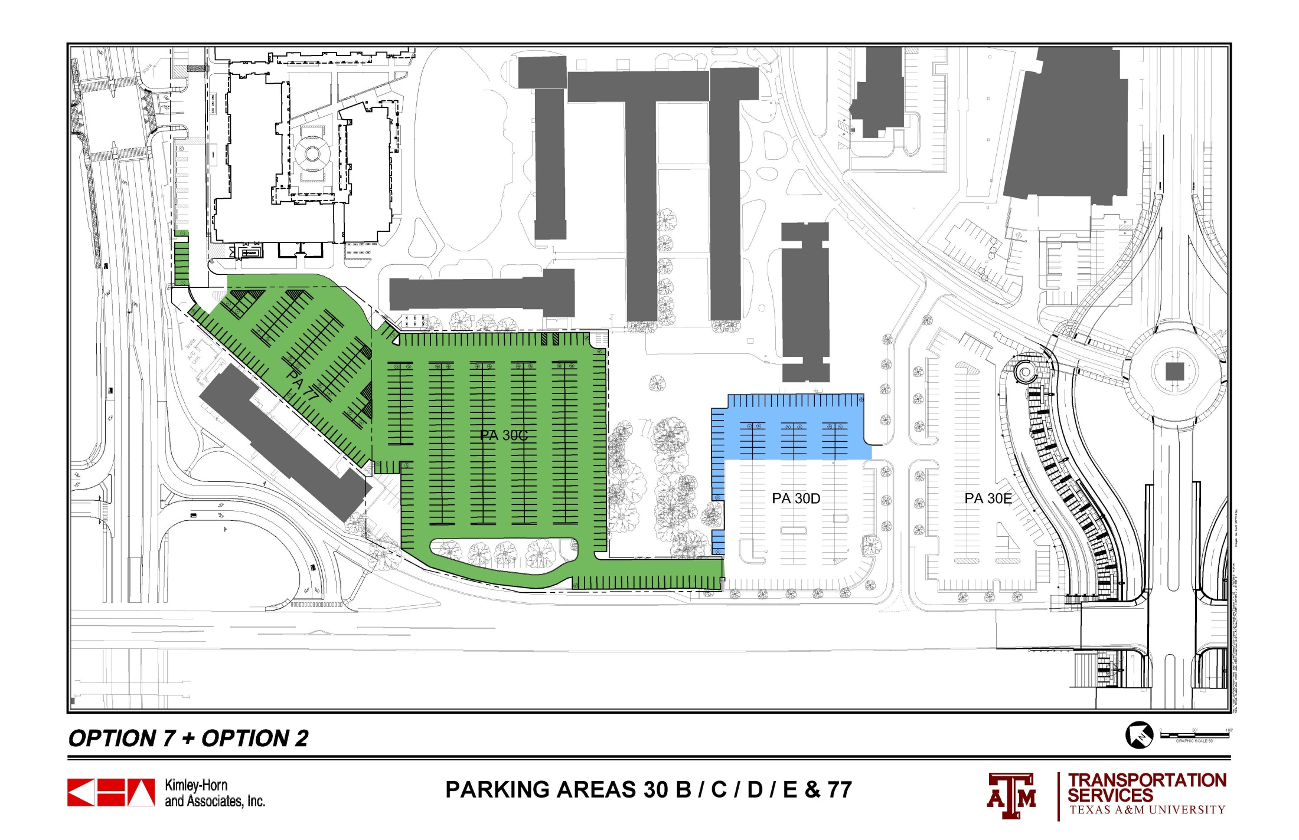
 |  | 30 A | 30 B | 30 C | 30 D | 30 E | 77 | TOTALS
ORIGINAL COUNT |  | 109 | 57 | 366 | 151 | 217 | 153 | 1053
CURRENT COUNT |  | 109 | 18 | 351 | 151 | 134 | 148 | 911
OPTION 7 + OPTION 2 |  | 109 | 26 | 339 | 204 | 134 | 100 | 912

Slide 28
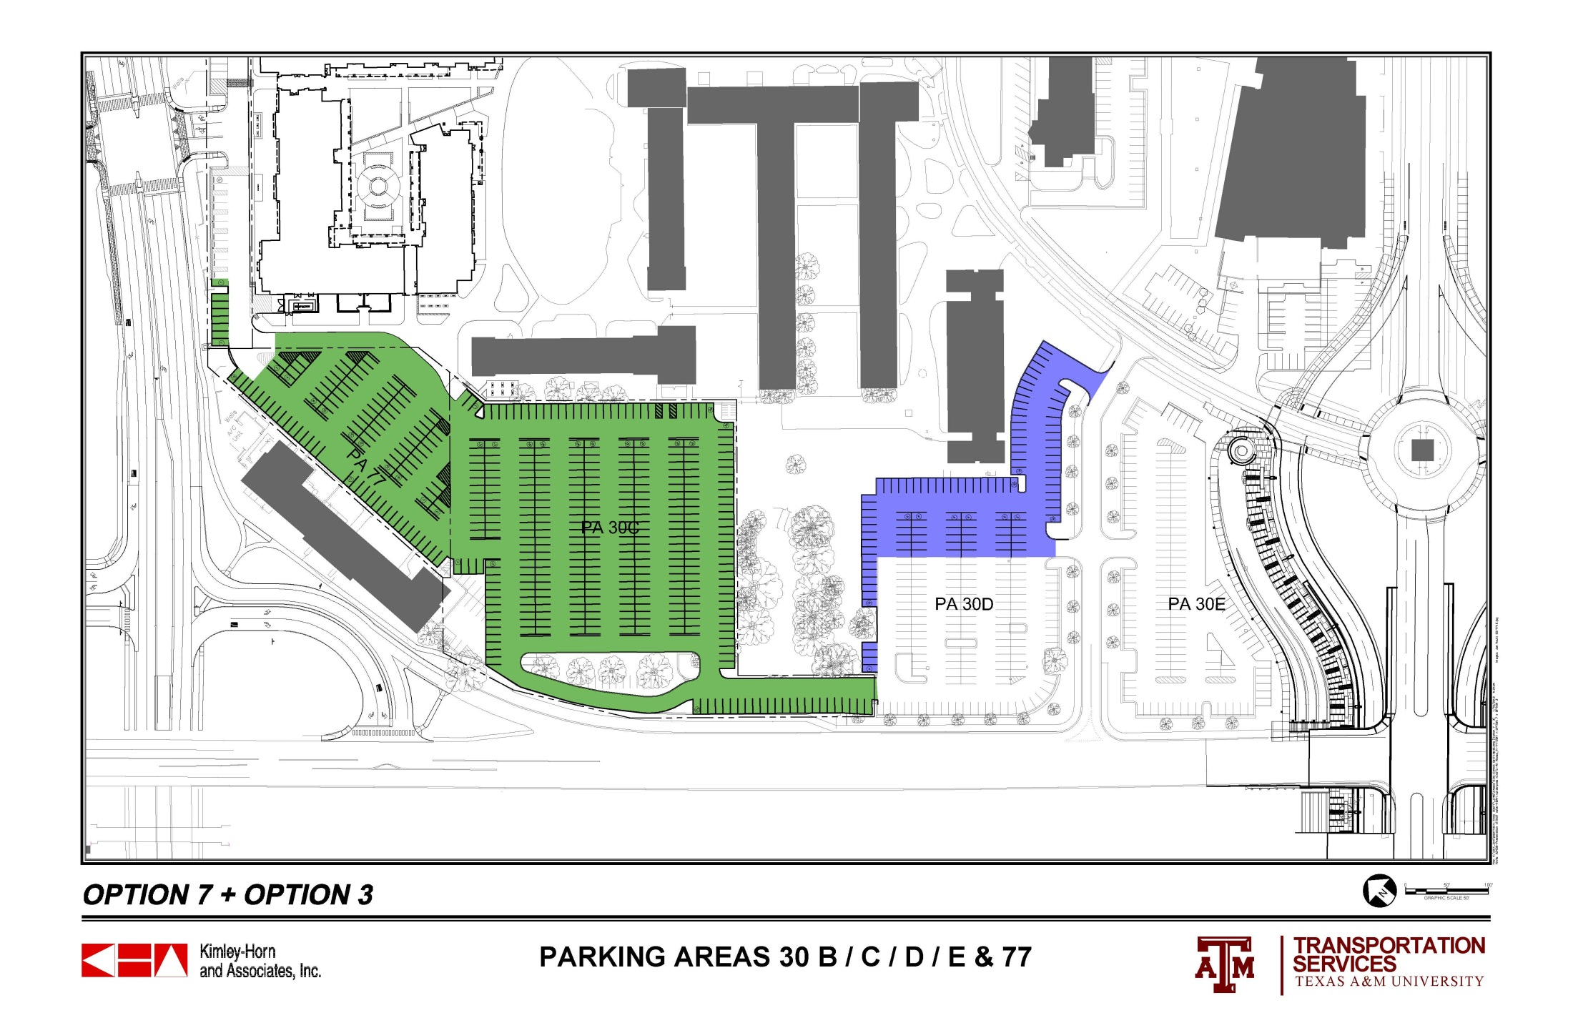
 |  | 30 A | 30 B | 30 C | 30 D | 30 E | 77 | TOTALS
ORIGINAL COUNT |  | 109 | 57 | 366 | 151 | 217 | 153 | 1053
CURRENT COUNT |  | 109 | 18 | 351 | 151 | 134 | 148 | 911
OPTION 7 + OPTION 3 |  | 109 | 26 | 339 | 238 | 134 | 100 | 946

Slide 29
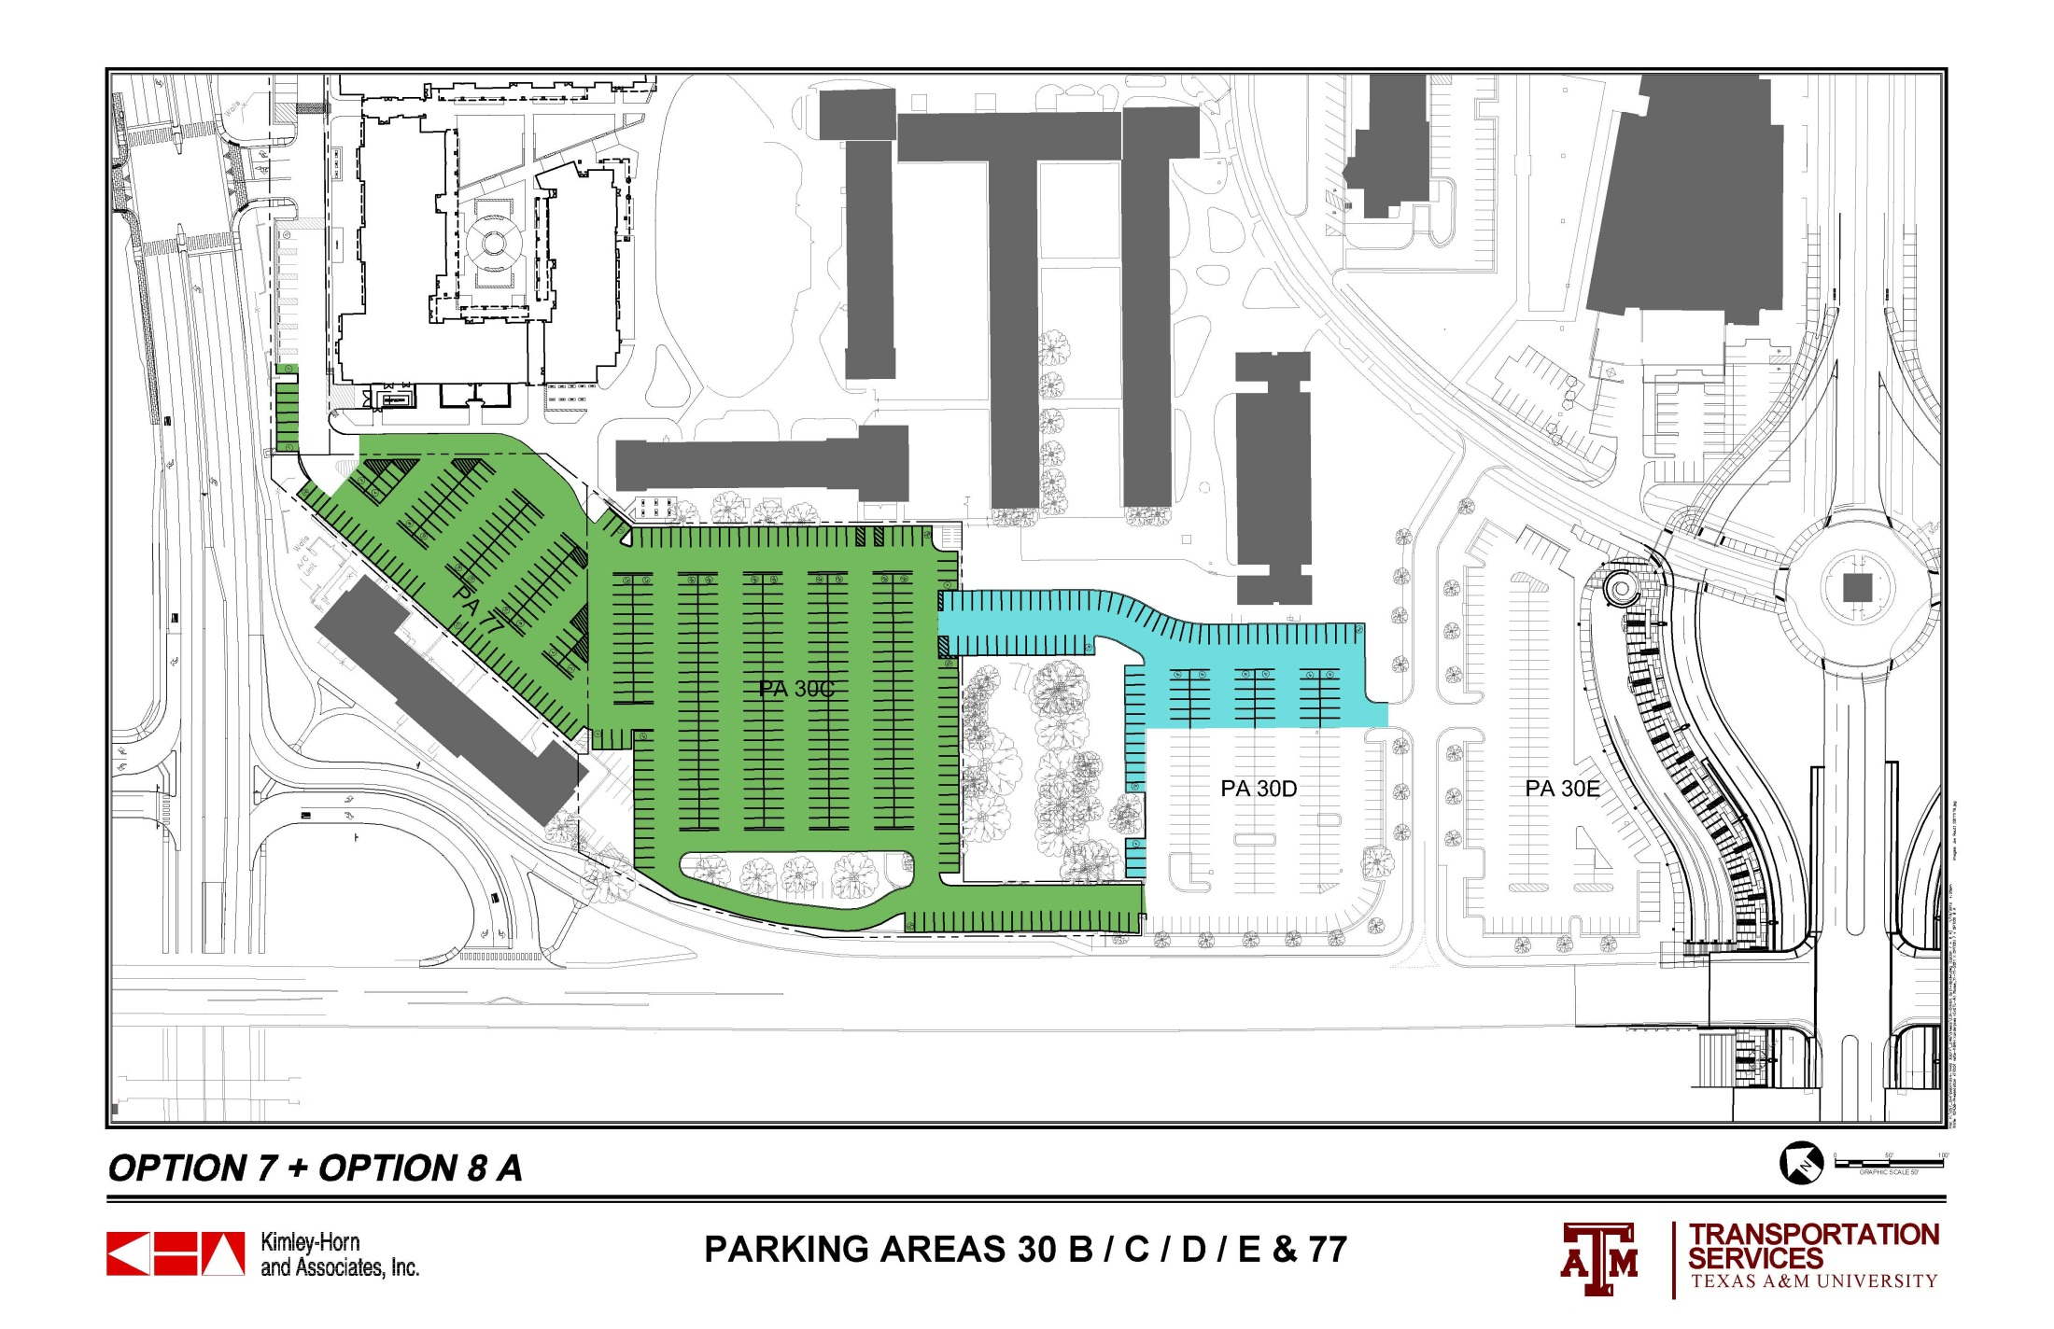
 |  | 30 A | 30 B | 30 C | 30 D | 30 E | 77 | TOTALS
ORIGINAL COUNT |  | 109 | 57 | 366 | 151 | 217 | 153 | 1053
CURRENT COUNT |  | 109 | 18 | 351 | 151 | 134 | 148 | 911
OPTION 7 + OPTION 8 A |  | 109 | 26 | 332 | 239 | 134 | 100 | 940

Slide 30
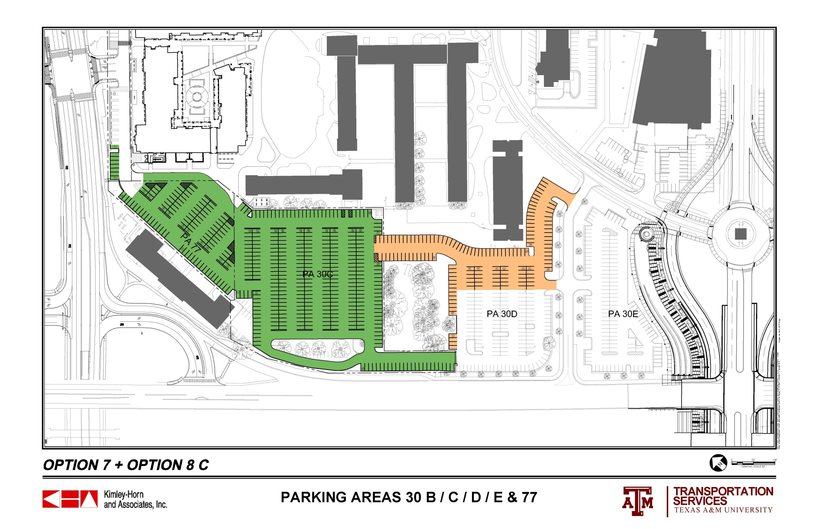
 |  | 30 A | 30 B | 30 C | 30 D | 30 E | 77 | TOTALS
ORIGINAL COUNT |  | 109 | 57 | 366 | 151 | 217 | 153 | 1053
CURRENT COUNT |  | 109 | 18 | 351 | 151 | 134 | 148 | 911
OPTION 7 + OPTION 8 C |  | 109 | 26 | 332 | 272 | 134 | 100 | 973

