Slide 1
Bike Lane Improvements
TSAC, November 7, 2012

Slide 2
Bicycles traveling northbound on Ireland create problems. Based on feedback from UPD, EHS and others we engaged professional engineers to study the problem.

Slide 3
Parallel Parking Option
Replace angle parking with parallel parking
Add northbound bicycle lane
Convert New St to 2-way traffic

Slide 4
Sidewalk Option
Eliminate angle parking
Add northbound bicycle lane
Convert New St to 2-way traffic

Slide 5
Angle Parking Option
Add northbound bicycle lane
Convert New St to 2-way traffic
Notes:
Addition of a northbound bike lane caused concern for the inability of cars parked along Ireland to simultaneously handle northbound bike traffic and back into south bound auto traffic along Ireland

Slide 6
Houston Street Bike Lane
Add southbound bicycle lane between Old Main and Lamar
Designate Bus Lane
Designate center lane as shared bicycle and vehicle lane

Slide 7
Houston Street Bike Lane
Add northbound and southbound bicycle lanes between Jones and Old Main

Slide 8
Jones Street Bike Lane
Add northbound and southbound bicycle lanes between Houston and Old Main

Slide 9
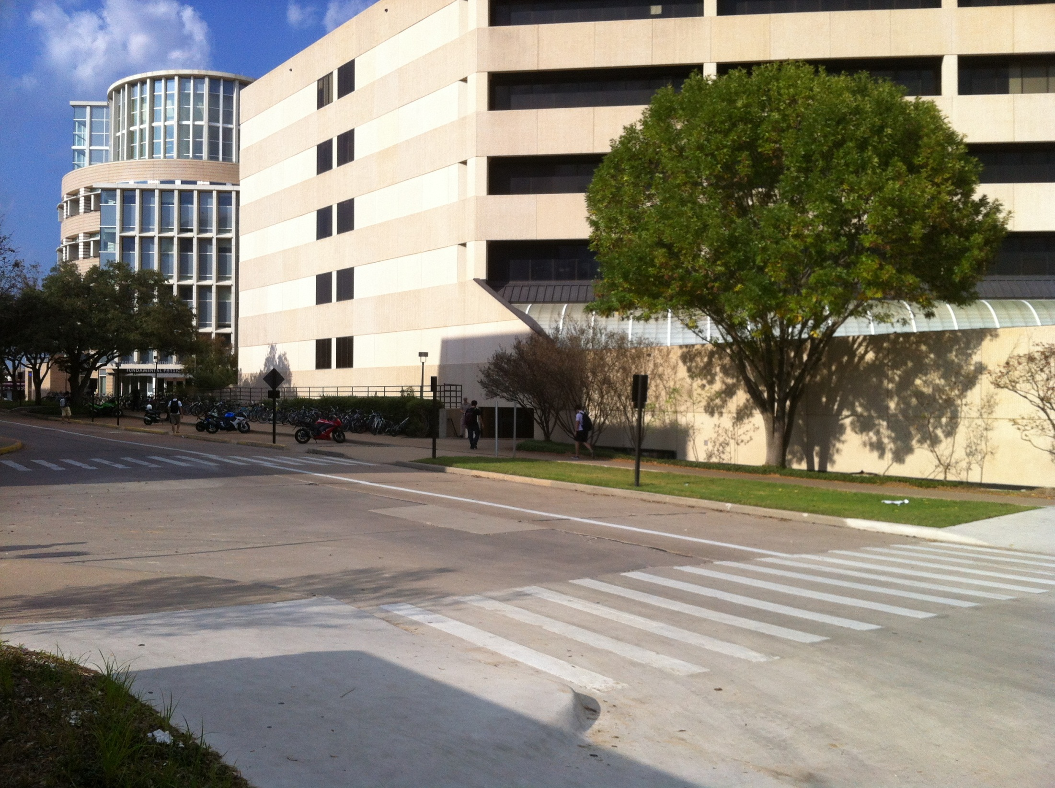

Slide 10
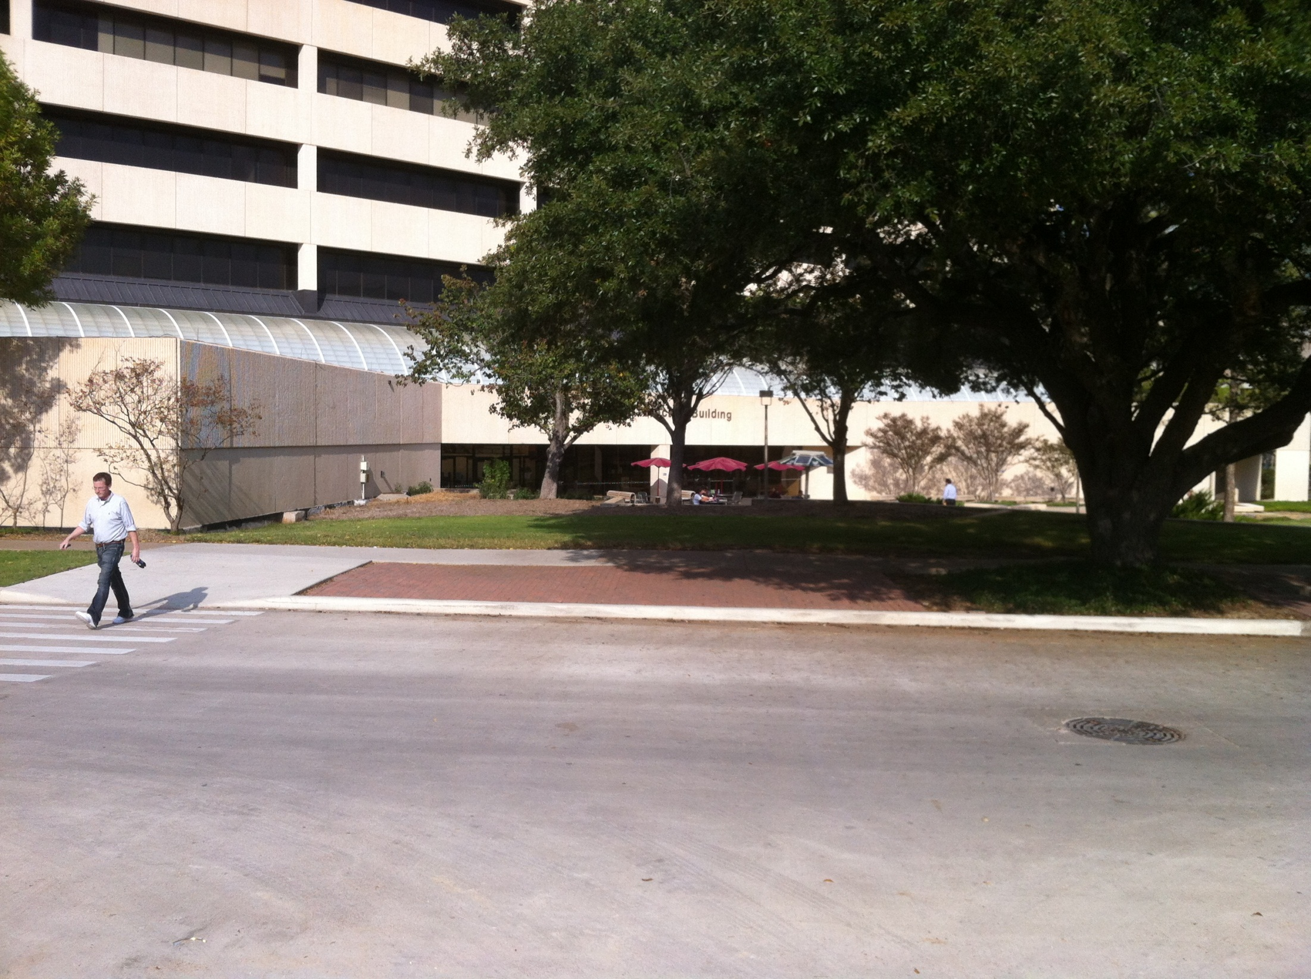

Slide 11
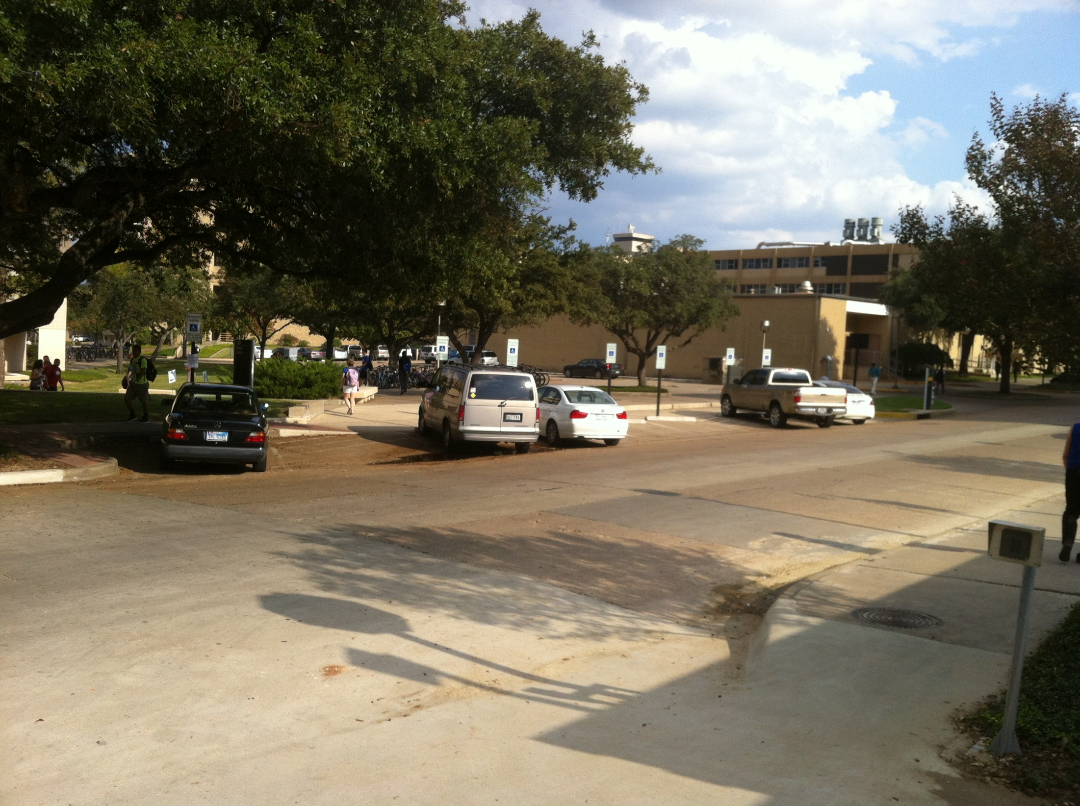

Slide 12
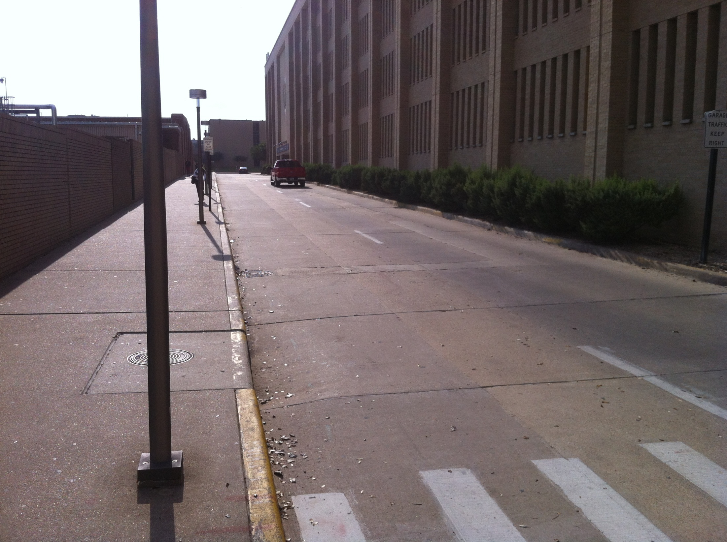

Slide 13
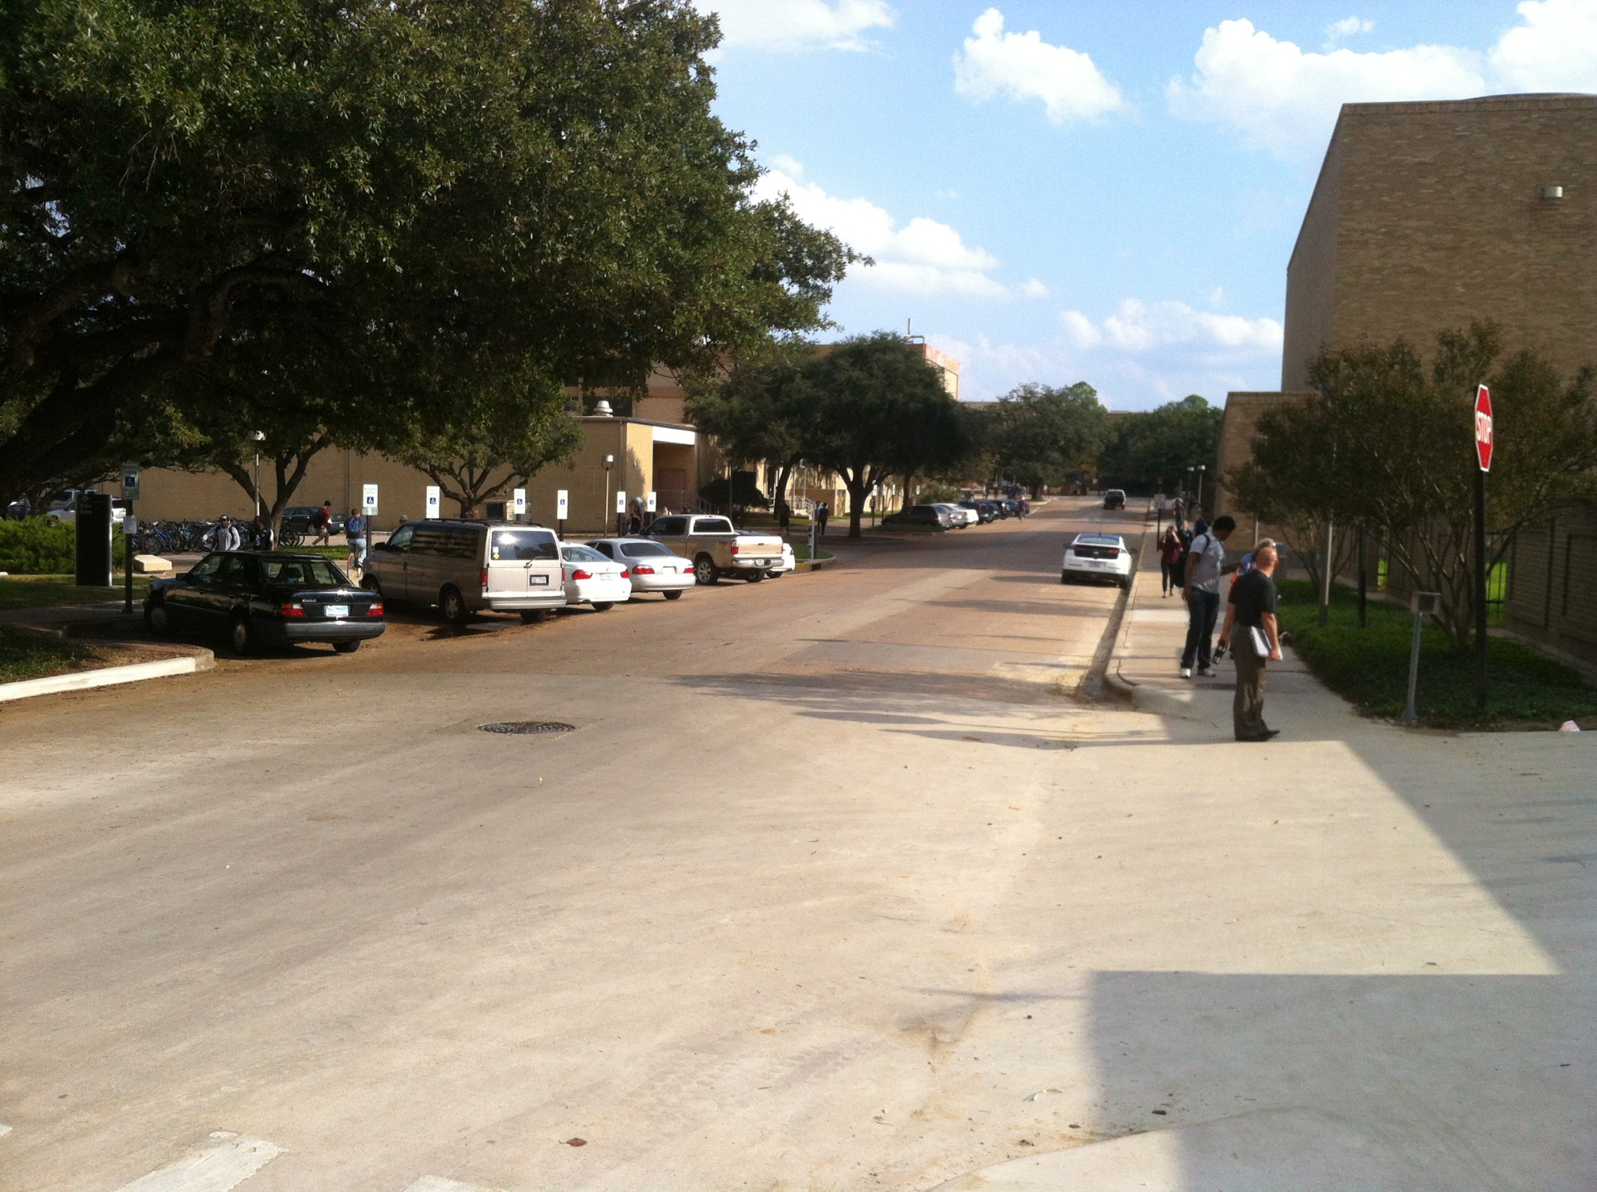

Slide 14
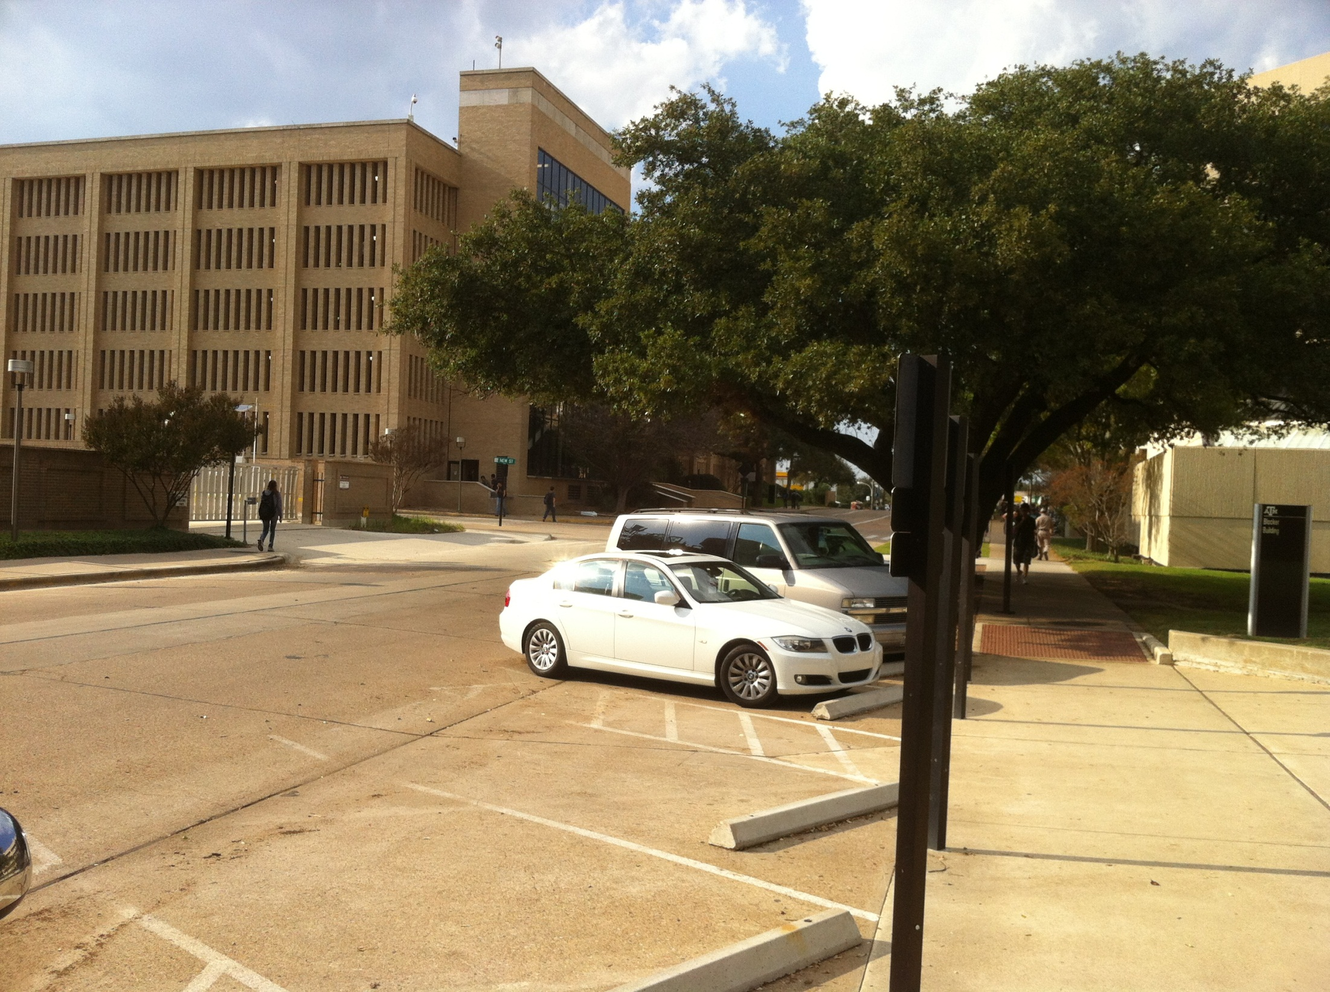

Slide 15
