Slide 1
DIRC goes to Aggieland
New Safety Awareness Campaign
For Pedestrians, Bicyclists,
Skateboarders, and . . .

Slide 2
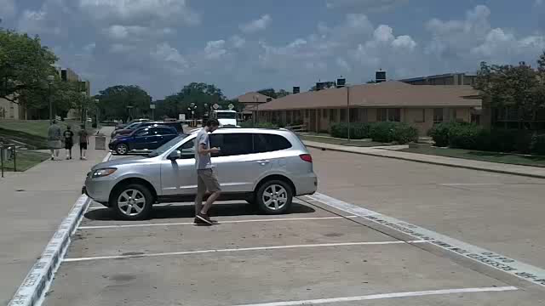
Have you ever seen a DIRC?

Slide 3
The History of DIRC
DIRC began at CU Boulder
  With permission, DIRC is now at Texas A&M ☺
So what exactly is DIRC?
  DIRC is a comprehensive self awareness safety campaign to minimize behaviors that may cause negative consequences to the Aggie community.
DIRC means:
  Dangerous Irresponsible Reckless and Careless

Slide 4
How DIRC is Done
Phase I
  “Yard Signs” depicting DIRC behavior and a link to learn more
Phase II
  Mock scenes of DIRC consequences
Phase III (Aggie Add-on)
  Purposeful video campaign depicting DIRC behaviors
  Hopeful homemade video campaigns

Slide 5
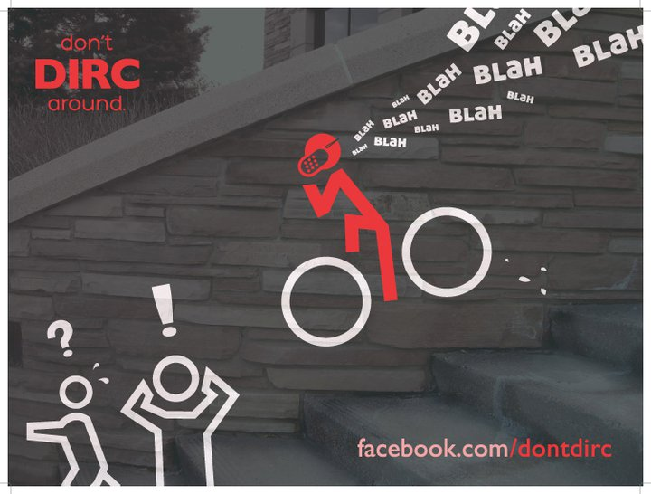

How DIRC is Done
From CU Boulder (Phase I)

Slide 6
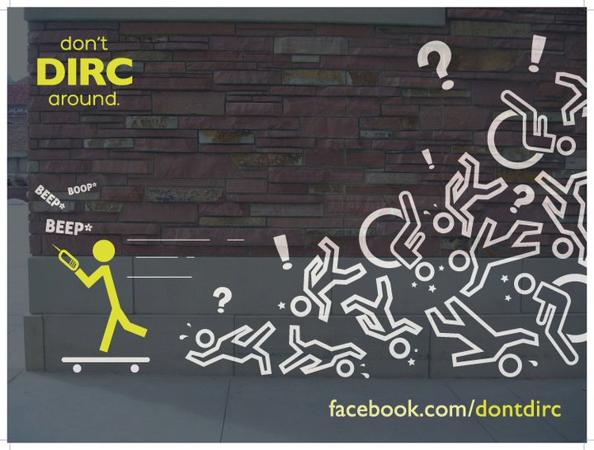
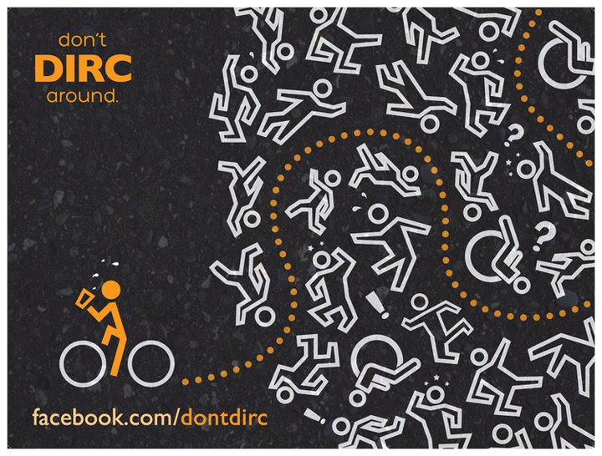
How DIRC is Done
From CU Boulder (Phase I)

Slide 7
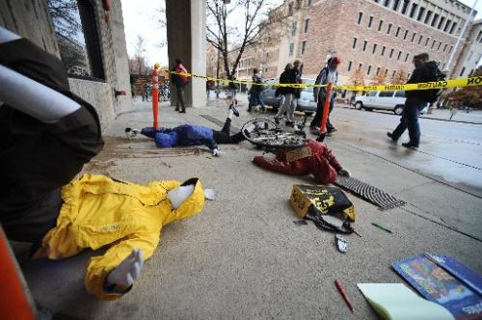
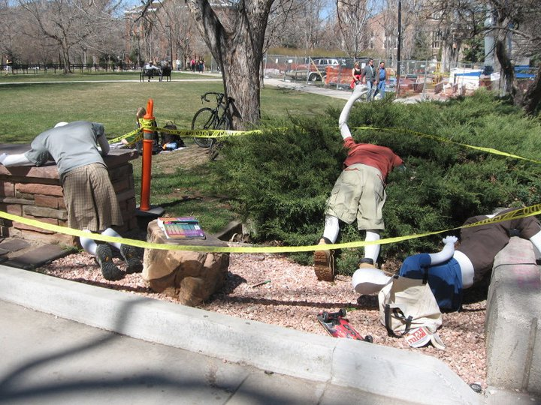
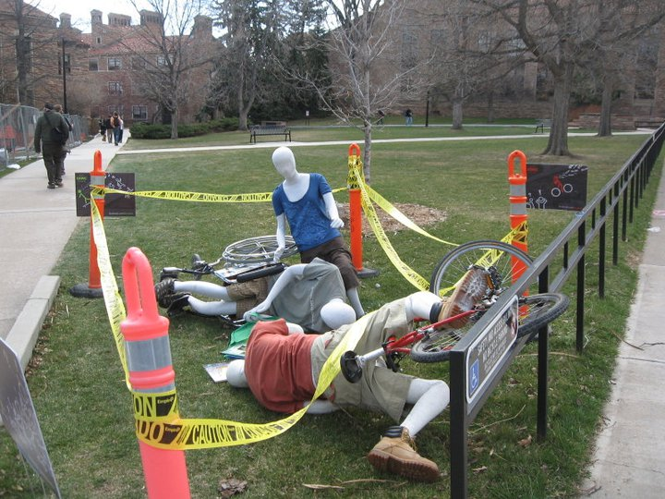
How DIRC is Done
From CU Boulder (Phase II)

Slide 8
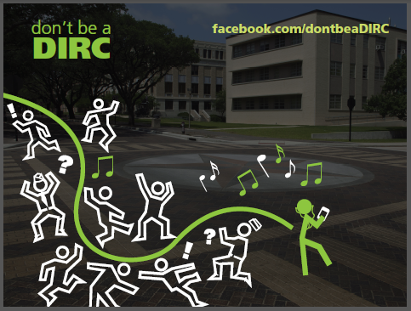
DIRC Phase I Aggie Style
Pedestrians

Slide 9
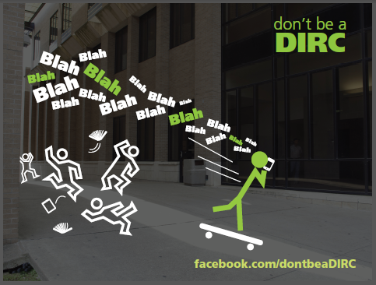
DIRC Phase I Aggie Style
Skateboarder

Slide 10
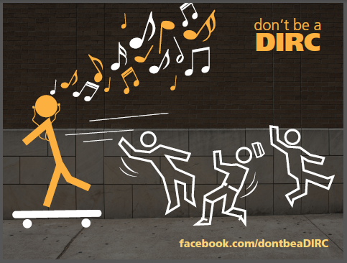
DIRC Phase I Aggie Style
Skateboarder

Slide 11
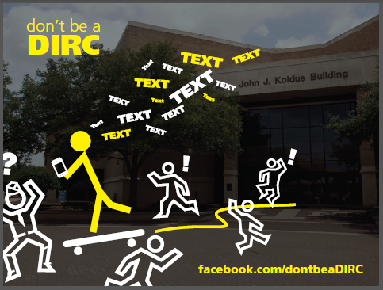
DIRC Phase I Aggie Style
Skateboarder

Slide 12
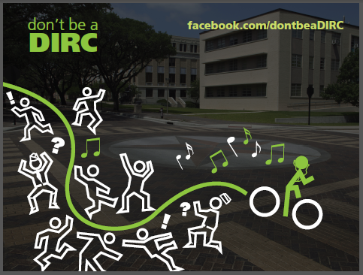
DIRC Phase I Aggie Style
Bicyclist

Slide 13
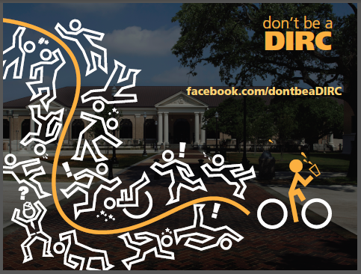
DIRC Phase I Aggie Style
Bicyclist

Slide 14
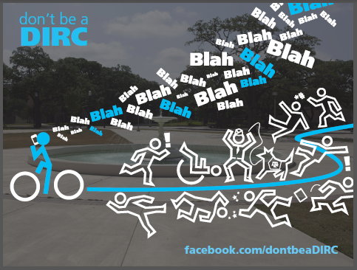
DIRC Phase I Aggie Style
Bicyclist

Slide 15
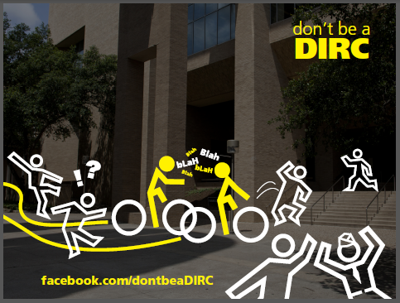
DIRC Phase I Aggie Style
Bicyclist

Slide 16

DIRC Phase I Aggie Style
Bicyclist

Slide 17
DIRC Phase II Aggie Style
Examples to be seen on campus at a later date.

Slide 18
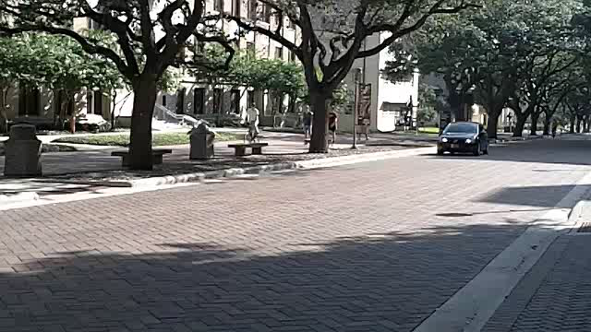
DIRC Phase III Aggie Style
Video Posts to Facebook

Slide 19
Personal Impacts of DIRC
  Share knowledge of behaviors and their impact
  Behavioral maturation process
  Shape attitudes for personal responsibility
  Fair and equitable in regard to safety of person

Slide 20
Personal Impacts of DIRC
  Rational and reasonable expectation
  Service to others
  Goals driven
  Individual power to change for good

Slide 21
Personal Impacts of DIRC
  Focus on the individual
  Personal growth
  Positive values for the Aggie community
  Address unfair treatment if victim

Slide 22
DIRC Campaign
The goal for the DIRC campaign is to establish university wide support for the message and expectation of DIRC.
The DIRC campaign should convey a Texas A&M University holistic message, not just that of a single entity.
How can you help this effort? . . .

Slide 23
Support DIRC
Formally support DIRC as an organization
  Resolution
  Permission to use your logo(s) on collaterals as a visible sign of support
Support DIRC as an individual
  Talk it up
  If possible, educate DIRCs when you see them in action
  Don’t Be a DIRC!

Slide 24
Current Supporters
Division of Student Affairs
Harold Vance Department of Petroleum Engineering
Rudder Theater Complex
Transportation Services
Transportation Services Advisory Committee*
University Police Department
University Staff Council
* Hopeful addition to the Current Supporters List

Slide 25
The END ☺
Q&A
Contact
  rsteedly@tamu.edu
  979-847-2453
  http://facebook.com/DontBeADIRC
    Fire up your FB app and like us today!

