Slide 1

Alt Trans Bike Update
TSAC
October 3, 2012

Slide 2
Summer Storage
Summer 2012 was the first ever bike storage offering for Texas A&M University
Stanford University stores between 85 and 110 annually during their summer storage program (Stanford is the only Bike Friendly University – Platinum Level in the country)
Texas A&M University stored 56 bicycles our first year

Slide 3
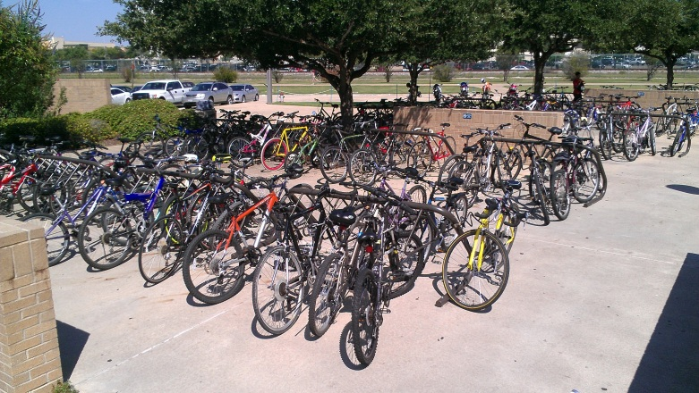
Installed Bike Racks
In FY 2012, the Alternative Transportation Unit installed 220 bike racks on campus
  100 racks were funded by the Aggie Greenfund
  Installation areas include:
    Kleberg
    Halbouty
    The REC
    MSC
    Zachery
    Many others

Slide 4
Bike Impound Procedures
Typically bikes are booted and released to owners after contact is made
If booted for more than 72 hours, the bike is impounded
Bike rack replacement areas are sectioned off and signed for removal notice. After notice expires, the remaining bikes are impounded.
All bikes are held for a minimum of 90 days

Slide 5
New Process with Surplus on Unclaimed Bikes
The bike impound area is being moved to a secure area at the surplus warehouse
Bikes released to surplus for disposal are being repurposed, sold outright, or sold at auction
On an annual basis, fifty percent of proceeds are shared with Transportation Services

Slide 6
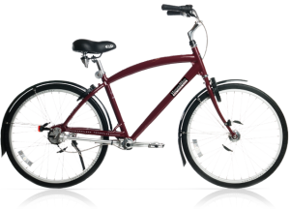
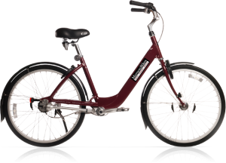
MaroonBikes
MaroonBikes was awarded the bike lease contract through an RFP in March 2012
MaroonBikes currently has leased 123 bikes and has sold 5 bikes outright.

Slide 7
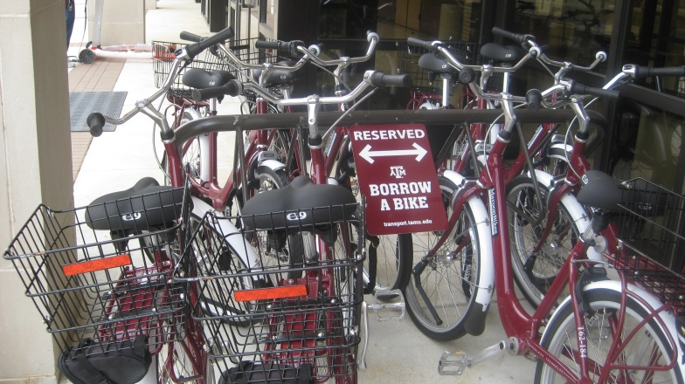
Borrow A Bike
Free service available to anyone employed by or enrolled at Texas A&M University
Fleet consists of ten MaroonBikes
Borrow today . . . Due back the tomorrow by 10:00 a.m.

Slide 8
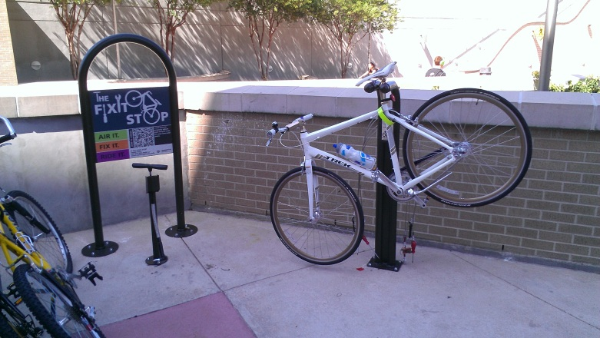
Bike Maintenance Station
Bike maintenance stations consist of
  Work stand with tools
  Manual tire pump with pressure gage
    Presta and schrader valves
  Sign with QR code to how to videos
Eight locations on campus

Slide 9
Q and A
Questions

