Slide 1
Options for
Access Improvements Near MSC
Wednesday, December 7, 2011

Slide 2
Joe Routt Boulevard

Slide 3
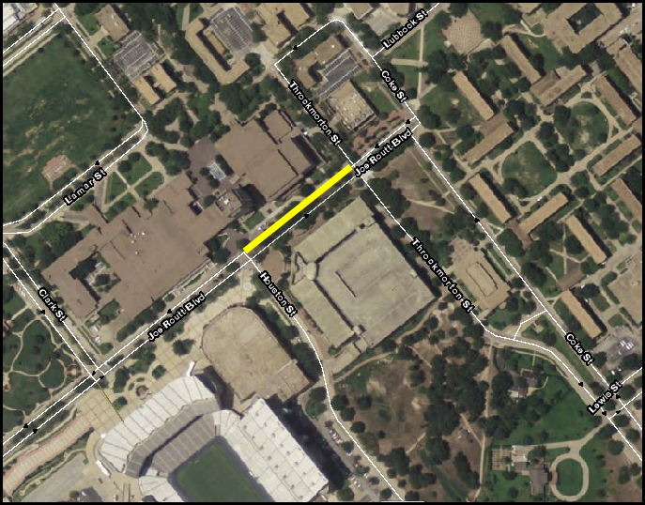

Slide 4
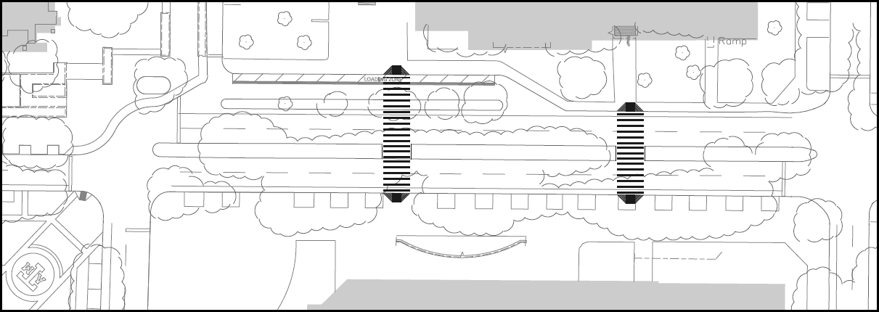
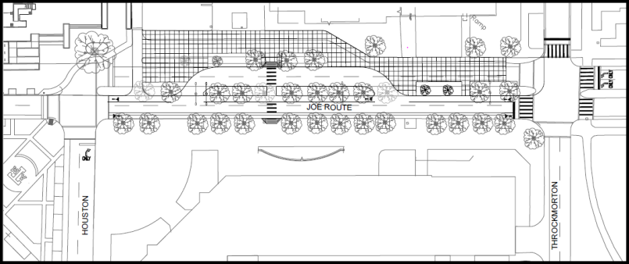
Joe Routt Boulevard
From Houston Street to Throckmorton Street, between Rudder Tower and the
Koldus Building

Slide 5
Joe Routt Boulevard
Access Design Option 1
This option would leave the design of Joe Routt Boulevard between Houston Street and Throckmorton Street the same but would improve the surface and add two at-grade crosswalks.

Slide 6
Joe Routt Boulevard
Access Design Option 1
Pros | Cons
Campus community is familiar with this design | Maintains high levels of two-way vehicular traffic in congested pedestrian zone
Allows two lanes of vehicular access in each direction between Houston and Throckmorton Streets | No additional sidewalk width is gained adjacent to Rudder Tower
Maintains a bike lane in each direction | Removes trees to add two new crosswalks
Allows two-way bus traffic flow, but a clockwise inner loop still will not be possible due to the one-way configuration of Joe Routt Boulevard between Houston Street and Gene Stallings Boulevard | Vehicles travelling westbound on Joe Routt Boulevard will have awkward turning transition at Houston Street due to two lanes of westbound traffic merging to one lane of southbound traffic on Houston Street
 | Design of new crosswalks will require two ramps, one at each end

Slide 7
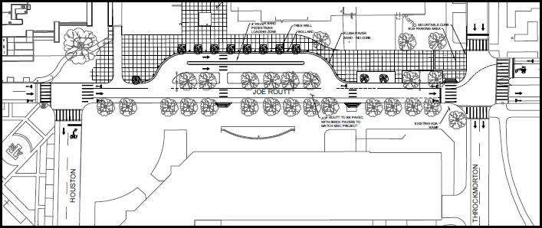
Joe Routt Boulevard
Access Design Option 2
This option would involve closing the westbound lanes of Joe Routt Boulevard between Houston Street and Throckmorton Street, creating a pedestrian-friendly extension of the MSC Plaza and continuing the one-way, eastbound vehicular traffic pattern established on Joe Routt between Gene Stalling Boulevard and Houston Street.

Slide 8
Joe Routt Boulevard
Access Design Option 2
Pros | Cons
Elimination of high levels of two-way vehicular traffic in congested pedestrian zone between Koldus Building and Rudder Tower will have a calming effect | Would require education of the campus community about the new design
Adds width to pedestrian plaza space adjacent to Rudder Tower | Removes trees to add two new crosswalks and expanded drop-off area
Enhances Rudder Tower drop-off zone by adding new 4’ buffer space between drop off lanes | Would require education about drop-off area traffic flow in opposite direction than current design
Maintains a bike lane in each direction | Eliminates one eastbound Joe Routt Boulevard vehicular travel lane which limits flexibility to manage traffic flow

Slide 9
Joe Routt Boulevard
Access Design Option 2 Cont.
Pros | Cons
Aesthetically pleasing because the MSC plaza design is extended to the space south of the Rudder Tower
Vehicles traveling westbound on Joe Routt Boulevard will have easier turning transition at Throckmorton Street due to two lanes of westbound traffic turning to two lanes of southbound traffic on Throckmorton Street
Adds two new pedestrian crossings between the Koldus Building and Rudder Tower with only one ramp at the Koldus Building plaza

Slide 10
West Lamar Street

Slide 11
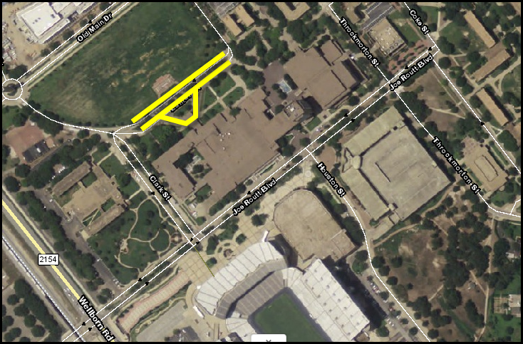

Slide 12
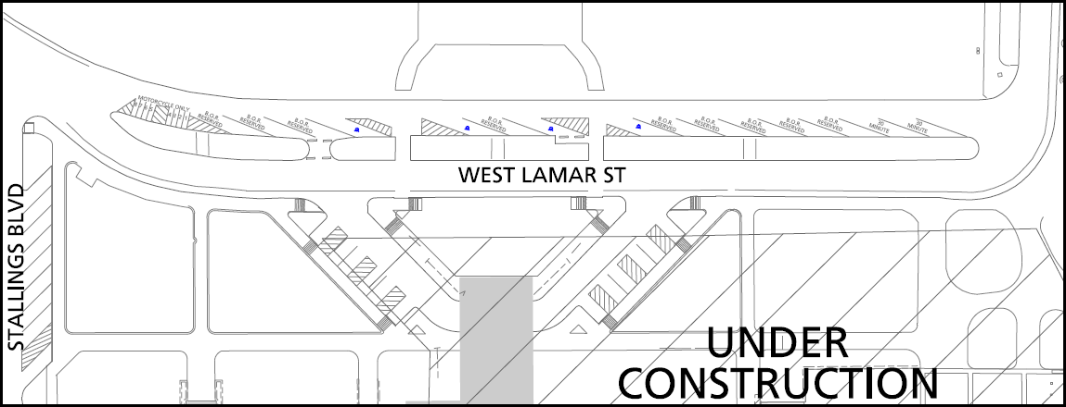
West Lamar Street Current Design
Between Memorial Student Center and Simpson Drill Field

Slide 13
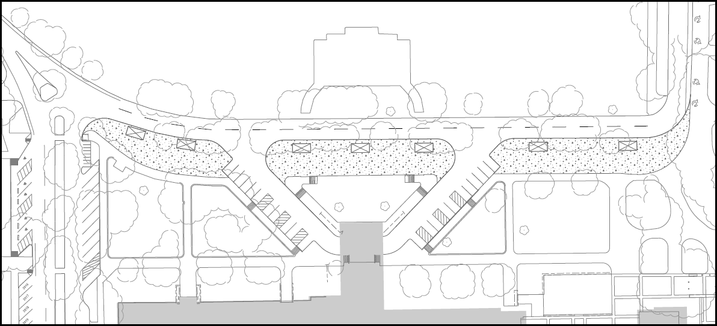
West Lamar Street Access Design Proposal
Between Memorial Student Center and Simpson Drill Field

Slide 14
West Lamar Street
Access Design Proposal
Pros | Cons
Increases motorcycle parking spaces from 8 to 11 | Eliminates one West Lamar Street vehicular travel lane which limits flexibility to manage traffic flow
Eliminates conflict associated with backing out of on-street parking spaces | Continues current configuration of no designated bike lane but rather a share-the-road model
Adds much needed width to pedestrian plaza space adjacent to the MSC
Adds enough space for the addition of bus shelters at the stops along West Lamar Street (19,000 boardings and alightings per day)
Eliminates current vehicle, bicycle and pedestrian conflict where the split lanes of West Lamar Street merge back into one lane at the turn to Central Houston Street

