Slide 1
Lot 71
Transportation Services
November 2, 2011

Slide 2
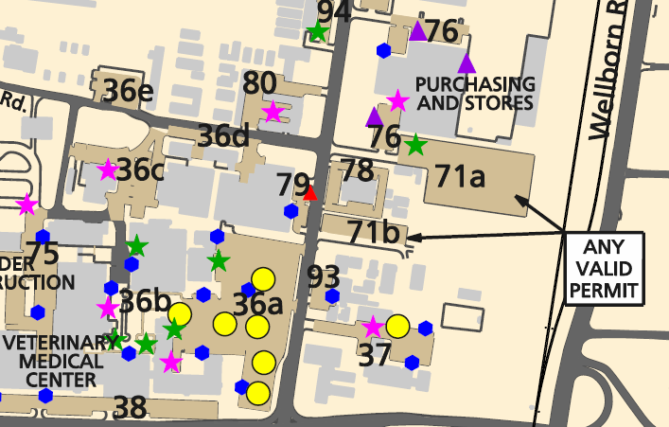
Lot 71 Facts
Located on Agronomy Road, north of the Vet Complex
Consists of two sections, 71a and 71b
Total number of spaces in both sections: 374
Designated as valid for any A&M permit

Slide 3
Permit History
2010 – offered 300 permits to renewing customers only
2011 offered 46 permits to renewing customers only
Currently have 23 customers with permits for Lot 71:
11 Seniors | 2 Freshmen
5 Juniors | 1 Staff
4 sophomores | 382 Customers on wait list
Data as of 10/27/11

Slide 4
Why Change?
Current configuration creates operational issues when permit holders can’t find space in their assigned lot
Properly sets expectations if no one is assigned or guaranteed space
Increased demand from undergrads with permits for other areas has kept permit holders from being able to park

Slide 5
Reasons for and Implications of Change in Operation
All customers with permits for Lot 71 have the same opportunity to park in Lot 71 today as they would if permits for the lot were never sold again
All other customers with permits for other areas have the same opportunity to park in Lot 71 today as they would if permits for the lot were never sold again

Slide 6
Reasons for and Implications of Change in Operation
All customers on the wait list who have permits for other lots have the same opportunity to park in Lot 71 today as they would if permits for the lot were never sold again
We support discontinuing permit sales for Lot 71. Additionally, making this change eliminates the risk of having customers with permits for Lot 71 not being able to have a space to park

Slide 7
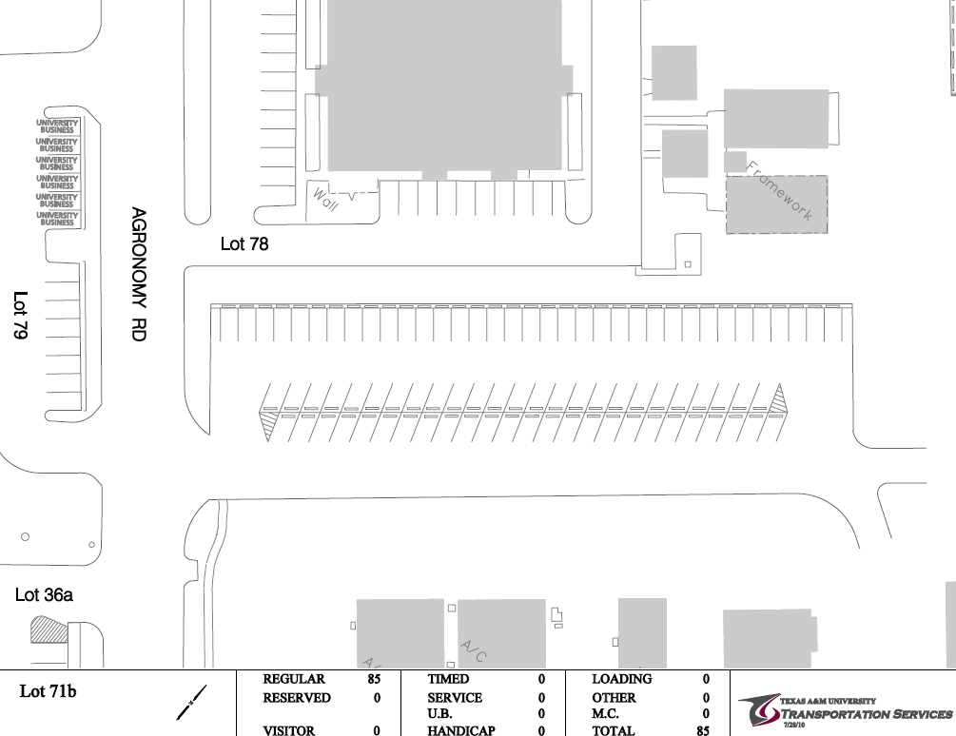

Slide 8
