Slide 1



Transportation services advisory Committee
Joe Routt

Slide 2
Survey Results
What We Distilled
Appearance is an important factor.
Bus traffic is a primary concern. (comparative between options 2 and 3)
There was no clear cut winner.

Slide 3
Jeff pickering’s Agenda
Bidirectional limited access from 6 a.m. to 6 p.m.
Non-limited private accesses after 6 p.m. and on the weekends. (Excluding special events i.e. Football games.)
A “mandatory reconsidering” of the limited access provision should the President’s office adopt it.
Definition of “Limited Access”
“Access is allowed to all official Texas A&M vehicles such as busses and maintenance vehicles and any and all emergency services”

Slide 4
Our goal here today
A Vote for Postponed Reconsideration
What this vote will do.
-Should the President’s office adopt a policy of “limited access” T.S.A.C. will place on its agenda a mandatory reconsideration of the limitation.
-This will allow all parties to obtain functional data with a reopened M.S.C. and operational bus routes.
What this vote won’t do.
-Bind this committee, or next year’s members, to any specific recommendation to President Loftin’s Office.

Slide 5
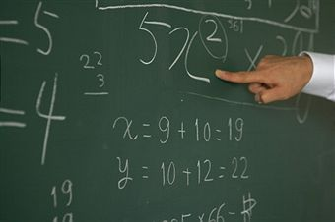
What will this require
Procedurally, this is simple to
do. It will require a 2/3rds vote
from the committee, and the approval of these minutes at the following meeting.

Slide 6
What am I voting for?
Provision 1
“This mandatory reconsidering will allow all parties time to gather functional with an open M.S.C. and operating bus routes data, regarding bus route efficiency, safety concerns, and student opinion.”
Provision 2
“This mandatory reconsideration is to take place no earlier than September 30th 2012 and no later than December 1st 2011.”

Slide 7

THANKS & GIG ‘em

