Slide 1

Accessible Parking Study
TSAC
January 11, 2012

Slide 2
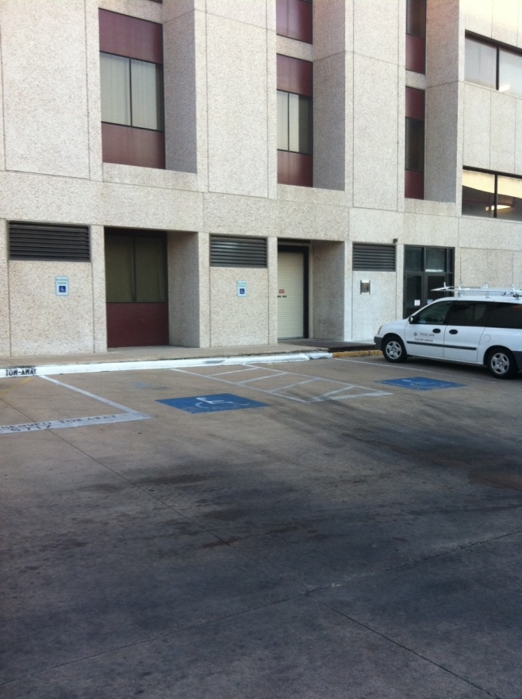
Study Elements
Total number of spaces required
Location of required accessible spaces
Compliance to current standards
Recommendations for non-typical campus events
Ongoing improvements

Slide 3
Guiding Principle
The University recognizes that parking is a foundational element of the campus’ vitality. The total amount of parking available, its location, and how it is managed play important roles in promoting the University and attracting and accommodating students and faculty. Transportation Services is committed to providing programs and services that ensure compliance with the nondiscrimination requirements contained in the Texas Accessibility Standards (TAS). With these important factors in mind, the University desires to gain a more detailed understanding of accessible parking on campus.

Slide 4
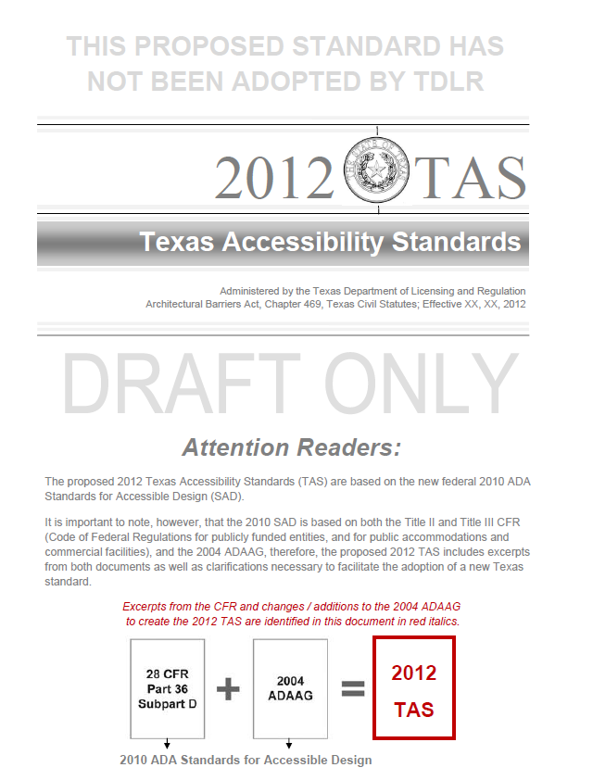
Requirements
BASED ON:
The Texas Department of Licensing and Regulation (TDLR) via the
The Texas Accessibility Standards (TAS)
1994 vs 2012

Slide 5
Requirements
Total Number of Parking Spaces Provided in Parking Facility | Minimum Number of Required Accessible Parking Spaces
1 to 25 | 1
26 to 50 | 2
51 to 75 | 3
76 to 100 | 4
101 to 150 | 5
151 to 200 | 6
201 to 300 | 7
301 to 400 | 8
401 to 500 | 9
501 to 1000 | 2 percent of total
1001 and over | 20, plus 1 for each 100, or fraction thereof, over 1,000

Slide 6
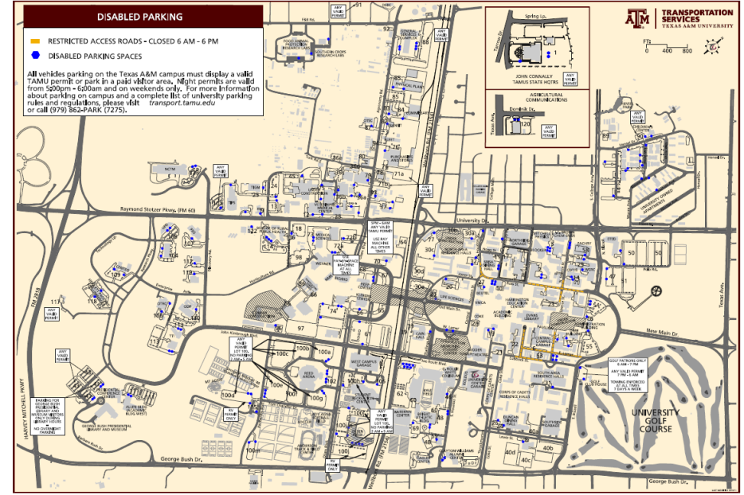
The Data
33,000+ spaces
170+ parking “facilities” on campus including 5 structures
Single “Site” versus “Zonal Approach”
52 Defined parking “Zones”

Slide 7
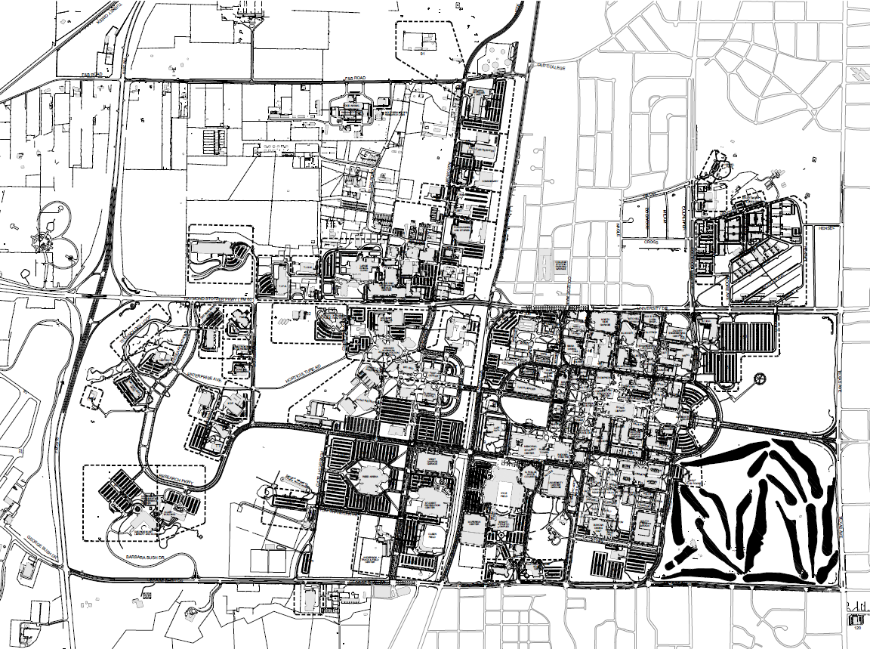
Study Area / Zonal Map

Slide 8
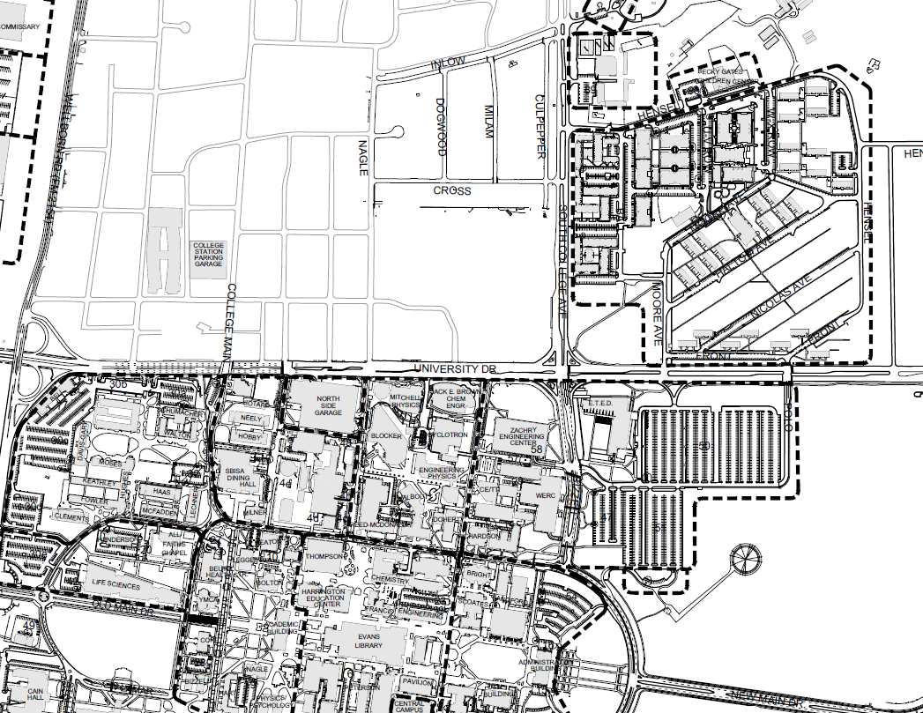
Study Area / Zonal Map

Slide 9
Other Considerations
Van versus non-van
Parking structures
Student housing areas
Visitor parking
Special events

Slide 10
Ongoing Project Incorporation
Engineering Technologies and Economic Development (ETED) building (Lot 51)
Wellborn Road grade separations (Lots 30e, 42, 49, 65 and 67)
Memorial Student Center (MSC) renovations (W. Lamar and Stallings Blvd.)
Phase II of the University Apartments
Northside student housing project (Lot 30b)
Central Campus Garage restriping

Slide 11
Results
TDLR has approved the Zonal approach
Current total accessible spaces = 725
Number required based on Zonal analysis = 607
Need to add and/or reallocate 124 accessible spaces to campus in 22 different zones
A procedure for adding future accessible parking spaces was developed

Slide 12
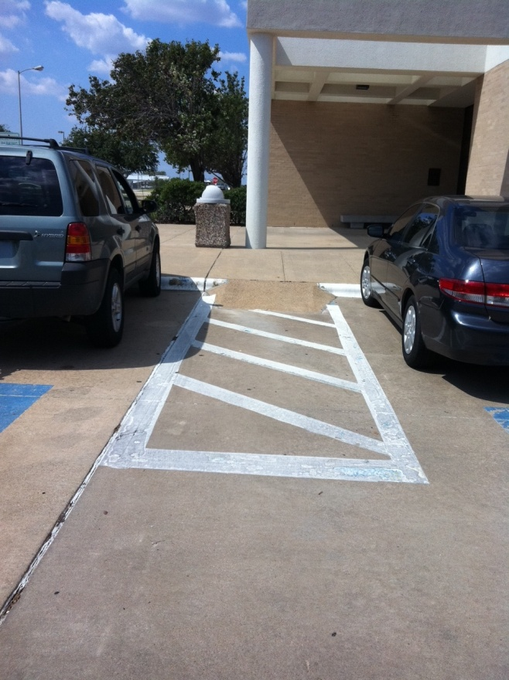
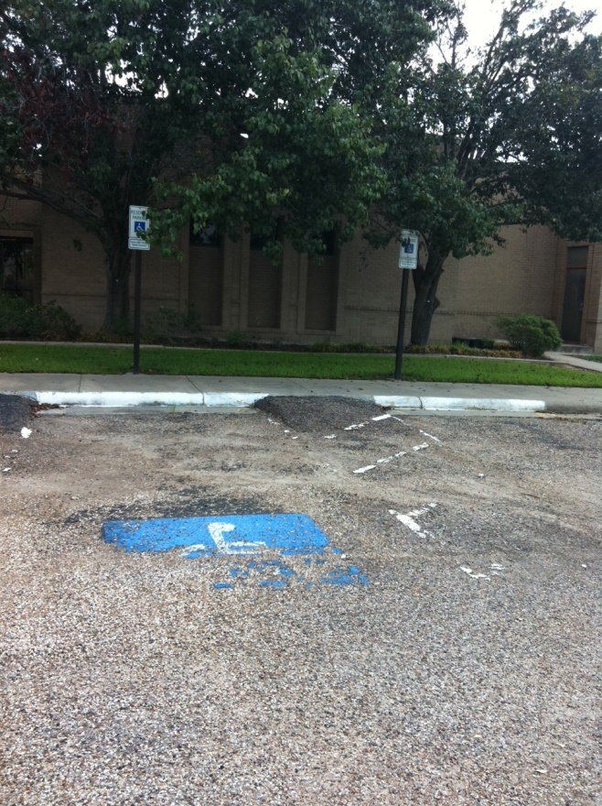
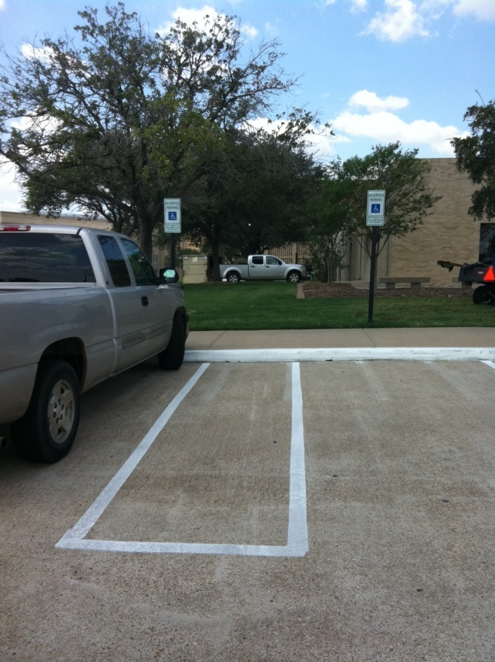
Compliance to Current Standards
2012 TAS/TDLR
  Items out of compliance with current standards include: accessible aisles, curb ramps, signage, and excessive slope

Slide 13
Recommendations for Non-Standard Campus Events
These additional spaces do need to comply with the 2012 TAS standards for items such as signage, accessible aisles, accessible paths, etc.
An alternate approach would be to label these additional event spaces as “convenience” or “special needs” spaces and not as “accessible” spaces then they would not need to comply with TAS standards

Slide 14
Ongoing Improvements
It is anticipated that Texas A&M University Transportation Services will address 25% of the identified accessible parking issues in each of the next four years, beginning in the spring of 2012
Improvements should be implemented as part of an ongoing Multi-Task Professional Architectural/Engineering Services On-Call contract similar to previous efforts

Slide 15
Next Steps
Implement procedure for adding future accessible parking (new construction and remodels)
Begin adding and/or reassigning accessible spaces based on Zonal model
Begin addressing non-compliant existing accessible spaces
Parking Demand Model

