Slide 1
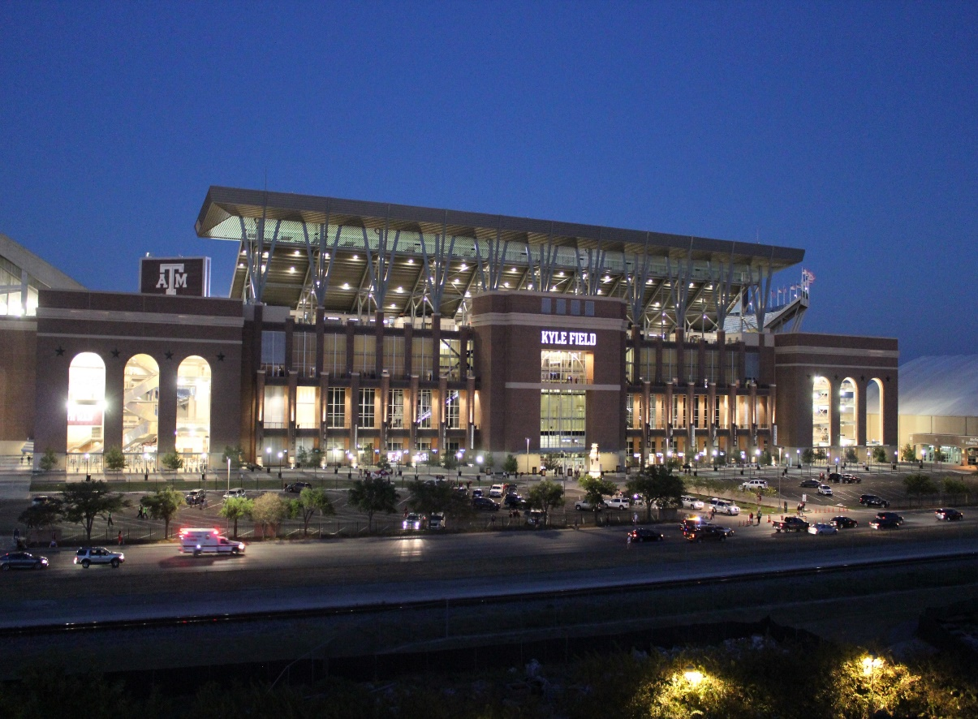
About Texas A&M
College Station, Texas
Fourth-largest U.S. university – 5200 acres
12,000 faculty/staff, 60,978 students
36,567 parking spaces; 6 garages remaining 2/3 in surface lots

Slide 2
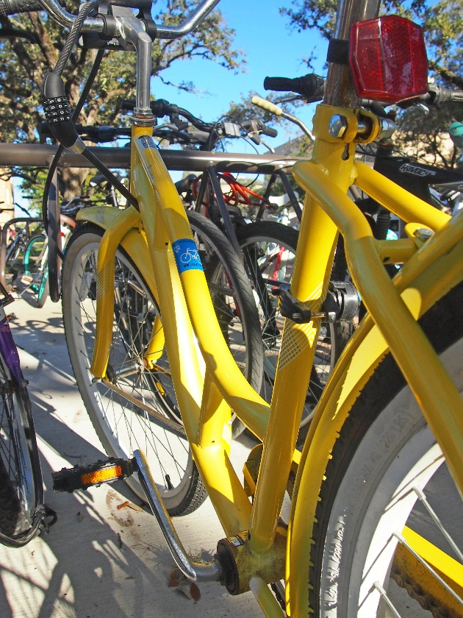
TDM at Texas A&M
11,000 bikes; 15,000 bike parking spaces
95 bikes in bike lease fleet
10 vehicles in car share fleet; 15-25% utilization
Ride share
Break/Weekend shuttles
Electric vehicle charging
Park and Ride

Slide 3
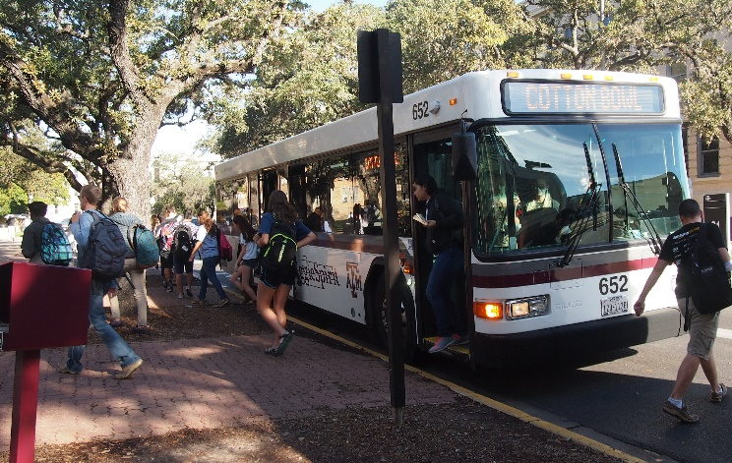
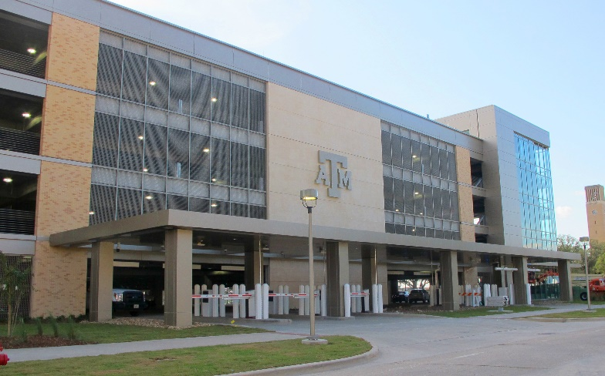
What drives choosing TDM at Texas A&M?
At or nearing capacity of transit
7.5 million rides per year
10 off-campus routes; 8 on-campus routes
Limited city transit service
Finally…… parking!
Convenience of available spaces
Green what?

Slide 4
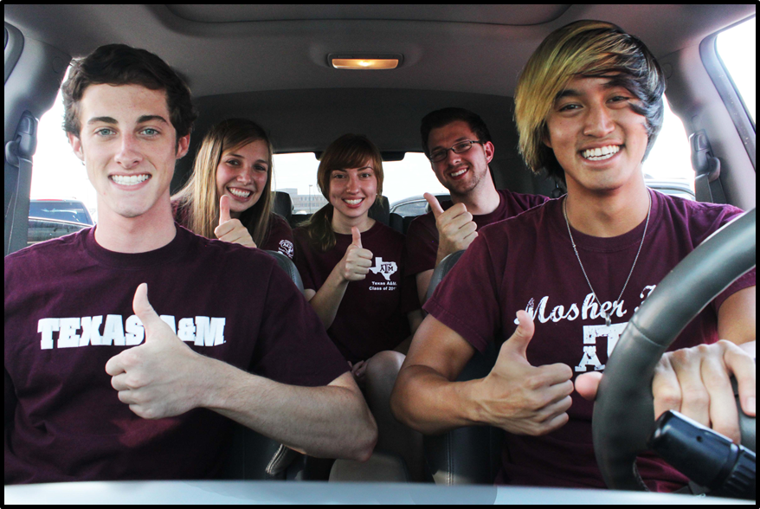
TDM Metrics
Car share utilization, Fleet size and fleet mix
Ride share utilization
Mode split tracking
Overnight bike rack utilization
EV charging station utilization
Break shuttle use

Slide 5
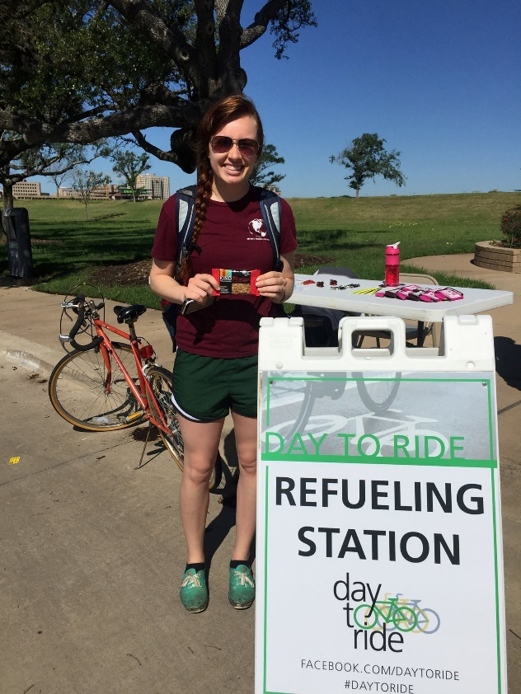
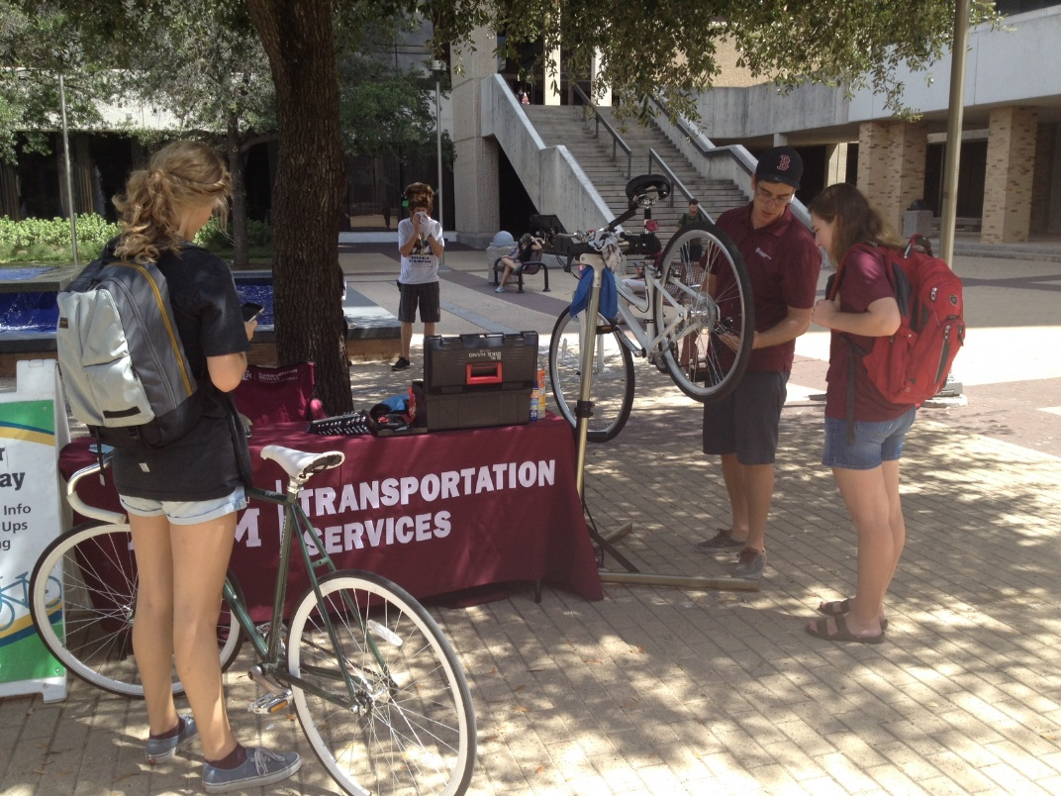
TDM Challenges
Customer demand levels
Funding sources

Slide 6
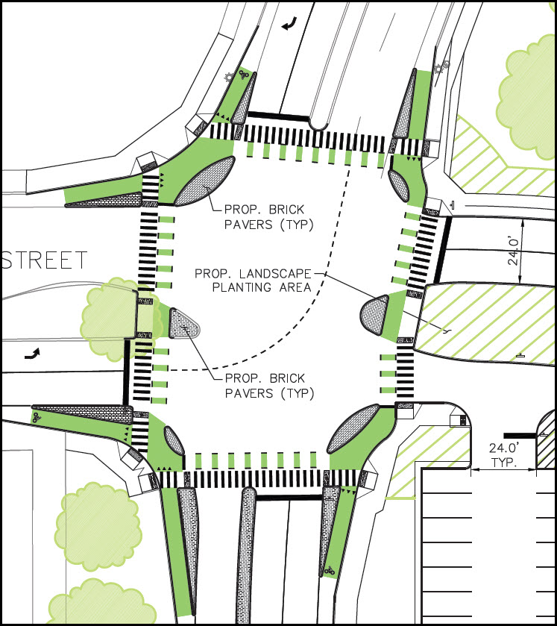
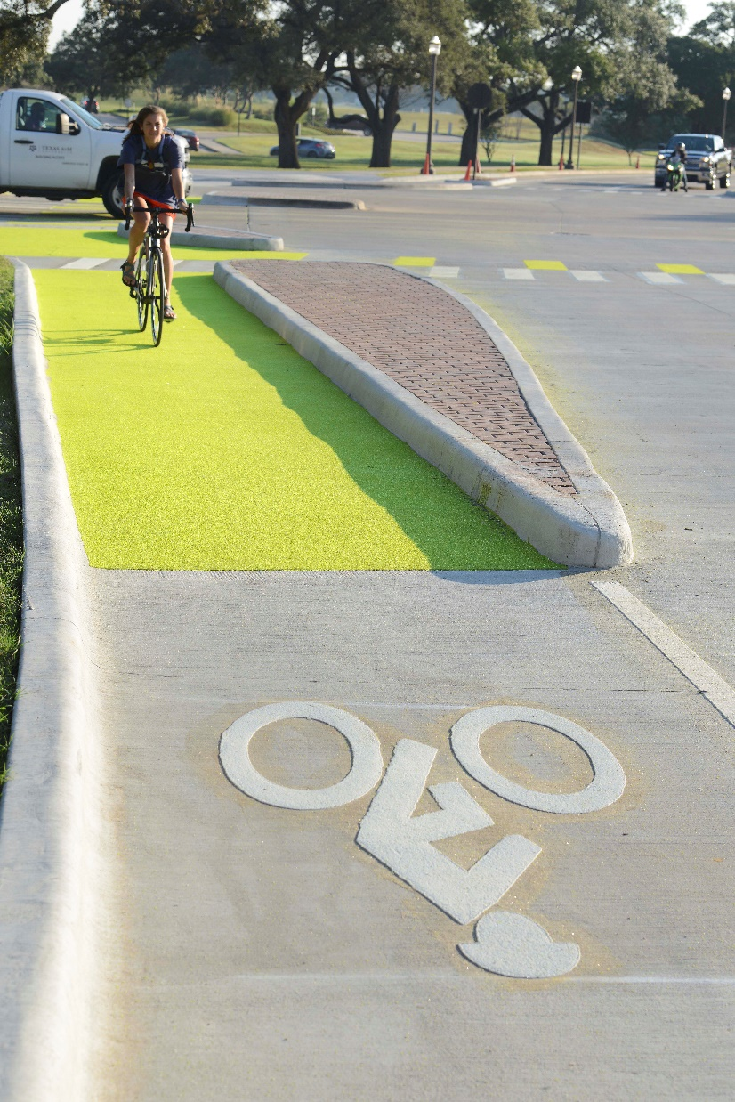
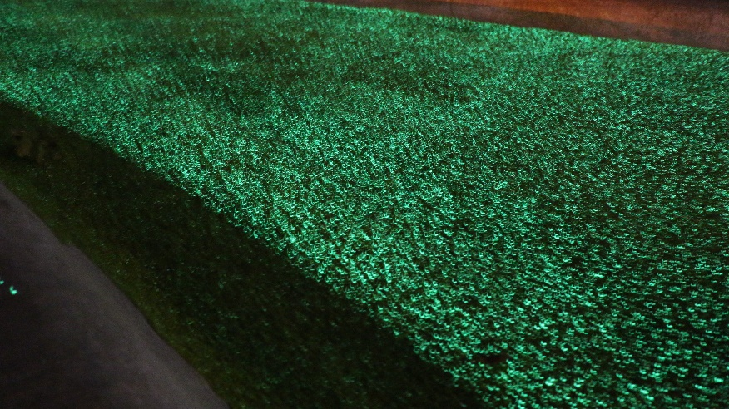
Recent TDM Win

Slide 7
Questions?

