Slide 1
All About Interfaces
Jessica Sands,
User Group 2011
Notes:
Presentation Title
Style: Trebuchet, 40 pt., white (reverse), title style capitalization (first letters)
Content: Presentation title
Subtitle
Style: Trebuchet, 24 pt., white (reverse)
Content: Presenter name(s), date

Slide 2
Objectives
T2’s interface definitions
Types of items in an interface
Custom Task Setup Utility and when it will be decommissioned
Interface purchase and implementation process
Interface packages currently available
Learn about Texas A&M’s interfaces
Notes:
Slide Title
Style: Trebuchet, 36 pt., gold, sentence style capitalization (first letters)
Content: Unique for each slide (unless slide contents are continued)
Text
Style: Main bullets are Times New Roman, 28 pt., black; supporting bullets are Times New Roman, 24 pt., black
Content: information and graphics pertaining to Slide Title
Limit bulleted lists to 7-8 lines; number of bullets may vary depending on length of content and on number of sub-bullets
Longer lists should continue to additional slide with duplicate Slide Title (cont.)
Do NOT divide text into columns; use tables instead
If using tables: use Title style for table header rows and Text style for table text
Avoid multi-colored text, use italics or bold typeface for emphasis
See T2 Style Guide for complete list of style and usage conventions
Graphics
If importing graphics, use the “Set transparent color” tool to make the white background disappear (to avoid covering text).
Recommended graphic placement: along right side or bottom of slide

Slide 3
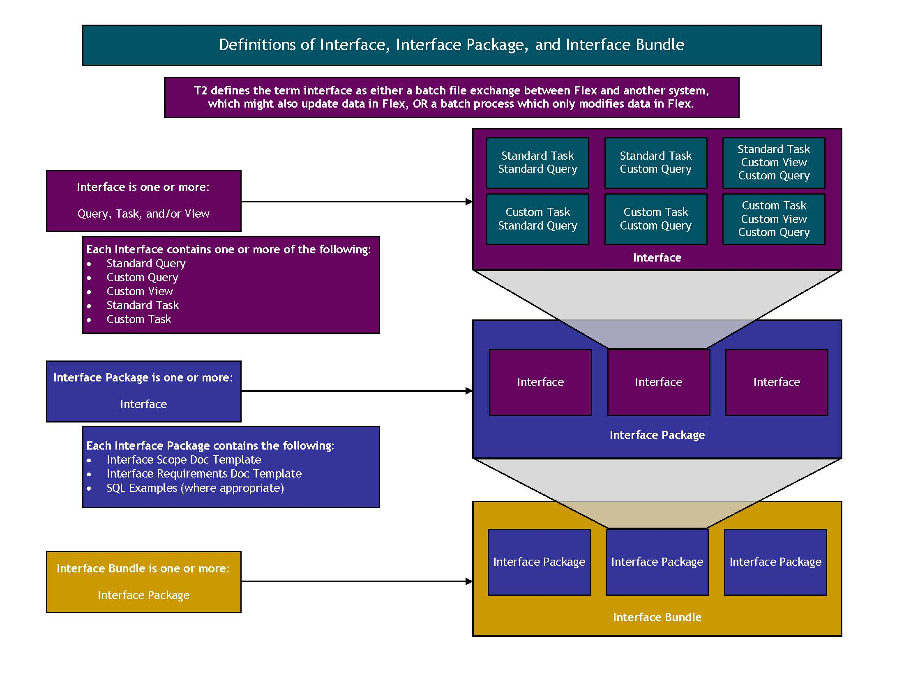
Definitions
Notes:
Slide Title
Style: Trebuchet, 36 pt., gold, sentence style capitalization (first letters)
Content: Unique for each slide (unless slide contents are continued)
Text
Style: Main bullets are Times New Roman, 28 pt., black; supporting bullets are Times New Roman, 24 pt., black
Content: information and graphics pertaining to Slide Title
Limit bulleted lists to 7-8 lines; number of bullets may vary depending on length of content and on number of sub-bullets
Longer lists should continue to additional slide with duplicate Slide Title (cont.)
Do NOT divide text into columns; use tables instead
If using tables: use Title style for table header rows and Text style for table text
Avoid multi-colored text, use italics or bold typeface for emphasis
See T2 Style Guide for complete list of style and usage conventions
Graphics
If importing graphics, use the “Set transparent color” tool to make the white background disappear (to avoid covering text).
Recommended graphic placement: along right side or bottom of slide

Slide 4
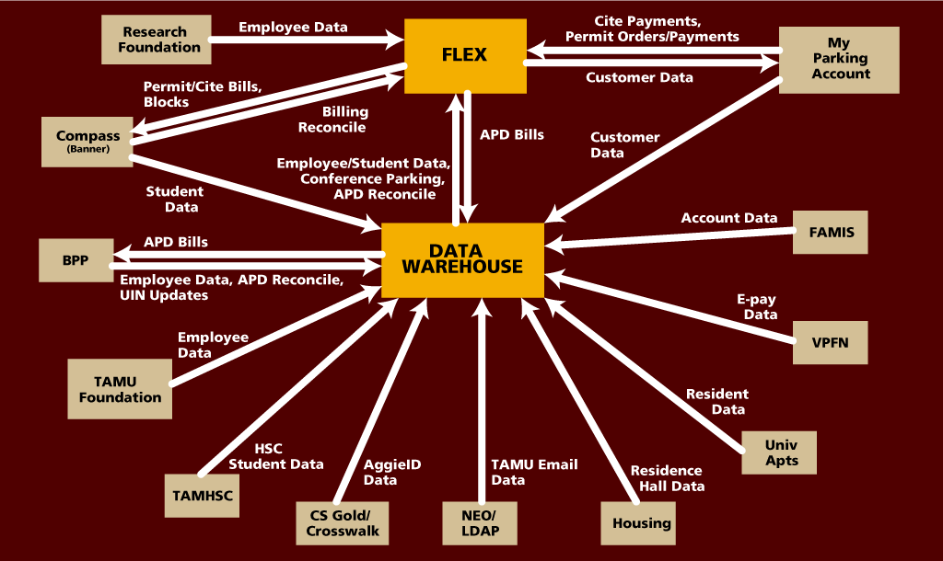
Data Flow Between the Data Warehouse and Other Systems

Slide 5
Citation Billing to COMPASS (Banner)
Processed Billing File
COMPASS/BANNER
FLEX
.NET
FLEX Billing File
Modified Billing File
Exception Reports
Notes:
This slide shows the updated process flow for tasks that originate in FLEX, are “manipulated” in TS .net code and passed over to COMPASS. There is data exchange both ways and exception reports from the .net code to notify users via email when changes or errors are occurring. Some messages are just FYI and others require action to correct a billing error. Once the file is processed it is returned to FLEX via .net code and updates are made as necessary.
5

Slide 6
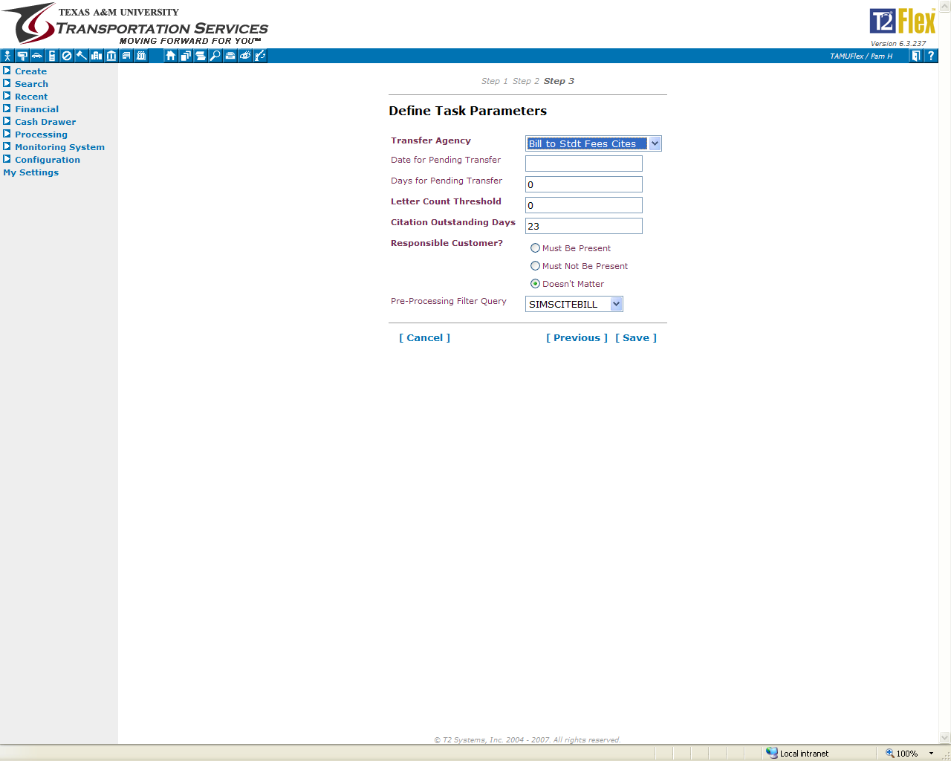
Notes:
Crop so text is bigger
6

Slide 7
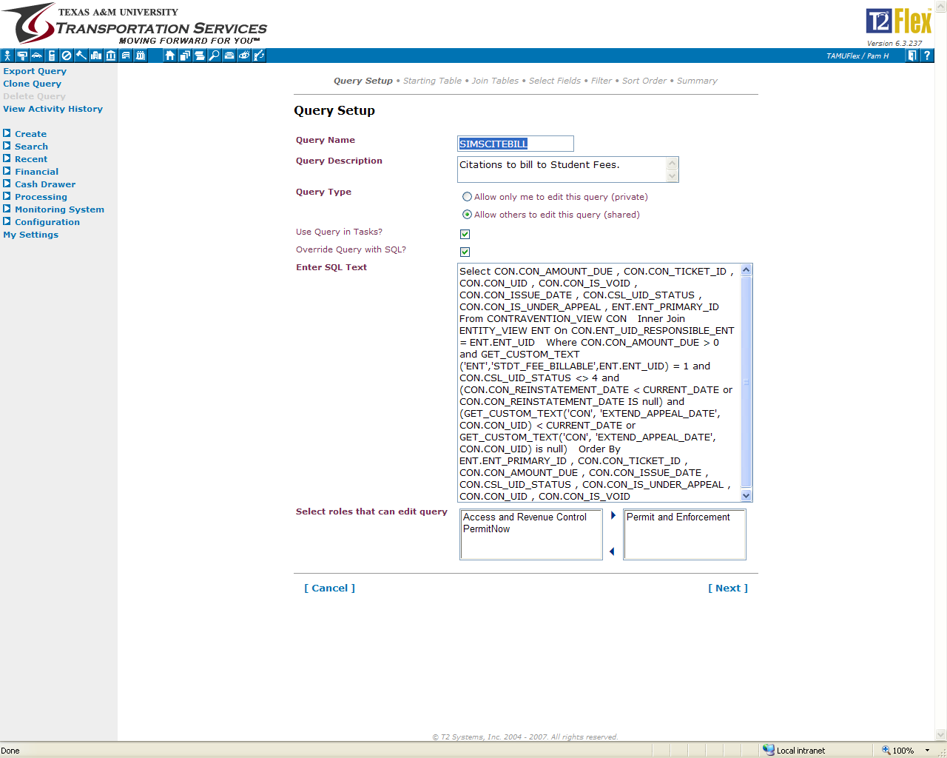
Select CON.CON_AMOUNT_DUE , CON.CON_TICKET_ID , CON.CON_UID , CON.CON_IS_VOID , CON.CON_ISSUE_DATE , CON.CSL_UID_STATUS , CON.CON_IS_UNDER_APPEAL , ENT.ENT_PRIMARY_ID, GET_CUSTOM_TEXT('ENT','BILLABLESTDT',ENT.ENT_UID) as ENT_SIMSTERM,ENT.ESL_UID_SUBCLASS , GET_CUSTOM_LKP('ENT','CUST_TAMU_CLASS',ENT.ENT_UID) as ENT_CUST_TAMU_CLASS From CONTRAVENTION_VIEW CON Inner Join ENTITY_VIEW ENT On CON.ENT_UID_RESPONSIBLE_ENT = ENT.ENT_UID
Where CON.CON_AMOUNT_DUE > 0 and GET_CUSTOM_TEXT('ENT','STDT_FEE_BILLABLE',ENT.ENT_UID) = 1 and CON.CSL_UID_STATUS <> 4 and (CON.CON_REINSTATEMENT_DATE < CURRENT_DATE or CON.CON_REINSTATEMENT_DATE IS null) and (GET_CUSTOM_TEXT('CON', 'EXTEND_APPEAL_DATE', CON.CON_UID) < CURRENT_DATE or GET_CUSTOM_TEXT('CON', 'EXTEND_APPEAL_DATE', CON.CON_UID) is null)
Order By ENT.ENT_PRIMARY_ID , CON.CON_TICKET_ID , CON.CON_AMOUNT_DUE , CON.CON_ISSUE_DATE , CON.CSL_UID_STATUS , CON.CON_IS_UNDER_APPEAL , CON.CON_UID , CON.CON_IS_VOID
Notes:
Pull out SQL to make bigger and what do we look for ? Red shows we are looking for amount still due and billable student. Purple is showing we want to skip over appealed citations and also to give appealed and denied customers the promised amount of them. The TASK is where we tell it to ignore citations that are under 23 days old.
7

Slide 8
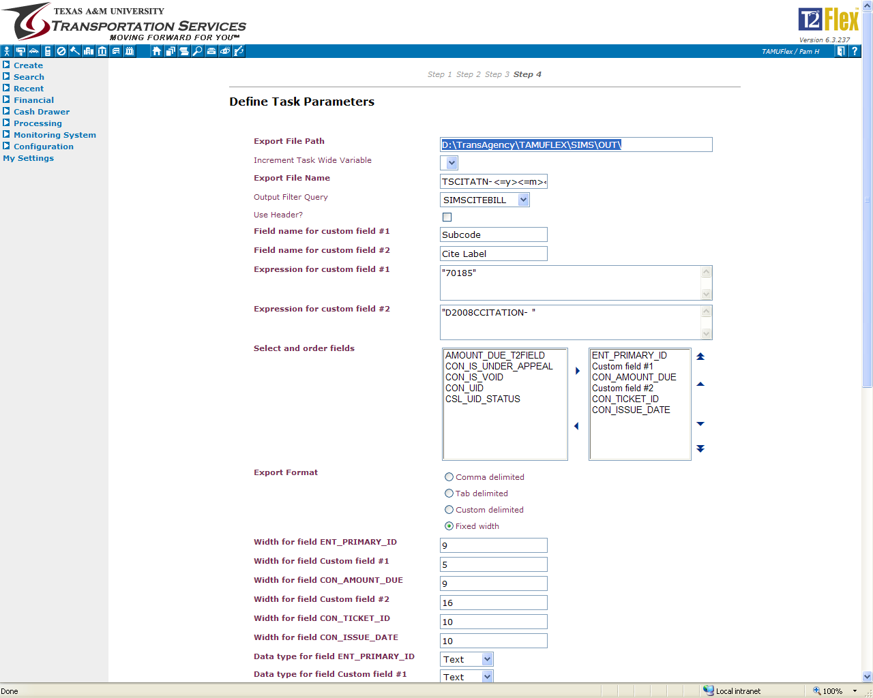
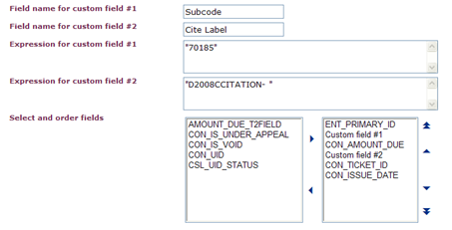
Notes:
Flex tasks allow insertion of custom fields, some are simple text insertions and others are flex fields that are complex format to fit the specified need of the system that receives the files.
8

Slide 9
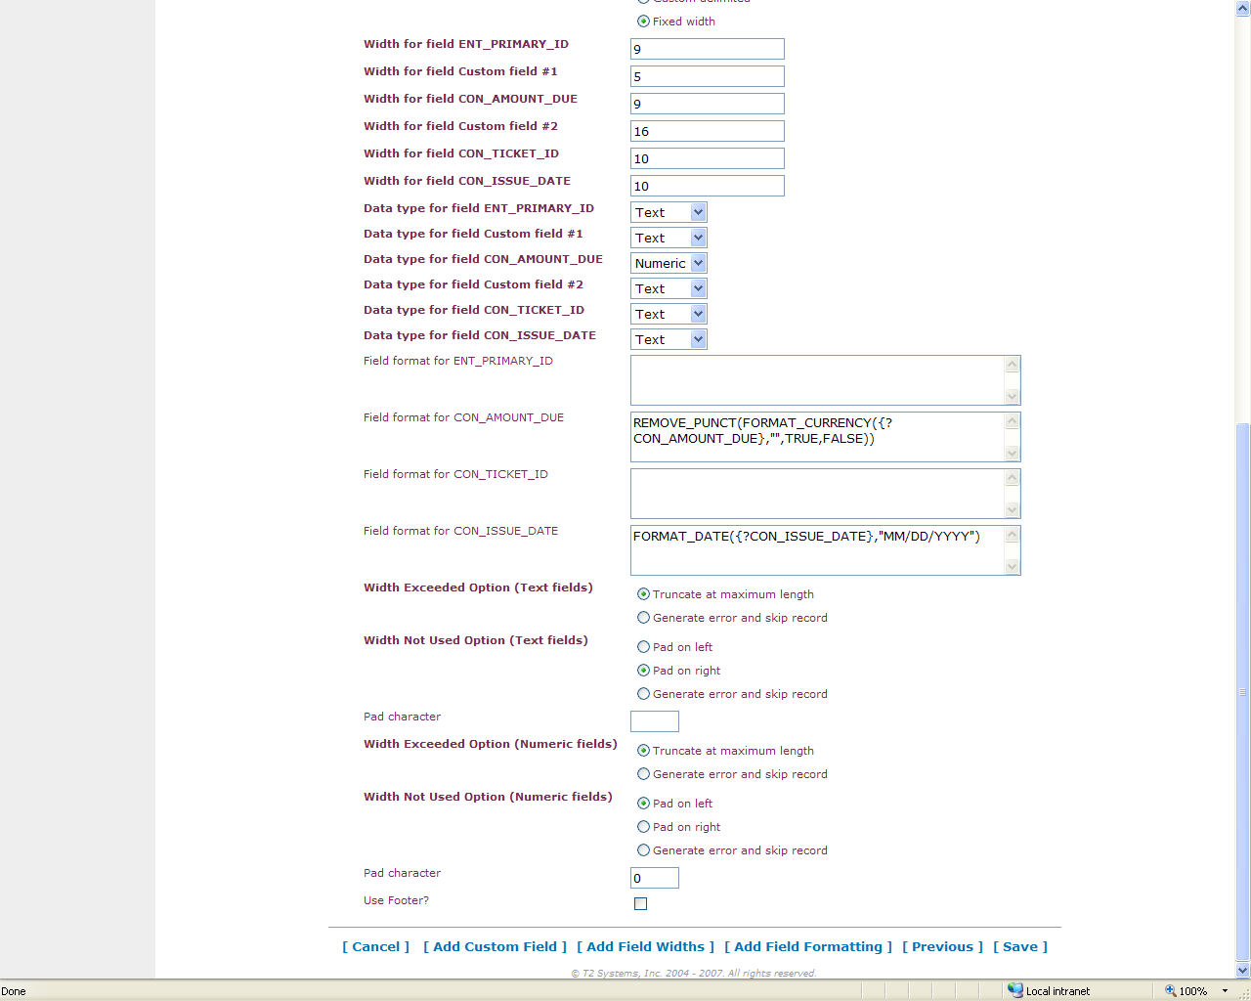
D:\TransAgency\TAMUFLEX\SIMS\OUT\
TSCITATN-<=y><=m><=d>-<=24h><=min><=s>.txt
Custom Field 2: Amount due in pennies
REMOVE_PUNCT(FORMAT_CURRENCY({?PAP_AMOUNT},"",TRUE,FALSE))
Width for field CON_AMOUNT_DUE : 9
Text padded on left with zeros
Notes:
Flexibility in location of file, naming of file ( so we can keep the uniqueness of each file), field formatting allows us to convert currency to a text field designated in pennies and leading zeros.
9

Slide 10
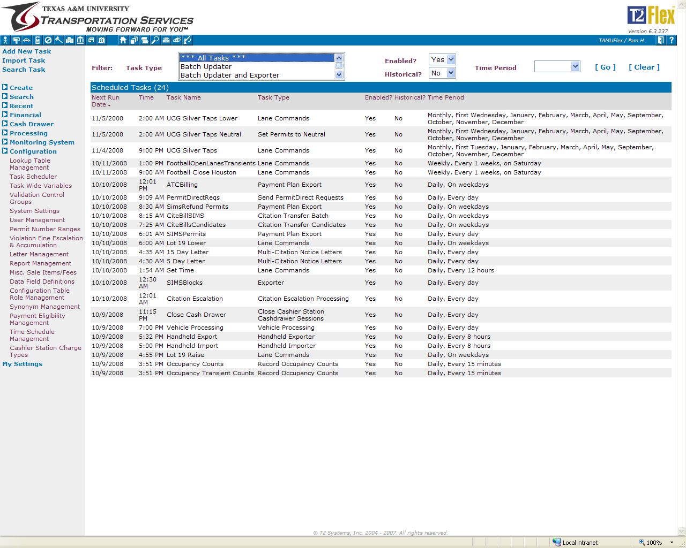

10/13/2009 | 7:25 AM | CiteBillsCandidates | Citation Transfer Candidates | Yes | No | Daily, On weekdays | Scheduled
Notes:
Pull out the Citation Transfer Candidate – blow up
30 Processes Run on Demand – Run as Needed
Payroll Deductions
Billing and Reconcile
Customer Letters
Permit Expiration Updates
Parking Advisories
Renewal Letters for Specified Permits
Waitlist Reminders
Raise/Lower Gates for Holidays /Set to Neutral
10

Slide 11
FLEX Access & CSGold
Updates pushed every 30 minutes
FLEX
.NET
Card Data
FLEX Updated Customers and Permits to allow ID at gates.
Queries to AggieID Files
Exception Reports
Notes:
This slide shows the updated process flow, data that is stored in FLEX, is “manipulated” in TS .net code and updated using queries in .net from CSGold that arrive on demand via query or near realtime with updates every 5 minutes from CSGold . There are exception reports from the .net code to notify users via email when changes or errors are occurring. Some messages are just FYI and others require action to correct a error. Once the file is processed it is returned to FLEX via .net code and updates are made as necessary and the new AggieID is operational as an access device in minutes.
11

Slide 12
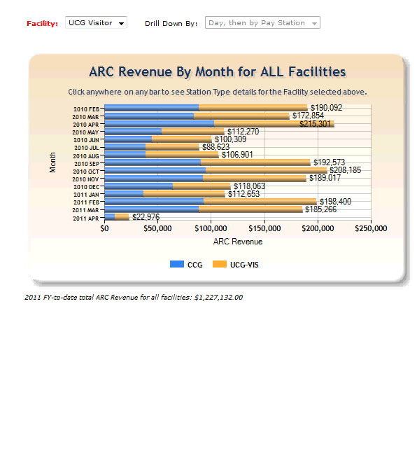

Slide 13
Questions

